Slide 1
My Digital Footprint
By: Monica

Slide 2
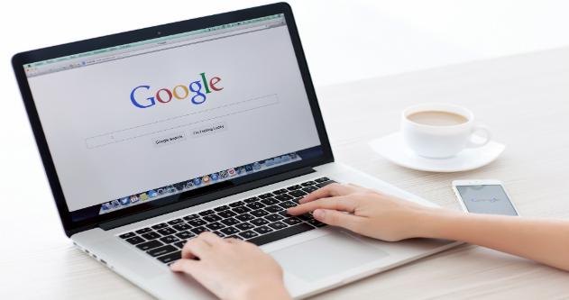
Googling Myself
When I Googled myself, I found not as many things as I thought I would find. What came up were some of my personal accounts, like Pinterest (3 accounts), Instagram, Facebook, and Goodreads. (which I only used once) In the photos section there was only one photo of me and that was off my Pinterest account. I was expecting more items to show up. For example, my actual Instagram account and not one I made when I was little. Or more photos from my Facebook, Instagram, or Pinterest. Overall, I don’t think if someone were to search me up on the internet that they would find anything bad.

Slide 3
How might your digital footprint affect your future?
Your digital footprint is important because if you don’t watch what you do or say online, it can deeply affect your future. When you apply for a job or for a university, they will look you up online to see what you post, how you act, and what you say online to see the type of person you are. If you have something bad on there, it'll affect your chance of getting into the school or job that you want. It also might affect people's impression of you. They'll see a post or something online about you and think differetly and that you arent what they thought. Always be cautious of what you say or do online.

Slide 4
3 Strategies To Keep Your Footprint Safe

Slide 5
1: Think Before You Share
It's a well-known saying that you think before you say or do something. As such, it's important to always think about what you're posting and who it's going to affect or how it's going to affect you. Thinking before you say or post something online can stop you from things like hate, drama, hurting someome, judgement, and many more.

Slide 6
2: Do NOT Post Personal Info
It's already given, but do not ever post or share private information online. This could be your full legal name, home address, phone number, and credit card info. People online can use this info and get accessto things you don’t want them to. You could get robbed or scammed or even have your identity stolen and have them post bad things that arent even true about you. Be careful of what type of info your giving out and that it's not going to backfire on you.

Slide 7
Digital Permanence
To simply state it, digital permanence is how data is stored permanently on different types of media. Meaning that even when you delete something online, whether it be a photo or comment, it's never really deleted. Somone could've still seen it and have been affected by it or it could affect you before you could delete it. Therefore you should always think about what you post or say because it does have consequences. Be smart and don’t act foolishly or out of anger.

Slide 8
3: Remove Old Accounts
If you search your name up on Google and you find accounts that are quite old or have things you don’t want people to see any more on them, delete them. If deleting them isn't an option, delete the posts and change the profile and name so it is untraceable to you.

