Slide 1
Creative media
By Adana

Slide 2
How have social media platforms changed the way we consume and understand information?
When we read or watch news on social media it shifts the way we formulate our own bias or opinion. Therefore we don’t have our own complete opinion on the topic. Instead of seeking the truth we seek things that suit the desired opinion.

Slide 3
When you see or read “news” on social media, do you take time to research the story further?
I usually do research on the news that I see online if I am about to tell someone about it. If I am casually scrolling by I usually don’t, unless it sounds outrageous.

Slide 4
What value do you get from online social interactions?
The value that I get when I’m on social media is that I can connect with family and friends without being in the same room as them. I also enjoy learning whether I will use it in the future or not and the internet is a very good place to acquire it as long as you do research on it after and not take it at face value.

Slide 5
How is social media and social capital helping to form youth culture?
Social media and social capital have played a significant role in shaping youth culture by providing a platform for us to connect, express ourselves, build networks, and create content. Being in the loop is included in this and was briefly mentioned in this video. Not understanding someone's referencing can make social interactions awkward and uncomfortable for people who are still shaping their social identity and figuring out who they are. This can lead to isolation as mentioned in the video.

Slide 6
When you post online do you consider how the post may be seen by others? What it may say about you? How that post may be seen in the future?
I don’t post online I do comment on others. I comment because I agree with what they are saying, I will say my own story in their comments as to relate to them, or I will correct misinformation. I don’t comment for likes because I don’t care if someone likes or dislikes what I say. This might say that I am a stand offish or defensive person. This is accurate. If a comment doesn’t age well then I will usually remove it.

Slide 7
Do you see any similarities between the world presented in this video and the world you live in?
Yes, I see plenty similarities like how she spits out the food and hated the coffee but said online that it was “heaven”. She was also being nice the guy in the second video but she was rated poorly because he had broken up with his partner. This is very common to how our world works as someone can go from getting all positive comments to hateful comments. People defending blindly for their friend because their friends partner broke up with them without knowing the whole story.

Slide 8
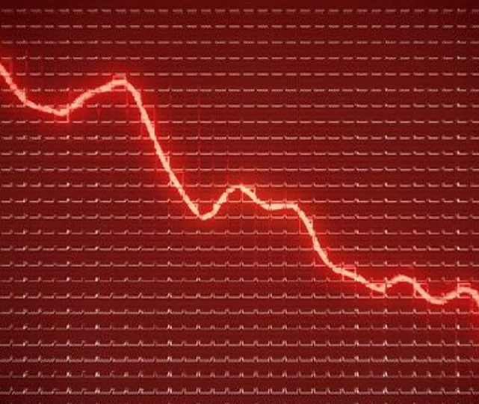
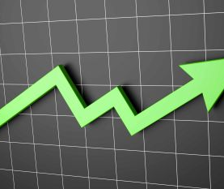
How does the main character gain and lose points? Why are these points important to her?
The main character gains points when people rate her highly and loses points when people rate her poorly. These points matter to her because that is what the society hat she lives in is based upon.

Slide 9
What value might be derived from this type of social interaction?
The value that would be derived would be empathy and kindness. This is the case because in that culture it is best to agree with the masses then have your own opinion.

Slide 10
How are social interactions changed in the world of these clips?
The interactions change because everyone’s status is based on what everyone else rates them at, the lower you're rating the worse you are treated.

Slide 11
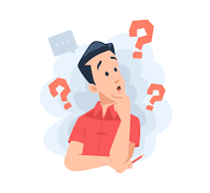
How did you tell the difference between facts and interpretations, opinions and judgements?
Facts are proven through testing and observations. Interpretations are someone explaining from their understanding. Opinions are someone’s view on the world usually not factual. A judgement is usually a opinion but defended with ego and pride. With this in mind it is usually pretty easy to know when someone is writing something true or false and if its intention is to hurt or heal.

Slide 12
How did you analyze evidence from different perspectives?
I try to have neutral bias when reading and writing so I can understand in full. I look for facts and if I need to look for facts I rewrite it so I don’t attract bias. I will watch news on different channels to get all sides of the argument even the ones that I don’t agree with.

Slide 13
Credits for photos
Unsplash. Best 500+ Professional Photographs [Stunning!] | Download Free Photos on Unsplash. https://unsplash.com/s/photos/photo. Accessed 22 Feb. 2023.
Unsplash. Best 500+ Professional Photographs [Stunning!] | Download Free Photos on Unsplash. https://unsplash.com/s/photos/photo. Accessed 25 Feb. 2023.
“Download Free Vectors, Clipart Graphics, Vector Art & Design Templates.” Vecteezy, https://www.vecteezy.com/free-vector/confused. Accessed 25 Feb. 2023.
“Download Free Vectors, Clipart Graphics, Vector Art & Design Templates.” Vecteezy, https://www.vecteezy.com/free-vector/confused. Accessed 25 Feb. 2023.
“Download Free Vectors, Clipart Graphics, Vector Art & Design Templates.” Vecteezy, https://www.vecteezy.com/free-vector/confused. Accessed 25 Feb. 2023.
Carnival Masks Svg Happy Sad Svg Party Mask Digital Download - Etsy Canada. https://www.etsy.com/ca/listing/633852586/carnival-masks-svg-happy-sad-svg-party?utm_source=OpenGraph&utm_medium=PageTools&utm_campaign=Share. Accessed 2 Mar. 2023.
Carnival Masks Svg Happy Sad Svg Party Mask Digital Download - Etsy Canada. https://www.etsy.com/ca/listing/633852586/carnival-masks-svg-happy-sad-svg-party?utm_source=OpenGraph&utm_medium=PageTools&utm_campaign=Share. Accessed 2 Mar. 2023.

