Slide 1
Assignments I'm proud of
-Adana

Slide 2
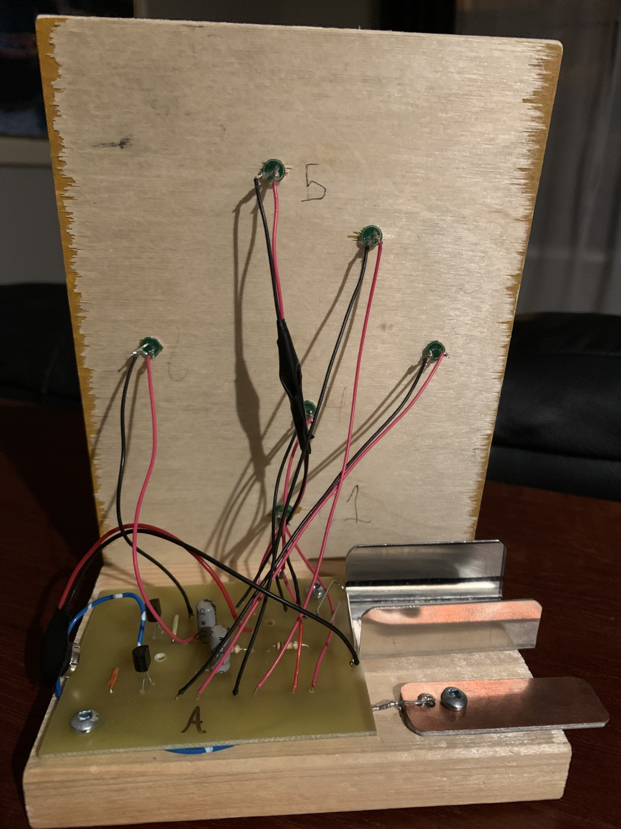
Achievement 1
My P.C.B board
My comfort zone.
I worked with my hands to make
very little knowledge on at the beginning of the year and now I have solid understanding of the parts inside and how to make one.
my skills and as a person
understanding concepts
My skill set.
Being sick and coming in during flex
One of the wires snapping
My goals in this class for the future would be to learn new skills, manage time, and how to work with others. I could use what I've learned in the future for any electrical project in the future. Other things I can use in the future would be problem solving, I use this every day so it is a very important skill. Trying new things is also a skill I have learned in doing this project that can also be used in everyday life.
Credit to myself for the photo

Slide 3
Achievement 2
something I thought I could never do and I'm proud of it.
Doing it on time.
one of my best works and it really taught me what I could do if I tried.
I chose this because I loved the wording that I used and how my hard work paid off.
This represents my growth by proving that I can do what I put my mind to.
This also represents my growth throughout the year as this essay was something I studied for. This included essay writing tactics, how to make a hook, and how to properly formulate a topic sentence without it sounding blocky.
the motivation.
My mindset.
Overcoming this mindset
I will definitely use what I've learnt in the coming years as knowing how to write an essay is crucial in high school and further schooling. My goal in English is to further understand and dive deeper into some of the texts that we have read. To understand to our full ability of what the author meant. I can use the skill I learnt to pick apart key sentences to understand them better.
Credit to istock for the photo

Slide 4
Achievement three
me and my dad installing the ethernet cables.
Why I chose it
My growth and how this achievement represents it.
My skill set
Some challenges I faced
What I have learned for the future from this activity would be to use the stud finder more accurately and to not cut random holes in the walls to look for cords in the wrong places. I have also learnt how hot it is in the attic when it is hot outside. I have also learned and now practiced how to make and install ethernet cables.
Credit to powerpoint for the photo.

