Slide 1
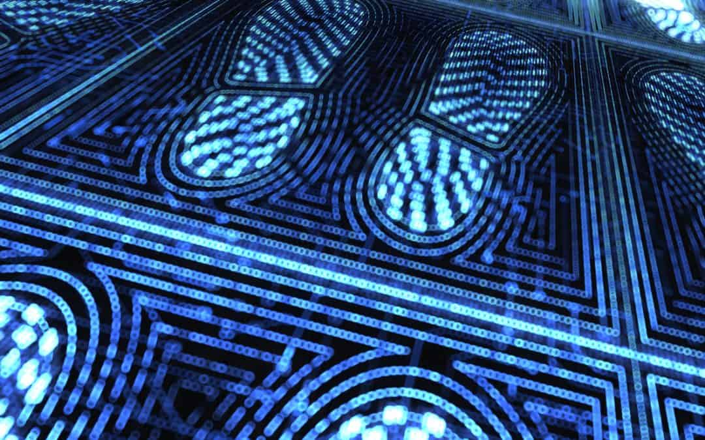
My Digital Footprint

Slide 2
How your digital footprint can affect your future.
You have to be careful what you put on the internet it can affect your future for example :
It can stop you from getting a job
It can stop you from going to a good college
It can ruin your reputation

Slide 3
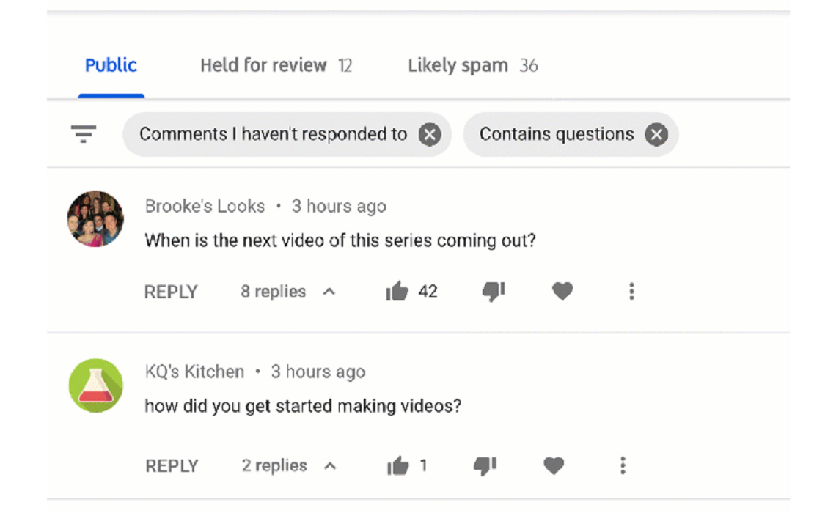
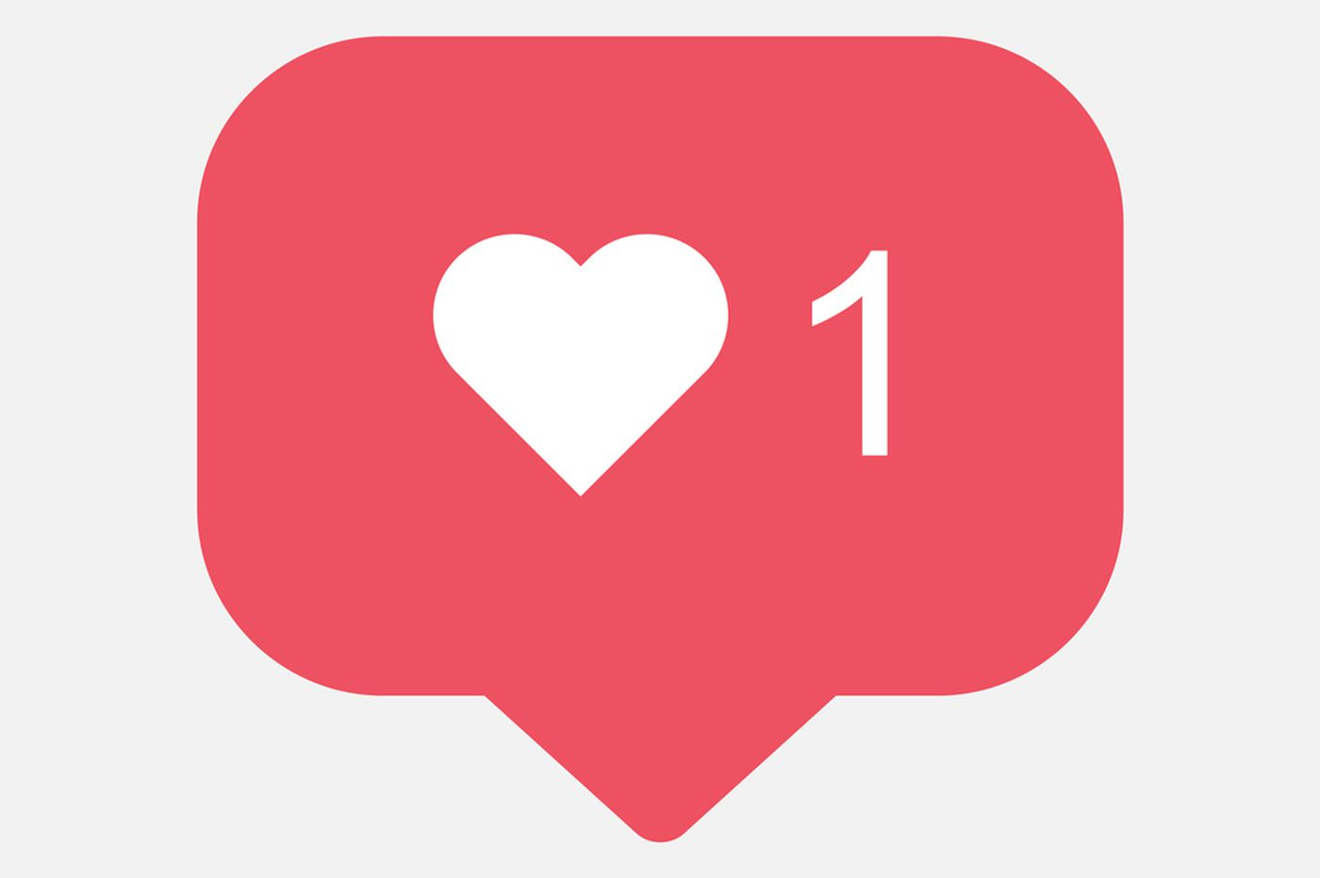
What is a digital footprint?
It is the data that you put on the internet that will follow you your whole life.
Also, if you talk to people on snapchat or comment of people's platforms it will also be part of your digital footprint.
Things that you 'like' or 'heart' will be part of your digital footprint.
“Https://Twitter.Com/Snapchat.” Twitter, https://twitter.com/snapchat. Accessed 25 Feb. 2021.
Inquirer, Annalise Mabe, For the. “Instagram Is Considering Hiding ‘like’ Counts. Here’s What That Could Mean for Millennial Mental Health. | Opinion.” Https://Www.Inquirer.Com, https://www.inquirer.com/health/instagram-hiding-like-counts-millennial-mental-health-20190508.html. Accessed 25 Feb. 2021.
“YouTube Just Implemented Creators’ Most Requested Feature To Date: Comment Filters.” Tubefilter, 27 Sept. 2019, https://www.tubefilter.com/2019/09/27/youtube-comment-section-filters-creators-comment-search-keywords/.

Slide 4
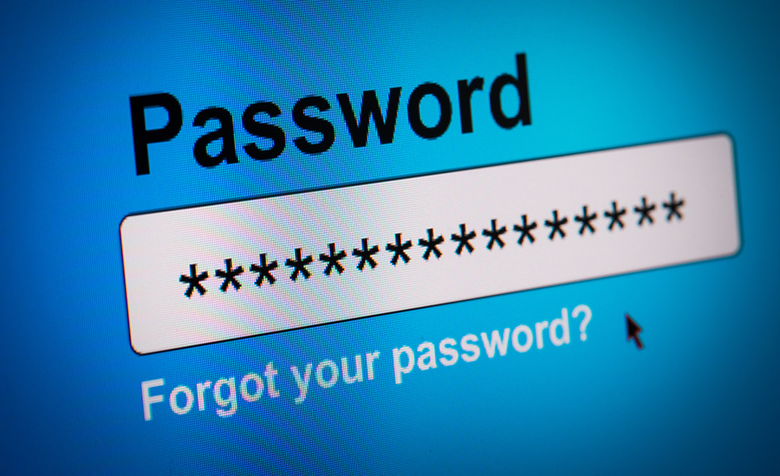
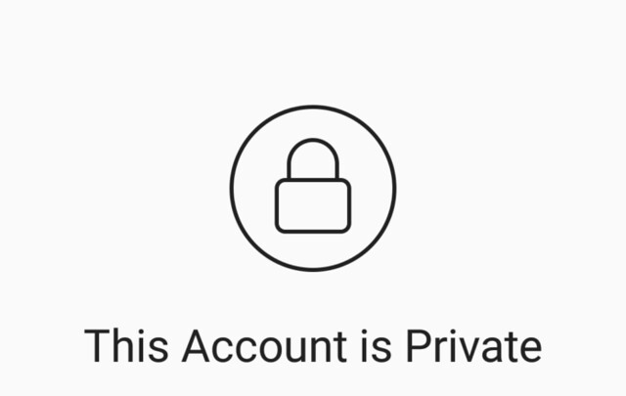
How to keep your digital footprint clean
Make all your accounts private
Do not post anything you do not want people to see
Put passwords that only you know
“Private Instagram Viewer No Survey - 14 Apps Works like a Charm.” Social Positives, 25 Sept. 2018, https://www.socialpositives.com/2018/09/private-instagram-viewer-no-survey/.The Worst Passwords of 2018. https://www.securitymagazine.com/articles/89694-the-top-100-worst-passwords?v=preview. Accessed 25 Feb. 2021.

Slide 5
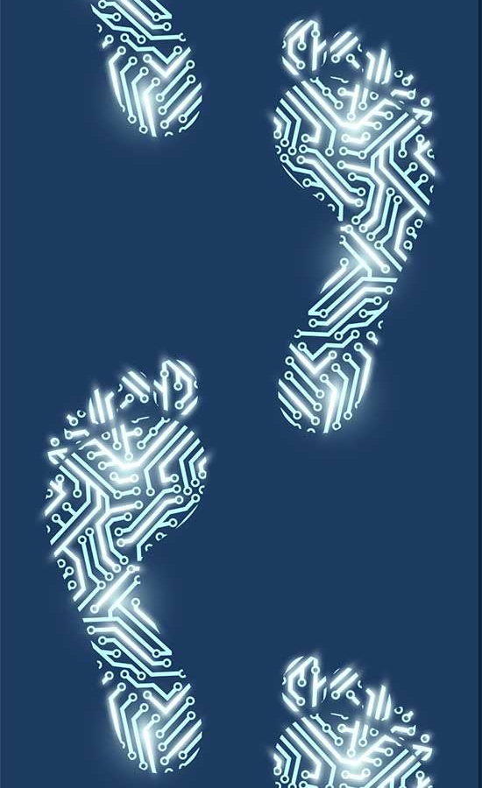
How important your digital footprint is
It is important to keep your digital footprint clean.
The reason is because whatever you post on the internet will stay there forever. Even if you delete it.
When you want to get a good job or go to university, they will probably look at your footprint. If there is something they do not like they will not higher you or accept.
Are You Paying Attention to Your Digital Footprints? https://www.enr.com/blogs/22-marketropolis/post/46137-are-you-paying-attention-to-your-digital-footprints?v=preview. Accessed 25 Feb. 2021.

Slide 6
Credits
Tattrie, Jon . "Canada and the Digital Economy". The Canadian Encyclopedia, 23 October 2019, Historica Canada. https://www.thecanadianencyclopedia.ca/en/article/digital-economy-in-canada. Accessed 11 February 2021.
Are You Paying Attention to Your Digital Footprints? https://www.enr.com/blogs/22-marketropolis/post/46137-are-you-paying-attention-to-your-digital-footprints?v=preview. Accessed 25 Feb. 2021.

Slide 7
Thanks for reading

