Slide 1
My Digital Footprint
Aden Zhu

Slide 2
Section 1
How might your digital footprint affect your personal brand and future opportunities? Why is it important to be aware of one's digital footprint?

Slide 3
How your digital footprint affects your personal brand and your future
Anything you post online becomes part of your digital footprint. This means that it will be connected to you, and anybody can see it. This can be very good to build your personal brand but can also give others very negative impressions of you based on what you post.
If you are trying to get a job somewhere, your employer will most likely look at your social media before accepting you. If you post your accomplishments and experiences on social media, it could improve your chances.
On the other hand, if your social media is filled with lots of harmful posts and pictures that paint you in a negative light, it can severely harm your chances at the job.
Different people have different footprints. Make sure yours is a good one to have a higher chance at success in the future.

Slide 4
Why you should be aware of your digital footprint
Your digital footprint is increasingly important in this modern age of technology. Many jobs are heavily reliant on technology, and your digital footprint will make or break your chances at the job.
If you are applying for a job and the company cannot decide between you and another applicant, they will usually base their decision on your digital footprint.
Colleges will also check your digital footprint when looking at your application. If a college googles you and finds lots of good things, it will give you a huge advantage over someone with many negative things on their digital footprint.
If you have a positive digital footprint, you should try to promote yourself on social media for employers to see!

Slide 5
Section 2
Three strategies you can use to keep your digital footprint appropriate and safe

Slide 6
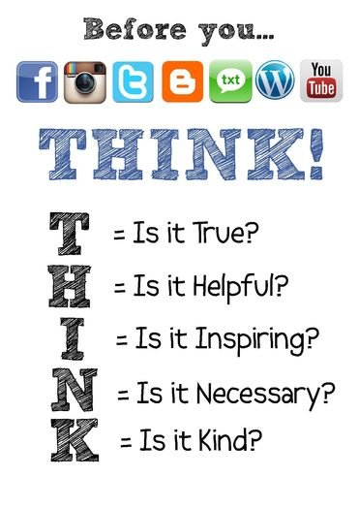
THINK before you post!
If you THINK before you post, not only will you create a positive digital footprint, but you will avoid most conflicts that could arise from an inappropriate post.
Before you post, always remember to use the T.H.I.N.K acronym.
T: Is it true? Make sure the information you post online is true, and not misleading.
H: Is it helpful? Is your post going to help or benefit you or others in any way? If not, it might not be a post you want to make.
I: Is it inspiring? Will your post inspire others? Not all posts have to be inspiring, but you do need to make sure they are not meant to discourage or demean others.
N: Is it necessary? Not all posts need to be urgent in order to post them, but you shouldn’t post things others don’t need to see, like personal information.
K: Is it kind? Make sure your post isn’t hurtful to others. Even if you don’t intend to harm others, it might be interpreted that way.

Slide 7
Google yourself
Google is a very powerful tool that can enable you to find many things. However, you won’t be able to find much if you aren’t searching for the right things. Searching all your different aliases can be very helpful if you know you have many.
It’s a good idea to google yourself occasionally. There’s no reason not to, and you might be surprised what you find.
Many colleges and employers will google someone before considering them, so googling yourself will show you what they see.
When you google yourself, use a private window or incognito tab so that your search results aren’t skewed based on your previous searches and location.
Make sure to do it often, because things posted online are very hard to erase. If you find something negative about yourself online, it’s much easier to suppress it if you find it earlier on.

Slide 8
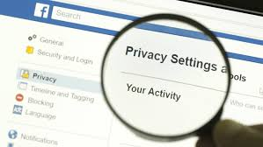
Use privacy settings
Privacy settings differ from app to app, so make sure you understand what they do in all your different apps.
Many social media apps have privacy settings that can control who sees your posts. Turning these on are very helpful if you only want a select group of people to see your posts.
Though privacy settings can hide your bad posts from others, it’s much better to just delete your posts instead. Some apps like Facebook might still allow others to see those posts if they are relevant enough.
If you want to keep some posts hidden but want your more positive posts displayed for everyone to see, you can consider creating one private account for yourself and another public account for others to see all your accomplishments.

Slide 9
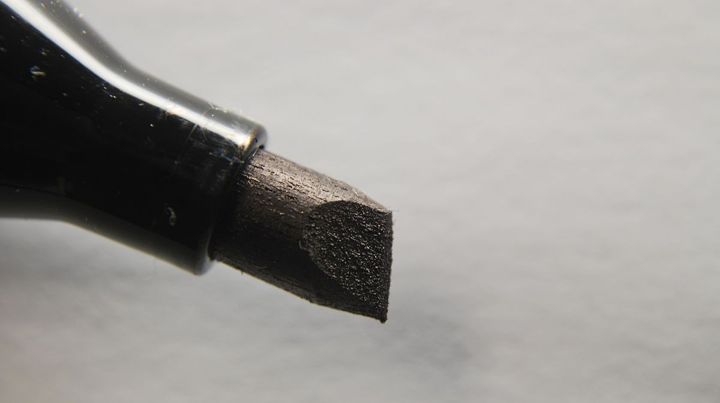
Section 3
What digital permanence is, and why we should be aware of it

Slide 10
Digital Permanence
It’s very important to be aware of digital permanence because being careless on the internet is very dangerous. Someone could easily save something you regret posting and it would exist virtually forever.
Even posts that aren’t inherently bad are dangerous. Anything on the internet can be modified into something else and leave a bad look on you forever.
You should constantly be thinking about digital permanence before doing something you might regret in the future. Always think twice before posting anything.
Digital permanence is the idea that anything posted online is permanent. You may think this is false, since you can just delete something you posted, but anybody could’ve downloaded or taken a photo of your post before you deleted it. This means it is very hard to completely erase something from the internet, and you should be very careful before posting online.
Another way people can find old posts is through search browsers like the Wayback Machine, which can allow you to see a snapshot of what a website used to look like.

Slide 11
References
12 Tips for Students to Manage Their Digital Footprints. (2019, May 10). Teachthought. Https://Www.Teachthought.Com/The-Future-Of-Learning/11-Tips-For-Students-Tomanage-Their-Digital-Footprints/
Conway, S. (2018, August 29). 5 Communications Tips for Boosting Brand Awareness. Agility PR Solutions. Https://Www.Agilitypr.Com/Pr-News/Public-Relations/5-Communications-Tips-For-Boosting-Brand-Awareness/
Cyber Security, Data Protection Banner, Lock Symbol, Abstract Background. Cloud Technology Design. (N.D.). Freepik. Retrieved December 9, 2020, From Https://Www.Freepik.Com/Premium-Vector/Cyber-Security-Data-Protection-Banner-Lock-Symbol-Abstract-Background-Cloud-Technology-Design_4619338.Htm
Digital as a “Strategic Portfolio.” (2019, November 29). Capgemini Worldwide. Https://Www.Capgemini.Com/2019/11/Digital-As-A-Strategic-Portfolio/
Digital Footprint – What They Are and How to Manage Yours. (2019, October 12). Canto. https://www.canto.com/blog/digital-footprint/
Download Think Sticky Note Below the Hand Drawn Yellow Light Bulb on Blue Background for Free. (N.D.). Freepik. Retrieved December 9, 2020, From Https://Www.Freepik.Com/Free-Photo/Think-Sticky-Note-Hand-Drawn-Yellow-Light-Bulb-Blue-Background_2773609.Htm
Help Protect Your Digital Footprint from Prying Eyes. (N.D.). Retrieved December 9, 2020, From Https://Us.Norton.Com/Internetsecurity-Privacy-Clean-Up-Online-Digital-Footprint.Html
Kon, I. (N.D.). Download Search Vector Icon for Free. Vecteezy. Retrieved December 9, 2020, From Https://Www.Vecteezy.Com/Vector-Art/367249-Search-Vector-Icon
Permanent Marker. (2020). In Wikipedia. Https://En.Wikipedia.Org/W/Index.Php?Title=Permanent_Marker&Oldid=991703115
Scratched Textured Permanent Stamp Seal Vector Image on Vectorstock. (n.d.). VectorStock. Retrieved December 9, 2020, from https://www.vectorstock.com/royalty-free-vector/scratched-textured-permanent-stamp-seal-vector-23785032
T. H. I. N. K. Before You Post – Technology Pursuit. (n.d.). Retrieved December 9, 2020, from https://technologypursuit.edublogs.org/2015/10/18/t-h-i-n-k-before-you-post/
The Beautiful Meaning and Hope Behind ‘Footprints in The Sand’&Nbsp; (n.d.). Crosswalk.Com. Retrieved December 9, 2020, from https://www.crosswalk.com/faith/spiritual-life/beautiful-ways-footprints-in-the-sand-offers-solid-hope.html
Townsend, T. (2016, July 28). The Right (And Wrong) Way to Use Google To Protect Your Reputation. Inc.Com. https://www.inc.com/tess-townsend/how-google-yourself-right-way.html

