Slide 1
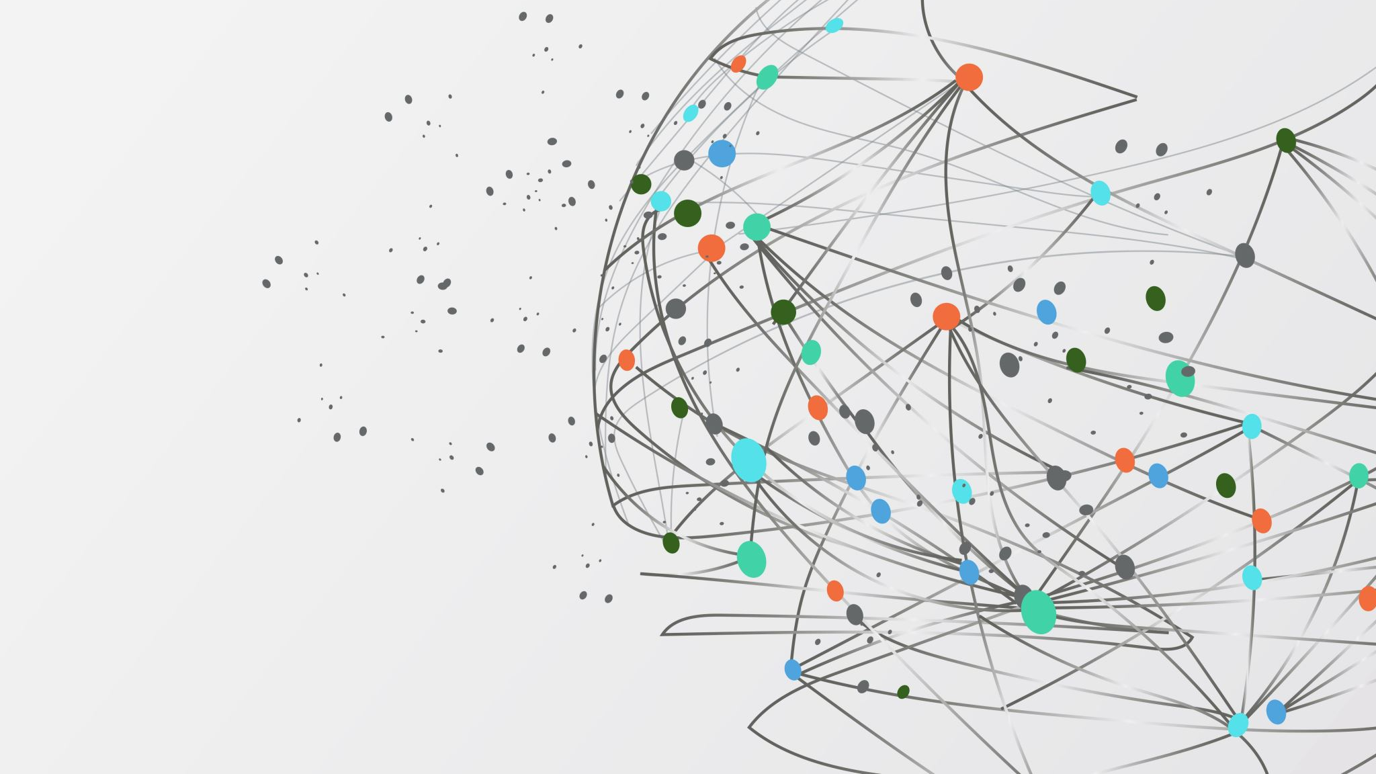
Social Media and Me
Aden Zhu

Slide 2
Section 1
Information and Social Media

Slide 3
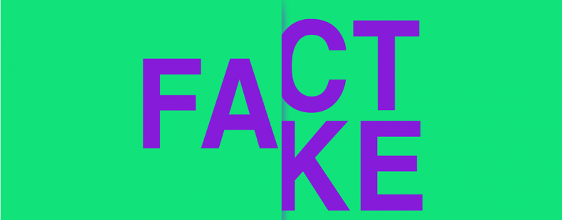
How have social media platforms changed the way we consume and understand information?
Misinformation runs rampant on social media these days thanks to how easy it is to get anyone to believe something. Many people rely on social media to instantly get the latest information and news without really looking further. People always want more information on an interesting story, so when they find it, they often don’t even think twice before believing it.
People are becoming more and more reliant on social media to find the “right” side of a story. However, social media doesn’t help us clear up the muddy water, it just constantly throws more mud in. When people are confused and left wanting more, they will keep looking for it on social media.

Slide 4
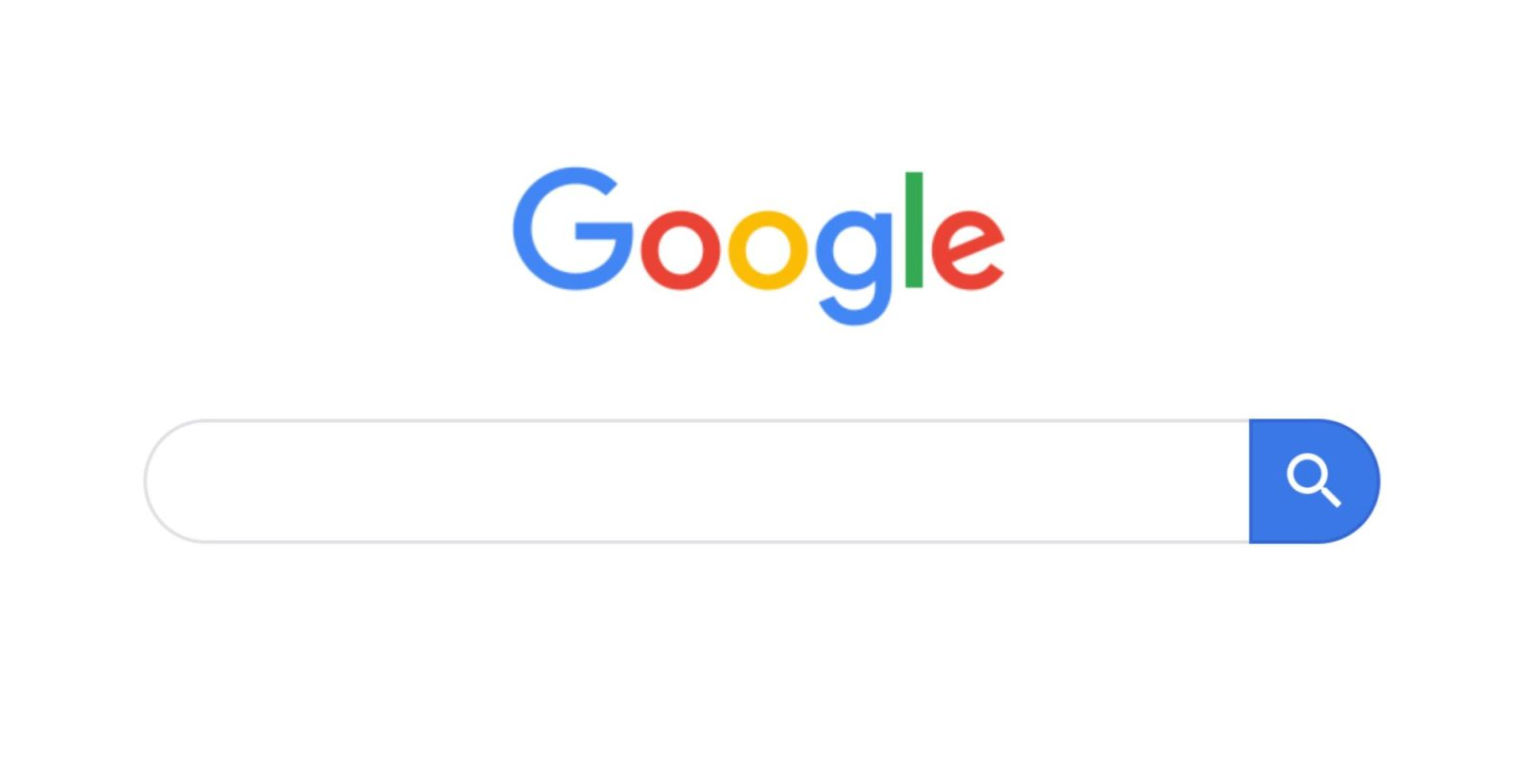
When you see or read “news” on social media, do you take time to research the story further?
Whenever I find news on social media, I always start off a bit skeptical. I’ve heard everywhere from all sorts of people about how there’s always fake news and misinformation on social media, so if there’s ever a story I’m interested in, I usually make a quick google search to see if there are any matching headlines or similar results.
Though this helps me weed out most misinformation, it’s not 100% effective. Headlines can be misleading too, and many news sources are not as reputable as they seem. If you want to be sure you’re getting all the right information, Snopes.com is a great resource to check all the facts.

Slide 5
Section 2
Social Media and Youth Culture

Slide 6
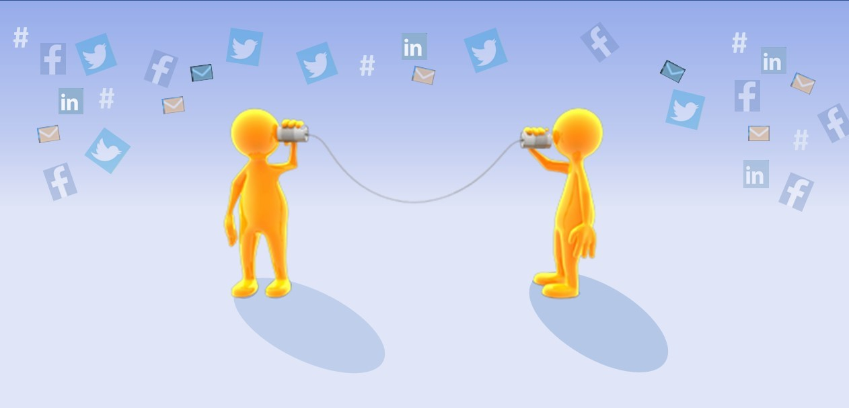
What value do you get from online social interactions?
Social media is a great way to connect with new people or old friends. It can help you stay in touch with people you don’t see anymore and talk to anyone at any time.
Though I don’t use social media often, it is a very useful tool that I can use to see what my friends are up to or to connect with someone I haven’t seen in a long time.

Slide 7
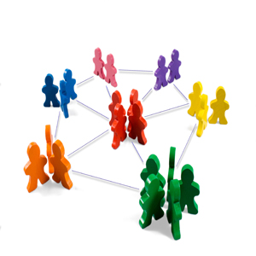
How is social media and social capital helping to form youth culture?
Many of today’s youth use social media almost obsessively. Since social media is such a prevalent part of their lives, many fall into the trap of defining their self-worth through their social capital.
This is a very toxic mentality that can keep people absorbed completely on their phones, focused on only their worth on social media based on their likes or followers. This can often lead to depression and other types of mental illnesses, and is very important to avoid if you are going to use social media.

Slide 8
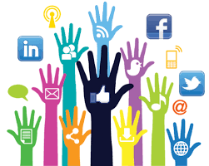
When you post online do you consider how the post may be seen by others?
When posting online, you should always keep your digital footprint in mind. Don’t post something you’ll regret posting in the future, because somebody can easily save it and share it when you might not want them to. For many people, social media is a first impression of you, and if it’s not positive, you could lose out on a spot in a good university or a job opportunity.
I generally stay away from social media apps where too many people will see the things I post. However, I always make sure the things I’m posting will paint me in a positive light as opposed to something that can be used against me.

Slide 9
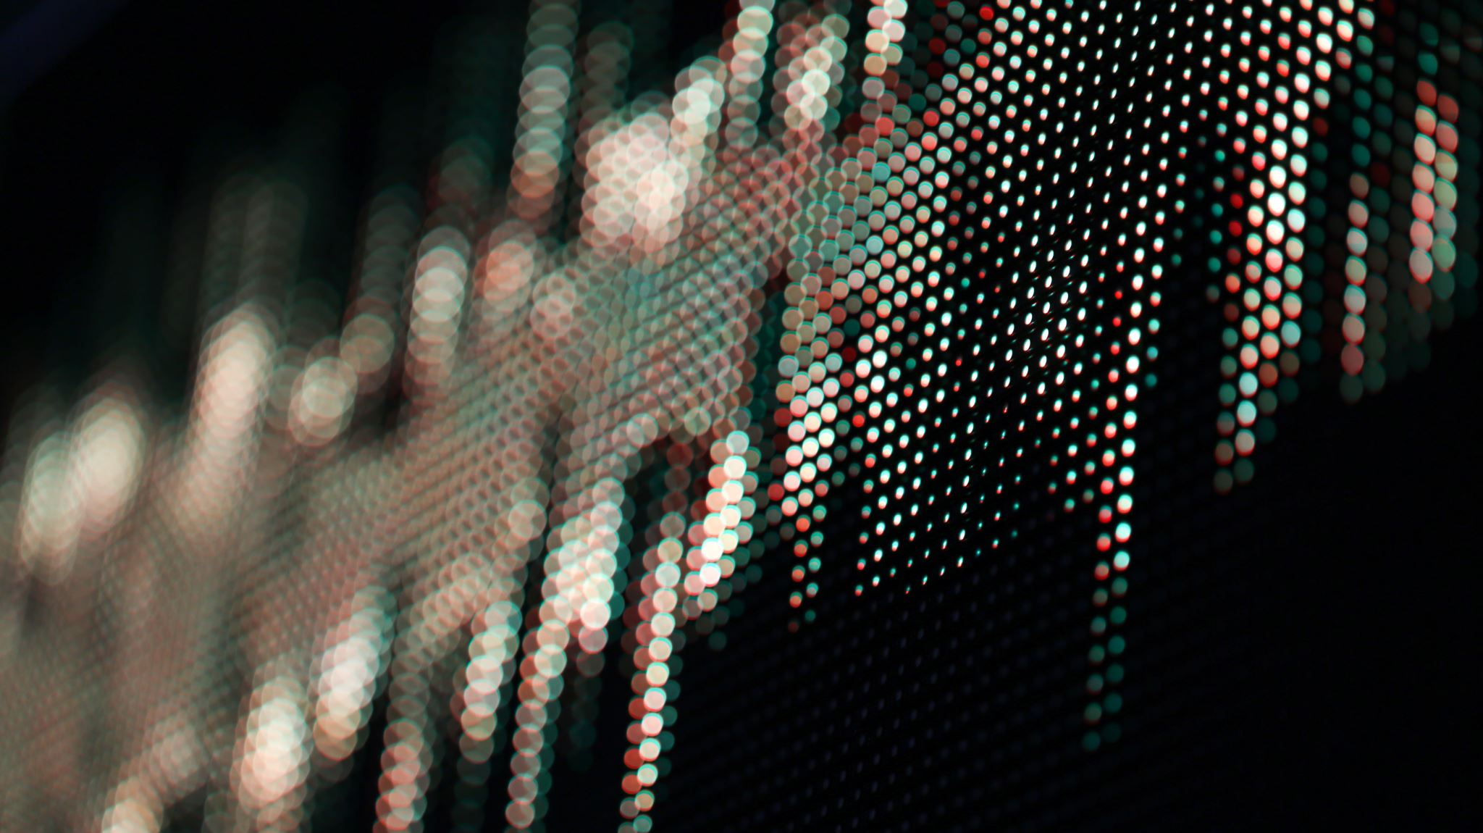
Section 3
A World of Social Media

Slide 10
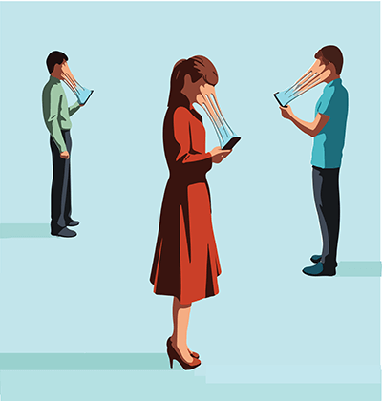
Similarities between our world and theirs
Though these videos might seem ridiculous and a very far future from reality, there are still many similarities between these videos and our society.
These people all constantly have phones in their hands. Clearly, not all of us are like this, but there are many people these days that will go out and just sit with each other on their phones, unable to look away.
In these videos, people are seen buying food just to take photos and post them. Many people in our world take photos of everything they eat, and often value how something looks over whether they really want to eat it or not.
Another example is how people are treated based on their status on social media. All everyone cares about is their rating, and when it drops too low everybody stops liking them. Though not to this extreme extent, many people are treated differently based on their social capital.

Slide 11
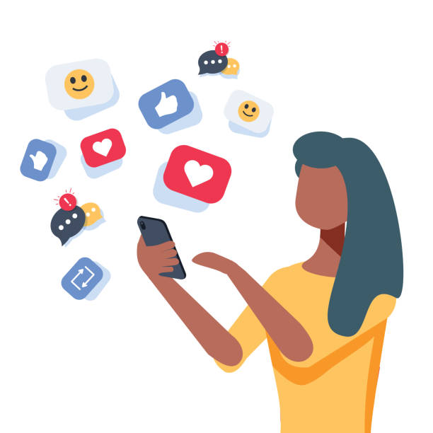
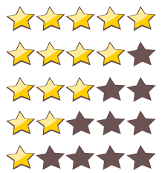
Social interactions in this world
In these clips, the main character is seen gaining and losing points based on how people rate her. When somebody gives her a high review, her score goes up. She, along with everybody else in this world cares a lot about these points because the way they are perceived is based entirely upon these points. If you have a high score, people like you substantially more, and you’re viewed as a better person.
In this world, your presumed worth or value can be viewed at any time by anybody, and what you do is shared all over. This can motivate people to do good things (or at least pretend to) so that they can see their score go higher.
Social interaction is wildly different in this world compared to ours. People would almost never interact with those who have a lower score and rely on their phones to decide who is and isn’t worth talking to. People would constantly be worried about their image and their score, trying to get as many people as possible to give them a good rating.

Slide 12
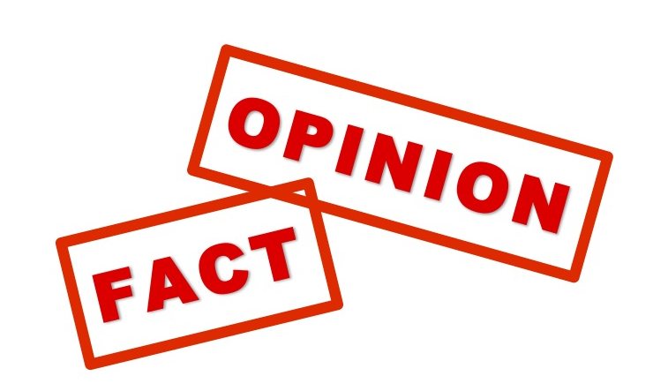
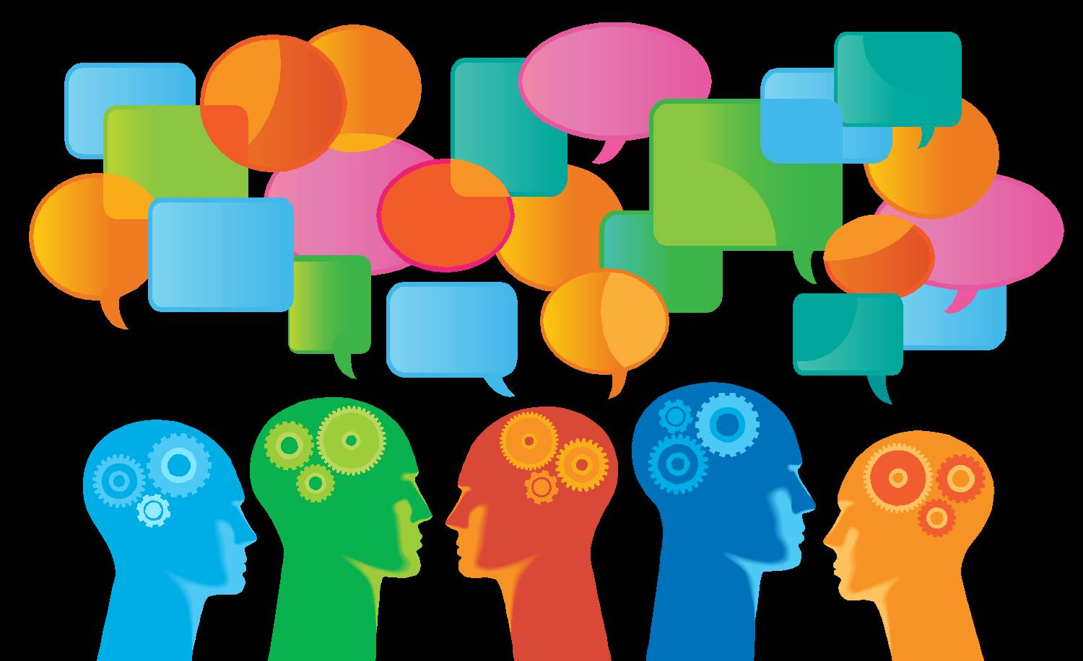
Reflection
Sometimes fact and opinion are hard to tell apart. It’s hard to find out which is which, especially when the person writing might think their opinions are facts. However, usually if somebody is trying to persuade you to think a certain way, that is an opinion. Often, they will only include things that support their case, and omit information that could convince you to think differently. If somebody is just posting evidence and letting you make your own decision, it is safe to say that what they are posting are facts.
When looking through evidence as a third party, it is important to look from different perspectives. When analyzing evidence from different perspectives it is very important to consider all evidence, and make sure all information is correct. Sometimes it is easy to convince yourself to think a certain way before reviewing all the evidence, but that will make it very difficult to come to an unbiased conclusion.

Slide 13
Citations
“First Impression Stock Illustrations – 251 First Impression Stock Illustrations, Vectors & Clipart - Dreamstime.” First Impression Stock Illustrations – 251 First Impression Stock Illustrations, Vectors & Clipart - Dreamstime, https://www.dreamstime.com/illustration/first-impression.html. Accessed 3 Mar. 2021.
Free 5 Star Rating Cliparts, Download Free Clip Art, Free Clip Art on Clipart Library. http://clipart-library.com/5-star-rating-cliparts.html. Accessed 3 Mar. 2021.
“Glued to Your Phone on Your Lunch Break? Do This Instead.” Rewire, 18 Oct. 2019, https://www.rewire.org/lunch-break-phone-no-break/.
“How Your Company Can Best Leverage Different Perspectives.” Jeff DeGraff, 9 Jan. 2019, https://jeffdegraff.com/blog/2019/01/how-your-company-can-best-leverage-different-perspectives/.
Inc, Depositphotos. “ᐈ Quicksand Stock Pictures, Royalty Free Quicksand Clip Art Images | Download on Depositphotos®.” Depositphotos, https://depositphotos.com/vector-images/quicksand.html. Accessed 3 Mar. 2021.
jennawilliamson87. “Social Capital.” Sustainable Development, 2 Mar. 2013, https://jennawilliamson87.wordpress.com/2013/03/02/social-capital/.
Li, Abner. “Google.Com on Mobile Web Rolling out Voice Search in Chrome for Android.” 9to5Google, 28 Jan. 2019, https://9to5google.com/2019/01/28/google-mobile-voice-search-chrome-android/.
“‘Misinformation’ vs. ‘Disinformation’: Get Informed On The Difference.” Dictionary.Com, 15 May 2020, https://www.dictionary.com/e/misinformation-vs-disinformation-get-informed-on-the-difference/.
Prinzing, Michael. “Facts and Opinions Are Not Contraries.” Medium, 29 Dec. 2019, https://practicalphilosopher.prinzing.net/facts-and-opinions-are-not-contraries-3da8d787885b.
“Snopes.Com.” Snopes.Com, https://www.snopes.com/. Accessed 3 Mar. 2021.
Social Media Illustrations, Royalty-Free Vector Graphics & Clip Art - IStock. https://www.istockphoto.com/illustrations/social-media. Accessed 3 Mar. 2021.
The Synergy Organization | Staying In Touch Is Important. https://synergyorg.com/staying-in-touch-is-important/. Accessed 3 Mar. 2021.
Unknown. “Personal Injury Defenders: Winning Your Claims through the Responsible Use of Social Media.” Personal Injury Defenders, 24 July 2014, http://personalinjurydefenders.blogspot.com/2014/07/winning-your-claims-through-responsible.html.
“Yummi Is a Social Network for Sharing Your Food Porn.” Digital Trends, 8 July 2016, https://www.digitaltrends.com/photography/yummy-is-the-social-media-for-food/.

