Slide 1
My Digital Portfolio
Aden Zhu

Slide 2
Let It Be Performance
“Let It Be (Beatles Album).” Wikipedia, 17 May 2021. Wikipedia, https://en.wikipedia.org/w/index.php?title=Let_It_Be_(Beatles_album)&oldid=1023715870.
Quarter 4 - Guitar

Slide 3
Character Analysis
Screenshot taken by me
Quarter 2 - English
Photo taken by me

Slide 4
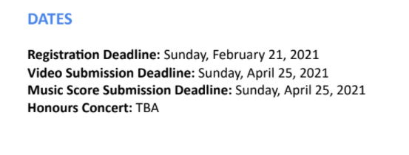
Piano Festival
Extracurricular Activity
Screenshot taken by me

