Slide 1
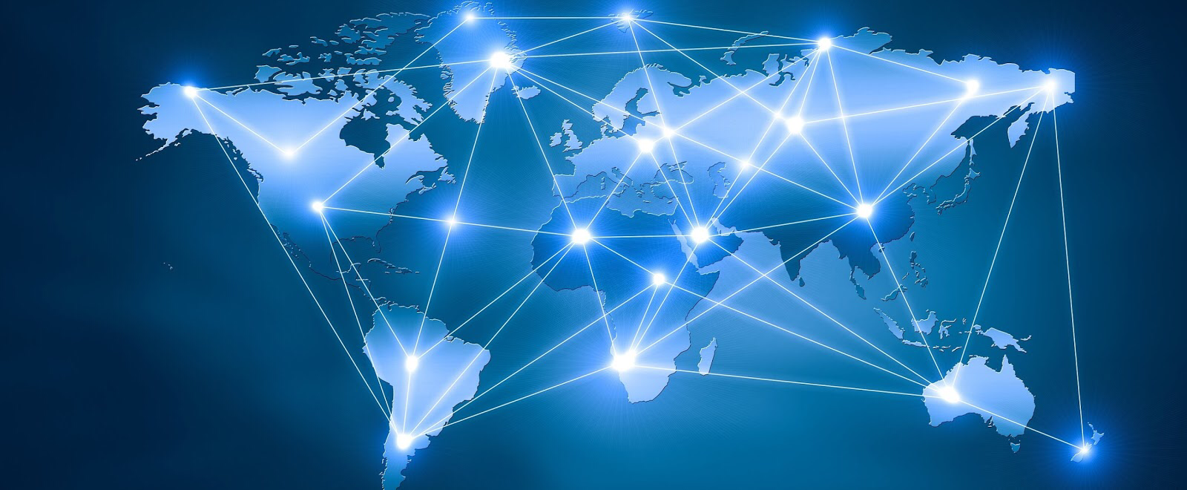
digital FootPrint
adhiban

Slide 2
What Is A Digital Footprint
A digital Footprint is a person’s online activity, For example, Photos of you, social media accounts and posts, tagged posts, Browsing history.

Slide 3
SECTION 1

Slide 4
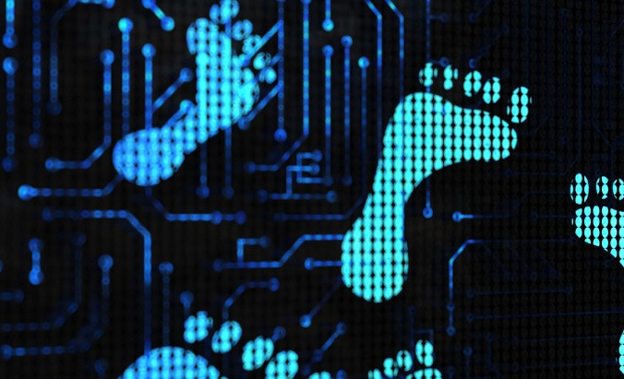
How Might Your Digital Footprint Affect Your Personal Brand And Future Opportunities?
Your digital footprint can affect you in so many ways. For example, If you were applying for a job, Employers will search your name up and everything to see what kind of person you really are. This could mean if you post pictures of yourself doing things that may not look good for you, an example is partying, drinking. Those pictures are visible to anyone, so your employer would see this and know that this is the kind of person you are. And if it’s not a good digital footprint that could mean loss of a job. Another reason why a digital footprint can affect your future is. Anyone can search your name up and your digital footprint is visible to everyone. Which means what you do even in the past can tell anyone who you really are. For example, people won’t trust you.

Slide 5
Why Is It Important To Be Aware Of Your Digital Footprint
Knowing your digital footprint is good. By looking at our digital footprint we can see what our personality is online. What we post, what we do. We would have little knowledge of what kind of digital footprint we have based on things we have done online like, posting pictures.
It also gives us a impression of ourselves as if we were in the point of view of a employer

Slide 6
SECTION 2

Slide 7
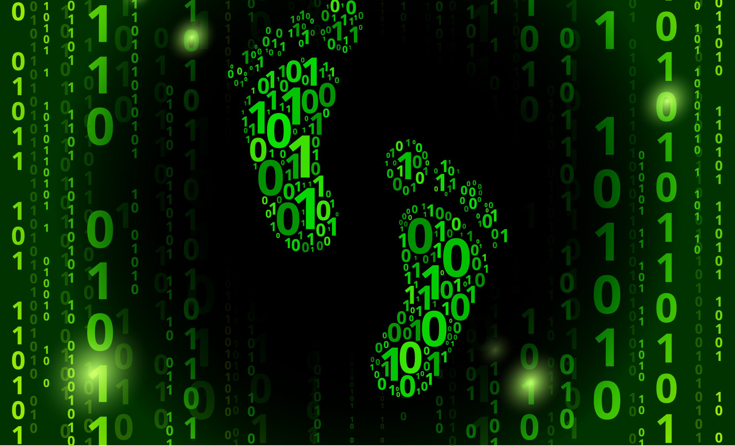
3 Ways I Keep My Digital Footprint Safe
PASSWORDS: - Whenever something online requires a password I always choose a hard password that is strong and not easy to get into my mixing letters and numbers and symbols. And I never reuse passwords.
SOCIAL: - I don’t post anything on my social media. I always think twice of what I’m doing on the internet so it doesn’t affect my future life.
SEARCHING MYSELF UP: - I often search my name in the internet to see what comes up and have an idea of what is being shown about myself.

Slide 8
SECTION 3

Slide 9
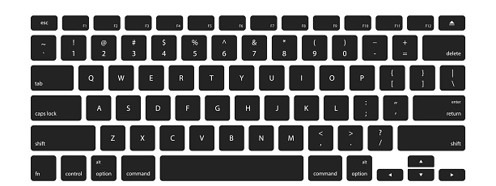
Explanation Of Digital Permanence
Something that has been posted on the internet that is never getting off. Once it’s in, There is no going back. Digital permanence is like a recording of what you do online.

Slide 10
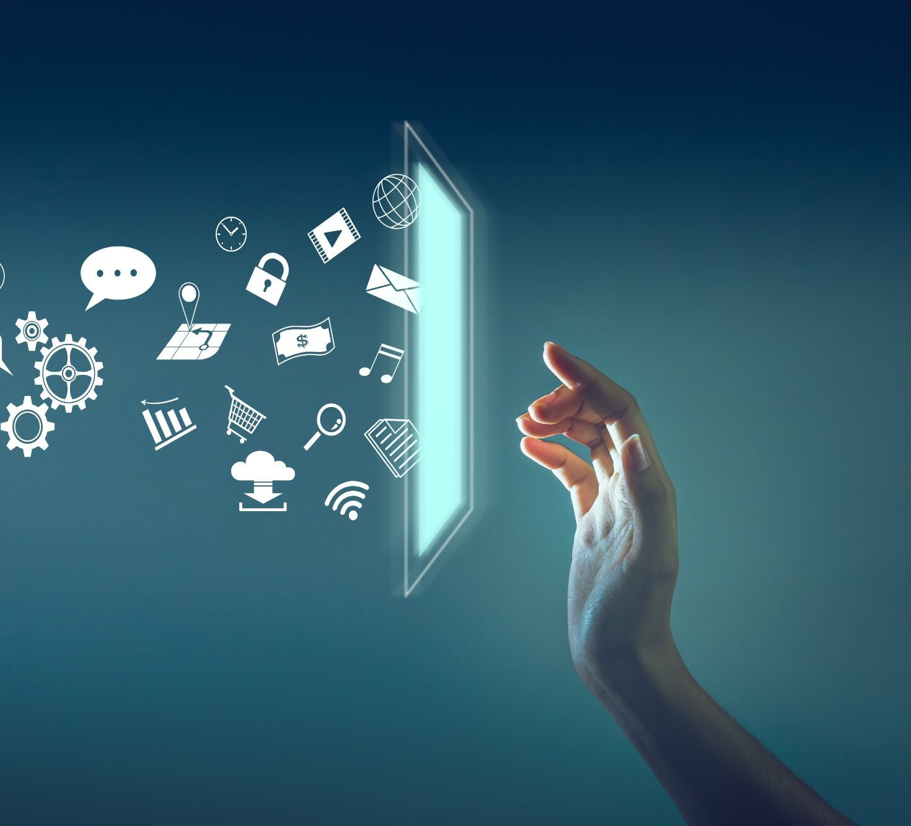
Why Should We Care About Digital Permanence
Just like our digital footprint. We should be aware of these things because it helps us look better and show who we really are. Being aware of what our digital footprint is can help us get us in huge opportunities and be successful.

Slide 11
References
12 tips for students to manage their digital footprints. (2019, May 10). TeachThought. https://www.teachthought.com/the-future-of-learning/11-tips-for-students-tomanage-their-digital-footprints/
Help protect your digital footprint from prying eyes. (n.d.). Retrieved December 9, 2020, from https://us.norton.com/internetsecurity-privacy-clean-up-online-digital-footprint.html
Live my digital for students: Digital footprint—Youtube. (n.d.). Retrieved December 9, 2020, from https://www.youtube.com/watch?v=OBg2YYV3Bts
Says, G. (2019, July 31). How and why you should reduce your digital footprint. Avira Blog. https://www.avira.com/en/blog/why-you-should-reduce-your-digital-footprint-and-3-ways-you-can
What is your digital footprint and why it is important to know about it? (2020, January 16). Geekflare. https://geekflare.com/digital-footprint/
Your digital footprint matters. (n.d.). Internet Society. Retrieved December 9, 2020, from https://www.internetsociety.org/tutorials/your-digital-footprint-matters/

Slide 12
Digital Footprint By Adhiban

