Slide 1
SOCIAL MEDIA AND ME
ADHIBAN

Slide 2
SECTION 1

Slide 3
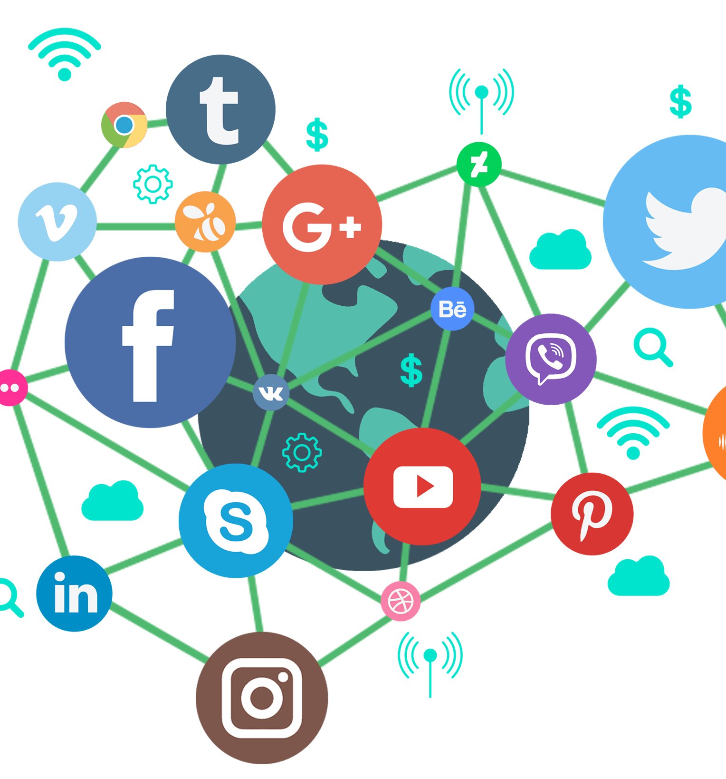
How have social media platforms changed the way we consume and understand information?
Social media platforms have changed the way we consume and understand information because it makes it difficult to trust. A lot of news these days are being shared on social platforms like Facebook, Twitter and Instagram. When back in the day it was all on the news and it was trustworthy because it wasn’t a bunch of people posting things that may be false information. Social media is great source of news, but not all of it is accurate and people have a hard time trusting the information that has been given. Although social media is a good and helpful way for us to see another person's perspective and it can help us understand the information better.

Slide 4
When you see or read “news” on social media, do you take time to research the story further?
Depending if the information interests me. Most of time when I see things posted online, I tend to not bother with it thinking that it is not accurate, but at the same time I sometimes do believe whatever is on social media because of how concise and easy it is to access. If it really gives me interest and is important then I take the next step which is taking a deeper look into the topic to be sure that the news is real and not false information.

Slide 5
SECTION 2

Slide 6
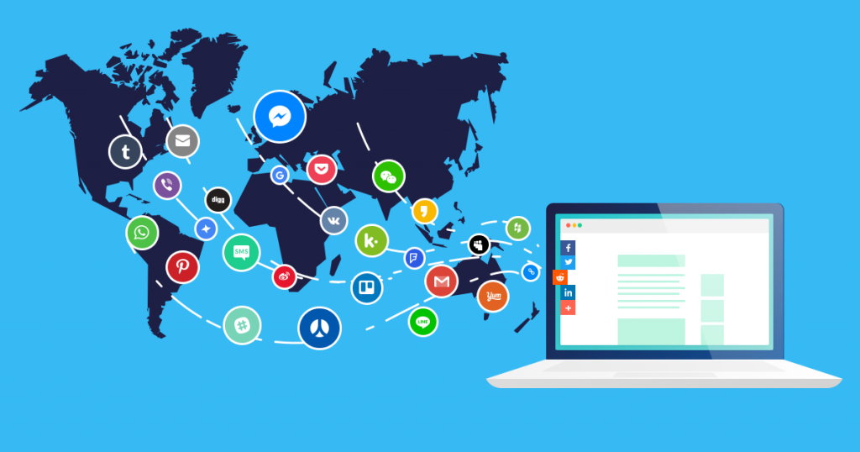
What value do you get from online social interactions?
A value of online social interactions are being able to communicate anywhere and anytime, Another value of online social interaction is that you can meet new people and interact with them without having to meet outside or anything like that, which means it is very easy to communicate. Personally, for me online social interactions are great because I can talk to my friends whenever and wherever.

Slide 7
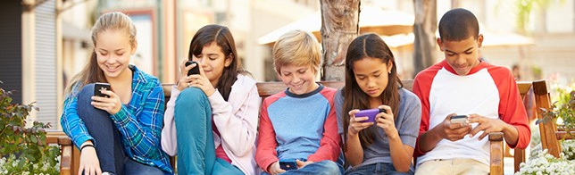
How is social media and social capital helping to form youth culture?
Social media is helping to form youth culture by getting their attention on information. Social media will get people to connect with others around the world. This is good because now the youth are in touch with the news and are aware of what is happening.

Slide 8
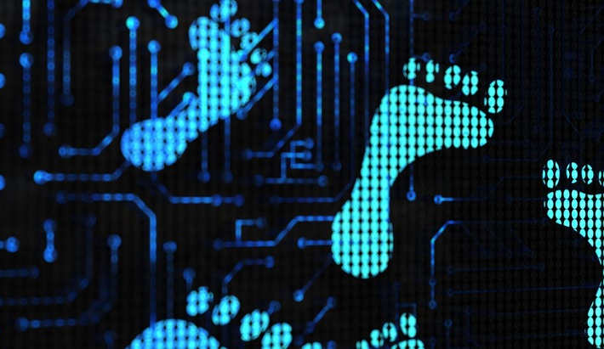
When you post online do you consider how the post may be seen by others? What it may say about you? Or how that post may be seen in the future?
Posting things is part of your online activity which is your digital footprint, and it is very important especially in the future when getting a job. For this reason, I do not post anything on social media. If I ever was to post anything for some reason I would always think first and ask myself, is it necessary before posting.

Slide 9
SECTION 3

Slide 10
Do you see any similarities between the world presented in this video and the world you live in?
From the world we live and the world that was presented in the video there are some similarities for example, all the people in the video are treating people differently based on their ratings. Which means people with higher ratings get treated better. This is similar to our world because everybody is judging them by numbers and not their personality. Things like followers and likes do not show what a person is like, you shouldn't judge them before getting to know them. Both worlds show that however you are represented on social media, it can affect how others see you.

Slide 11
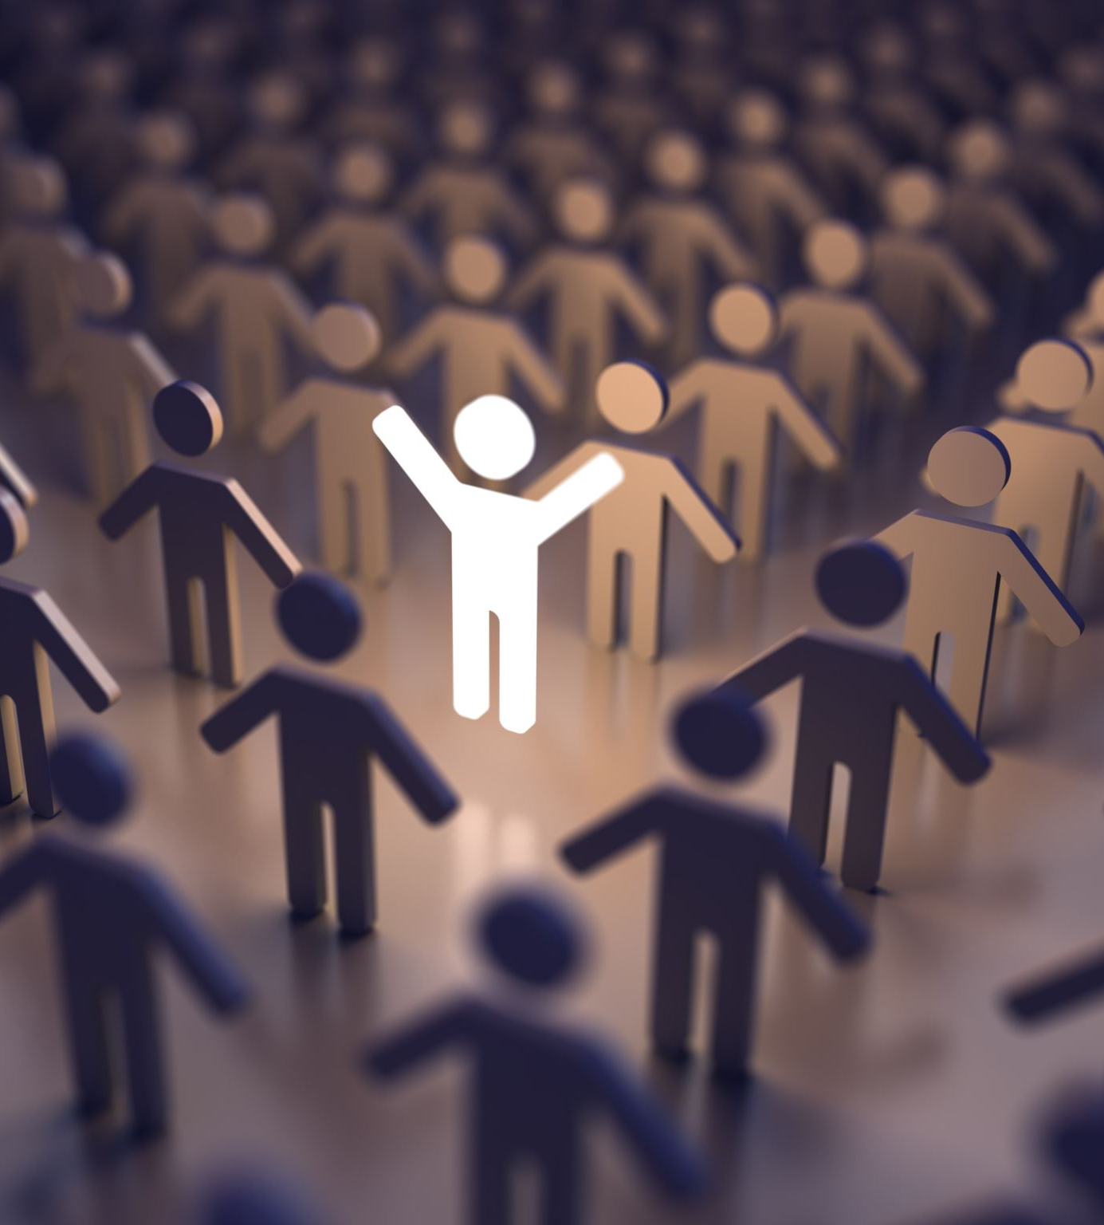
How does the main character gain and lose points? Why are these points important to her?
The main character loses and gains points depending on the way people rate her. She gained points by posting something about her life and got likes based on that. The points she receives from this is very important because it can affect how people treat her and this also represents what kind of person she is.

Slide 12
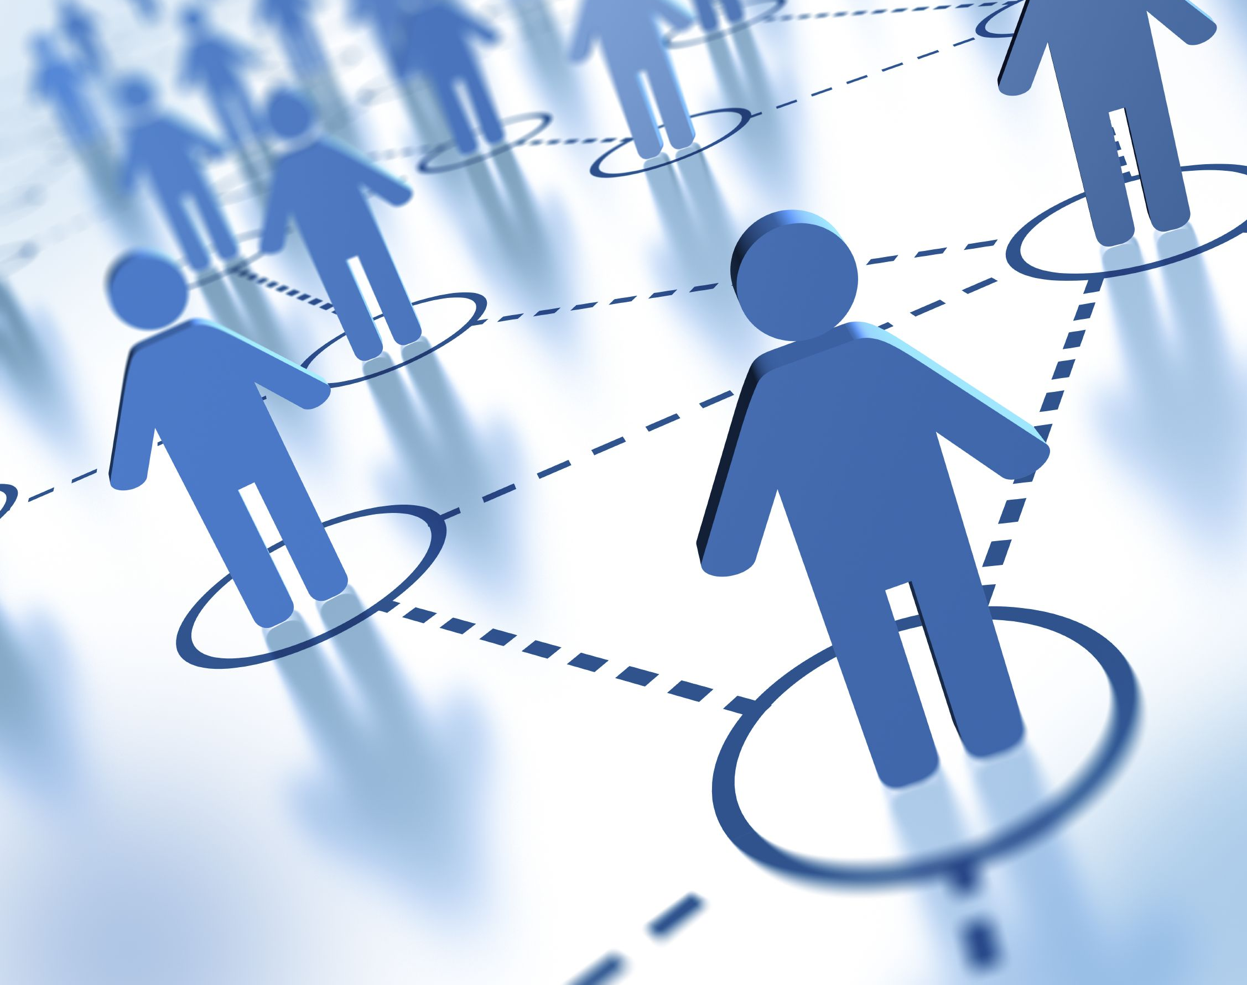
What value might be derived from this type of social interaction?
The social interaction we saw in the video is damaging society. Everyone will not be able to share their thoughts and opinions to others knowing that it will ruin their character and may put a negative look on them. No one will be able to express their feeling on others. For that reason, there is no value from this type of social interaction because everyone will be so occupied worrying about what others will think of them and what ratings they have.

Slide 13
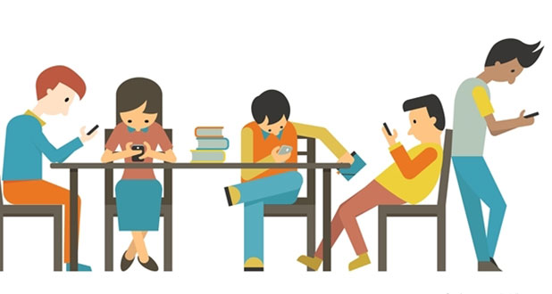
How are social interactions changed in the world of these clip?
In this world everyone is so attached to their phones and interacting all within social media. There is rarely any face-to-face communication. This is happening all the time now that everyone these days have some sort of technology. It is like humans do not exist and everyone is just dependent on their points.

Slide 14
Critical Thinking Core Competency Reflection

Slide 15
How did you tell the difference between facts and interpretations, opinions and judgements?
The way I can tell the difference between facts and interpretations, opinions and judgements is by taking a deeper look into it and by seeing how it is written. If the fact gives confidence and has some information that has been shown in other sources than it most likely is going to be a fact. Although if it is written like an opinion or if it shares thoughts then it is an opinion. A judgment is easy to tell because it is their thoughts on the information they have. Interpretations is more of guessing and connecting with the facts you have.

Slide 16
How did you analyze evidence from different perspectives?
I analyzed evidence from different perspectives by trying to understand what the sources had to say and to be in their point of view. I viewed a few other sources to make myself produce ideas and then created my opinion. I use their facts and opinions from all the sources combined and then form my own opinion.

Slide 17
Citations
Black Mirror, Nosedive, Trecho - YouTube. https://www.youtube.com/watch?v=GQW6mUK2aDQ&list=PLJk1a21GKEZXxT9wwmnVle-zautJw4q12&index=3. Accessed 3 Mar. 2021.
Brodwin, Erin. “What Psychology Actually Says about the Tragically Social-Media Obsessed Society in ‘Black Mirror.’” Business Insider, https://www.businessinsider.com/psychology-black-mirror-nosedive-social-media-2016-10. Accessed 3 Mar. 2021.
Ethics, Business, et al. “The Impact of Social Media: Is It Irreplaceable?” Knowledge@Wharton, https://knowledge.wharton.upenn.edu/article/impact-of-social-media/. Accessed 3 Mar. 2021.
Horgan, Colin. “Confusion Is the Point.” Medium, 16 Oct. 2019, https://gen.medium.com/the-confusion-is-the-point-6ab1d5a933aa.
“How Social Media Affects Teens - Dangers of Social Media Today - JSY.” Just Say YES, 20 May 2019, https://www.justsayyes.org/topics/how-social-media-affects-teens/.
Is Social Media Hurting Your Mental Health? | Bailey Parnell | TEDxRyersonU. www.youtube.com, https://www.youtube.com/watch?v=Czg_9C7gw0o. Accessed 3 Mar. 2021.
Kindness May Not Deserve Kind Return. www.youtube.com, https://www.youtube.com/watch?v=tyUi6-Opzzw. Accessed 3 Mar. 2021.
Nesi, Jacqueline. “The Impact of Social Media on Youth Mental Health: Challenges and Opportunities.” North Carolina Medical Journal, vol. 81, no. 2, Mar. 2020, pp. 116–21. www.ncmedicaljournal.com, doi:10.18043/ncm.81.2.116.

Slide 18
Images
5 Little-Known Social Media Marketing Tips That Will Take Your Marketing to New Heights. https://www.whatmobile.net/News/article/5-little-known-social-media-marketing-tips-that-will-take-your-marketing-to-new-heights. Accessed 3 Mar. 2021.
“Computational Models of Social Interaction.” University of Birmingham, https://www.birmingham.ac.uk/research/activity/ias/workshops/2014/computational-models-social.aspx. Accessed 3 Mar. 2021.
“Data Privacy Day: Understanding Your Digital Footprints.” Internet Society, 22 Jan. 2014, https://www.internetsociety.org/blog/2014/01/data-privacy-day-understanding-your-digital-footprints/.
“Have Smartphones Ruined Social Interaction between Teens?” The Hiring Advisors, 16 Apr. 2018, https://thehiringadvisors.com/smartphones-ruined-social-interaction-teens/.
Most Popular Social Media Platforms Around the World - AddThis. https://www.addthis.com/blog/2019/06/06/most-popular-social-media-platforms-around-the-world/. Accessed 3 Mar. 2021.
“Pakistan’s Digital Media Policy: Attempt to Promote Influencers over Journalists? | SAMAA.” Samaa TV, https://www.samaa.tv/news/2020/05/pakistans-digital-media-policy-attempt-to-promote-influencers-over-journalists/. Accessed 3 Mar. 2021.

Slide 19
The End

