Slide 1
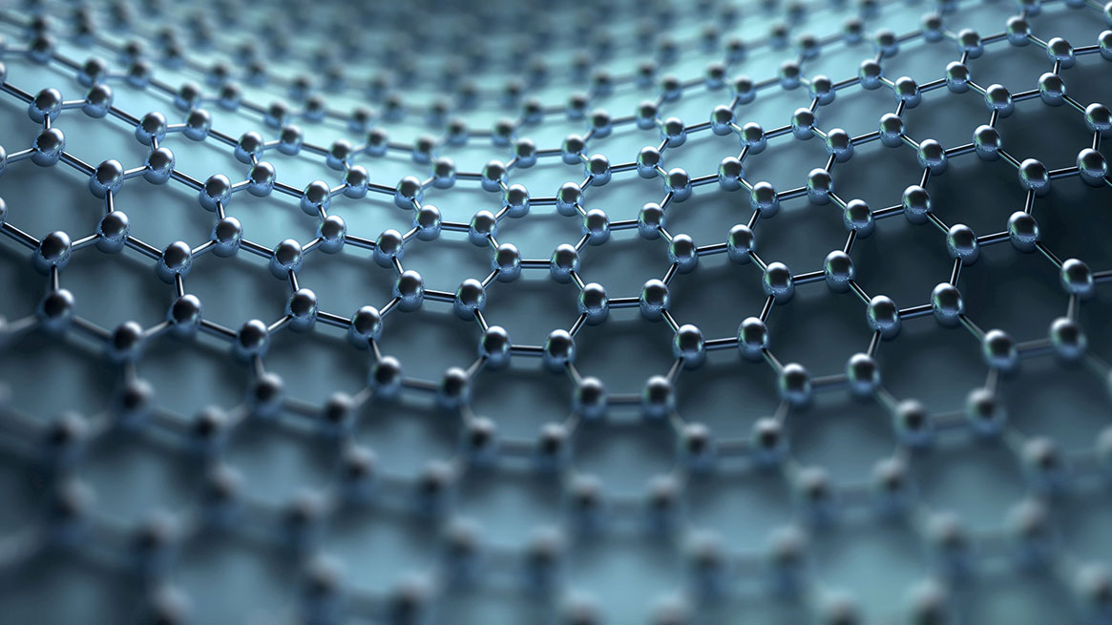
Social Media and Me
1
Sec.6 DL

Slide 2
Section 1: Self Reflection
2
How have social media platforms changed the way you consume and understand information?
Ans. I believe that social media has a big impact on the way we think and how we understand information. Nowadays, almost every teenager has at least one social media account, and a large number of them spend over 2 hours on it every day. This is a lot of time that we spend either posting something, or scrolling through others posts online. Which is how social media platforms change the way we consume and understand information.

Slide 3
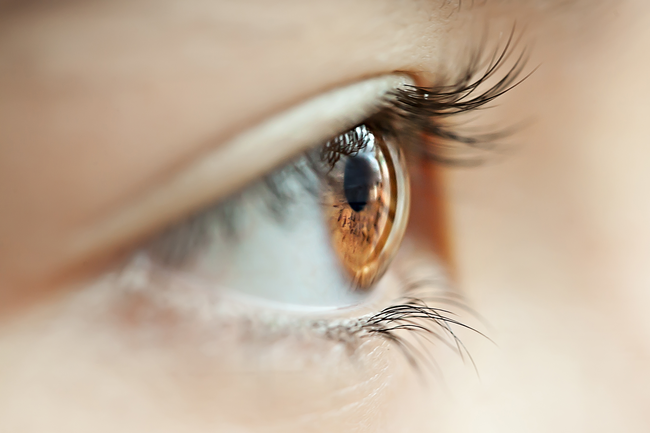
Self Reflection (Continued)
3
When you see or read “news”on social media, do you take time to research it further?
Ans. Personally, when I read an interesting fact, or a breaking news online, If it is something that interests me, I will take time and research it further. This has somewhat become a necessity these days because there are a lot of people out there that post fake news, far fetched facts, etc. To know what is right and what is not, one should research the information we get through social media.

Slide 4
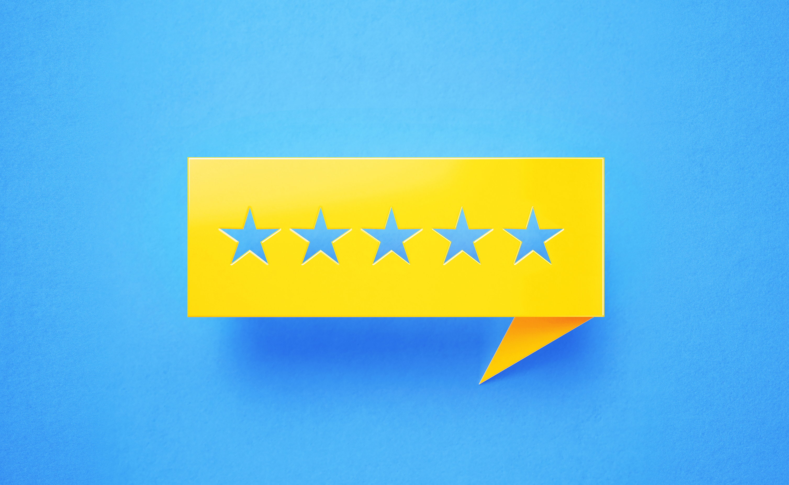
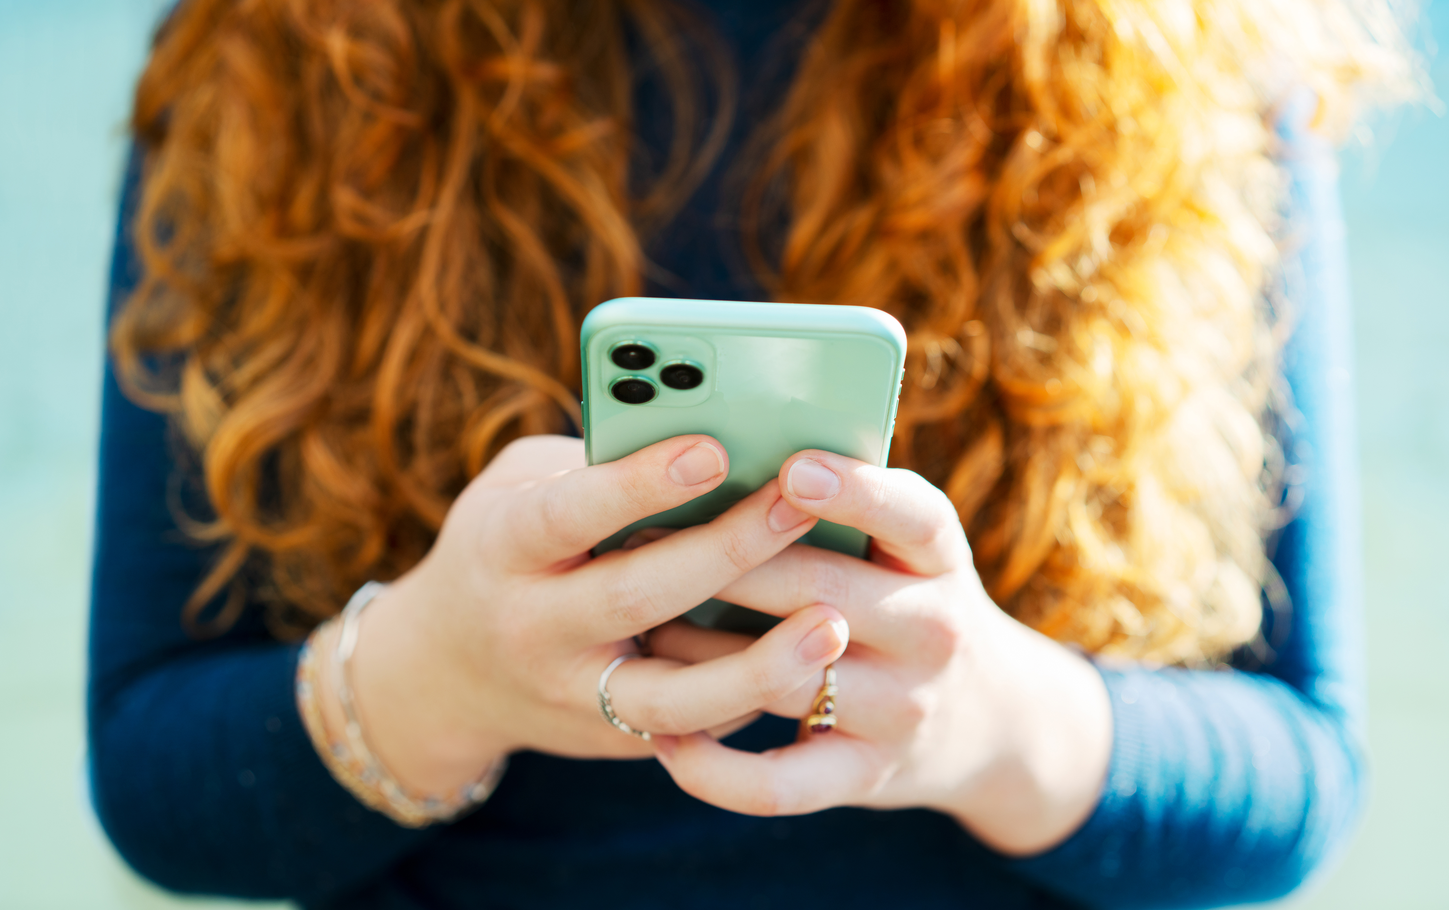
Section 2: TEDx Talk
4
What value do you get from online social interaction
Ans. Online social interaction can help in communicating with friends and family, a feeling of social support, enhance the sensation of social belonging, etc.
How is social media and social capital helping to form youth culture?
Ans: Someone once said, “What you see is what you get”. This quote holds a lot of meaning. What we see online is what we think. Be it negative or positive. We don’t control what our next scroll is going to be, and therefore we are basically letting social media decide our mood and what we think. As much as this affects adults, it affects the youth even more. This is because the Pre-frontal Cortex of their brain is still being developed, which is why negative thoughts and opinions from others have a greater impact.

Slide 5
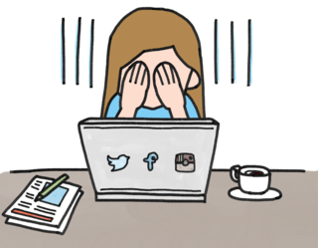
TEDx Talk (Continued)
5
When you post online, do you consider how the post may be seen by others? What may it say about you? How that post may be seen in the future?
Ans: When I post online, I always consider what others will think about it, whether it will make them think of me differently. I also make sure that it is not controversial, or rude to anybody. I recently got to know that it can take years to take down a post or to delete a photo from social media platforms. While taking precautions is fruitful, It also develops a feeling of insecurity, like what if I make a mistake? What will others think about me then, etc.

Slide 6
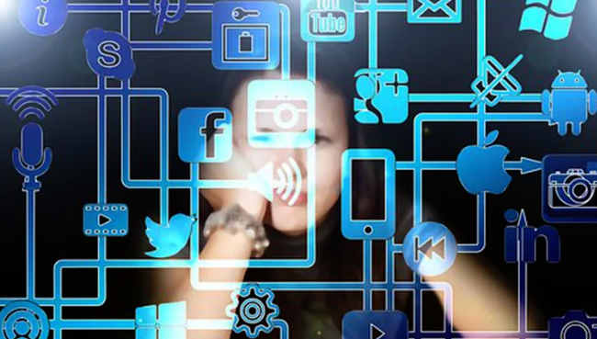
Section 3: Consider The Future
6
Do you see any similarities in the world presented in this video and the world you live in?
Ans: Yes, I see a lot of similarities in the video presented and in real life. Some of them are:
Happiness depends on social media
Your mood depends on how many likes/views you have.
What others think about you matters so much, that you are willing to change yourself for others
The stereotype that people with more followers (or higher ratings in this case) are better individuals.

Slide 7
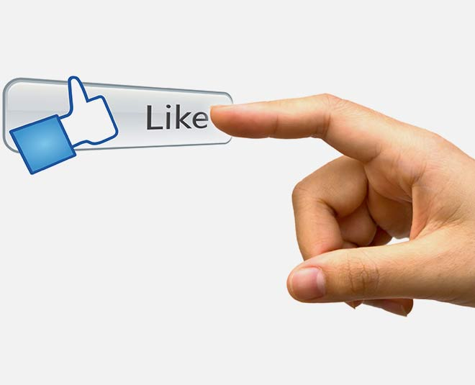
Consider The Future (Continued)
7
How does the main character gain or lose points? Why are these points important to her?
Ans. The main character gains or loses points based on how many people like their posts. Her happiness is solely dependent on her rating, which was 4.2 , not being too bad. In the second video, she met her colleague, who brought her a smoothie to help his 3.1 rating. Everyone looked at him in disgust, and when the main character showed an act of kindness by giving him a better rating, others started rating her low. Also, apparently something bad happens when one has a rating 2.5 or lower.

Slide 8
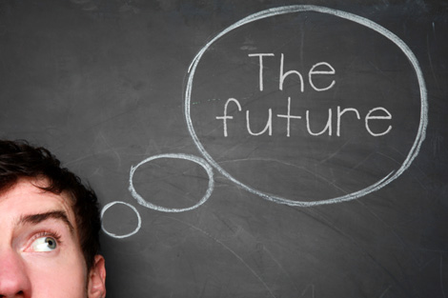
Consider The Future (Continued)
8
What values might be derived from this type of social interaction?
Ans: Everybody interacts with each other only for likes, They stay away and make people with low ratings feel bad, and if someone tries to be kind and help them, society turns their back on them, the main character drank coffee so she could get more likes, the person with a 3.1 rating only brought her a smoothie so that she could like him, etc.
All these things show how dependent society is on social media and how everybody finds happiness when others like them, not being happy by themselves. This is a very disappointing truth, and I hope nothing like this ever happens in real life.

Slide 9
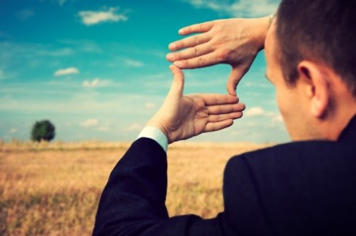
Consider The Future (Continued)
9
How are social interactions changed in the world of these clips?
Ans: Social interactions in the world presented isn’t about talking to others or having a general conversation. It is all self-centered. Nobody talks to each other for any other purpose than to get a better rating. This is a really sad truth of how social media has made everybody selfish and self-centered and how isolated the world really has become.

Slide 10
Section 4: Critical Core Competency Reflection
10
How do you tell the difference between facts and interpretations, opinions and judgements?
Ans: The Merriam-Webster Dictionary states that a fact is “Something that has an actual existence” or something that is true. An interpretation in my understanding is an understanding or opinion of a person. People can have different interpretations.
The Merriam-Webster Dictionary states that an opinion is “A view, or an appraisal formed in the mind of a particular matter”. It also says that a ‘Judgement’ is “The process of forming an evaluation by discerning and comparing”. All of this holds a lot of importance these days especially on Social Media Platforms. One should have the ability to decide what is true and what is not, respect others opinions and interpretations, and finally take correct judgements based on the given evidence.

Slide 11
Critical Core Competency Reflection (Continued)
11
How do you analyze evidence from different perspectives?
Ans: Analyzing evidence from different perspectives is important to differentiate between false judgements and facts. One important thing I will mention is to not read anyone else's opinions on it, as your opinions will most likely be biased or related to it. What I normally do is I search it on the internet. You will find a variety of different results, so don’t believe them at first site. Then I search for a trusted website on which I will further research the fact. If I am not convinced, I will search for other sites. But if I am convinced, I will search for similar sites, which hold similar meanings to the first one. This is a long process, but it is worth it as I always find out what is believable and right.

Slide 12
Citations
12
Quote: ‘What you see is what you get’: http://bit.ly/3HxidAm
Image Source: Stock Images http://bit.ly/48Hf8JZ
Fact meaning: https://bit.ly/3UdlpZj
Opinion meaning: https://bit.ly/42bL0Us
Judgement meaning: https://bit.ly/42dzND1
Social Media and its effects: https://bit.ly/3u5eFSz
Time spent on social media: https://bit.ly/3vQTdRV

