Slide 1
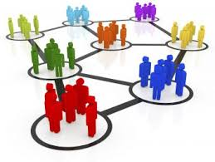
Social interactions
People join online groups when they share something similar or they want to talk to someone like Reddit

Slide 2
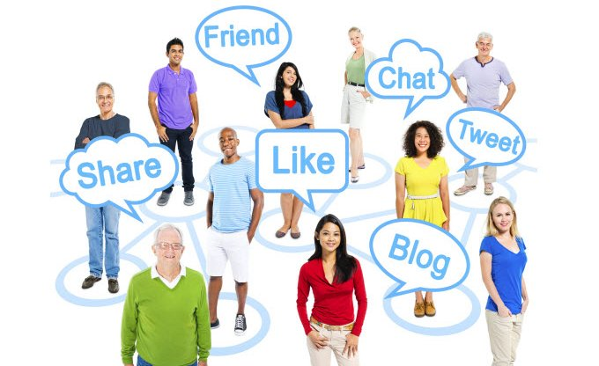
There are so many groups online, with people wanting to join the conversation.

