Slide 1
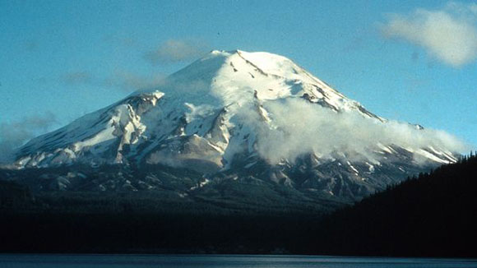
Mount St Helens
By Ember M. and Aili U.

Slide 2
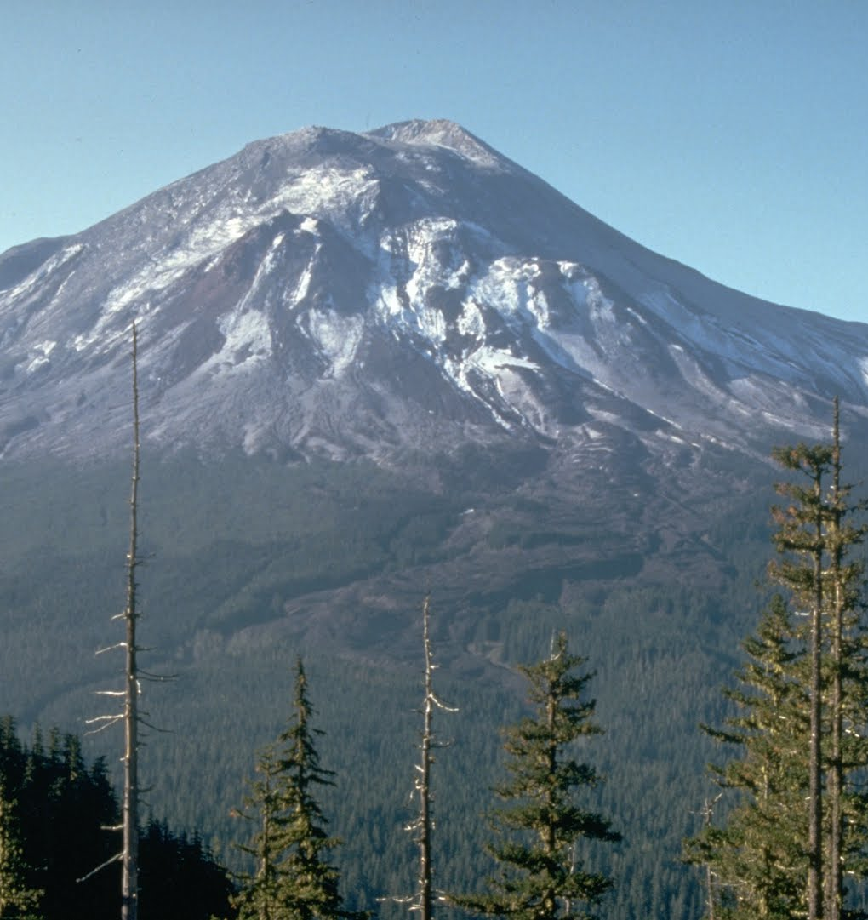
Background of Mt. Saint Helens
Located in Washington state
Erupted May 18, 1980
One of most violent eruptions, equivalent to largest hydrogen bomb ever exploded
Eruption destroyed 550 square kilometers
Composite volcano
Has been dormmate since 1857

Slide 3
How did the eruption of mt. St. Helens effect the environment and citizens?

Slide 4
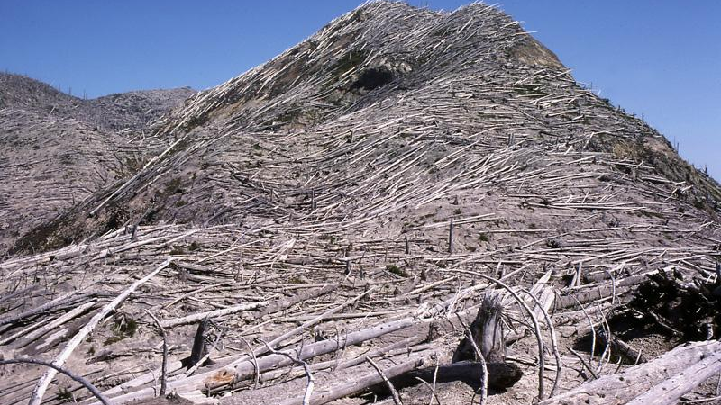
Effect on environment
Devastated surrounding land scape
Gases and debris killed thousands animals and their homes
Destroyed large parts of forest
Ash blocked rivers destroying fishing sites and flooding

Slide 5
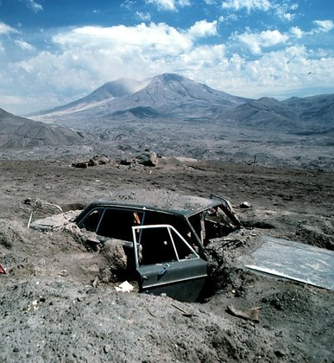
Effect on citizens
killed 57 people, by ashfall and in lateral blast
200 homes were destroyed or damaged
People living close suffered from post-traumatic stress syndrome

Slide 7
Before
Snow (Hydrosphere) is on the mountain (Geosphere)
Plants (Biosphere) grow in the soil (Geosphere)
Plants (Biosphere) produce oxygen (Atmosphere)
Melted snow (Hydrosphere) used by plants (Biosphere)

Slide 8
During
Lava (Geosphere) flows over the mountains plants (Biosphere)
Gases (Atmosphere) goes into the air (Atmosphere)
Snow (hydrosphere) melts when lava (Geosphere) flows over
Ash (Geosphere) goes into the air (Atmosphere)

Slide 9
After
Plants (Biosphere) growing again in soil (Geosphere)
The snow (Hydrosphere) on the top of the mountain and lower plants (Geosphere)
The little stream (Hydrosphere) running down the cracks in the ground (Geosphere)
The cloud/fog in the sky (Atmosphere) touching the mountain (Geosphere)

Slide 10
Bibliology
Volcanic Eruption: Mount St. Helens, 1980. (2016). In A. H. Blackwell & E. Manar (Eds.), UXL Encyclopedia of Weather and Natural Disasters (2nd ed., Vol. 5, pp. 769-773). Farmington Hills, MI: UXL. Retrieved from https://link.gale.com/apps/doc/CX3629500271/GPS?u=43dcbs&sid=GPS&xid=cbf666a2
Society, National Geographic. “Volcanoes.” National Geographic Society, 1 Nov. 2016, http://www.nationalgeographic.org/media/volcano-satellite-images/.
Contributor 2018-10-16T22:14:00Z, Mary Bagley-LiveScience. “Mount St. Helens Eruption: Facts & Information.” Livescience.Com, https://www.livescience.com/27553-mount-st-helens-eruption.html. Accessed 16 Jan. 2020.

