Slide 1
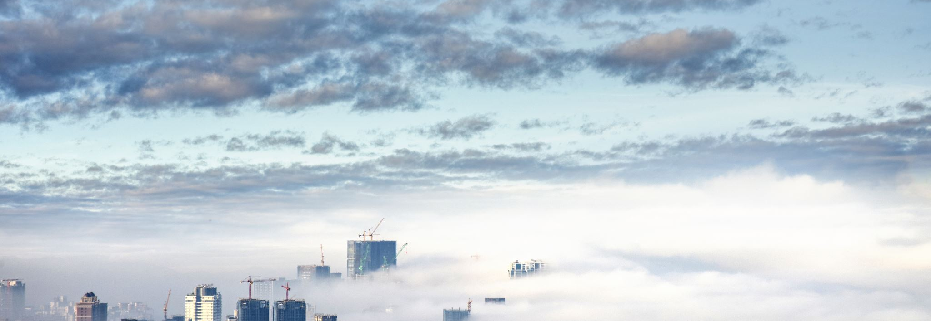
Social Media and Me
By Ario

Slide 2
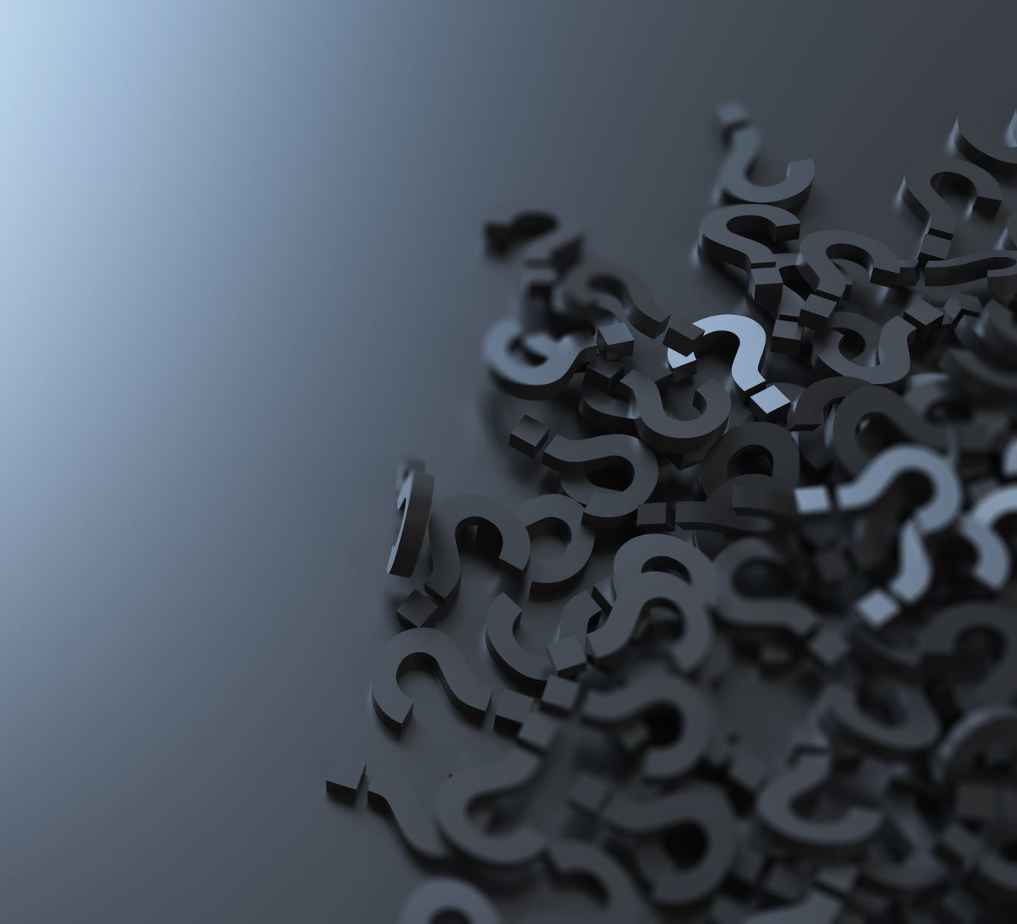
Section 1: Article – Confusion is the point

Slide 3
How have Social Media platforms changed the way we consume and understand information?
Social media has brought both negatives and positives to the way that information is being spread nowadays. It makes spreading news much easier because of apps and some news agencies that have profiles in certain apps. It also makes it easier to find news because if you are following a news agency in for example, Instagram, you can just scroll down to find their post or check if they have made certain stories. There are many negatives though that in my opinion outnumber the positives. There is a lot more bias in social media, lot more fake news, lot more fake information, and many times no context to some things. People believe what they see especially if it is catchy and looks good, and this causes them to believe fake stories or fake information released from people with a malicious intent. This means that conspiracies and falsely informed people increase which is why flat-earthers and anti-vaxxers main way of recruiting is social media. The lack of context could be one of the most dangerous things of social media because this also affects what we decide to believe or not. The lack of context makes us think twice about a statement and what to pursue more information about it only to end with it from where we began. This makes us question dumb things and makes us used to dumb things because of the enormous amount of those things in social media. There are many empty statements made by politicians in social media, people like to take these sort of statements and make up an opinion about these statements that politicians make. Usually, these statements lack information and are out of context so, basically if people argue over these statements then they are arguing over nothing. Social media is filled with empty statements either shared via news or self-employed "journalists" who spread most of the fake news. This makes social a type of tool.

Slide 4
Section 2: Ted Talk – Is Social Media hurting your mental health?

Slide 5
What value do I get from online social interactions?
I don’t value Social Media and my online social interactions because I don't use Social Media that much. I don’t care about online interactions because I prefer talking with friends in real life even though, it is easier with social media because you can be anywhere and still be able to talk with your friends. I mainly use Social Media just to ask friends what are our homeworks and to work on projects but occasionally I would call them, and we would play games. I don’t care about social currency and how many likes I get because I don’t depened on those sort of things to boos my self-esteem and because I don’t post anything.

Slide 6
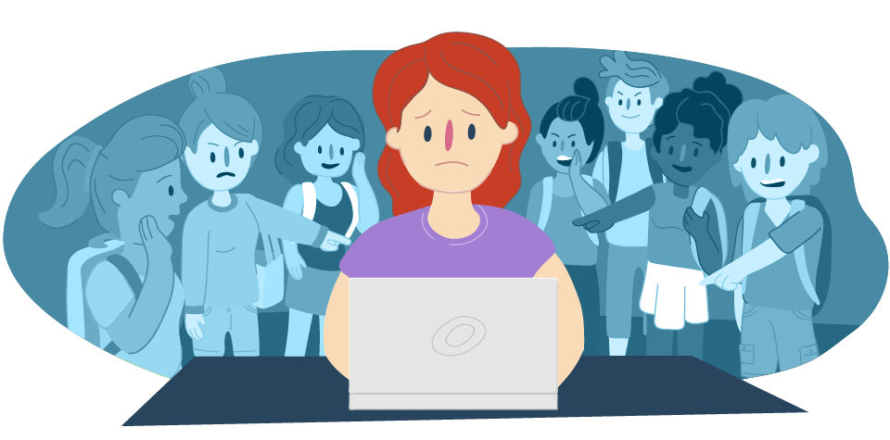
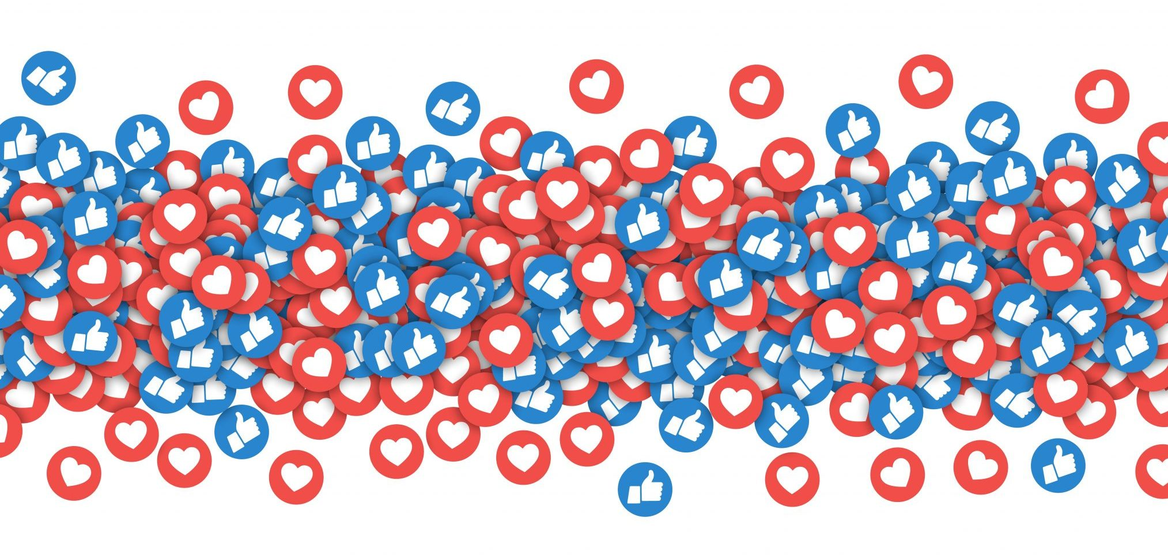
How is Social Media and Social Capital helping to form youth culture?
Well, there are pros to cons to how it is like almost everything else, but I believe that there are more negatives than positive.
PROS:
Allows for an easier platform to meet people
Allows friends and groups of friends to communicate more easily
Makes it easier to express oneself
Makes it easier to talk to other people and become more extroverted
Makes it easier to teach and educate
Makes it easier to do charities and raise awareness for things
Helps people access their interests more easily
CONS:
Easy to Cyber-bully someone
Makes people addicted to Social Currency
Makes it easier for your information to be sold to corporations
Makes it easier for someone to hack your acc
Makes you more prone to being stalked or kirdnapped
Causes people to put on fake "masks" and act lik someone else who is always happy

Slide 7
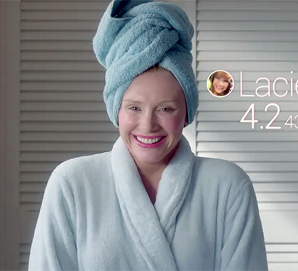
Section 3: Black Mirror – Nosedive Clips

Slide 8
Similarities between the Real World and Nosedive
In both worlds some people have fake personalities because of their social ranking
Real life interactions seeem hypocrtically and awkard which is also seen in some rich people and celebrities who hangout not because they are friends but because of their fame
People find some value in their social currency and likes in both world's although in our world it's not as extreme
People don’t get close enough to eachother and the interaction in the elevator scene is something that happens between coworkers in our world
People always trying to be perfect on social media

Slide 9
How does the character gain and lose points? And why are these points important to her?
The main character of Nosedive gains and losses points through her interactions. In the scene where she accepts a smoothie from an unpopular person, her ratings go down because she is not expected to talk to someone who people have a bad opinion of. She gains points by doing things people like and find respectable in their society. This causes all of them to not truly be them self and try to be someone else by trying to gain more points for higher ratings therefore, causing them to have fake personalities.
This makes the points very important because if your points are low then you won't have a good job and won't have a good life. We know this because the woman she was in the elevator with had a higher rating than her and worked on the top floor of the same building she worked in.

Slide 10
What value might be derived from this type of social interaction? And How are social interactions changed?
No type of value because everyone is being fake with one another not showing their true opinions and true self because they care so much about a rating. This makes them look very awkward and obnoxious to the normal populous of Nosedive because they always act so weird and like someone else. Everyone has their phones out all the time and eye contact is rarely being made and it's all a big contest of who can out-nice the other person.
They are changed in the way that everyone isn't really them self anymore and it's like they are all like robots unlike the real world where people talk about their emotions. The people in Nosedive seem very hypocritical while in the real world only some people are like that. In the real-world social media isn't also that important unlike in Nosedive.

Slide 11
Conclusion
We in order to save proper social interactions in our world and reduce the risks of social media need to know how to use social media the right way. We need to be careful of the information we receive online because it could be fake or made to spread rumours. We need to know how social media can harm our communities and why it is important to try to avoid doing bad things in social media. We must try to keep social interactions face to face because we need to avoid making our world like the one in Nosedive. I don’t think our world will ever become like the one in Nosedive but there is always the chance. We need to stay self-confident without our need for social currency and likes. We need to be honest about who we are and not become fake people because of what we think others think of us and we need to be careful of how much time we spend on social media, and what we us that time on.

Slide 13
Bibliography
Horgan, Colin. “Confusion Is the Point.” Medium, 16 Oct. 2019, https://gen.medium.com/the-confusion-is-the-point-6ab1d5a933aa.
YouTube---. https://www.youtube.com/watch?v=Czg_9C7gw0o. Accessed 21 Feb. 2020.
YouTube---. https://www.youtube.com/watch?v=4hK4fG3rcHA&feature=youtu.be. Accessed 21 Feb. 2020.
YouTube---. https://www.youtube.com/watch?v=tyUi6-Opzzw&feature=youtu.be. Accessed 21 Feb. 2020.
Additional Sources:
Brown, Jessica. Is Social Media Bad for You? The Evidence and the Unknowns. https://www.bbc.com/future/article/20180104-is-social-media-bad-for-you-the-evidence-and-the-unknowns. Accessed 21 Feb. 2020.
“Is Social Media Bad for You?” Psychology Today, https://www.psychologytoday.com/blog/i-hear-you/201906/is-social-media-bad-you. Accessed 21 Feb. 2020.
Walton, Alice G. “6 Ways Social Media Affects Our Mental Health.” Forbes, https://www.forbes.com/sites/alicegwalton/2017/06/30/a-run-down-of-social-medias-effects-on-our-mental-health/. Accessed 21 Feb. 2020.

