Slide 1
My DIGITAL PORTFOLIO
By ario

Slide 2
My Proudest achievements this year
Academic: Electronics 9 Cyber Mask Project
Academic: English 9 Short Story
Extracurricular: Studying and Working At Kumon

Slide 3
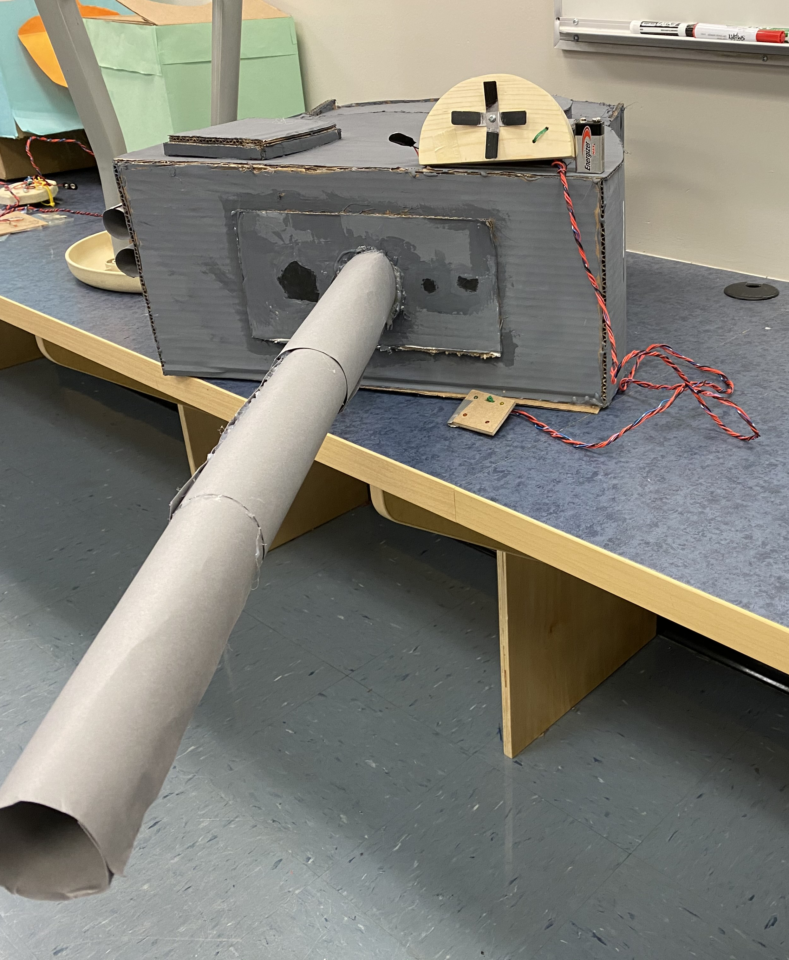
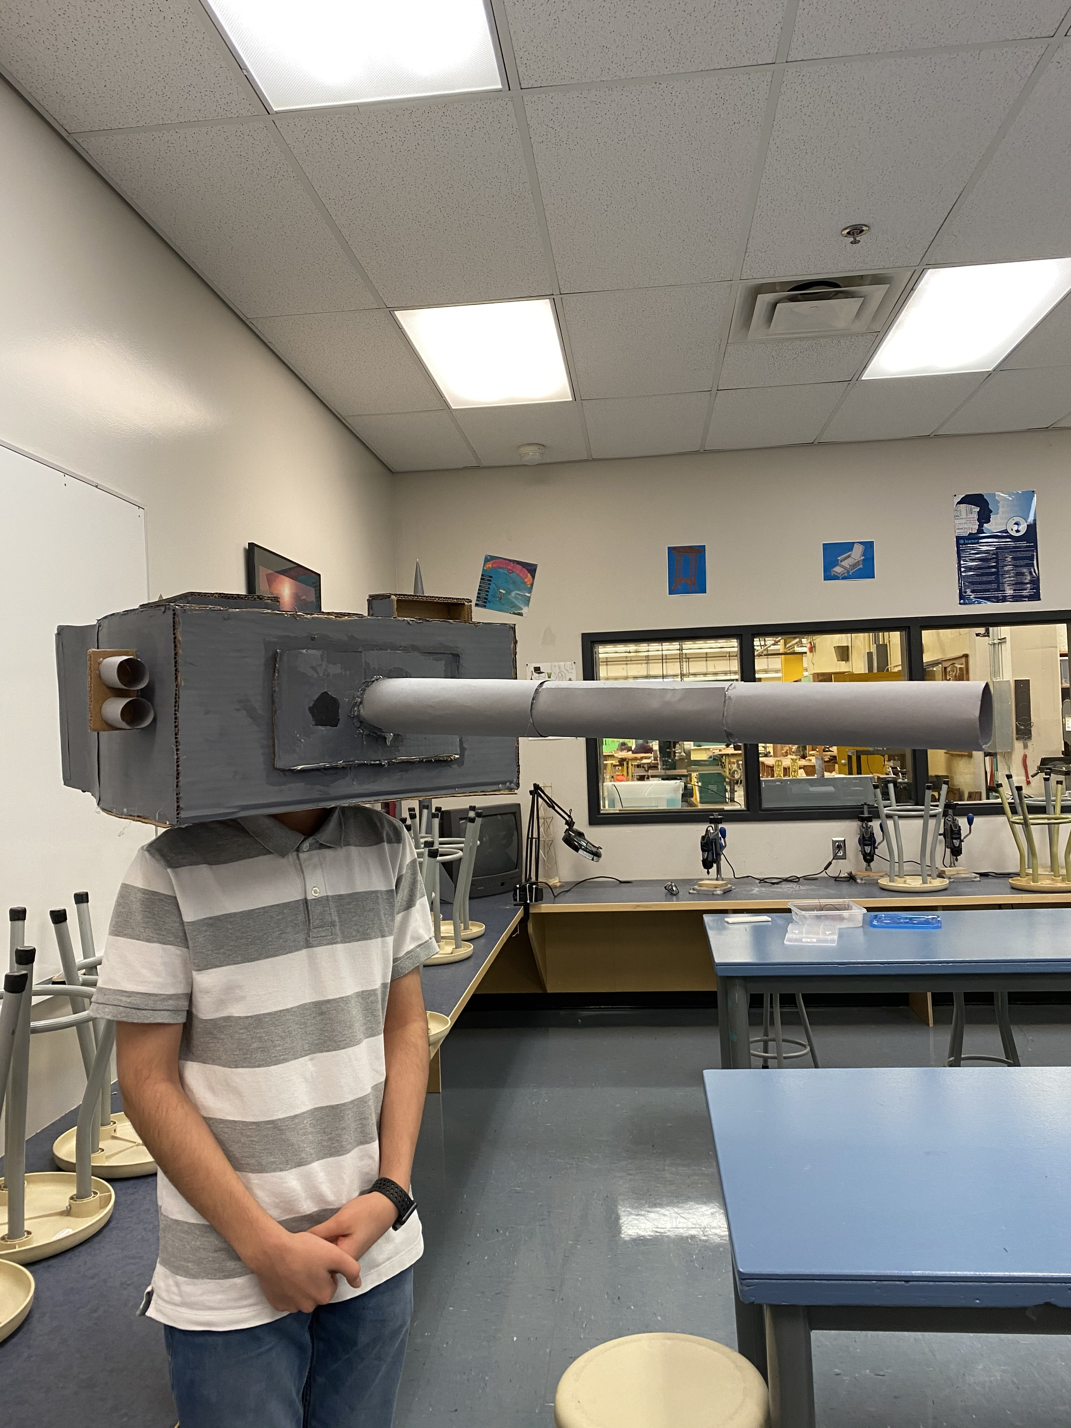
Electronics 9 Cyborg Mask Project
Why did I select this achievement?
I selected this achievement because this was my favorite project this year. My partner and I decided to build a tank for our Cyborg Mask and the way it worked was that he would wear it and I would control what he does through LEDs connected to an indicator board inside the tank. Me and my partner put a lot of effort into this and a lot of our time and got an A for our project. We did a competition and our project also became the most creative mask.

Slide 4
Questions
How does it represent my growth throughout the year?
It represents my growth throughout the year because when I first started Electronics 9, I thought doing projects like this would take ages and would be very hard to do. After going through all the theory and doing things step by step my partner and I found it very easy to do the project. The project also increased my relationship with my partner making it easier for us to work with each other during future projects. I also became better at using machinery in the woodshop than last year in grade 8 because of newer and better techniques taught to us by our teacher.
What were some challenges I faced during this achievement and how did I overcome them?
The main challenge my group faced was an accident with one of our parts while we were making it. It made us fall behind other groups because we had to redo the part, but we managed to make the part better than we had intended initially and worked at flex and lunch to catch up to other groups. Another challenge we had was with soldering the wires but after getting help from other peers, we managed to use the proper techniques and finished soldering our wires quickly.
What are my goals in this subject for the future? How might I use what I have learned in the future?
My future goals for this subject are to get better at my assembling skills so that I can use less materials but do more in future projects. I also want to come up with more complex builds which can be used to make something I do in my routine easier or quicker. I also want to come up with more creative designs for future projects. During this project me and my partner took many risks when assembling somethings and I am also going to focus on ways to reduce risks when building something.

Slide 5
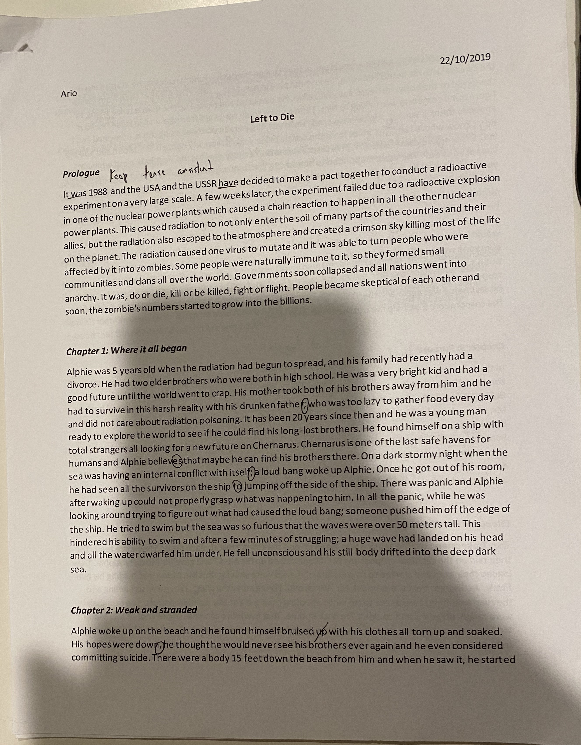
English 9 Short story
Why did I select this achievement?
I picked this achievement because initially it proved to be very difficult to start on for me, but I persevered and got an A for my story. It was also very fun for me because I got to be as creative as I wanted to be, and I got to play around with new methods of writing and using figurative language. We also had to do peer reviews which were very fun to do because we got to read other student's stories.

Slide 6
Questions
How does it represent my growth throughout the year?
It represents my growth through the year because I never expected to be able to write a short story and one of the horror genre. I managed to though, using techniques and strategies our teach taught the class. I managed to get an A on my assignment, and I was very proud of my story. Considering this was also my first time writing a short story and not having any experience before but still getting a good mark also shows my growth throughout the year.
What were some challenges I faced during this achivement and how did I overcome them?
My main challenge was actually being able to start the story and making it good. Since I had no experience before hand with writing stories, this was a very difficult hurdle to cross but after doing a couple of mind maps and making an outline of how I wanted my story to be, I started on my story and I got it to really pick up. I also didn't have any experience in the horror genre, so I had to ask some of my friends what some horror books and movies are like.
What are my goals in this subject for the future? How might I use what I have learned in the future?
My goals in this subject for the future are to get better at writing essays and coming up with original content which is good. I will achieve these goals by doing mind maps, creating outlines and doing timelines which all help me make sure what I am writing is good. I will also have more confidence in my own abilities since sometimes when I expect something to go bad it actually goes well.

Slide 7
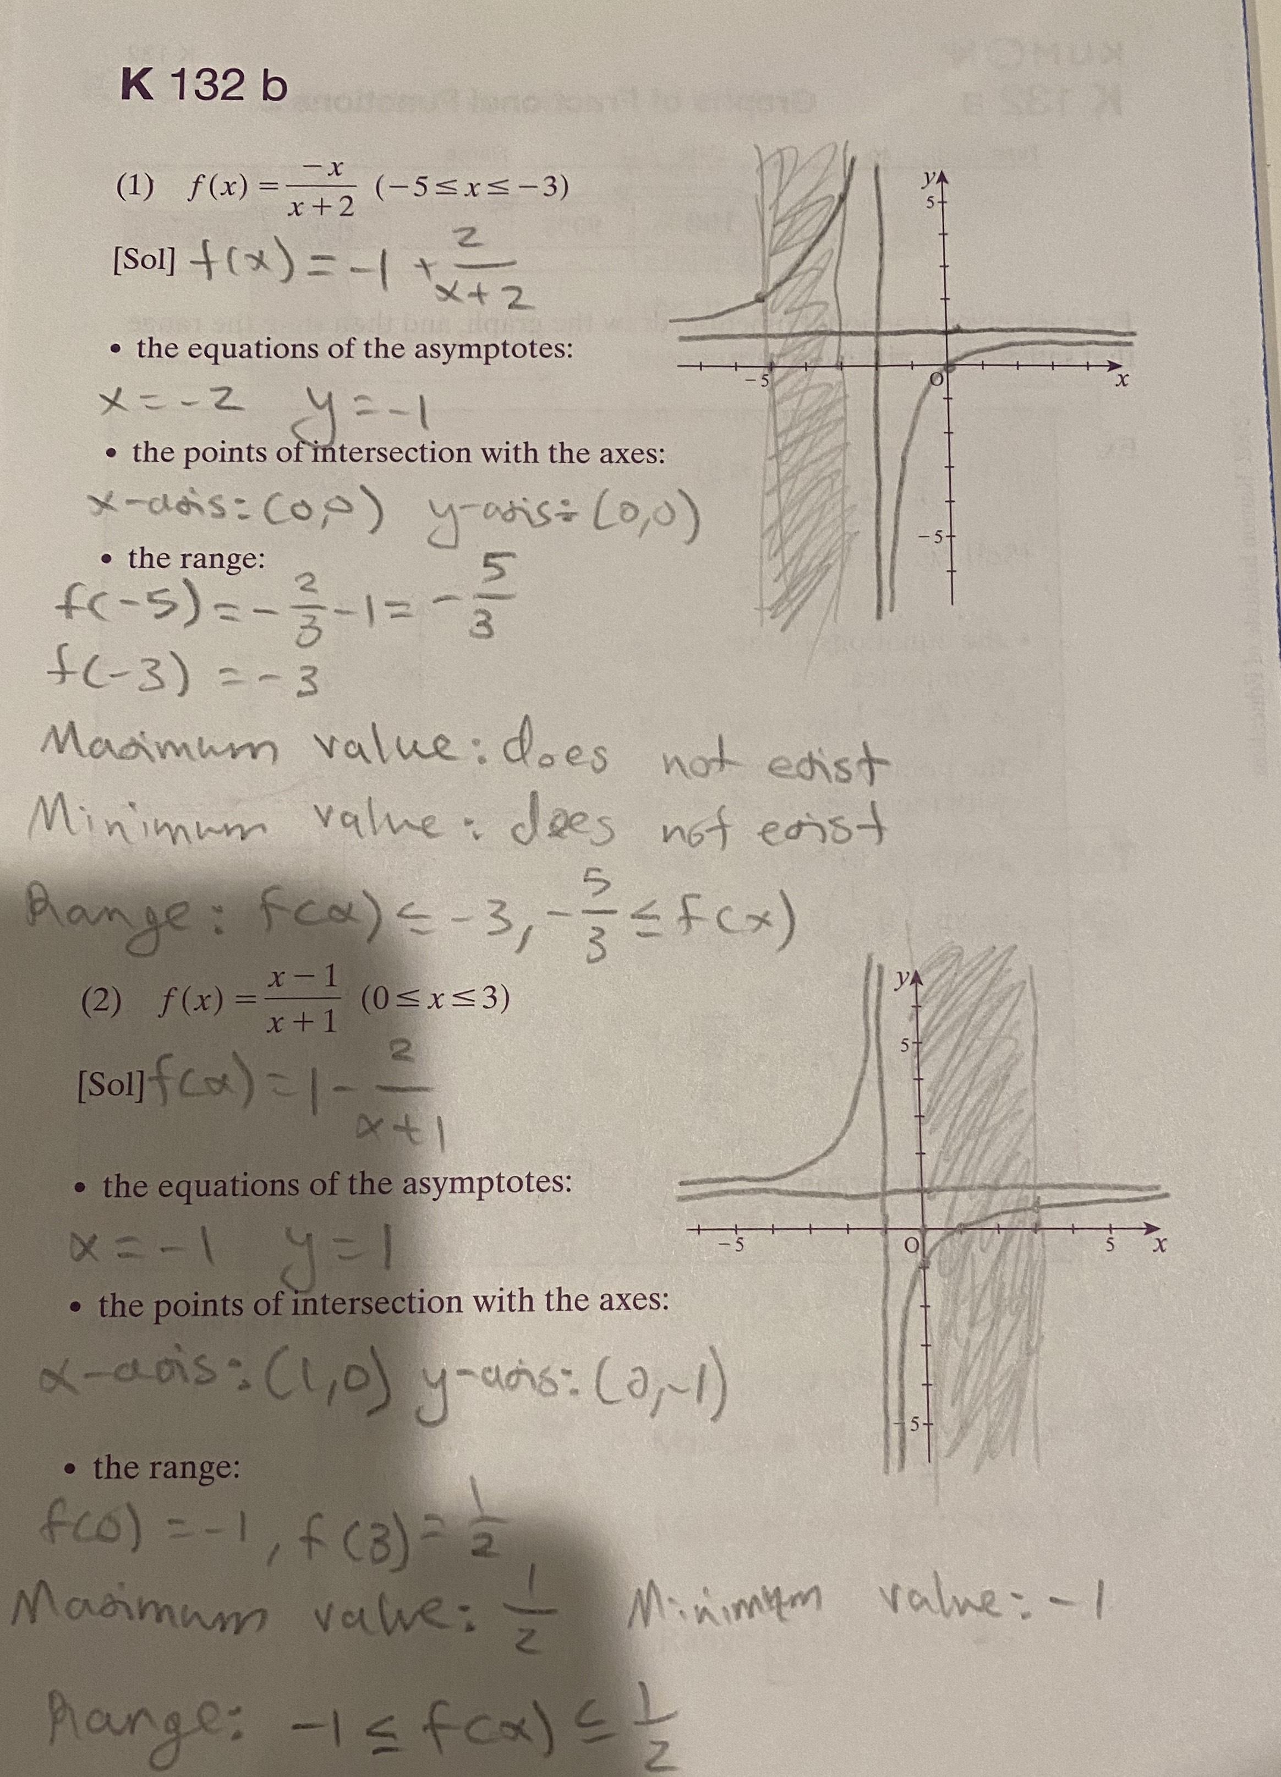
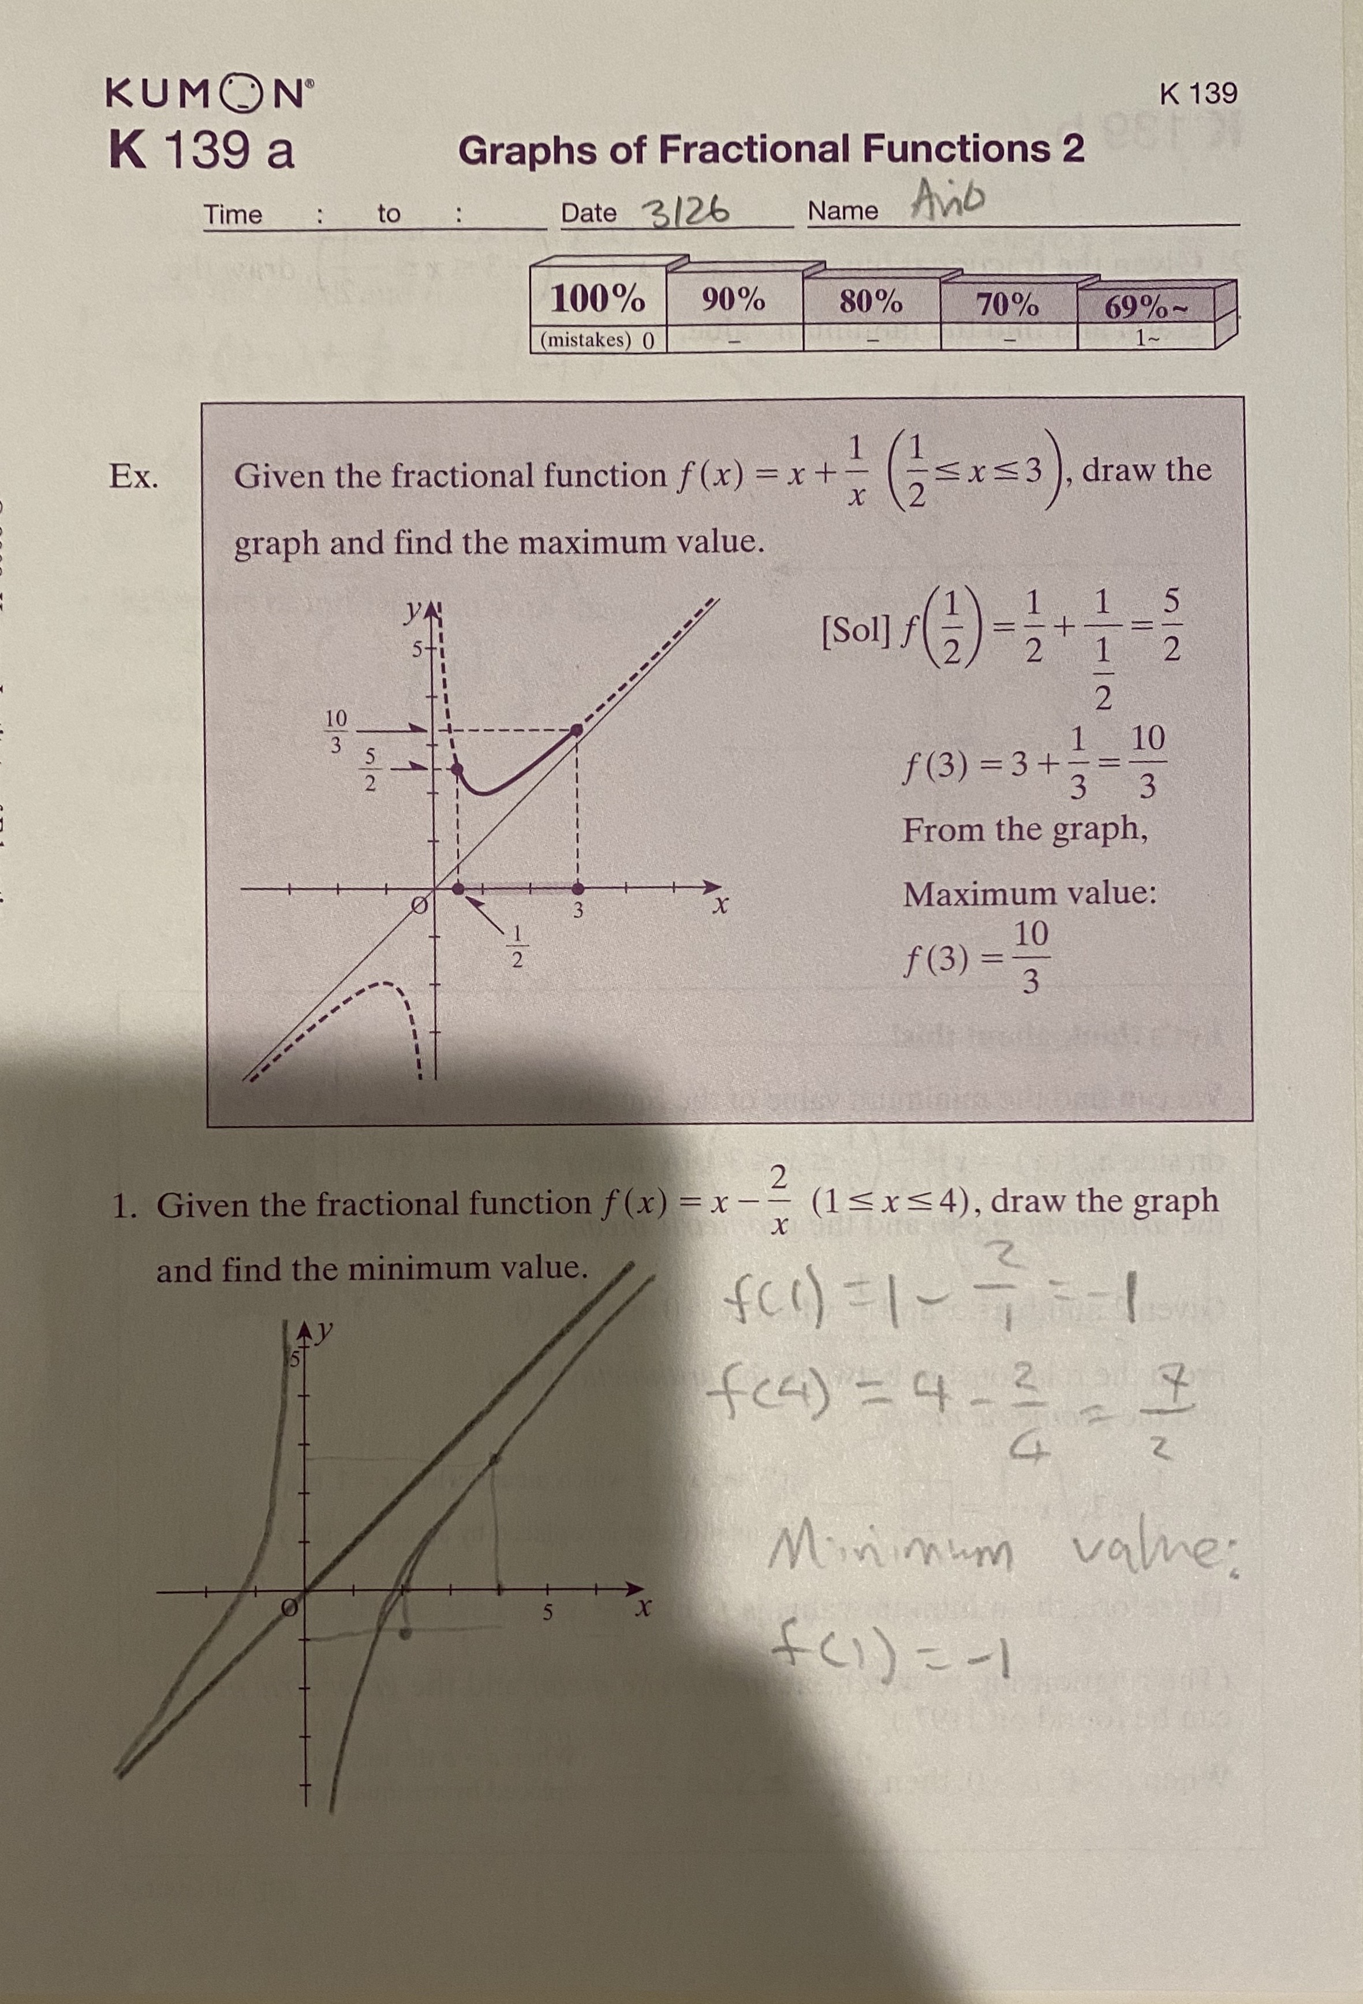
Studying and working at Kumon
Why did I select this achievement?
I selected this achievement because I am very proud of what I have been doing in Kumon for the past two years. I have had a unique opportunity to work and study there which is good for future job applications for me and for my university resume as it shows I have had working experience and extracurricular academics. I have also been able to surpass my school's math and have started grade 10 and 11 math.

Slide 8
Questions
How does it represent my growth throughout this year?
It represents my growth because studying at Kumon and working there has made the math that I do at school much easier and makes the math I do at school in higher grades also easier since Kumon gives me a head start to all the theory. Going there also increases my responsibility because when I am instructing kids who come there to learn, I am supposed to help them and if I teach them the wrong thing, they will start to make mistakes. Therefore, I need to be on my best behavior and be very respectful while helping kids and marking their work.
What were some challenges I faced during this achievement and how did I overcome them?
My main challenge was getting used to the environment of Kumon and making a proper co-worker relationship with my boss and co-workers. I also had to get used to their rules and guidelines but after going there for work and studying I got accustomed to how things work there.
What are my goals in this activity for the future? How might I use what I have learned?
My goals for this activity are to finish the Kumon program and to work there for the rest of high school. I also plan to use what I learn there for my school's math so that I can find my school math much easier. I can also use the discipline and respect in the Kumon work enivironment at school and this would help me with group projects

Slide 9
Sources
Navidi Moghada, Ariobarzan, 2020, IMG_0956
Navidi Moghada, Ariobarzan, 2020, IMG_0957
Navidi Moghada, Ariobarzan, 2020, IMG_1068
Navidi Moghada, Ariobarzan, 2020, IMG_1074
Navidi Moghada, Ariobarzan, 2020, IMG_1076

