Slide 1
Social Media and Me
Bernard. L

Slide 2
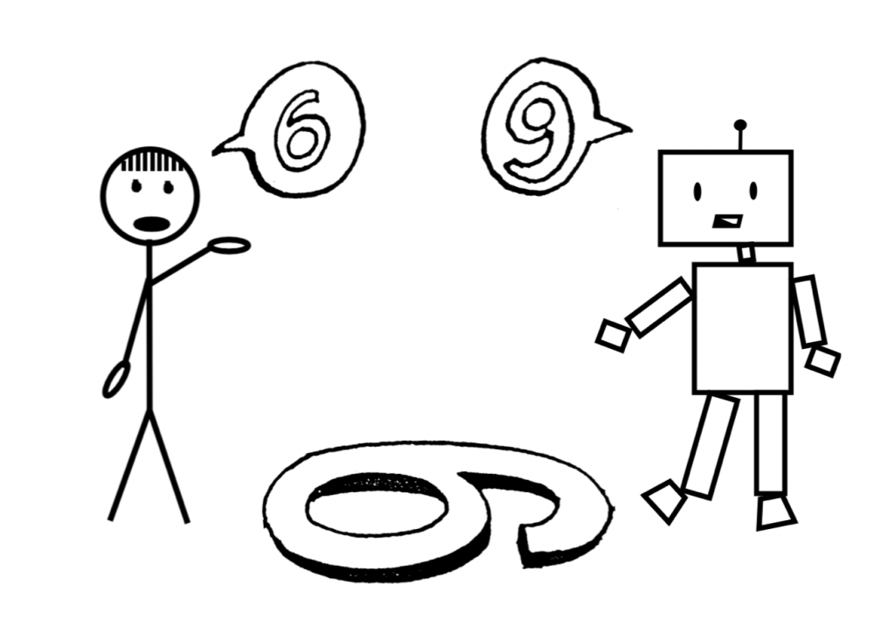
Article: Confusion is the Point
How have social media platforms changed the way we consume and understand information?
Social media platforms changed the way we take in information by giving us various standpoints/perspectives. These different perspective coming from different sources are meant to help the viewer understand the context of it, but it just ends up confusing us and making us want more information to try to understand it.

Slide 3
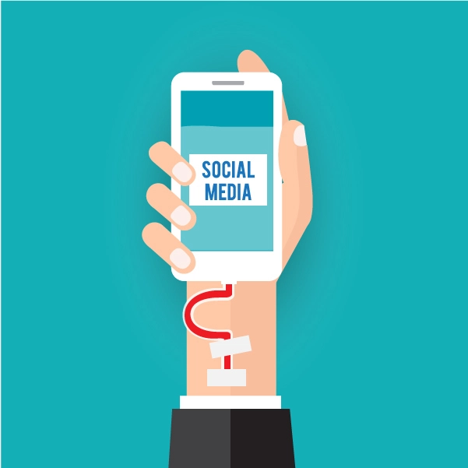
Ted Talk: Is Social Media Hurting your Mental Health?
What value do you get from online social interactions?
For me, I get a lot of value from online interactions. I've gained many friends through social media by talking about similar interests and made existing bonds stronger by talking to them more on social media when I can't talk in real life. My friends and I like to talk a lot on a chatting app called Discord and we can frequently share funny stories or memes with each other.
Although there's a positive side, many negative effects can hurt people too. Some people are follower hungry, wanting more followers that make it seem that they are more "popular" and appear higher in the social ranks. As said in the TED talk, social media can be very addictive, and people are missing out on real life events because they are stuck staring at their screens.

Slide 4
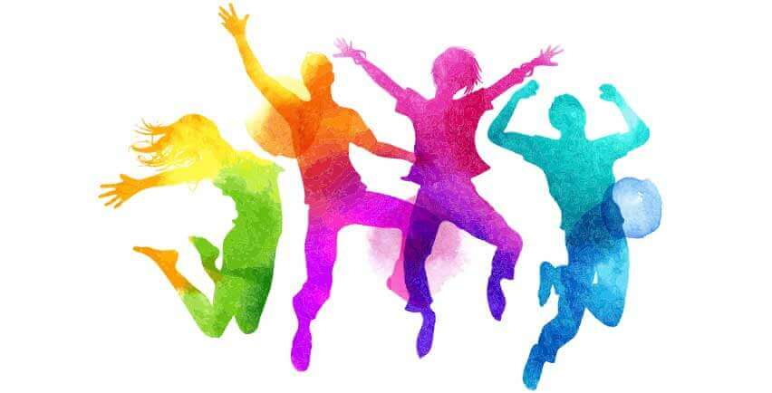
Ted Talk: Is Social Media Hurting your Mental Health?
How is social media and social capital helping to form youth culture?
The new generation of youth are growing up on social media and electronics, so there is no escaping the fact that many of them will be stuck on them. However, social media will act as the modern day of newspapers and TV, giving the youth entertainment and news that is happening across the world. I think the youth these days are getting connected with people outside their schools through social media.

Slide 5
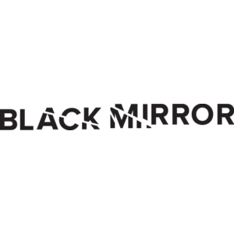
Black Mirror: Nose Dive Clips
Do you see any similarities between the world presented in this video and the world you live in?
The most obvious similarity in this world to ours is the fact that some people get judged based on their social profile and their status online. The people that are more socially accepted into the society do way better than others, like higher ratings on a hotel are better than lower ones.
How does the main character gain and lose points? Why are these points important to her?
The main character gains or loses points when someone "rates" her out of 5 stars. If she gets positive reviews above her current rating, then she goes up, but if she gets a negative rating her points go down. These points are important because in the world she lives in the points defines a person. The more points the more you'll be accepted into society.
How are social interactions changed in this world?
Social interactions in this world are very fake, as everyone is trying to be nice to raise up their points. If you are angry and you show that, you will probably lose points. So no matter how sad or angry you are its best to show that you're happy to keep your score high. And even small things are exagerated to keep your score high, like giving someone a smoothie with a very fake smile on your face.

Slide 6
Thanks for Reading!
Have a good day :)

