Slide 1
Your digital footprint.
By Carlito, Lopez.

Slide 2
Part one: whats a digital footprint?

Slide 3
Your digital footprint. (1)
Your digital is what ever you do social media.
Ie. Example: you write a comment on someone's post.
You post a photo of yourself on vacation.
You share links via public chat.
All these things contribute to your footprint.
Your footprint can be traced via searchs and looking throught your profile.

Slide 4
Your digital footprint. (2)
The more you post, like, comment, share, the more you contrubute to your footprint.
The more you do social media the bigger the footprint gets.
Your footprint follow you even throughout your life.

Slide 5
Part two: How your digital footprint affects you and how to protect yourself.

Slide 6
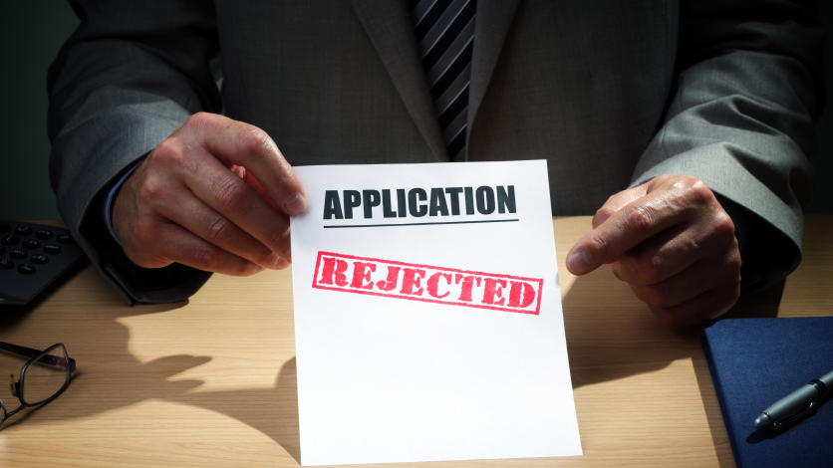
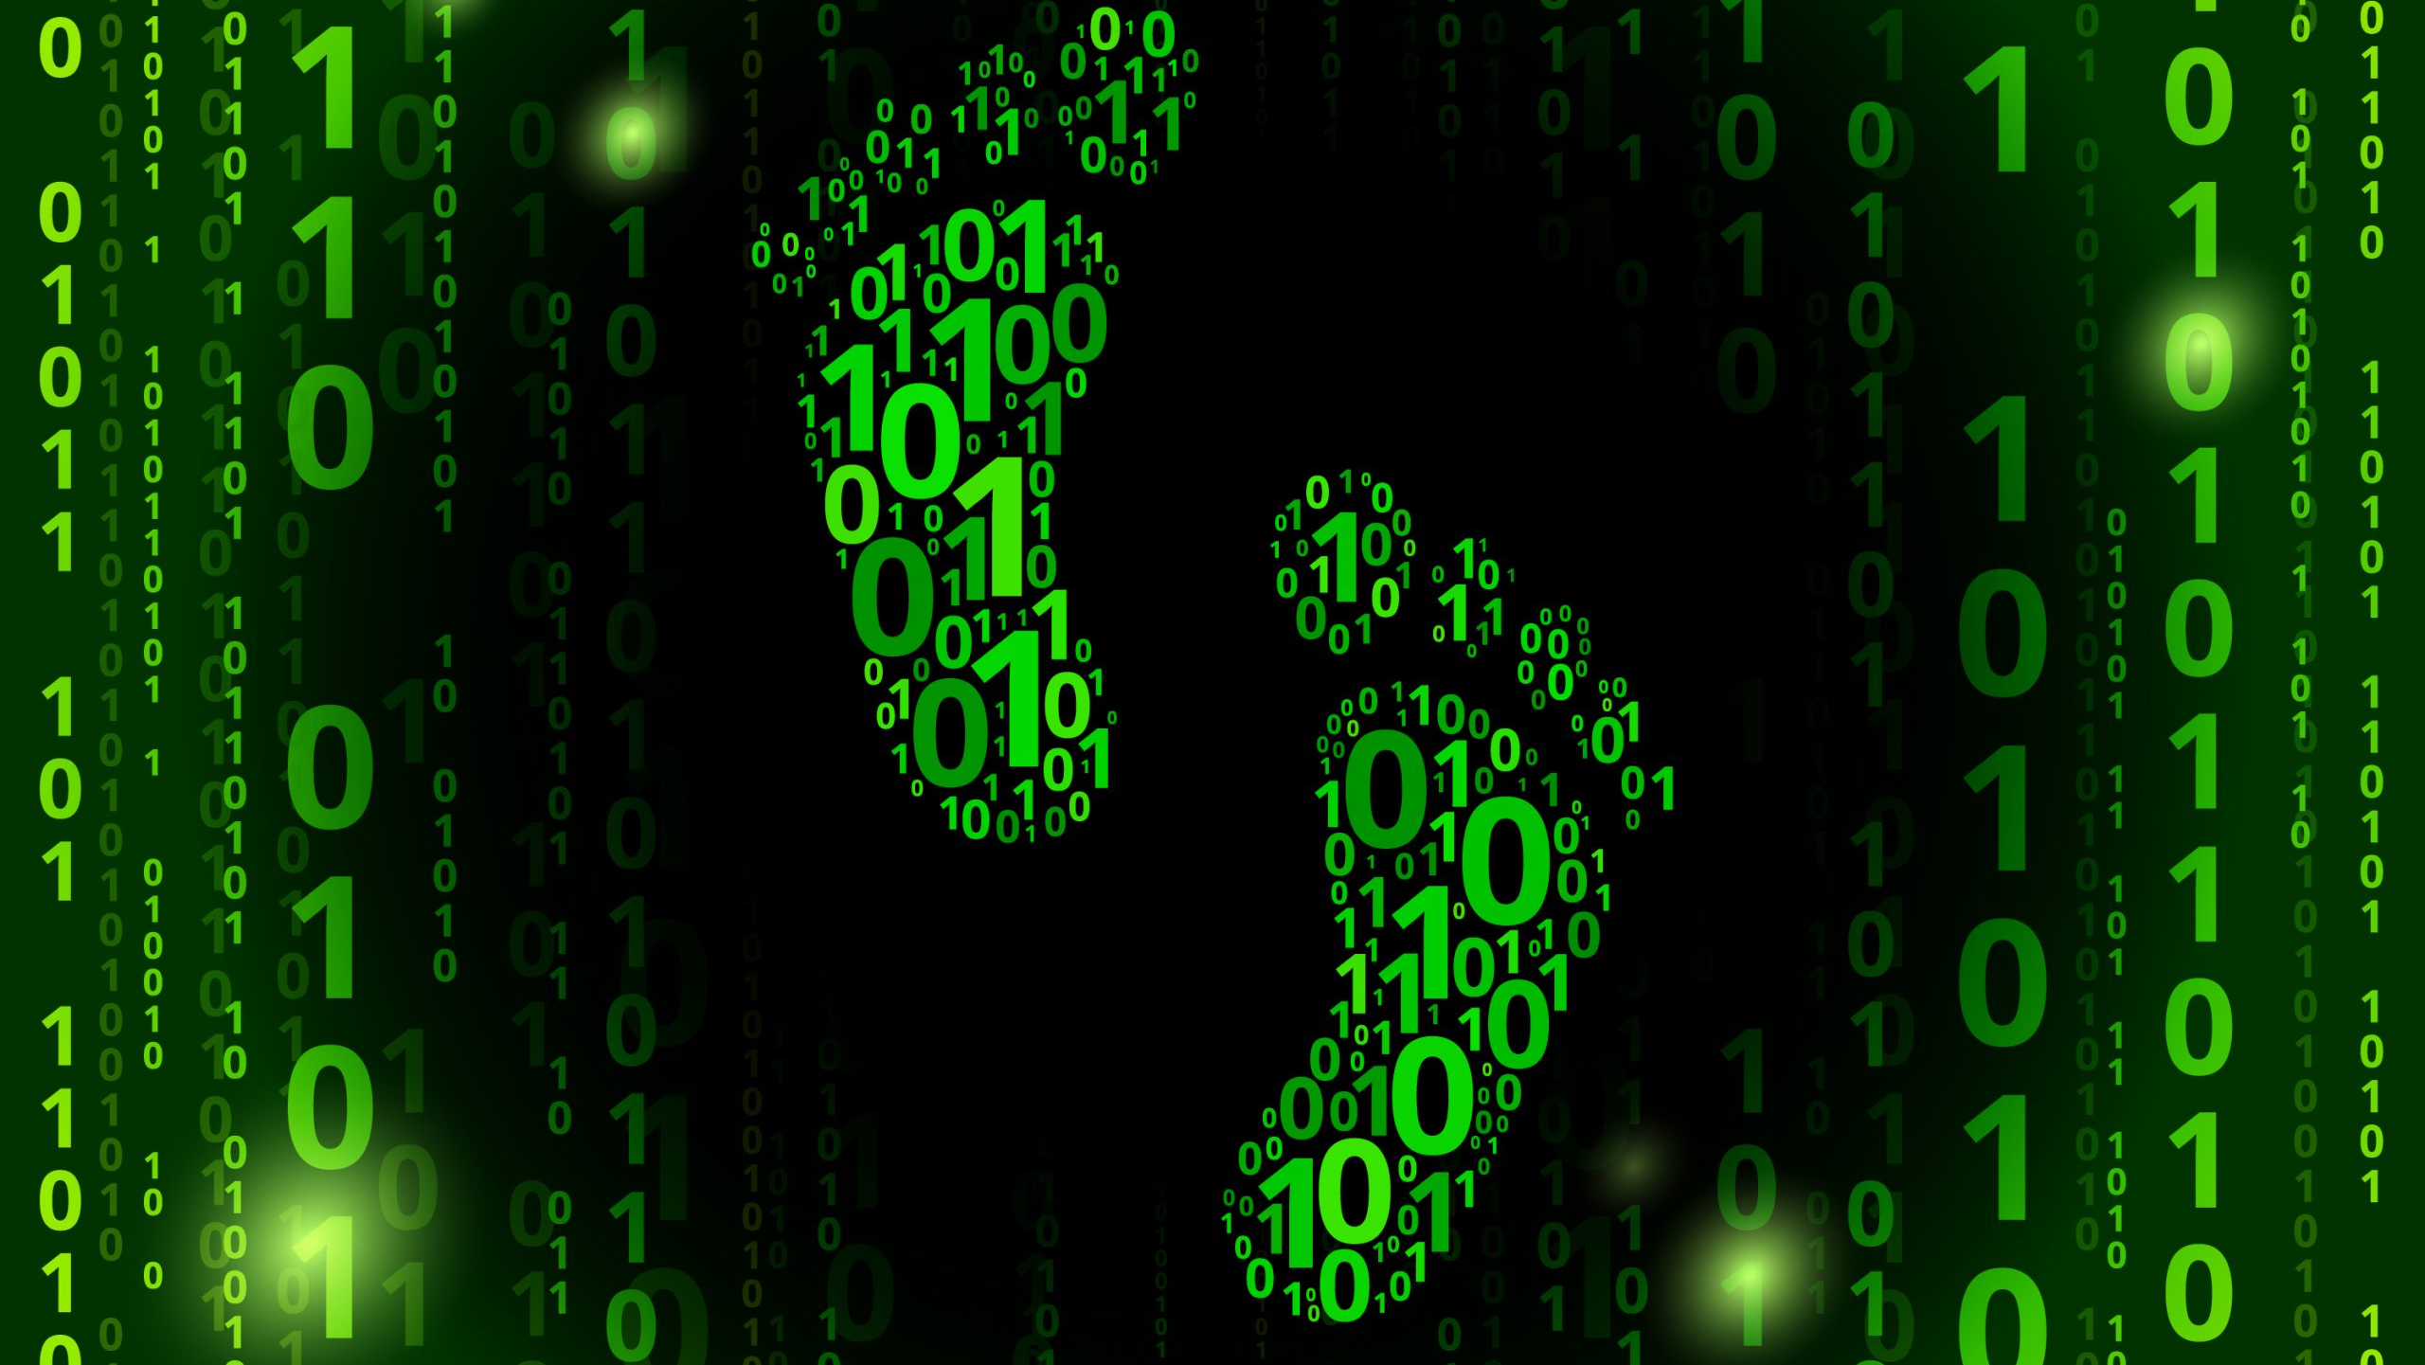
How your footprint affects you.(1)
Your footprint is your actions so be carefull.
Your footprint has everything you said and done on social media bad or nice.
Ie example: you say something mean to someone.
If you say something offensive to someone anyone can see what you said
Most jobs search you up to see what you did in your past
If you did many bad thing, they won't hire you

Slide 7
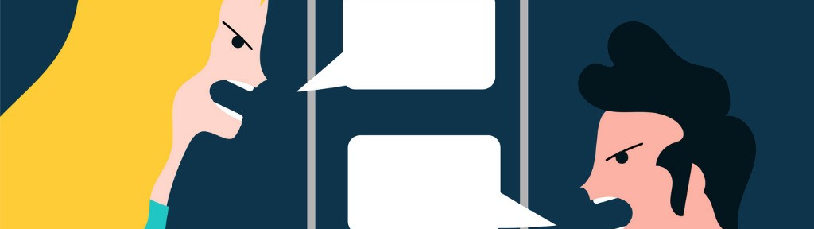
HOW YOUR FOOTPRINT AFFECTS YOU.(2)
Your footprint affects you getting a job and your relationships with people.
Ie example: you said I hate my family on social media.
Your family would think that you hate them and make them sad.
You say something offensive in a post and who ever reads it will think you’re a bad or rude person.
Your footprint also makes up who you are
What you like, do, where you live, where you go.

Slide 8
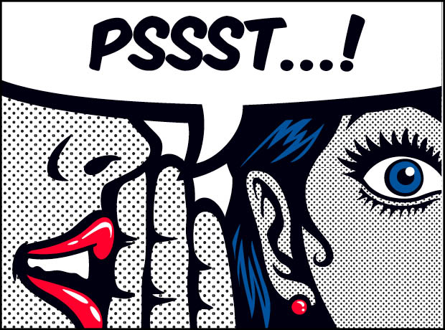
HOW YOUR FOOTPRINT AFFECTS YOU.(3)
Your footprint is you, so ads become personolized to you.
You foortprint is data about you, which is sold by companys.
When companys sell your data, ads become more adapted to you.
Your data is shared, so your info is shared between company's.

Slide 9
Part three: how you can protect yourself.

Slide 10
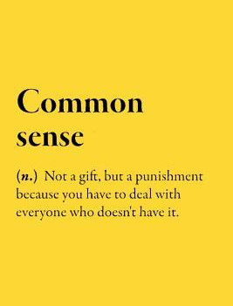
Ways you can protect yourself. (1)
The best way to protect yourself is throught spreading this knowledge to everyone.
The more people know and are aware the better and safe people are
Its about common sense, don’t say stuff you'll regret later or say rude things when your man on social media
Also don’t sign up for everything you see on the internet and don’t post anything inappropriate.

Slide 11
Ways you can protect yourself. (2)
The second-best way to protect yourself is through software and services.
Softwares like vpn servies and ad blcokers.
These services help keep your information from companys.
These sevices also have malware removers so you'll be safe from viruses.

Slide 12
Ways you can protect yourself. (3)
The last way you can protect yourself is through an auto cookie cleaner.
It automatically clears your cookies from your browser.
It can also clear your serch history automatically.
Ussaly these softwares are free so don’t pay money for one.
ONLY USE CREDIBLE SOFTWARE, DON’T USE STRANGE SOFTWARE FOUND ON A SCETCHY WEBSITE.

Slide 13
Part three: how would you tell other people.

Slide 14
How you would tell other. (1)
The many ways I would tell people are:
Thought social media posts talking about awareness of your footprint.
Throuth telling my friends and asking them to spread the word about it.
Telling them about how much harder it would be to get a job since they look you up before hireing you.

Slide 15
Part three.5: whats digital permanance.
Digital permanence is the idea of whatever anyones dose on the internet is recorded even if deleted.

Slide 16
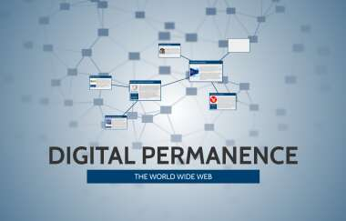
Digital permanence. (1)
Digital permanence is the idea of whatever anyones dose on the internet is recorded even if deleted.
This can be bad since if you deleted a video or picture that you posted a month ago it could have been reposted or shared and downloaded.
This is bad for the the person who wants it deleted since they have no power to delete the reuploading of the photo/video.

Slide 17
Digital permanence. (1)
Everyone should care about digital permanance since it affects everyone.
To comments and post on social media are all part of digital permanence.
So, everyone should care about there digital footprint and digital permanence.

Slide 18
The end.
Made by carlito Lopez
Thanks for actually listening

Slide 19
Sorces for photos
author, Tove Marks Main, et al. VPN Explained: How Does VPN Work and Why Would You Use It? 2 Dec. 2020, vpnoverview.com/vpn-information/what-is-a-vpn/.
Circle Holding Hands Silhouette. Vector Illustration of a Circle of People Holdi , #Affiliate, #Hands, #Silhouette, #C... in 2020: Hand Silhouette, Clip Art, Silhouette Free. 3 Nov. 2020, www.pinterest.ca/pin/505810601901862534/.
Common Sense (n.) Not a Gift, but a Punishment Because You Have to Deal with Everyone Who Doesn't Have It.: Blank Lined Funny Saying Definition Quotes Simple and Elegant Notebook Journal, 110 Pages 6 x 9 Inches Sarcastic One Liners by NOT A BOOK. 14 June 2019, www.goodreads.com/book/show/52391761-common-sense-n-not-a-gift-but-a-punishment-because-you-have-to-deal.
DIGITAL PERMANENCE. prezi.com/kyhz_c2bwp0t/digital-permanence/.
Gambetta, Vern. Looking for Secrets. 19 Dec. 2018, www.hmmrmedia.com/2018/12/looking-for-secrets/.
Hope, Emily Cosgrove and Sara. From TJ Magazine: Let's Talk. 12 Apr. 2019, www.trainingjournal.com/articles/features/tj-magazine-lets-talk.
Instagram Tests Hiding How Many People like a Post. That Has Influencers Worried. 15 Nov. 2019, www.theguardian.com/technology/2019/nov/15/instagram-likes-influencers-social-media.
Maday, Rochel, et al. How and Why You Should Reduce Your Digital Footprint. 24 Aug. 2020, www.avira.com/en/blog/why-you-should-reduce-your-digital-footprint-and-3-ways-you-can.
McCombs, Texas. Don't Be Rude: Polite Answers Favored by Online Questioners. 4 Mar. 2020, medium.com/texas-mccombs/dont-be-rude-polite-answers-favored-by-online-questioners-20876036a2.
Peterson, About The Author Tim Peterson Tim, and Tim Peterson Tim Peterson. Facebook Will Disable 'Like' Button in Third-Party Mobile Apps. 10 Nov. 2017, marketingland.com/facebook-will-disable-like-button-third-party-mobile-apps-228159.
Sam Becker Google+ More Articles November 13, 2017. Not Hired? These Excuses Employers Give Might Sound Like BS, but They're Legal. 13 Nov. 2017, www.cheatsheet.com/money-career/not-hired-excuses-employers-give-legal.html/.
Share Link for Youtube Like & Subscribe. www.facebook.com/youtubelikesubscribe/posts/100603641647163:1.
What Is Software? 20 July 2020, www.information-age.com/software-123466740/.

Slide 20
Sources for research
DIGITAL PERMANENCE. prezi.com/kyhz_c2bwp0t/digital-permanence/.
https://www.youtube.com/watch?v=ykbLjXxGj0k
“Your Digital Footprint Matters.” Internet Society, 30 May 2018, www.internetsociety.org/tutorials/your-digital-footprint-matters/.

