Slide 1
My Digital portfolio
By Carlito, Lopez

Slide 2
SLIDES
Introduction
Slides
Social's project
Physical education log
Learned to cook

Slide 3
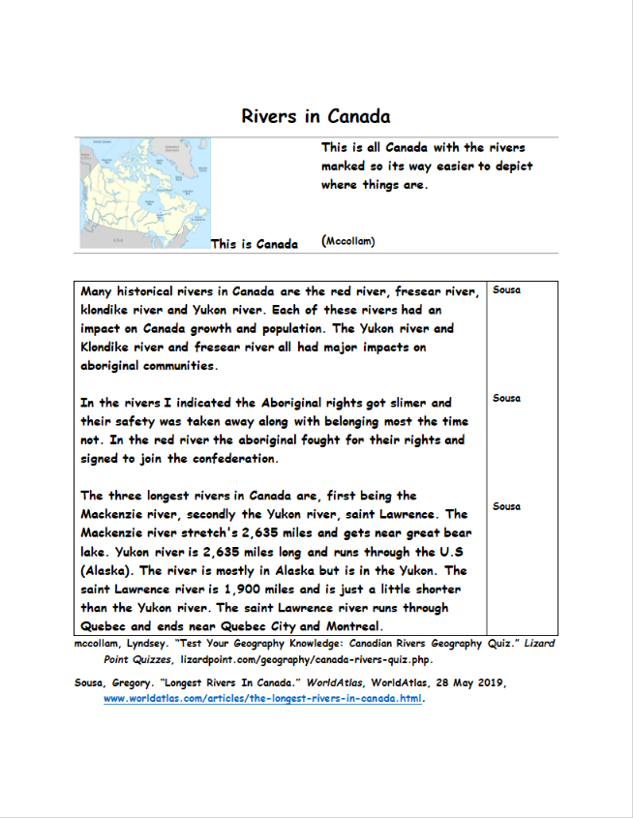
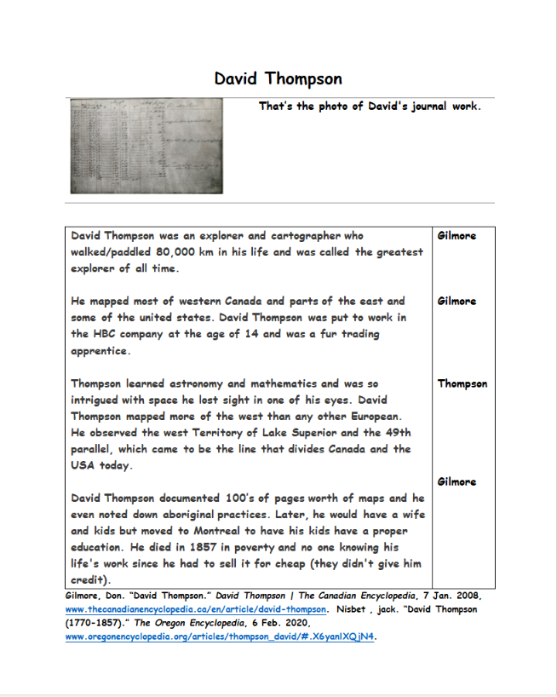
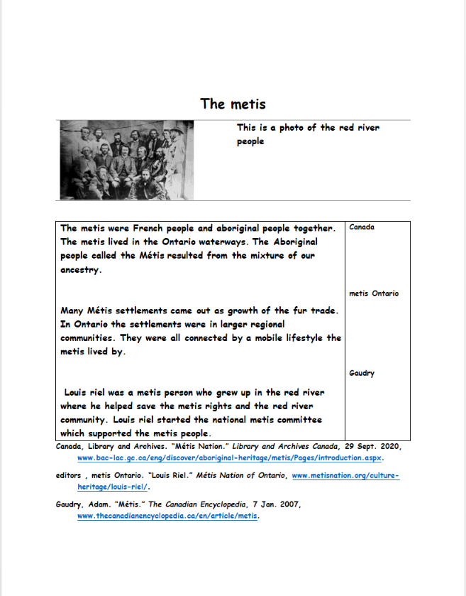
Social project

Slide 4
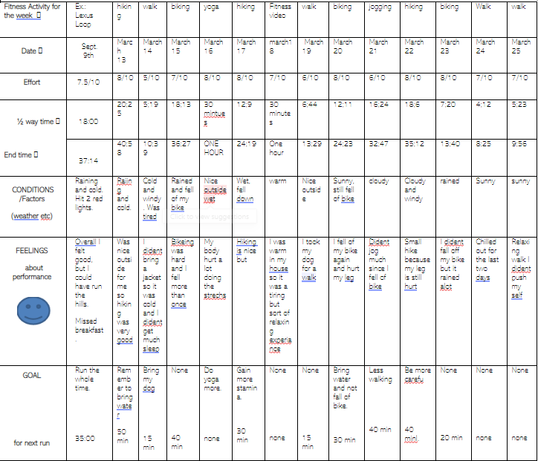
P.E

Slide 5
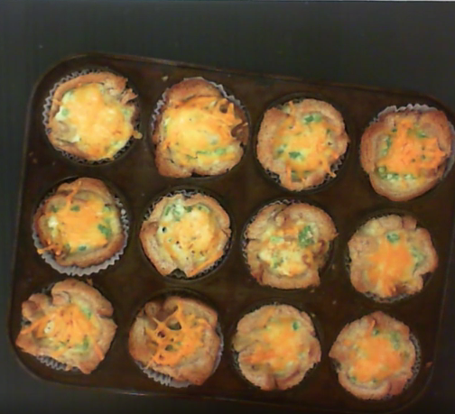
cooking

Slide 6
The End
By Carlito Lopez

