Slide 1
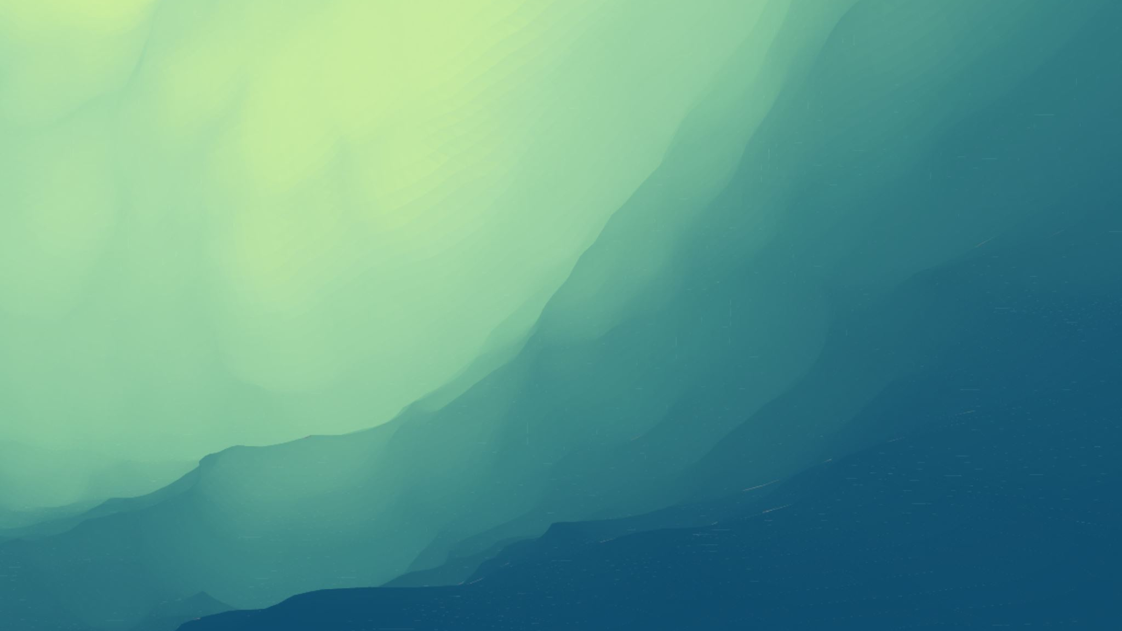
What happened during the 2011 Japan earthquake and tsunami
Power point by Cassandra h.

Slide 2
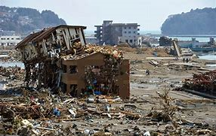
What Spheres were Involved?
Aftermath Of the Earthquake/Tsunami
The buildings and debris – Biosphere/Geosphere
The ground and mountains – Geosphere
The water puddles – Hydrosphere
The trees on the mountains - Hydrosphere
The sky - Atmosphere

Slide 3
The Earthquake
9.0 magnitude earthquake
The Pacific tectonic plate was forced below the North America plate
Nuclear power plants were damaged, with one breaking and exploding, causing fires
Nuclear disaster categorized as 2nd most hazardous nuclear crisis, with Chernobyl being the most hazardous
In the years after the event, over 5,000 aftershocks occurred across Japan

Slide 4
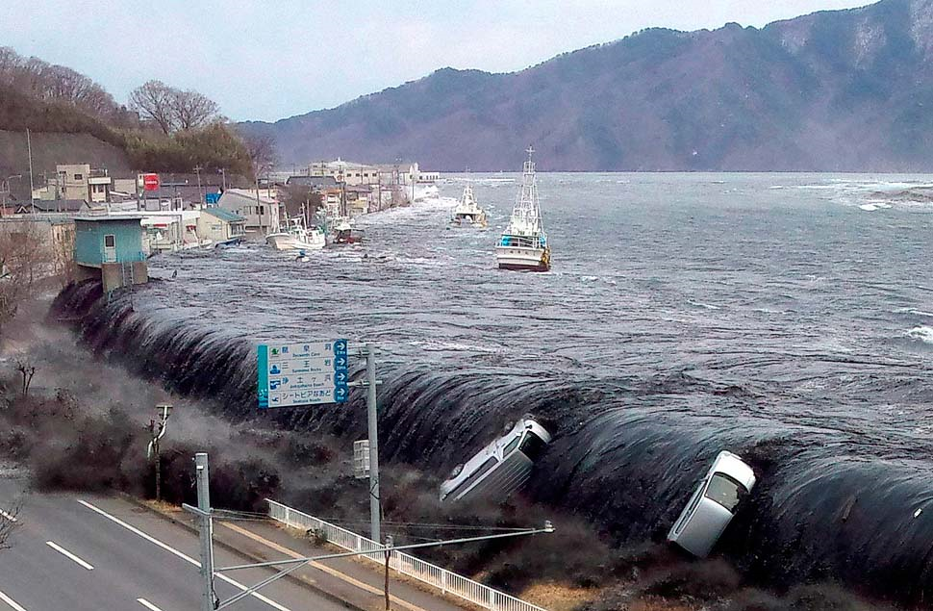
The Tsunami
Occurred after the earthquake
The waves went up to 30 feet tall
Many buildings were destroyed, and cars were swept away
Evacuation sites were destroyed by the tsunamis
A wave hitting Japan

Slide 5
The Aftermath
Killed over 230,000 people
The area around the powerplants had to be evacuated because of the radiation
Many buildings and resources were destroyed, with costs totaling over $300 billion
The earthquake and tsunami was the worst incident for Japan to have
The earthquake was the 5th largest that ever happened in the world
https://www.abc.net.au/news/specials/japan-quake-2011/ before and after pictures

Slide 6
The Interactions
The earthquake damaging buildings and power plants – Geosphere and Biosphere
The radiation from the power plants on the environment – 1 - Biosphere and Biosphere, 2 -Biosphere and Geosphere, 2 - Biosphere and Atmosphere, 4 -and maybe Biosphere and Hydrosphere
The tsunami destroying buildings and cars – Hydrosphere and Biosphere
The earthquake causing the tsunami – Geosphere and Hydrosphere

Slide 7
Bibliography
Taylor, A. (n.d.). Japan earthquake: Aftermath - the atlantic. Retrieved January 17, 2020, from https://www.theatlantic.com/photo/2011/03/japan-earthquake-aftermath/100023/
What happened in japan earthquake 2011? – Recent earthquakes. (n.d.). Retrieved January 17, 2020, from https://www.whatcausesearthquakes.com/japan-earthquake-2011.htm
canadiani. (2015, January 14). Facts about japan earthquake and tsunami of 2011. Canadian Islamic Congress. http://www.canadianislamiccongress.com/facts-japan-earthquake-tsunami-2011/
Japan earthquake: Before and after - abc news. (n.d.). [Collection]. Retrieved January 17, 2020, from https://www.abc.net.au/news/specials/japan-quake-2011/

