Slide 1
My Digital Portfolio
By Chloe Holdenried

Slide 2
My topics
Side Table ( woodwork 9 )
Final Socials Project ( social study's 9)
Spring Concert (concert choir and string orchestra)
The achievements I'm most proud of

Slide 3
Side table wood work 9
Question 1.
I chose this achievement because I was happy and proud of the outcome. I spent a large amount of time on this project. I think that I was creative with the painting and design . I also think I gained many skills and good work habits while working on this project.
Question 2.
I think this represents my growth because at the beginning of the course I was struggling to do basic tasks in the shop. At the end of the term I think that I was definitely showing more understanding and skill in the course. For example when using the machines I was at first unsure of how to work them, but I got a hang of it as the year progressed. I also think the quality of my work got better throughout the term.
Question 3.
I faced challenges in this project when trying to make sure that the measurements for cutting the wood were correct. This was definitely something that I did not want to mess up because we were following a process and if I made a mistake it would be hard to fix. I overcome this challenge by making sure that I always double checked all my measurements when making a cut. In the end I made few mistakes because I made sure to be careful and double check my measurements.
Question 4.
In the future I am excited to try new techniques and skills to do with woodwork. I want to use my knowledge that I have collected to enhance my future projects and be more creative. I will use what I have learned to try more complicated projects and experiment with new machines and tools. I think that this course has taught me lots of valuable skills and I am excited to build on them

Slide 4
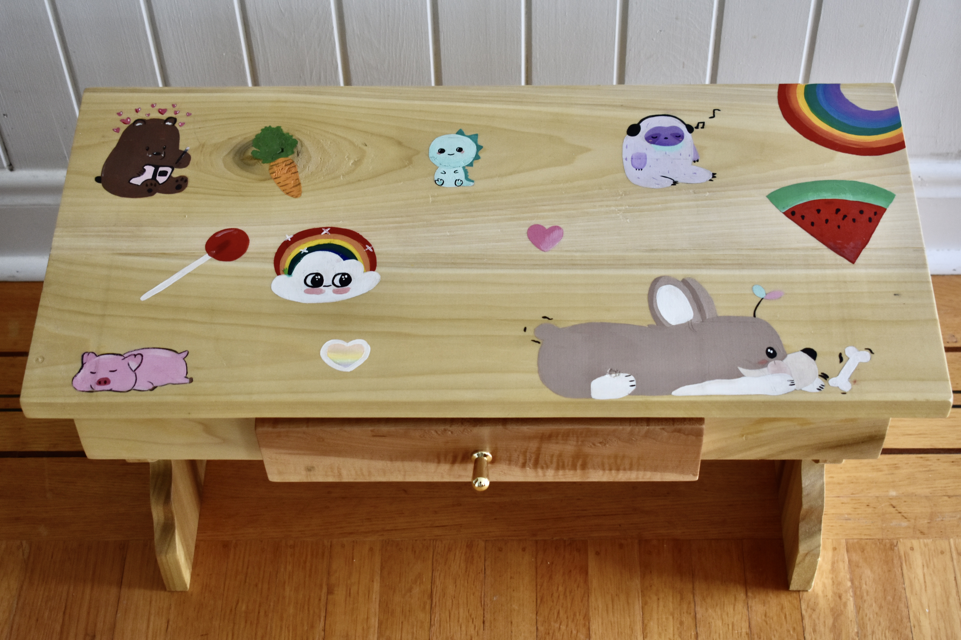
Photos of my side table

Slide 5
Socials final project socials 9
Question 1.
I chose this achievement because this project took a long time to complete and I was proud of the outcome. I think I put a lot of effort into the completion of this project and was very determined to finish it. I tried to fit a decent amount of detail into each page. I also think that I tried to keep the quality of work consistent throughout the book.
Question 2
This was the last project that we did in socials 9. When working on this book I tried to think about the feedback I had been given on previous projects. I tried to take this feedback and put it in to my final project to make it better and show that I had learned and improved. In my opinion this was the best project that I did in this course because I took all the things that I had learned and compiled it in to one project.
Question 3
I faced many challenges when doing this project. This project was very draining to work on because it required a lot of detail. To overcome this I took time each day to work on it and took breaks, so I didn’t get too tired and start making mistakes. Figuring out how to do the layout of the pages was also hard since we were only aloud to have one page for each letter. I fixed this problem by making the font size smaller and playing around with the layout.
Question 4
In the future when I take another socials course, I would like to improve on the amount of information that I am putting into my projects. I think that I could put more detail in to my writing. I will take what I have learned in this course into consideration when doing projects. I think that the information I have collected will be valuable in the future.

Slide 6
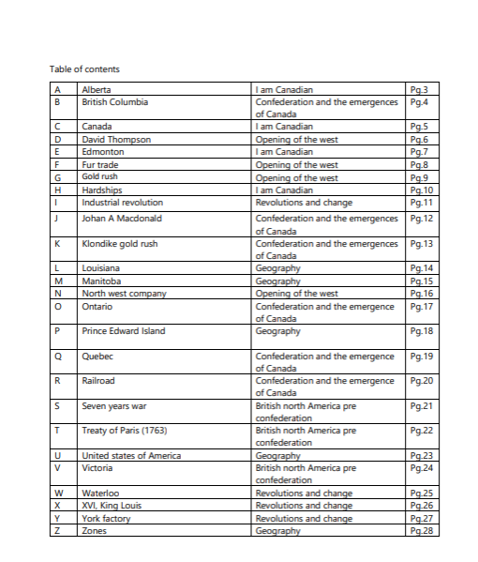
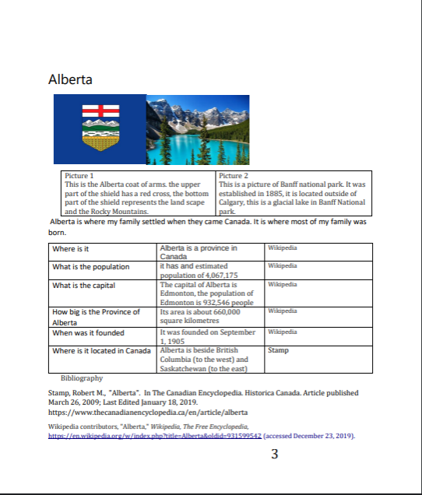
Socials project

Slide 7
Spring concert
Question 1
I chose this achievement because I was proud of my performance at the concert. The string orchestra had been practicing the songs that we were performing for quite some time and I think I made a great deal of improvement. The songs that we were performing were of more difficulty then I am used to playing so I was happy that I was able to play them. I was also proud of my performance with the choir and enjoyed the songs the we preformed.
Question 2
I think that these achievements represent my growth throughout the year because at the beginning of the year I was struggling to keep up with the orchestra. I think I have showed improvement because I now find it easier to sight read and catch on to the music faster than I did at the beginning of the year. I also think that I have improved in choir, we have been doing more difficult song that are more technical then to ones that we were doing at the beginning of the year. I think I am also catching on to the materiel faster.
Question 3
I had many challenges when I was practicing these pieces. The music was harder than I am used to playing. I tried to fix the problems in the music by going over the parts that I was having difficulty with and practice them repeatedly. When singing the songs for choir if I was having difficulty with a part, I would try to practice it in groups with other members of the choir.
Question 4
I have many goals for the future. I want to grow my skills playing the violin and try new techniques to make my playing better. I also want to practice my sight reading so that I can focus on more technical things when it comes to my playing. For choir I want to improve on my pitch so that I can be more precise when it comes to my playing.

Slide 8
Video from spring concert

Slide 9
Citations
Picture 1 and 2 taken by Chloe Holdenried on March 23, 2020
Picture 3, 4 and 5 taken by Chloe on Tuesday March 31, 2020
Video taken by Lori Holdenried on March 10, 2020

