Slide 1
My Digital Portfolio
Daniel Lee
Grade 9
Digital Learning 10

Slide 2
Achievement #1 Fahrenheit 451 Essay (English 9)
Why did I choose this assignment?
This was one of my big assignments for the course and although I didn’t receive the best marks for the assignment I was still proud of the work I did and I remember working quite hard to perfect it. I was especially proud of the work I did to make sure the paper was clean and polished.
How does it represent my growth throughout the year?
As it was a final project that was based on a book, I feel it represents not only my growth in essay writing itself but also to find meaning in a piece of literature and adapt that into an essay format. And on top of that I believe that not only does it represent my growth in those subjects, I feel it shows my ability to stay on task and focus to create an end product.

Slide 3
Achievement #1 Fahrenheit 451 Essay (English 9)
What were some challenges I faced during this assignment and how did I face them?
I initially faced some challenges in coming up with a main topic to do my essay on but I was eventually able to focus and find a topic that fit what I wanted to say about the book. I also later had some issues with focusing on that main topic in my actual writing and not going off on errant tangents at times. And for that I just had to manually read through and remove any parts I considered unnecessary. In the end however, I was proud of my accomplishment and I believe I did the best I could.
What are your goals for the future in this subject?
In the subject of English, I believe that I can approve greatly. I can work on my paragraph organization and formatting my ideas, and although I think my strongest suit is vocabulary, looking back I can already pick out spots where I could have used more descriptive and accurate vocabulary.

Slide 4
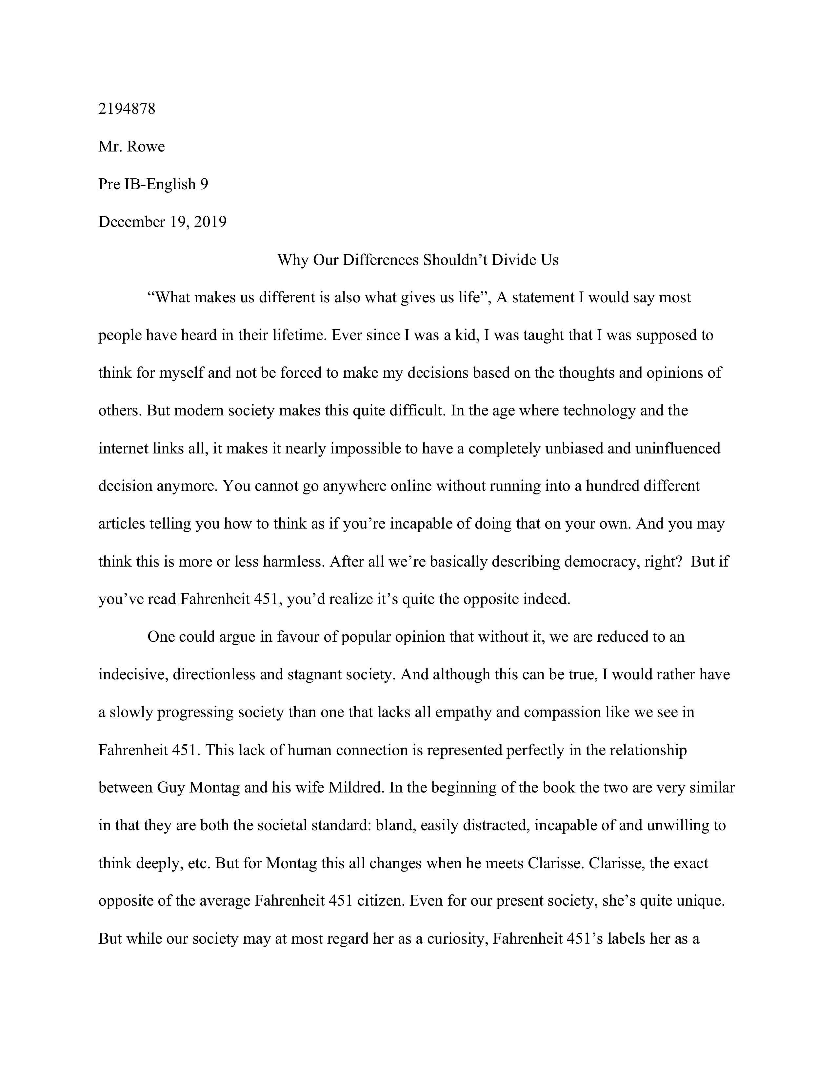
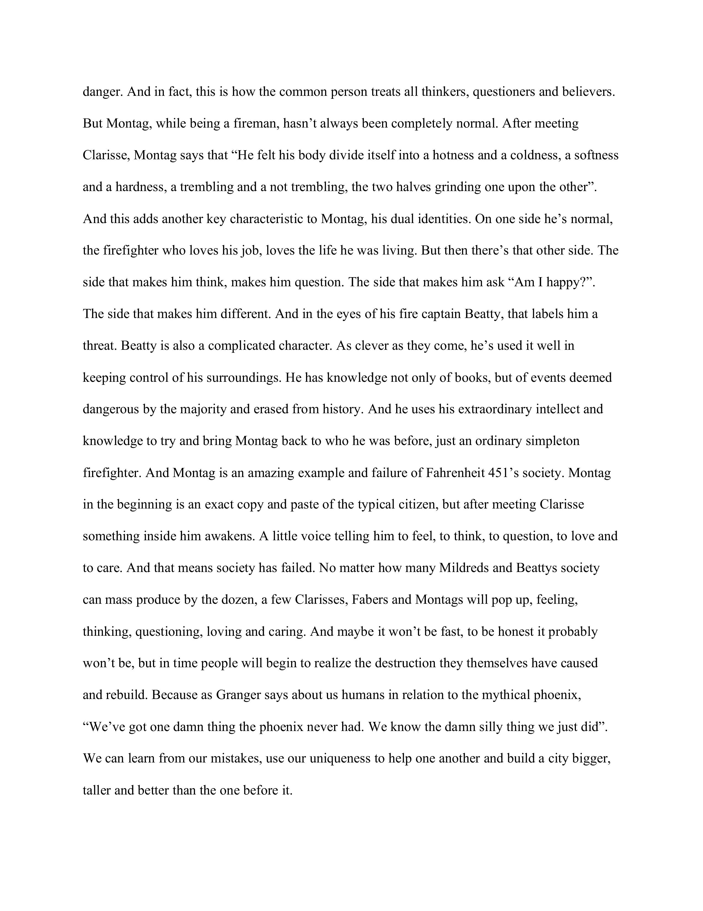
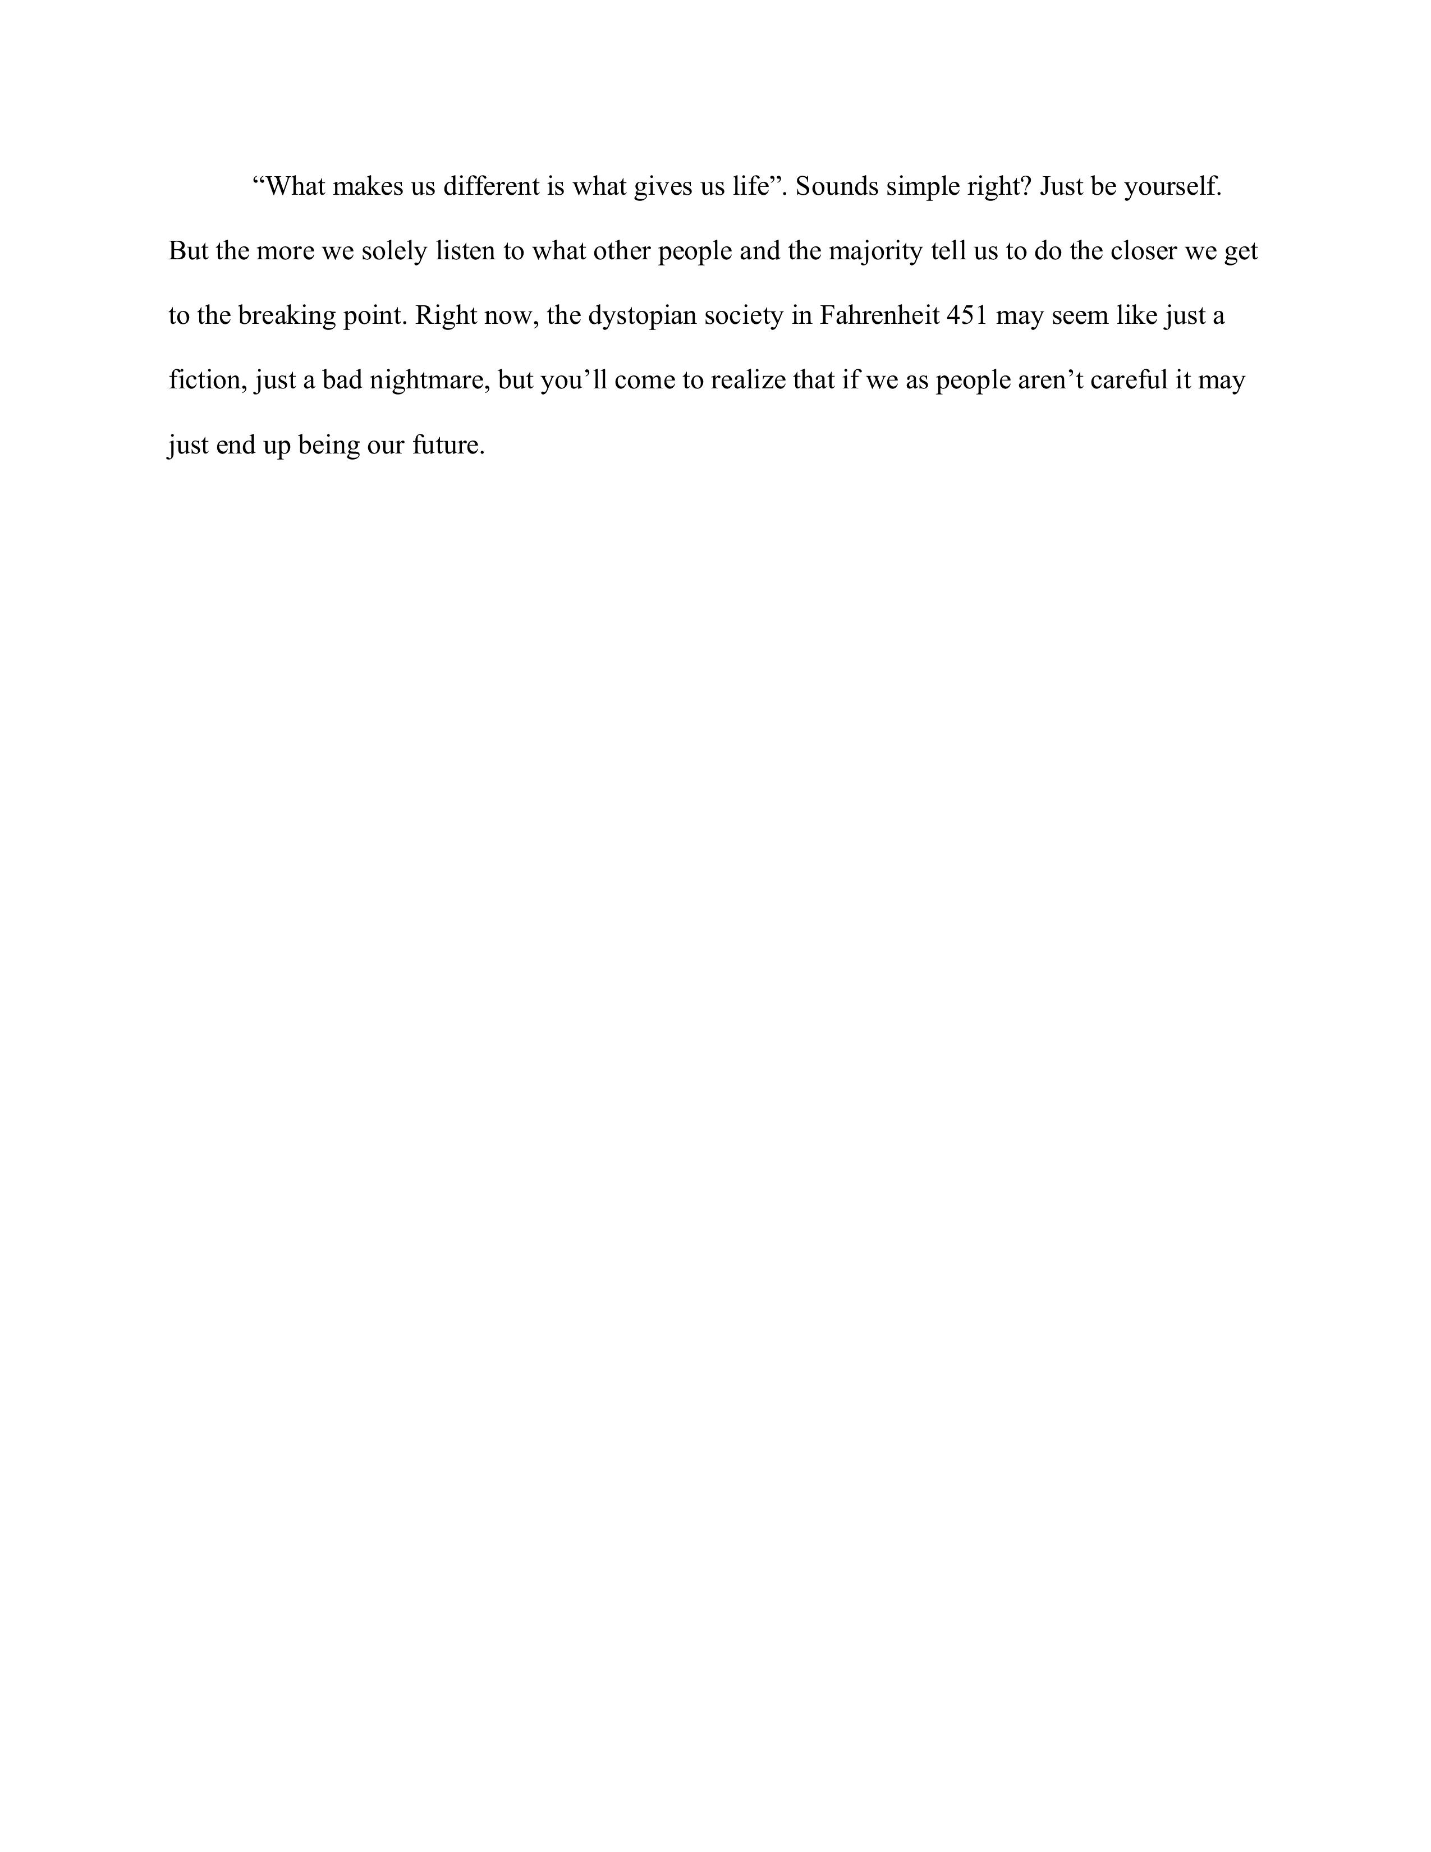

Slide 5
Achievement #2 Drafting Earthquake Tower
Why did you choose this assignment?
I felt this was one of the most difficult school projects not only of this year, but of my entire life up to this point. The pure frustration I felt while completing this project is still fresh in my mind. The many setbacks and hardships I faced while completing this project only made finally "finishing" it that much better. And even though the end result differed very greatly from our original idea, I can't help but feel proud of my accomplishment and perseverance.
How does it represent my growth throughout the year?
Up to this point, all of my assignments had been fairly simple and easily completed. This was my wake up call of sorts to how high school was different from middle school and I learned quickly that this would not be any ordinary task. I feel this shows not only my growth into a high school student but also shows how I had to adapt quickly.

Slide 6
Achievement #2
What were some challenges I faced during this assignment and how did I face them?
One of the many roadblocks I faced during this assignment was me and my partner making several key construction mistakes. This resulted in a tower far different than our original design. Me and my partner also missed several days due to us being sick or other absents. To work around this we just had to work twice as fast which most likely resulted in more mistakes. But in the end we did finish the tower the best we could.
What are your goals for the future in this subject?
Although I don't plan on taking drafting in the future as an elective, the skills of perseverance and the work ethic I gained from this project will definitely be useful in the future. My goals are just to continue to apply the skills I gained during this assignment in all future projects I do. And if I ever happen to be in a similar situation to this, I hope I can learn from the many mistakes I made.

Slide 7
(Picture of the testing of our EQ tower)

Slide 8
Achievement #3 Basketball
Why did you choose this achievement?
The thing I believe shows the amount of effort I've put into this sport is that I only started playing basketball during November of last year. And in the beginning, I was definitely and clearly a beginner but approximately 6 and a half months later, I would say improvement is obvious. I chose this particular achievement as I not only enjoy playing the game but also wanted to assess my growth throughout these 6 and a half months.
How does it represent my growth throughout the year?
In the beginning it was just something me and a few friends played to pass the time but I began to realize that I really did enjoy playing the game. And so I started practicing outside on a court just around my house. And looking back, I definitely feel proud of how far I've come, but I also realize that there is still a long road of improvement ahead.

Slide 9
Achievement #3
What were some challenges I faced during this achievement and how did I face them?
There were countless days where I wasn't feeling 100% enthusiastic about practicing and countless others where my shot just wasn't falling or where I was sore from the day before. And even though I wanted to just take a day, or a few, or even a week off sometimes eventually I just took it easy and worked harder to compensate for whatever I couldn't do that day.
What are your goals for the future in this subject?
Unlike drafting, I am sure I will continue playing basketball for the foreseeable future. I want to continue working throughout the summer on overall consistency and I also want to make sure I'm durable enough to play while also not hurting myself. I will probably try to join the school team next year and like most things in life there really never is too much work you can do.

Slide 10
Then vs. Now

