Slide 1
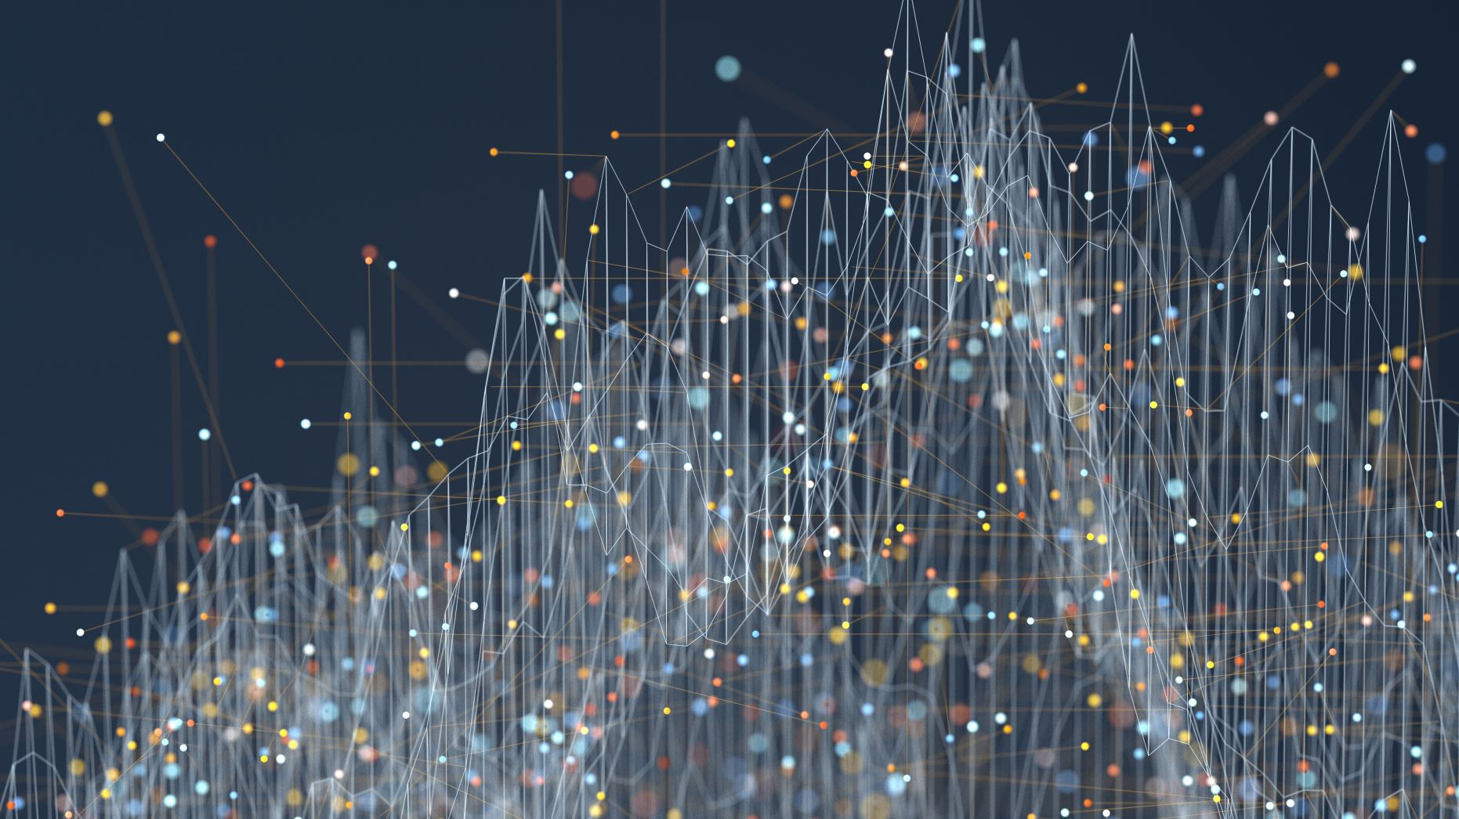
My Digital Footprint
Digital Learning Assignment 2

Slide 2
Section 1
Your digital footprint

Slide 3
How might my digital footprint affect my future?
Most universities, colleges and employers nowadays look toward your digital footprint to see whether or not to recruit you. If you want to apply for one of these things, having a bad digital footprint will affect you greatly. Also, if anyone exposes your personal data, it can affect you emotionally, especially if the data is something valuable, such as personal messages, a bad search history, etc.

Slide 4
Why is it important to be aware of one's digital footprint?
Your digital footprint is the data you leave behind when doing basically anything on the internet. You should be careful when you're on the internet, because if you put anything on the internet, it'll be there forever, because even if you delete something, people will still find it if they dig deep enough (digital permanence, see slide 7~9). You should stay aware of it and make smart decisions, so it won't affect your future negatively.

Slide 5
Section 2
Safety

Slide 6
How can I keep my digital footprint safe?
Firstly, you can keep yourself safe by searching up your name in a search engine. If you see results you don't like, you can ask for it to be taken down. Secondly, you can delete apps and accounts you don't need anymore. This reduces the amount of data going to advertisers, and also helps with organization. Lastly, you can build up a positive reputation online, so that this is what employers, your bosses, etc. see when they first look at your digital footprint.

Slide 7
Section 3
Digital Permanence

Slide 8
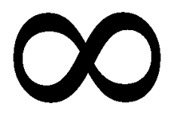
How would I explain the idea of digital permanence?
In my own words, I would say that digital permanence is the fact that everything you put online is permanent. Even if you think you have deleted something, it's still there, and anyone can find it if they dig deep enough.

Slide 9
Why should we care about digital permanence?
Your digital footprint is a record of everything you do online. Digital permanence ensures that your digital footprint will be permanent. If you have a positive digital footprint, when people look you up online, then they'll see you as a trustworthy person, and all the positive things about you will be permanent. However, having a negative digital footprint can affect you negatively (see slide 3).

Slide 10
Citations
VectorHome. (2019, March 20). Brand Awareness Icon On A White Background. Stock Vector - Illustration of line, media: 142413483. Retrieved December 03, 2020, from https://www.dreamstime.com/basic-cmyk-image142413483
What Every Teen Needs to Know About Their Digital... (n.d.). Retrieved November 30, 2020, from https://www.netnanny.com/blog/what-every-teen-needs-to-know-about-their-digital-footprint/
Curtis, A. (n.d.). How can you protect and reduce your digital footprint? Retrieved November 30, 2020, from https://blog.infoarmor.com/employers/how-can-you-protect-and-reduce-your-digital-footprint
ProSymbols. (n.d.). Job application on The Noun Project. Retrieved December 03, 2020, from https://thenounproject.com/term/job-application/2016740/
Lock Icons - Free Download, PNG and SVG. (n.d.). Retrieved December 03, 2020, from https://icons8.com/icons/set/lock
PNG Infinity Symbol, Infinity icons Free Download. (n.d.). Retrieved December 03, 2020, from https://www.freepnglogos.com/pics/infinity-symbol
Download Question Mark for free. (2014, August 14). Retrieved December 03, 2020, from https://www.freepik.com/free-icon/question-mark_731610.htm
The importance of understanding your digital footprint. (2016, June 27). Retrieved December 04, 2020, from https://blog.trendmicro.com/the-importance-of-understanding-your-digital-footprint/
NortonOnline. (n.d.). Help protect your digital footprint from prying eyes. Retrieved December 05, 2020, from https://us.norton.com/internetsecurity-privacy-clean-up-online-digital-footprint.html
Leaving a digital footprint. (n.d.). Retrieved December 05, 2020, from https://www.digitalcitizenship.nsw.edu.au/articles/leaving-a-digital-footprint

