Slide 1
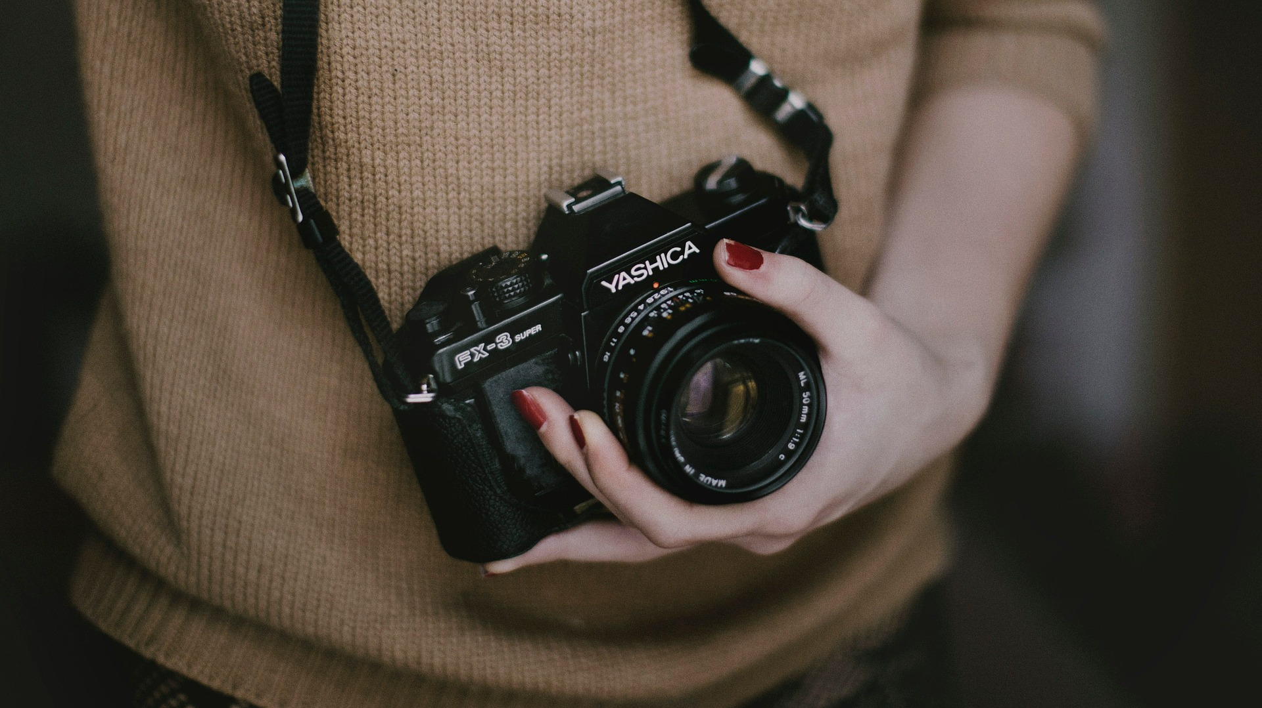
SOCIAL MEDIA AND ME
a DL10 project

Slide 2
Intro.
Social media is a more relevant topic than ever; with more activities and facets of daily life having been moved online than ever, from yoga classes to court hearings, it’s important to think about how our online world affects us as individuals and as a larger society.

Slide 3
Social media platforms operate under the guise of presenting stories and information. However, saying they obfuscate important facts and details by design to fabricate interest and controversy would be closer to the truth. Though it has always been a social issue, social media makes the spreading of fake news easier than ever. Stories and posts that are outrageous and/or offensive attract attention, and thus may be promoted even more than legitimate news by content aggregation algorithms, as they are built to prioritize clicks and engagement rather than try to verify whether information is true.
How have social media platforms changed the way we consume and understand information?
SECTION 1

Slide 4
Researching stories found on social media is always important. Mindful consumption of social media requires keeping in mind that the true purpose of social media is to generate clicks and attention, rather than necessarily to promote a true narrative. Because of this, I always try to find other, unbiased sources to either confirm or refute the claims made in news from social media, even if they may seem credible at first glance.
When you see or read “news” on social media, do you take time to research the story further?
SECTION 1

Slide 5
Online social interactions, while they might come across to some as vapid and artificial compared to face-to-face communication, can be a vital way to communicate with peers, family, friends, and even politicians and authorities — especially when meeting in person isn’t possible. This has become more apparent than ever during the COVID-19 pandemic, as many things became socially distanced and online-only. Online communication has thus become one way to mitigate the feelings of isolation that may be caused by COVID restrictions.
What value do you get from online social interactions?
SECTION 2

Slide 6
Social media has mostly replaced older forms of media as a platform for sharing information and thus propagating trends. Today’s culture is defined by a global interconnectedness due the modern technology that makes it easier than ever to communicate with people regardless of distance or even language. As a by-product of this, virtual forums and online servers have almost completely replaced the gathering places of old, and as such, how someone presents themselves online has become much more important in every aspect of our “real” lives.
How is social media and social capital helping to form youth culture?
SECTION 2

Slide 7
As virtual interactions become more and more important to everyday life, to the point of dictating future educational or career opportunities, it’s always important to think about what you post before you post it. This concept of “digital footprints” was discussed in the second DL10 assignment—to put it simply, everything on the internet can be traced. All your online interactions can be used to make a log detailing who you are and what you do. This means that employers and educational institutions from now to far into the future could easily find information on you simply by using common search engines.
When you post online do you consider how the post may be seen by others? What do they say about you? Or how that post may be seen in the future?
SECTION 2

Slide 8
In today’s world, what we post on social media can greatly affect the rest of our lives. Not taking care to think about what one posts can result to harsh consequences such as academic disciplinary action or even fines and jail time. Like in these clips, your social media activity may have a major effect on not only how you are viewed by other people, but it can also affect your academic and professional life, as people see what you post and may make judgements on your character based on your social media activity.
Do you see any similarities between the world presented in this video and the world you live in?
SECTION 3

Slide 9
According to the clips, these points contribute to a sort of social ranking as part of a larger reputation system. It is also mentioned that she can expect to suffer consequences if her rating drops too low. Her rating is dictated by how other people rate her on their smartphones and visualized by a star system displaying the average of all her ratings.
How does the main character gain and lose points? Why are these points important to her?
SECTION 3

Slide 10
These social interactions are almost all about raising one’s own reputation score. This reputation system might have originally been intended as a way of gauging someone’s social skills or overall “trustworthiness”. Some might see this kind of social interaction as a more straightforward system; after all, reputation already existed, but assigning a number to it may make this clearer.
What value might be derived from this type of social interaction?
SECTION 3

Slide 11
In these clips, almost all social interactions have become blatantly performative ways of raising one’s social rating score. Though the system is based off today’s concept of reputation, it’s taken to an extreme. Social standing and others’ opinions of the main character are based completely on numbers rather than human qualities or personality traits.
How are social interactions changed in the world of these clips?
SECTION 3

Slide 12
Conclusion.
Thank you for watching my “Social Media and Me” presentation. Overall, I found this assignment not only thought-provoking but enlightening; it’s always a good idea to try to be more mindful of the content we consume online, and social media is no exception. “Skeptic” shouldn’t be a negative word, and I hope that this sentiment was accurately portrayed over the course of my project.

