Slide 1
My Digital Portfolio
By Jaclyn Singh

Slide 2
-1st Achievement-
First Woodwork Project

Slide 3
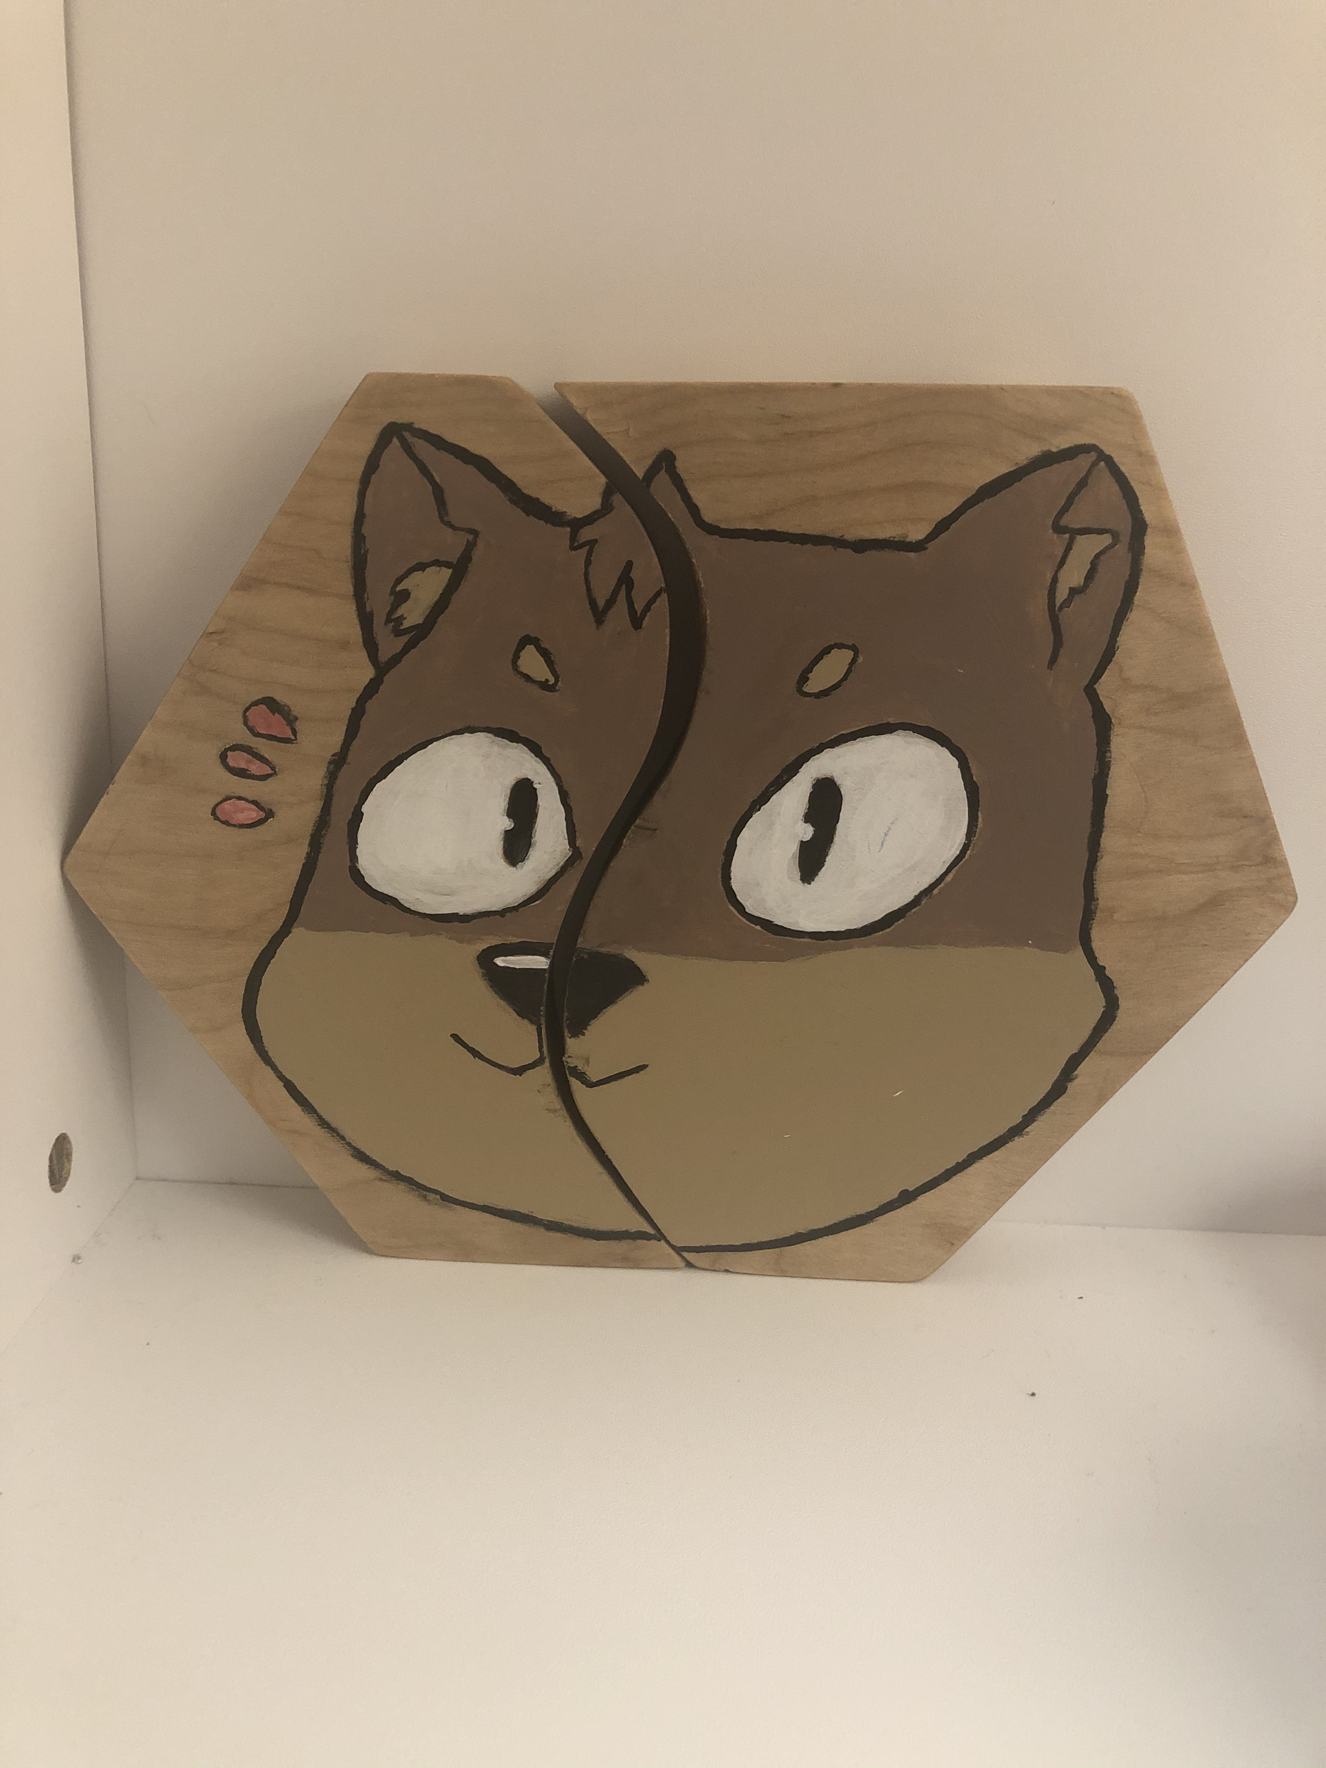
Puzzle Piece Project
I selected this achievement because it was my first time working with hand tools in the woodworking area. It represents my growth as I used to be scared to use hand held tools. Some challenges I faced were being able to cut through the hard wood. I overcame this by learning how to control my strength on the saw. After completing this project, I was able to use my new skills using hand held tools on my later projects throughout the course.

Slide 4
-2nd Achievement-
English Short Story

Slide 5
Short Story
Sample Paragraph
This was the first short story I’ve written in over a year. I’m proud of this because I was able to showcase my writing skills. I was able to grow from this by getting feedback and applying it to my next story. One challenged I faced was making the plot as my creativity was at a pause. I eventually overcame this with time. I hope to continue advancing my creative writing skills.
Their heads both turned towards the door as Izzy decided to take a step towards it. Livi had a bad feeling in her stomach as Izzy looked through the peep hole. Before they knew it, the door was being unlocked from the other side.

Slide 6
-3rd Achievement-
Completing Bronze Cross

Slide 7
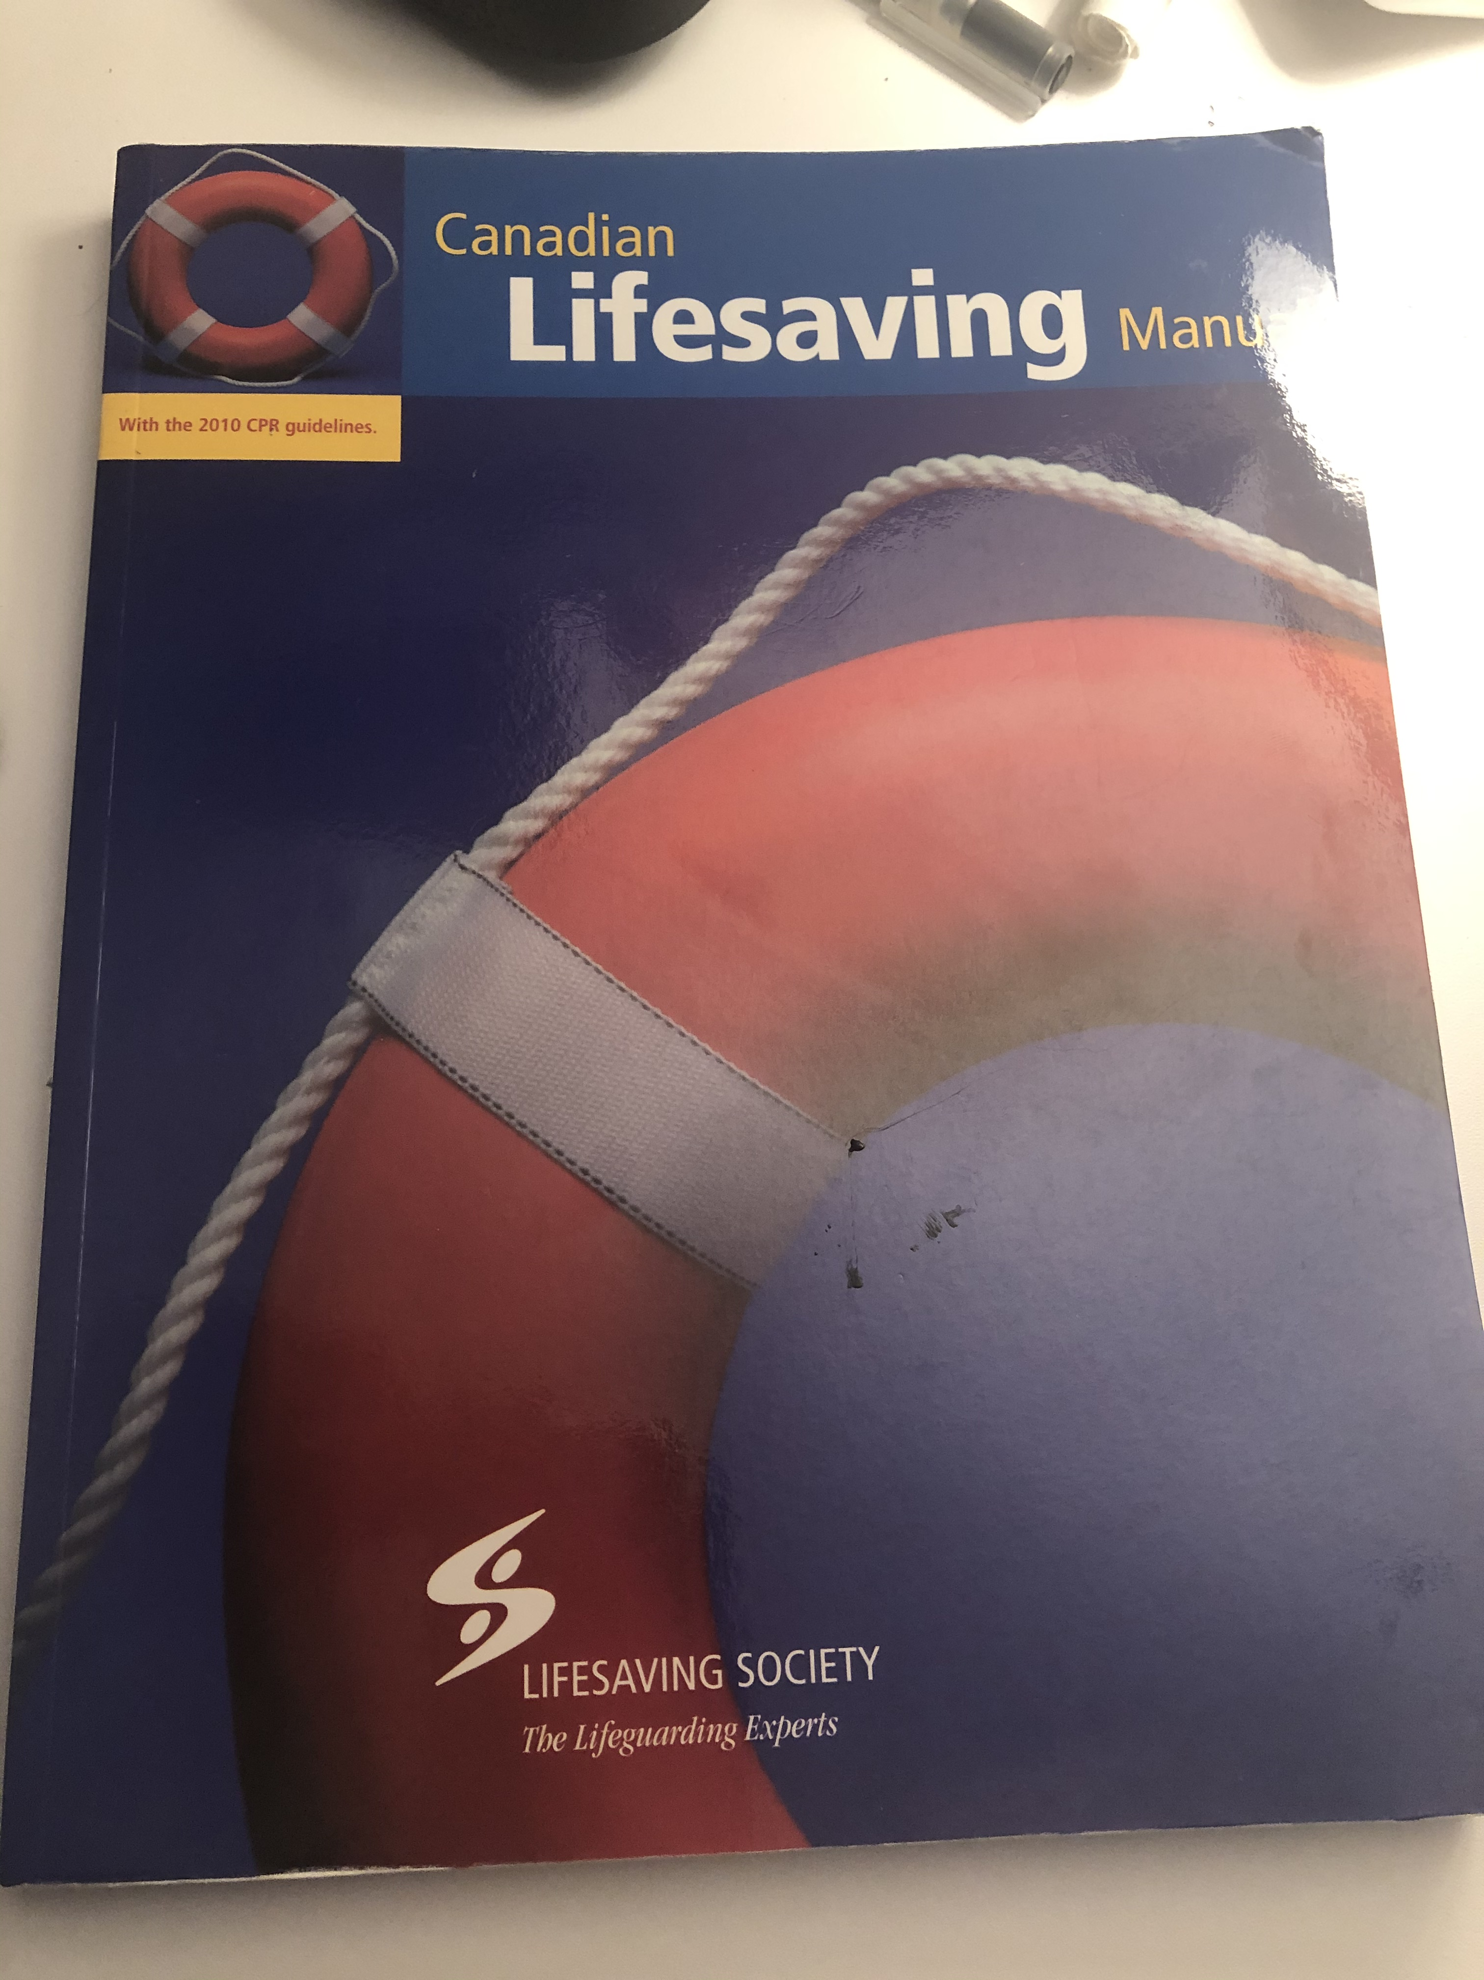
Bronze Cross
This life guarding course taught me a lot about life saving skills. I’m now able to preform CPR and know how to handle certain situations. Some challenges were being strong enough to swim for long periods of time. I overcame this by giving it my all, and it payed off. I hope to complete all the necessary things to become a life guard once I’m legal age to do so.

