Slide 1
The Disastrous Consequences of The Song of Storms in Ocarina of Time
Research Question: What is the effect of the Song of Storms if used in real life?
By: The great, magnificent, brilliant, overly modest, very humble, Joey

Slide 2
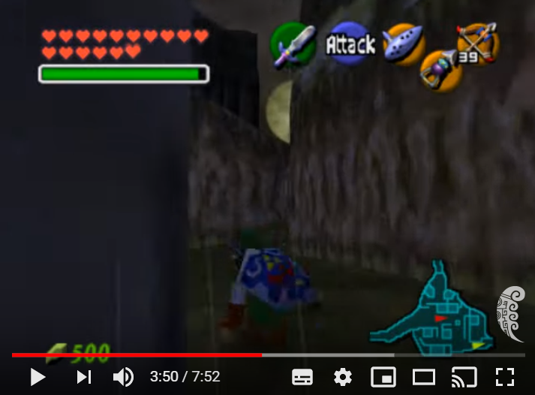
Ocarina of time: Song of storms
Wind (Atmosphere) is summoned.
A Storm (Atmosphere) and rain (Hydrosphere)

Slide 3
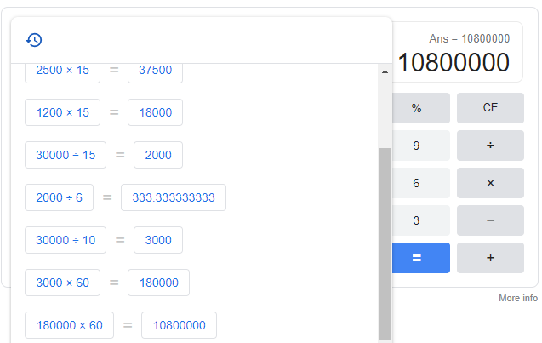
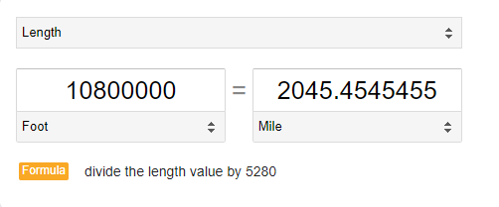
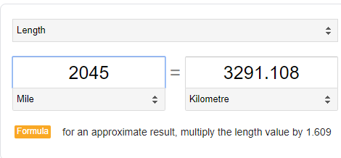
Some boring math equations for the nerds out there

Slide 4
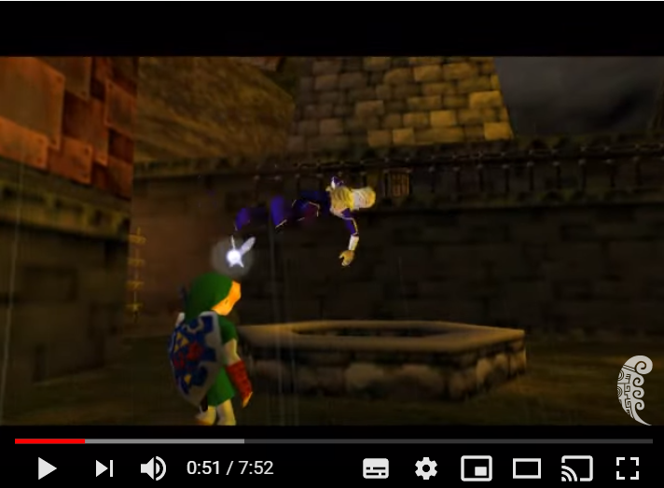
Consequences
Trees uprooted (Biosphere and Atmosphere)
People getting thrown around by wind (Atmosphere)

Slide 5
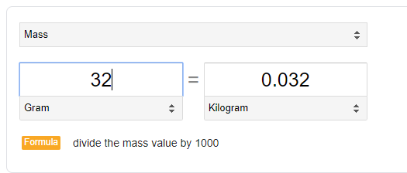
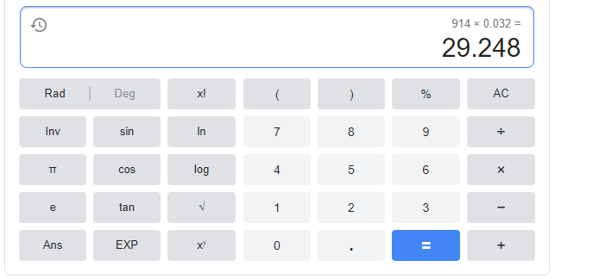
Some boring math equations for the nerds out there (Part two: the sequel)

Slide 6
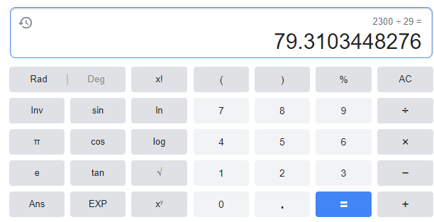
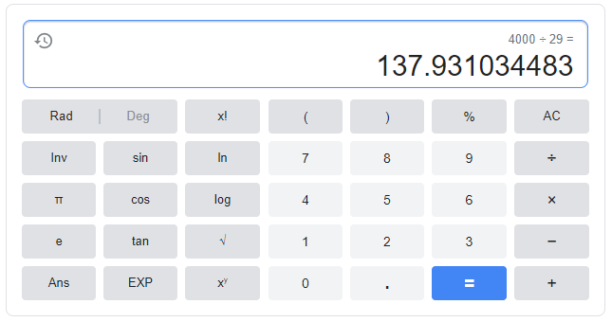
More Consequences! And more math!
Moving the Earth (Geosphere)
Potential tsunami (Hydrosphere)

Slide 7
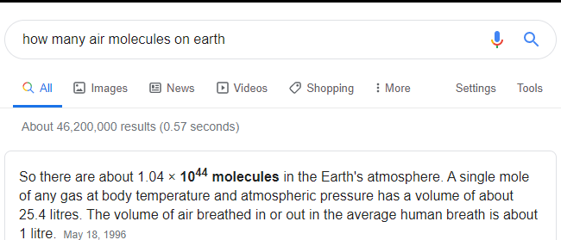

Slide 8
Answer to research question
What is the effect of the Song of Storms if used in real life?
Well, the effect would be very, very, bad. First, the wind will push everyone up. Trees would be uprooted, and houses may fly off their foundation. Then, as the cold air moves down, everything in the vicinity would be flattened, crushed to paste. The force of the wind would crush skulls and destroy everything it touches. It may actually push the Earth in some direction. Everyone may die.

Slide 9
Bibliography
Service, N. N. W. (n.d.). Https://ptwc. Weather. Gov/ptwc/faq. Php. Retrieved January 16, 2020, from https://ptwc.weather.gov/ptwc/faq.php
Air—Molecular weight and composition. (n.d.). Retrieved January 16, 2020, from https://www.engineeringtoolbox.com/molecular-mass-air-d_679.html
Service, N. N. W. (n.d.). Https://ptwc. Weather. Gov/ptwc/faq. Php. Retrieved January 16, 2020, from https://ptwc.weather.gov/ptwc/faq.php
Staff, S. (n.d.). Game of thrones exposed: The science of skull crushing. ScienceAlert. Retrieved January 16, 2020, from https://www.sciencealert.com/game-of-thrones-exposed-the-science-of-skull-crushing
The last word. (n.d.). New Scientist. Retrieved January 16, 2020, from https://www.newscientist.com/article/mg15020308-500-the-last-word/
The space review: Moving the earth. (n.d.). Retrieved January 16, 2020, from https://www.thespacereview.com/article/2547/1
Vertical momentum—How fast does supercell air go up? (n.d.). Stormtrack. Retrieved January 16, 2020, from https://stormtrack.org/community/threads/vertical-momentum-how-fast-does-supercell-air-go-up.578/

