Slide 1
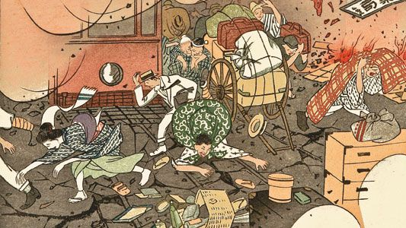
The Japan Earthquake
Write by Alex J and Alex R

Slide 2
Question :
How earthquake affect environment?

Slide 3
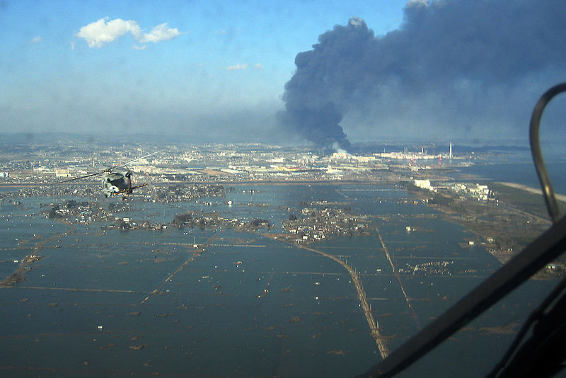
Atmosphere: the gaseous envelope surrounding the earth; the air we breathe.
Earthquakes can make greenhouse effect heavier. (atmosphere, geosphere)
They are known to release methane from pockets within the ground to the atmosphere by the movement of tectonic plates.(atmosphere, geosphere)
Methane is one of the increased greenhouse gases.
Methane and carbon get radiation and then radiate it from the earth in the form of infrared radiation.
This warms the atmosphere, and because the levels of these gases are higher than usual, the temperature of the atmosphere has been rising.(geosphere,atmosphere)

Slide 4
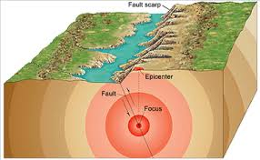
Lithosphere
However if an earthquake happens in an area with less compacted sediments, damage to buildings can occur(geosphere,biosphere), including structures being destroyed and power lines falling. These incidents can cause fires and harm to civilians.(geosphere,biosphere)
Serve movement in the Earth's crust causes the ground near lakes and rivers to cause slumping.(geosphere,hydrologic)

Slide 5
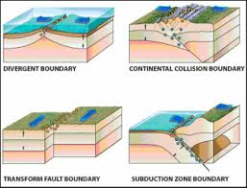
Hydrosphere
Confined and unconfined aquifers can both be affected by earthquakes.(hydrosphere,geosphere)
Confined aquifers that are within the area of the earthquake are more likely deform due to the movement of the earth, than unconfined aquifers. Groundwater level changes can be affected, which is evident in both types of aquifers.(hydrosphere,geosphere)
Permanent deformation of aquifers lasts until pressure within the aquifer equalises with the water table. This equilibrium can be met at varying lengths of time. This only applies in the vicinity of the earthquake. The process and recovery of aquifers is still unknown.
Ground breakage creates new lakes also known as “sag ponds”. They increase groundwater flow from springs and displacing stream channels.(hydrosphere,geosphere)

Slide 6
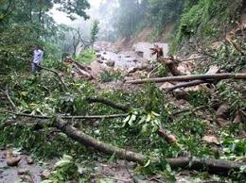
Biosphere
The intense shaking of the earth’s surface causes damage or loss of human and animal life. Earthquakes themselves do not kill or harm life, it’s when structures or certain flora collapse.(biosphere,geosphere)
The creation of new springs and lakes created by ground breakage alters the surrounding environment. There is potential for flooding, changes in the food chain and can cause changes in animal behaviour in the area affected. In the long run, this can lead to new species being formed or the extinction of modern species.(hydrosphere,biospere)
Landslides release pathogenic microbes into the atmosphere impacting on human and animal health. This can have a devastating effect, such as becoming an epidemic or wiping out a species. Both situations lead to further alteration in the biosphere. (atmosphere,biosphere)

Slide 7
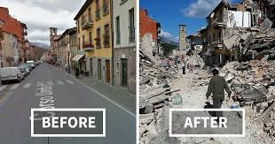
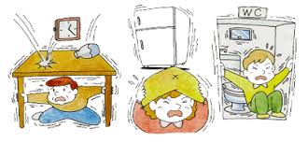
During an earthquake, the earth's crust will vibrate violently, and the buildings on the ground will also vibrate with it, causing houses to collapse, etc. An earthquake in the sea will cause a tsunami.
There are precursors to earthquakes, such as crustal deformation and abnormal groundwater activities. But this may not be caused by the earthquake. Therefore, we must first identify the causes of these changes and then consider whether they are related to earthquakes.
After the earthquake, the house collapsed and the earth's crust stopped vibrating, but there may also be aftershocks, after that everything will quiet down

Slide 8
Thank you for listening

