Slide 1
My digital footprint
By: Mishalie

Slide 2
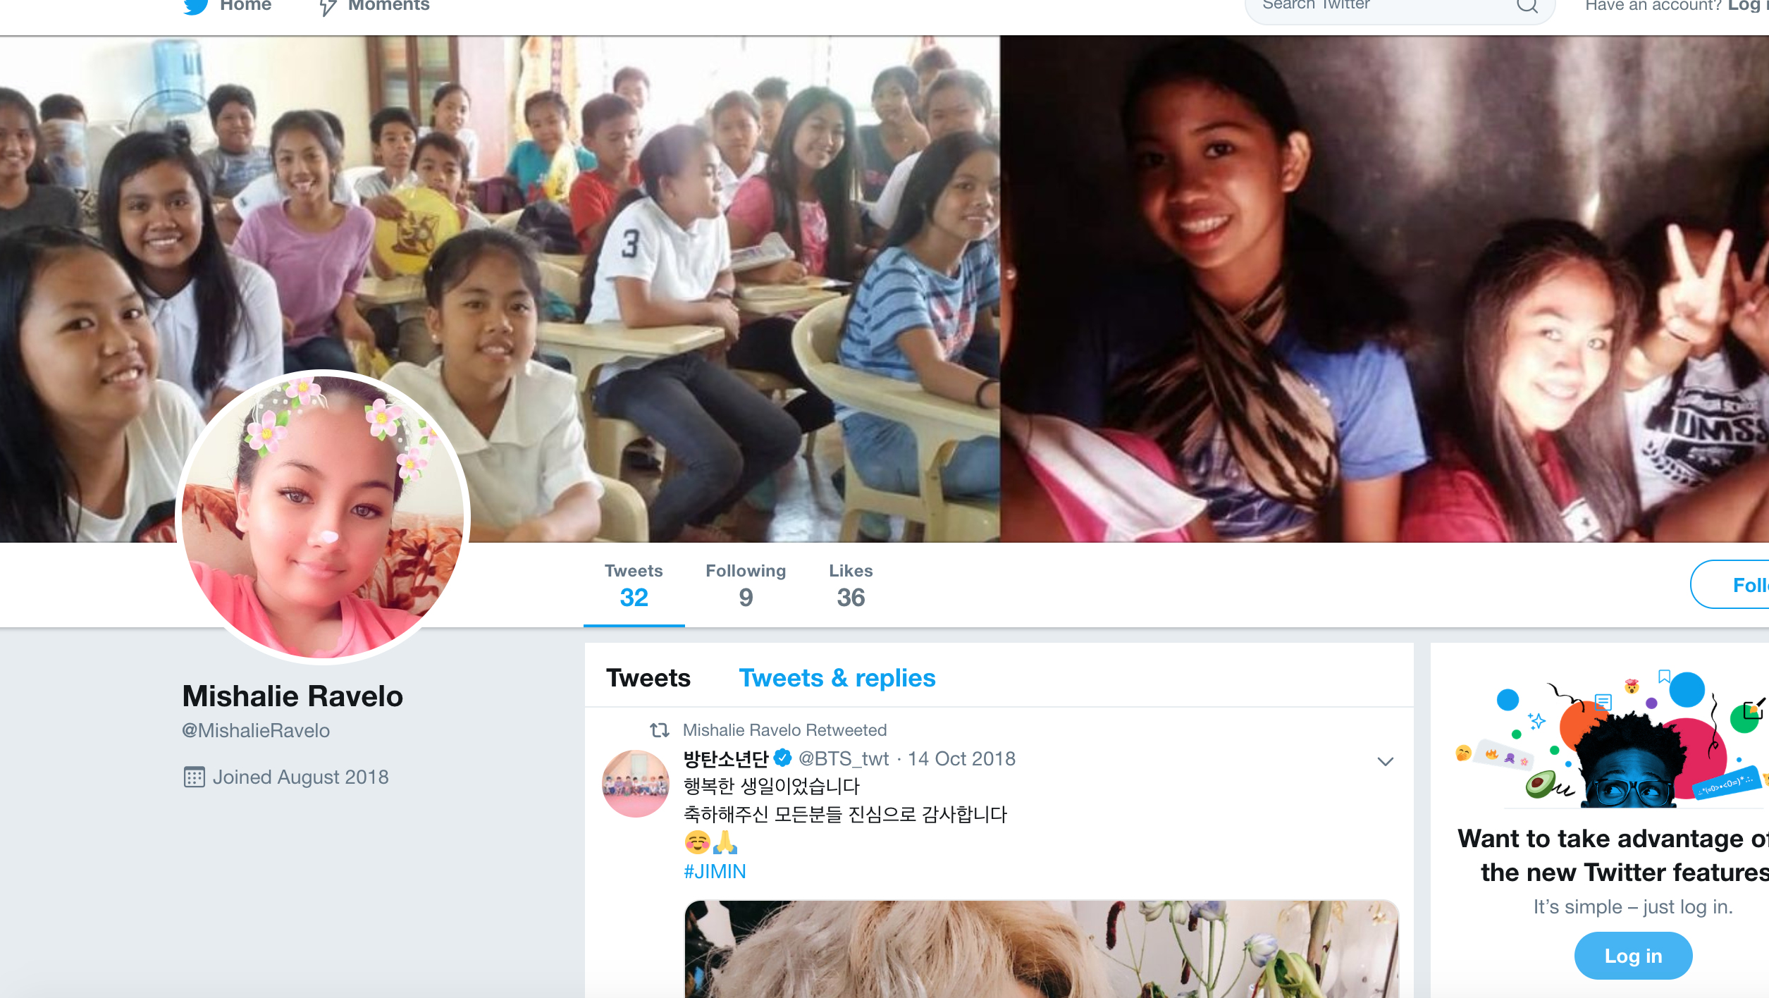
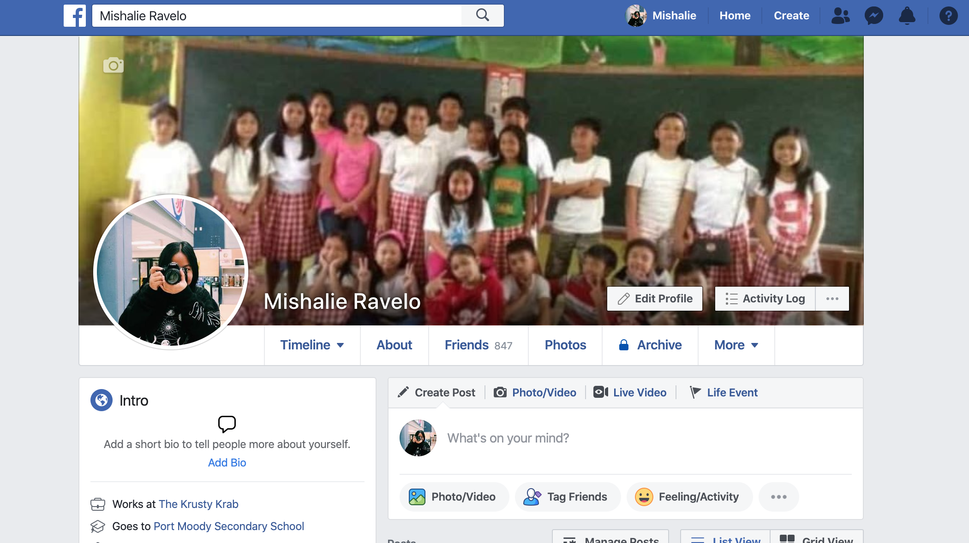
Reflect
When I search my name I saw my facebook account and my old twitter account.
My facebook account is there's a lot of account that the same name as me.
My Twitter and facebook account is in publish.
If people want to search my name if would be funny because they will see my old ugly picture in my twitter.

Slide 3
Why each strategy is important or valuable
It's important because if you don’t know what your doing. your digital footprint might something happen and even if you delete the picture that you post in social media the pictue will stay still.

Slide 4
What is the three strategies to keep your digital footprint safe.
Don’t post anything inappropriate in social media BECAUSE if you try to delete the photo that you post it will stay there forever.
Don’t download social media BECAUSE THEN YOU WILL NOT HAVE DIGITAL PERMANENCE ABOUT YOURSELF.
DON’T PUT YOUR REAL NAME BECAUSE THEY WILL COPY YOUR NAME AND PRETEND TO BE YOU.

Slide 5
How you explain the idea of digital permanence to other people
Digital PERMANENCE IS WHERE YOU caN'T delete the PHOTO THAT YOU POST IN SOCIAL MEDIA .

Slide 6
Citations
https://tinyurl.com/y48csr7f
https://tinyurl.com/yywu5ens
https://tinyurl.com/y5tq3f3k

