Slide 1
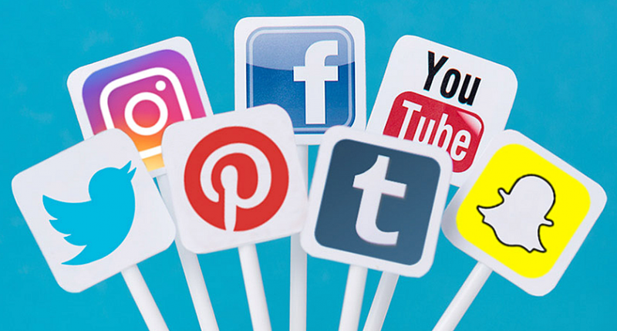
Social Media and Me
By Nathan K.

Slide 2
How Have Social Media Platforms Changed the Way We Consume and Understand Information?
Social media makes it much easier for all sides of an argument or conflict to be heard.
Witnesses might be smothered by corrupt organizations, but social media gives everybody a chance to share their stories.
Anyone can post anything though, so it can also be false information
A total of 50% people interviewed in a servey conducted by Forbes News so social media has a huge impact

Slide 3
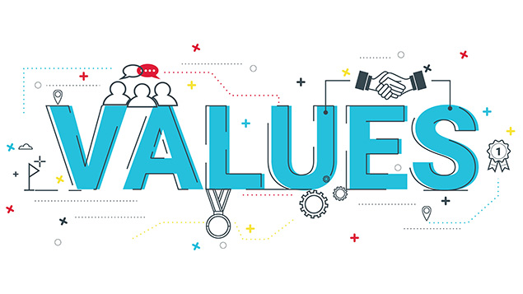
What Value Do I Get From Online Social Interactions?
I feel included whenever I have a social interaction and I get to talk with people, which online and offline, is a fun thing to do.
I rarely have bad online social interactions, and when I do, I take steps to make sure it doesn’t happen again.
While I like online interactions, I don't feel as if I'm addicted or must check my notifications every thirty seconds

Slide 4
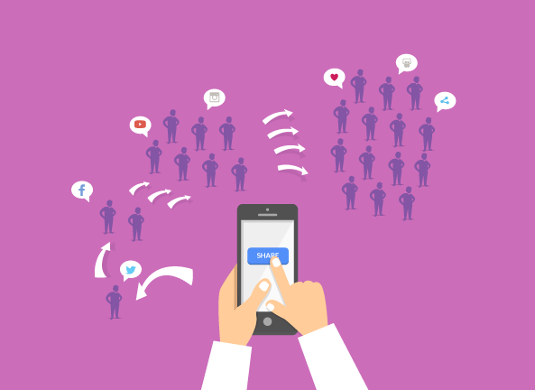
How is Social Media Helping to Form Youth Culture
Social media helps to start trends which are a huge part of our culture.
Social media also spreads news, and one of the key factors for this generation is awareness of current events and news
Finally, social media is the gateway to online social interactions, which most would say is the most important factor in youth culture

Slide 5
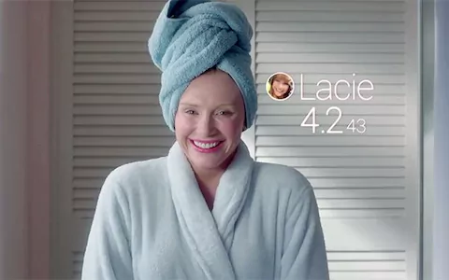
Similarities Between Black Mirror and Real World
Black Mirror
Real World
Everything revolves around the people's phones and the ratings they get
People will do anything for good ratings, causing interactions to become fake
When someone has a low rating they are ignored and become a disappointment to the community
People care about social currency, but it isn't hugely important for most people
People generally act normal, but people will do crazy things for likes, eg: some people will spend hours picking an outfit for a social media post only to stay at home the entire rest of the day.
In this world rating doesn't matter all that much, but it is become more and more important to people over time
Black mirror is basically our world in the future

Slide 6
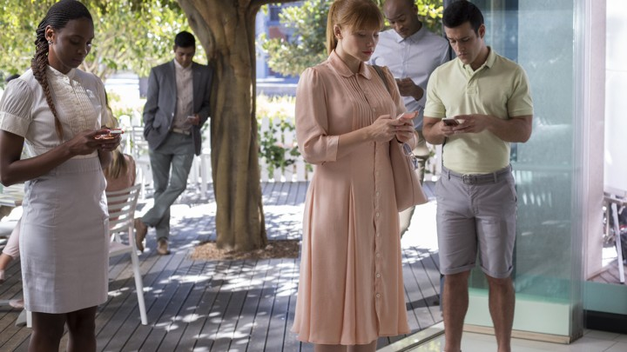
How Does the Main Character Gain and Lose Points? Why are These Points Important to Her? What Value Might be Derived From This Type of Social Interaction?
She gains and loses points based on what others rate her
These ratings shape what she thinks about herself and what others think about her
If she has a bad rating she would probably be shamed and not included in anything, and everyone wants to feel included
She gains the value of self-appreciation, feeling included, and being like by others

Slide 7
How are Social Interactions Changed in the World of These Clips?
How people feel about the people in these clips depends heavily on social interactions
If someone has a bad interaction they are rated badly and if they are rated badly, they are shunned by everyone
This makes these social interactions fake because everyone is trying too hard to have a perfect interaction which makes these interactions fake
People are afraid to act out or act differently because they might be shunned for it, so everyone acts the same nothing ever changes
That is until there is a conflict, which are inevitable in all societies
When there is conflict people pick sides and new media doesn't matter, only what the people of the Black Mirror hear from the people involved matters

Slide 8
Website Citations
“Black Mirror.” Wikipedia, Wikimedia Foundation, 30 Jan. 2020, en.wikipedia.org/wiki/Black_Mirror.
Bozarth, Jane. “Nuts and Bolts: Assessing the Value of Online Interactions.” Learning Solutions Magazine, 2012, learningsolutionsmag.com/articles/1019/nuts-and-bolts-assessing-the-value-of-online-interactions.
Martin, Nicole. “How Social Media Has Changed How We Consume News.” Forbes, Forbes Magazine, 30 Nov. 2018, www.forbes.com/sites/nicolemartin1/2018/11/30/how-social-media-has-changed-how-we-consume-news/#33597e323c3c.
Neale, Larry, and Rebekah Russel-Bennett. “View of What Value Do Users Derive from Social Networking Applications?: First Monday.” View of What Value Do Users Derive from Social Networking Applications? | First Monday, 20 July 2009, firstmonday.org/article/view/2506/2278.
Poyntz, Stuart R., and Jennesia Pedri. “Youth and Media Culture.” Oxford Research Encyclopedia of Education, 18 Sept. 2018, oxfordre.com/education/view/10.1093/acrefore/9780190264093.001.0001/acrefore-9780190264093-e-75.

Slide 9
Image citations
Ahmad, Irfan. “How Social Media Helped Spread The News - #Infographic.” Digital Information World, 18 June 2014, www.digitalinformationworld.com/2014/06/how-social-media-spreads-news-and-go-viral-infographic.html.
Corey, Debra. “Getting Value out of Your Company Values.” Personnel Today, 19 Dec. 2019, www.personneltoday.com/hr/getting-value-out-of-your-company-values/.
Gilbert, Sophie. “'Black Mirror' Is Back: 'Nosedive' Is a Sharp Satire About Social Media.” The Atlantic, Atlantic Media Company, 16 Nov. 2016, www.theatlantic.com/entertainment/archive/2016/10/black-mirror-nosedive-review-season-three-netflix/504668/.
Sugai, Nick. “4 Lessons from Top Social Media Publishers.” AdLibbing.org, 9 Feb. 2018, www.adlibbing.org/2018/02/12/4-lessons-from-top-social-media-publishers/.
Vincent, Alice. “Black Mirror Is Coming True in China, Where Your 'Rating' Affects Your Home, Transport and Social Circle.” The Telegraph, Telegraph Media Group, 15 Dec. 2017, www.telegraph.co.uk/on-demand/2017/12/15/black-mirror-coming-true-china-rating-affects-home-transport/.

Slide 10
Thanks

