Slide 1
Digital Portfolio
By: Nathan Kirkham

Slide 2
Horror Short Story (English)
I selected this because I’m very proud of this short story and how well I did on it. It represents my growth throughout the year very well.
This represents my growth because it was one of the final projects of the year and the amount that my writing had grown since the start of the year was quite a lot.
I faced many challenges like coming up with a creative horror story. I also wanted to have some humor which is difficult to incorporate with a horror story. I also had to be sure that the writing made sense to everyone else which needed lots of editing.

Slide 3
Horror Short Story (continued…)
My goals for the future of English and Writing are to work on them throughout school as everyone will and maybe later in life like in my retirement I’ll decide to become an author or something.
I don’t really see writing as a major part of my future, but you never know.

Slide 4
Styrofoam Airplane
I chose this because I’m very proud of it and it was one of the only airplanes in my drafting class to fly first try. It was very difficult and stressful to make and very rewarding to see it fly for the first time.
This project represents my growth in drafting in many ways. My skills in drawing, sketching, and computer editing designs and plans for things such as a Styrofoam airplane had greatly improved.
I faced many challenges during this project. Whenever I made a mistake which happened quite a bit I’d usually have to start over on whatever I was working on. Messed up the body of the plane even a little bit it wouldn’t have been able to fly. I also had to make everything perfectly aerodynamic for it to work properly.

Slide 5
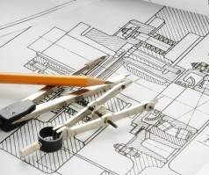
Styrofoam Airplane (Continued…)
My future goals for this are to be able to use my drafting skills in everyday problems, house renovations, and if I chose, maybe for my job.
Being able to draft is very useful for many jobs mostly trades, but other jobs as well.
It’s also very useful for doing house renovations and building things.
I don’t really see anything about the aerodynamics having a major affect in my life, but we will have to see.

Slide 6
Hockey Playoff Finals
I chose this because I’m very proud of my team and I and how we played in our final game to win the banner. It was especially sentimental because I scored the winning goal.
This represents my growth as well as my teams to go from the bottom of the league to the top in a single season. I grew over the season to be a great contribution to the team.
I faced many challenges during the season mainly losses, but others too. At the beginning of the playoffs we lost our first 3 games forcing us to win all of the next ones. On top of that in the final game we were down 4-1 and came back to win 5-4. A challenge I personally faced was that I’d only started hockey last year and wasn’t that good yet, but I improved a lot over the year and helped my team.

Slide 7
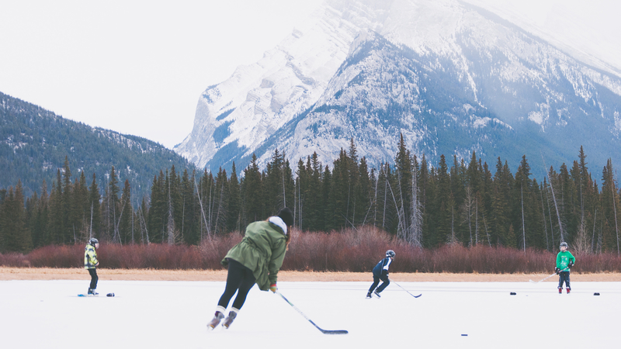
Hockey Playoff Finals (continued…)
I have many goals for my future in hockey.
I know that I won’t make the NHL and I don’t really want to anyway, but I know hockey will still impact my life.
I will try to play adult hockey for as long as I can.
I also might ref hockey or coach a team in the future.

Slide 8
Citations
Carrasco, Mario. “Council Post: Stop Reading Business Books: The Importance Of Diversifying Your Reading List In 2018.” Forbes, Forbes Magazine, 18 Jan. 2018, www.forbes.com/sites/forbesagencycouncil/2018/01/18/stop-reading-business-books-the-importance-of-diversifying-your-reading-list-in-2018/#c84c15a5e3d4. (Slide 2)
Danbom, Dan. “Tips for Buying Used Books Online from a Denver Bookstore Owner.” The Know, The Know, 2 Apr. 2020, theknow.denverpost.com/2020/04/03/tips-for-buying-used-books-online-coronavirus/236733/. (Slide 3)
N, A. “Drafting.” Tecvalco, 13 Dec. 2016, www.tecvalco.com/custom-drafting/drafting/. (Slide 5)

Slide 9
Citations (Continued…)
N, A. “Free Photos and Images.” Free Photos and Images, 0AD, www.goodfreephotos.com/canada/alberta/banff-national-park/people-playing-hockey-on-frozen-lake-in-banff-national-park-alberta-canada.jpg.php. (Slide 7)
Quidwai, Sabba. “5 Things Everyone Should Include In Their Digital Portfolio.” EdTechTeacher, 13 June 2018, edtechteacher.org/5-things-everyone-should-include-in-their-digital-portfolio/. (Slide 1)

