Slide 1
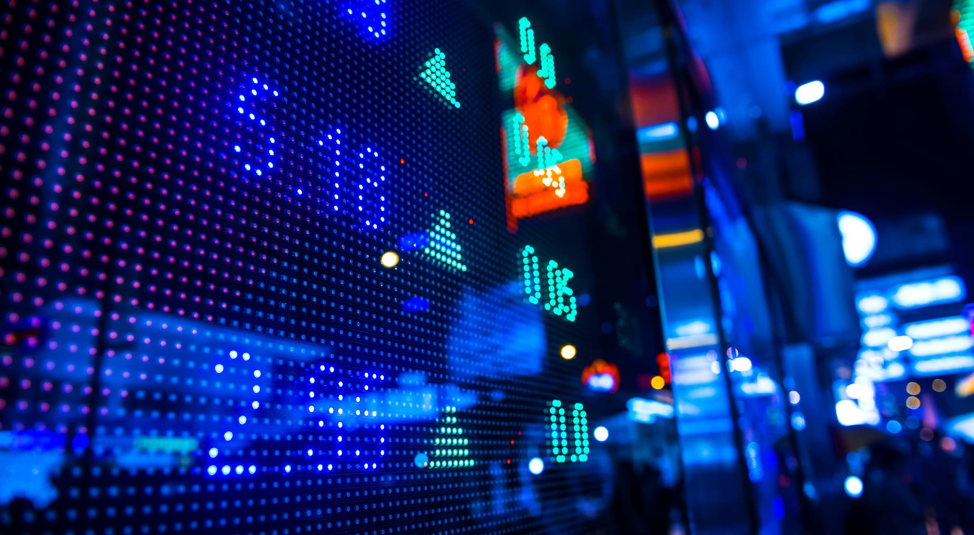
SOCIAL MEDIA
By the way! Don’t click to move the slides. It’s on auto play! Wait awhile. It’s timed to move.
Nicholas Yun

Slide 2
What are We Becoming?
How will we take action and change our own lives from digital slavery?
We must ask ourselves that question

Slide 3
How have social media platforms changed the way we consume and understand information?
Section 1
Confusion is the point

Slide 4
Section 1
Mentally
Physically
Virtually
The internet has taken over the minds of most youth and adolescents. Their minds are completely under control of social media.
YouTube has taken over youth minds as their parents. Where did they learn to vape? YouTube. If YouTube tells them to do it, they’ll do it.
You can’t open a web page without having multiple ads flashing in your face. Most of them advertising Insta, or Facebook, or even Twitter. Social Media is a poison slowly spreading through or lives and blood.
answer

Slide 5
What value do you get from online social interactions?
Section 2
Is Social Media Hurting Your Mental Health?

Slide 6
Section 2
1 like?
2 likes?
COOL! I got one more! But what about her? She has millions of followers and likes. These are just meaningless numbers that raise your virtual rank. You don’t need these. Power outage? Boom! No rank now. Just some random guy relying on a phone to live.
WOW! I’m moving up the ladder quickly. But what about him? He gets thousands of followers every week. Why should you care about numbers that fall and rise everyday. Someday, you will fall out of style and no one will like you or follw you anymore. All you get is virtual value that is meaningless. A Nobel Prize would be much better.

Slide 7
How is social media and social capital helping to form youth culture?
Section 2
Is Social Media Hurting Your Mental Health?

Slide 8
Section 2
These days, social media is changing the opinions about cultures and religions. Making everyone confused. Racism and Sexism is rampant through posts and comments. Saying that the Canadian Anthem is sexist towards girls. Social media has the say on what to change. If some guy who has a decent amount of followers posts something saying that Christians are actually demons in disguise, people may believe it and then the entire world will shun Christians. I know. Terrifying!

Slide 9
Do you see any similarities between the world presented in this video and the world you live in?
Section 3
Black Mirror: Nose Dive Clips

Slide 10
Section 3
These days, people are judging other people by their digital rank and number of followers and likes. This video was talking about the near future. But it could have as well been now, too. Criticism about our own people is becoming a very scary thing. Even online.

Slide 11
How does the main character gain and lose points?
Section 3
Black Mirror: Nose Dive Clips

Slide 12
Section 3
This character gained and lost points because she commented on others. She lost points on her ratings because she helped a guy named Chester who had less points than an average person. Her coworker said that Chester broke up with someone, and then he lost a bunch of points because of that.

Slide 13
How are social interactions changed in this world?
Section 3
Black Mirror: Nose Dive Clips

Slide 14
Section 3
Social interaction is different in this future because everyone can access everyone’s posts and lives overall. All you do is touch a button on your phone, and boom, suddenly your friend or stranger can access everything you’ve said online and posted online. They use forced cheeriness to be seen better in front of others. The two people in the elevator probably never knew each other before, yet they asked personal questions because they knew everything about the other just by pressing a button.

Slide 15
Thank You

Slide 16
Important Videos
https://www.youtube.com/watch?v=4hK4fG3rcHA
https://www.youtube.com/watch?v=tyUi6-Opzzw

