Slide 1
My Digital Portfolio
By Nicole Li
This Photo by Unknown author is licensed under CC BY.

Slide 2
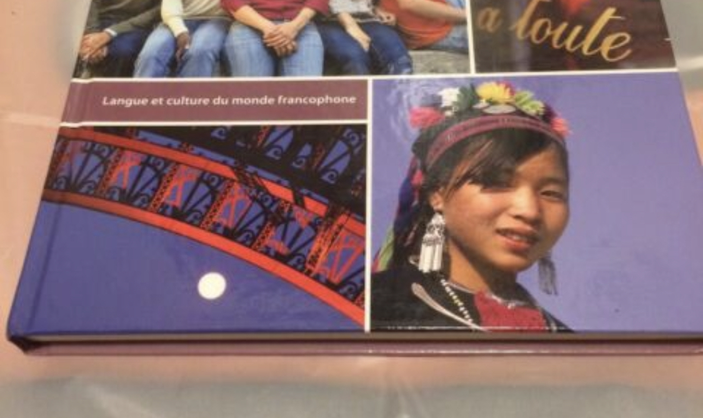
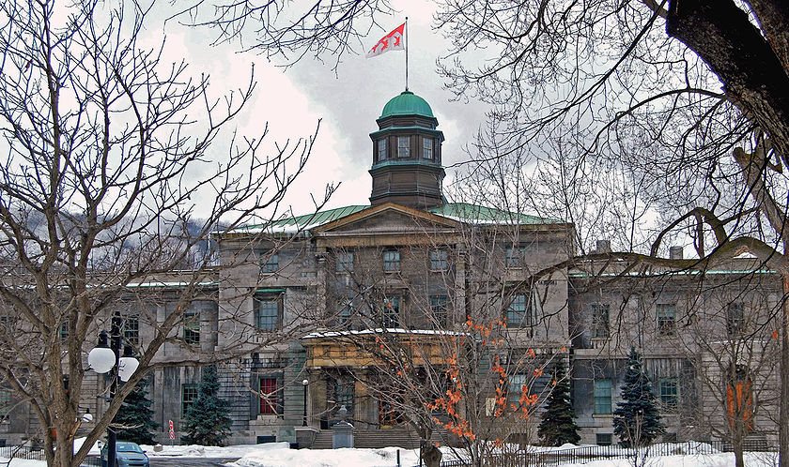
French ICW 3
I selected this achievement because I put a lot of effort into it and received 100 percent on it. I believe it shows my ability to listen and apply what I learn to my assignments. I also chose it because I find it difficult to get 100 percent on assignments that are not made up of questions, like a test.
This represents my growth throughout the year because it required me to use all of the grammar and vocabulary I had learned throughout the term. It also showed my improvement from the previous in class writes we did in the terms before. From the first in class writes, I learned how to correctly structure my sentences.
Some challenges I faced during this were staying under the word limit. I found this difficult because I also had to use examples from all grammar and vocabulary categories. I overcame this obstacle by using less adjectives and adverbs, and by combining multiple sentences into one.
My goals for French are to be able to easily write and speak in French. I can achieve these goals by continuing to take the French course. In the future I might be able to use what I have learned if I go to Mcgill University in Montreal. I will find it easier to communicate with the French speaking people in Quebec.
This Photo by Unknown author is licensed under CC BY-SA.

Slide 3
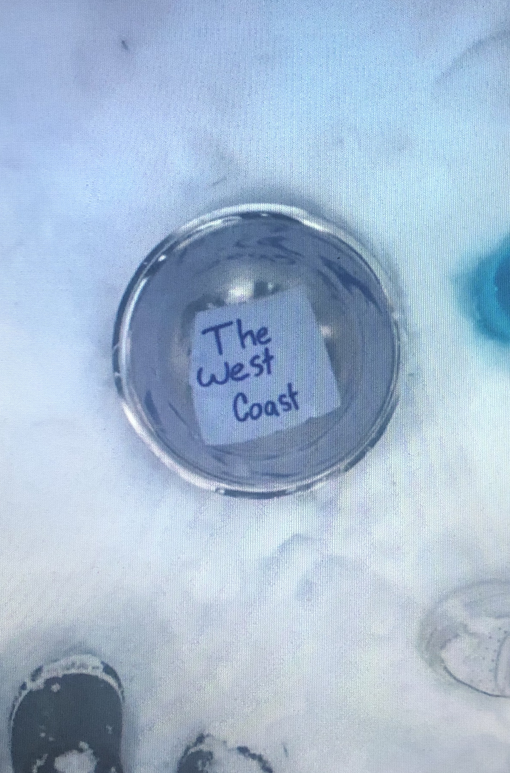
Cascadia Earthquake Science Project
I selected this achievement because science is my favourite subject. I think it was a very creative idea to use a Tik Tok as the intro to the video. I also think I did a good job on editing it, considering I am not very experienced as a video editor. I spent a lot of time outside of school working on it, and as a result I got an A on the project.
This represents my growth throughout the year because it shows what I have learned in multiple different classes. I used what I learned in science to make the video factual and accurate. In math class, I learned a bit about different sources I could use, and how to use them to edit videos during a vacation on a budget project. I could not have done this project at the beginning of the year.
A challenge I faced during this was making time outside of school to work on my project. I found this difficult because my extracurricular activity is very time consuming. What made it even worse was that it was a partner project, so my partner and I needed to find a time that worked for both of us. We overcame this by rescheduling our activities.
One goal I have for science in the future, is to get a job in the medical field. I will work towards this by continuing to put effort into all science assignments. In the future I will be able to edit videos when I need to, possibly for other classes. I also learned a lot about Vancouver's potential for an earthquake so I can better prepare for when it happens.

Slide 4
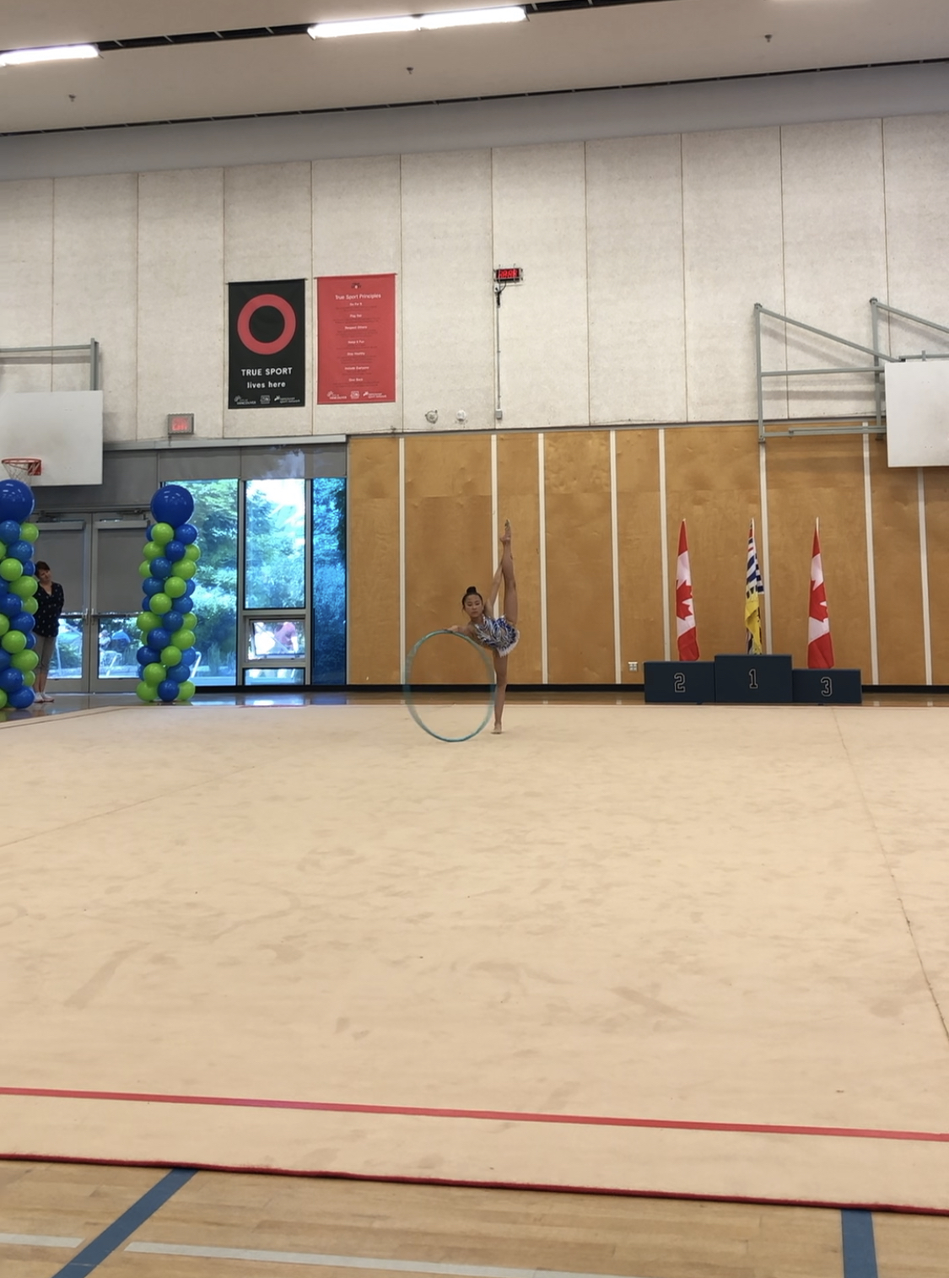
Gym Power Rhythmic Gymnastics Competition
I chose this achievement because I have worked hard since the beginning of June to prepare for this competition, which was in January. It took a lot of time and energy, and in the end, I got 4th place. Overall it was a very fun experience since I got to fly to Edmonton with my friends.
This represents my growth throughout the year because I made a lot of progress at gymnastics and got to show it at the competition. I also got to meet a lot of new people from other clubs in other parts of Canada. It was interesting to meet these people since there are not a lot of rhythmic gymnastics clubs in BC.
I faced many challenges when I was preparing for this competition. One of them was making enough time for my schoolwork to be done because I was spending most of my time at practice. Typically I got my work done by doing it in class, at lunch, or at flex. I also had to miss a couple days of school, which put me behind the rest of the class. I caught up by asking my friends what I missed and by doing some work while I was in Edmonton
A goal I have for gymnastics is to be in the top three places at my next competitions. I can achieve this goal by going to every practice, and by listening to my coaches. In the future I can use what I have learned to improve my time management skills and be active. I could also use my experience to later become a coach.

