Slide 1
My Digital Footprint

Slide 2
Googling myself
When I googled myself the only thing that came up was my Instagram. Some other people with the same name as I came up too. Other Noah's Instagram's came up as well and some peoples twitter, and a couple different websites popped up. Nothing to interesting but when I scrolled down, I saw a PAC information website for Seaview community school which was the elementary school I went to.

Slide 3
How might your digital footprint affect your future job opportunities and or post-secondary?
Your digital footprint can strongly affect your future jobs and opportunities. Hypothetically, if you were to post/share a video on social media of you and your friends throwing eggs at people's houses, you would think it was hilarious at the time. Years later when you apply to some sort of job or university, they will do a background check on you. They will look at your Instagram/Facebook/Twitter etc. They're most likely going to find that video, even if you've deleted it, and for that reason they'll believe your irresponsible and won't hire you. That's just one example of why you should be aware of what you put on the internet. It's a good idea to just share things like your hobbies. you shouldn't ever share private information. I share on my Instagram what I like to do. Looking at my Instagram you will see video's and pictures of me mountain biking, snowboarding, hiking, skimming, flipping and other adventures of mine. I wouldn't share my phone number, address, school, or the complex I live in. One time by accident I posted a picture and I didn't realize that my street name was in the background. luckily, my mom realized right away and told me so I could delete it and crop it out of the photo and re-post it.

Slide 4
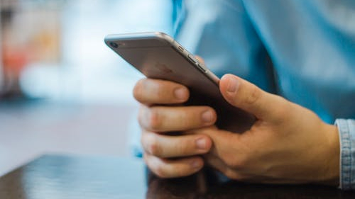
What kind of methods can I use to keep my digital footprint appropriate and safe?
One good strategy to keep your digital footprint safe and appropriate is to always keep your social media accounts private. I personally only have Instagram but I'm sure on any social media account you can go into your settings and make your account private. When you have a private account you can control who can follow you and who cannot. This way you can let just people you know follow you, like friends and family. Another good strategy to keep your digital footprint safe is to not share any private information. You never want to share your address, school/work, phone number or any other piece of information that you wouldn't share with everyone. By not sharing this kind of information you are protecting yourself from bad people who might want to know where you live so they can break in and steal your belongings. The last way to keep your digital footprint safe and appropriate is to not post/share inappropriate pictures of yourself. Future employers won't want to hire you if you post inappropriate things on your social media accounts. If you want to do some sort of government job there is no chance, they will hire you if you post inappropriate things on your social media accounts, no matter how qualified and good at the job you are.

Slide 5
What is digital permanence?
What is digital permanence? Digital permanence is when somethings on the internet and no matter what you do you can't ever remove it from the internet. Digital permanence is something everyone should know about. Kids should especially be explained what digital permanence is. I would explain to young kids by telling them is like writing with permanent maker, something that can never be removed. You could explain it to adults literally it's not the hardest thing to explain but it's something everyone should know and be aware about. Digital permanence is important because it can decide your future for you, and you may not have as many opportunities depending on what is permanently on the internet about you.

