Slide 1

My Digital Portfolio
By Parnika

Slide 2


Drama
  Why did I select this achievement?
  How does it represent my growth throughout the year?
  What were some challenges I faced during this achievement and how did I overcome them?
  What are your goals in this class/activity/subject for the future? How might you use what you have learned in the future?

Slide 3

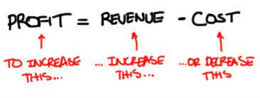
Grade 9 marketing
  Why did I select this achievement?
  How does it represent my growth throughout the year?
  What were some challenges I faced during this achievement and how did I overcome them?
  What are your goals in this class/activity/subject for the future? How might you use what you have learned in the future?

Slide 4
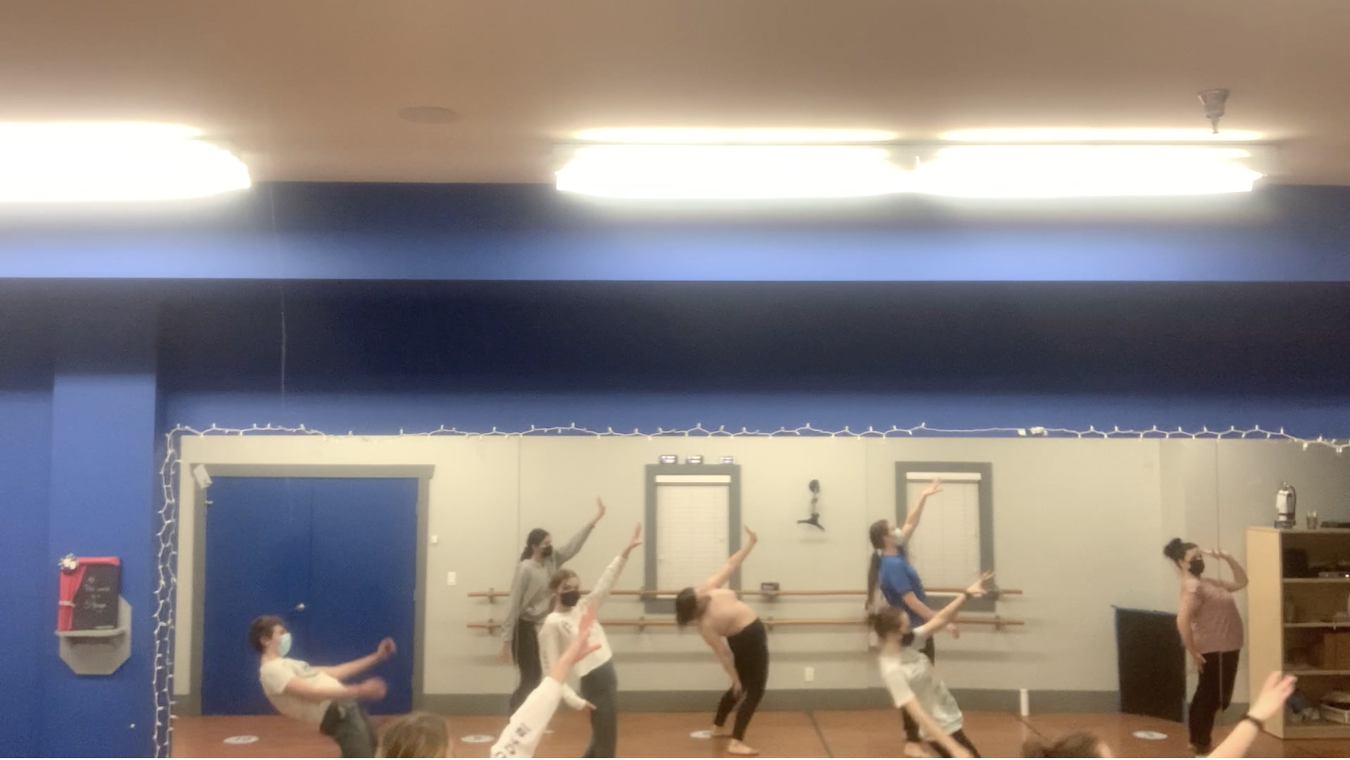
Dance
Why did I select this achievement?
How does it represent my growth throughout the year?
What were some challenges I faced during this achievement and how did I overcome them?
What are your goals in this class/activity/subject for the future? How might you use what you have learned in the future?

Slide 5

Citation:
Agatowski, Tassia. ‘The Benefits and Challenges of Method Acting’. Medium, 5 November 2019. https://medium.com/med-daily/the-benefits-and-challenges-of-method-acting-53b21ce5277f.
Brenner, Michael. ‘What Is Marketing?’ Marketing Insider Group (blog), 4 April 2019. https://marketinginsidergroup.com/strategy/what-is-marketing/.
Librarian, Kendall. ‘LibGuides: COST CONTROL: REVENUE, EXPENSE, PROFIT’. Accessed 19 May 2021. https://guides.kendall.edu/costcontrol/revenueexpenseprofit.

