Slide 1
Social media and me
Start

Slide 2
Confusion is the point
Learn more

Slide 3
How have social media platforms changed the way we consume and understand information?
Back
With the rise of social media, we’ve gained a new and efficient method of consuming information. The appeal is that it is fast and we’re presented with things that are interesting to the eye, like attention-grasping thumbnails and titles. However, posts on social media often obscure the entire story, and leaves consumers with a skewed idea of what actually happened. These platforms make let people easily cherry pick information and spread their bias. As a result, these posts may spread misinformation, which could have a variety of negative consequences.
When you see or read “news” on social media, do you take time to research the story further?
Admittedly, I do not always do further research on the stories I see on social media. If it is particularly interesting or important to me personally, I will, but often it is not. Due to this, I know that I am subject to consuming misinformation.

Slide 4
“We will absorb whatever is there — whether it’s been deceptively edited or not. As long as it’s information, it will flow.”
Next
— Colin Horgan

Slide 5
IS social media hurting your mental health?
Choose the correct answer to each of the following questions
Go!

Slide 6
What value do you get from online social interactions?
Back
For many, receiving likes and comments on social media serve as the addictive sense of validation one may crave from people online. From the perspective of my own Instagram account, I can tell you that not every one of my followers is someone that I’m friends with. There are peers from school that I’ve never even seen in the hallways, students from the next district over whose school I’ve never heard of, or even someone living across the world who I texted for maybe a week after we were added to a group chat from replying to the same comment. When I used to post, receiving a notification from someone I didn’t know filled my head with ”wow, they thought my post was good enough to like?” or “I don’t know them but they took the time to comment that I looked good!” It felt validating knowing that a stranger appreciated my online presence.
Choose answer
How is social media and social capital helping to form youth culture?
Social media and social capital affect youth culture in both positive and negative ways. On one hand, social media serves as a space for youth to essentially grow up together through popular trends. Furthermore, it allows us to easily spread awareness about important issues, like climate change or social injustice. Or, as a learning environment people share life advice. However, it does have its many downsides. Social media has become a cesspool of toxicity that fuels harassment and cyberbullying. Moreover, it’s a place that runs on youth who compare themselves to others and the fosters their insecurities. With time, we can only hope that this toxic culture dies out.
Choose answer

Slide 7
When you post online do you consider how the post may be seen by others? What may it say about you? Or how that post may be seen in the future?
Back
Whenever I make posts on social media, I am always conscious of how it will be perceived by others. I used to think it unfortunate that I have been affected by toxic social media culture in the sense that I dwell too much on what others think of me and the things I post, but, in retrospect, I believe my caution to be a very good thing that has probably kept me out of a lot of hot water. Because I am so careful, I don’t think anything negative would have come out of them. As an outsider, I may interpret myself to be someone who has many interests and likes to hang out with her friends. If I, or someone else would be to look back at my old posts in the future, it would come off as, at worst, simply carefree.
Choose answer

Slide 8
Black mirror: nose dive
Next
Select an option to learn more

Slide 9
similarities between the world presented in the videos and the world we live in
A
B
C
Back
The rating system is very similar to a social media following, and how we can be judged/valued based on the number
We go out of our way to make our life seem perfect, even if that means straying away from being who we really are
There is an extreme overreliance on social media/the rating system
Select
Select
Select

Slide 10
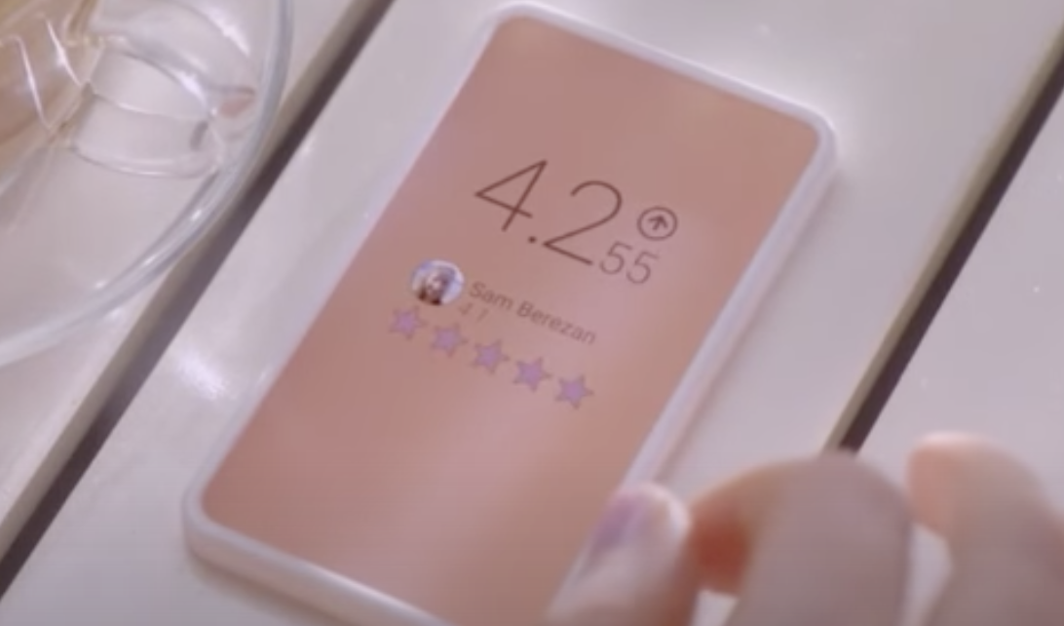
How does the main character gain and lose points? Why are these points important to her?
Back
Points are gained or lost based on ratings from other people. If you do something that is well-liked, your rating increases. However, if you do something that upsets others, it will drop. These points are important because it essentially determines a person’s value. This is extremely damaging as it means that your worth as a person is entirely determined on the opinion of others, which will cause an individual to lose sight of their own importance.
Select

Slide 11
What value might be derived from this type of social interaction?
Back
In this satirical world, receiving high ratings would boost an individual’s confidence and provide them with a sense of validation. However, it could easily have the opposite affect if one were to receive low ratings instead. Furthermore, it would cause the population to develop an addiction to social media validation and reduce social interaction dramatically to being solely digital. Because of this, the system would prove to have a negative impact on society as a whole.
Select

Slide 12
How are social interactions changed in the world of these clips?
Back
In the world of these clips, social interactions and the popularity of each individual is heavily dependant on one’s rating. People in this world rely on positive social media attention to give them a measure of their self worth. This simple number evidently dictates society and pushes it towards a future of nothing but meaningless online interactions. It is so important that it acts as a point of stress in daily life and often the topic of conversation. To exemplify, the main character was shown displaying nervousness when posting a picture of her meal and obvious relief when it was received positively. Furthermore, when she spoke to her co-worker in the second clip, it was solely about another employee’s rating and why it was so low.
Select

Slide 13
Core Competency reflection
How did you tell the difference between facts and interpretations, opinions and judgements?
Next
When someone is presenting their opinions and/or judgements, they often use the word “I” to convey it. Even if they don’t, it can also be obvious if they cannot provide evidence for their claims. Facts are disprovable pieces of data that I can observe for myself. If I question what I’m reading, I can check their sources or simply look up what I want to know. As for interpretations, I can look at the facts and infer for myself whether what they are saying is 100% true or just something they believe to be.
How did you analyze evidence from different perspectives?
When analyzing evidence from different perspectives, I try to always gather as much information as possible from both sides. Due to there being the chance of bias, I compare and contrast the evidence to see where it overlaps. This allows me to conclude which pieces of evidence are the most reliable and which are best left out.

Slide 14
Resources
Next
Horgan, C. (2019, October 16). Confusion is the point. Retrieved February 28, 2021, from https://gen.medium.com/the-confusion-is-the-point-6ab1d5a933aa
Parnell, B. (Performer) (2017, June 22). Is Social Media Hurting Your Mental Health? [Video file]. Retrieved March 2, 2021, from https://www.youtube.com/watch?v=Czg_9C7gw0o
Slade, D. (Director). (2011). Black Mirror [Video file]. UK: Channel 4. Retrieved March 2, 2021, from https://www.youtube.com/watch?v=GQW6mUK2aDQ&list=PLJk1a21GKEZXxT9wwmnVle-zautJw4q12&index=2

Slide 15
thanks
End

