Slide 1
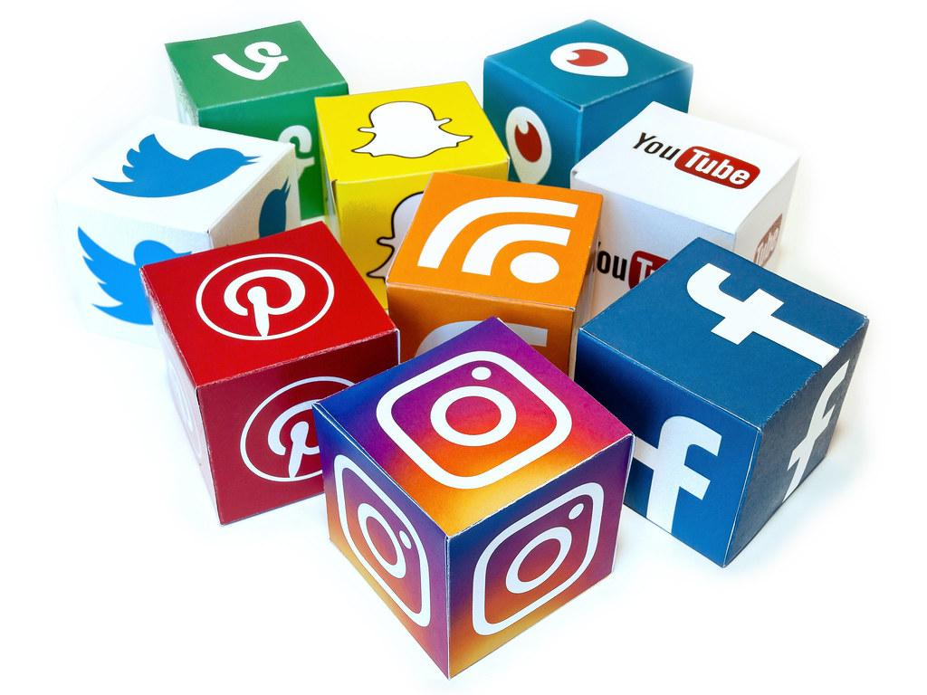
Social Media and Me
Rebecca

Slide 2
Social media platforms have consumed the way we think about and understand ideas by, people don’t generally have their own opinion, they just hear someone else say something and automatically say or think the same thing. If you were to just read the article about the video you would think the boys were being rude and disrespectful of the elderly and firsts nations culture. However you would get a different story from watching the video, it doesn’t look that bad as it sounds in the story, but it does look slightly as if the boys are making fun of him by laughing. are thoughts are consumed by what others say but when we see it for ourselves we typically have a different opinion.
https://www.youtube.com/watch?v=5FogNIr2x40
https://gen.medium.com/the-confusion-is-the-point-6ab1d5a933aa

Slide 3
The value we get from social interactions, is we think they are important to us but are they really. We fell dependent upon social interaction and if we don’t have them then we feel like something is missing or wrong. We don’t really get anything from social interactions except for the rethinking about our posts if it doesn't get the feedback we thought, and start thinking we aren't good enough. This is the main factor in why people always say be yourself, and don't be someone your not. If you don’t get more likes than your friends who cares, as long as you like the picture that's all that should matter.
The value we get from social interactions
https://www.youtube.com/watch?v=Czg_9C7gw0o

Slide 4
Social media and social culture are shaping our youth by, changing our minds. We are now so consumed of what other people think and say, our generation is hardly growing up without our own voice. But we are going to have to find our voice soon to help put an end to global warming to make sure generations ahead can have a good life. Social media takes are attention away from other things, we go to check one text and end up online for hours. With social media taking hours away from us, we now tend to spend less time outside and more time online.
https://www.youtube.com/watch?v=Czg_9C7gw0o

Slide 5
The difference I see between the life in the video and our present day life, is that here we can’t just look around and see someone's social media status. There is a similarity that I spotted where when Lacy looks around after speaking to Keith, everyone whos sitting at a table is with another person, yet they check their phone and go on it. A lot of kids go on their phone even if they are in the presence of other people, they’d just rather have an online interaction opposed to an in person one. Another thing that Lacy di that can be similar for some people, is that after she post about her coffee and cookie she gets rated, she then immediately looks around and smiles and feels loved on the inside.
https://www.youtube.com/watch?v=GQW6mUK2aDQ&list=PLJk1a21GKEZXxT9wwmnVle-zautJw4q12&index=2

Slide 6
In the clip you gain points when people rate you, you get rated base on how you are to them nice or mean. You gain points when your nice, and lose them when your mean. The points are important to Lacey because in her world if you have a low score it’s bye bye. She’s is normally a nice person and maintains a high points range but when she them starts talking about Chester behind his back, she then loses a bunch of points.
https://www.youtube.com/watch?v=tyUi6-Opzzw

Slide 7
In Laceys world the social interactions are different than the present day world, because people judge you more in her world. Just one look at someone and you see they have a low rating you don't want to associate yourself with them. Even if they aren't a bad person, in this reality people really “judge a book by its cover.” They judge the person based on their rating opposed to basing them on their personality.

