Slide 1
My digital portfolio
By sammy adelimashhadi
March 11, 2020

Slide 2
My math vacation project
I think this is one of my favourite projects because it was very fun using creativity to build a actual travel agency and making a video trailer about it and presenting and showing it to all my classmates and friends

Slide 3
My play in drama class
I enjoyed being a part of the play because it was great spending time with my friends and classmates organizing and being a part of the play I think I learned a lot from the play like acting and improv I hope to go to drama again next year and spend more time with friends and classmates

Slide 4
My Dance Assignment
The dance assignment is the only thing in this list that is from the second semester that I included in this I think it’s an achievement because it got me out of my comfort zone and got me to experience new thing and talk to new people I enjoyed picking out a song and then choreographing a dance with it as well

Slide 5
How did I represent my growth throughout the year
I wasn’t really planning on doing anything like these assignments at the start of the year but they helped me learn and have fun at the same time I think these assignments helped me grow as a person by getting me to do things I would do before which I found very interesting and special

Slide 6
What are my goals for next year
I hope to improve my dancing and my acting because although I enjoy participating in these activities and have a lot of fun I’m not very good at them and regularly fail in performing them my goal for the following year is also to do more fun and exciting things like these next year inside and outside of school

Slide 7
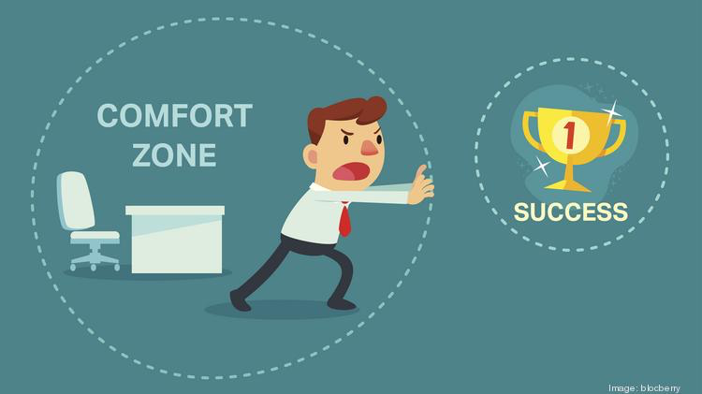
What were some challenges I faced
I think the main challenge I faced was me getting outside if my comfort zone and trying new thing which I found hard because I usually don’t do things like that I usually just keep to my self and stay in my comfort zone but I think that these were great opportunities to push me out of my comfort zone and experience new and exciting things

Slide 8
The End

