Slide 1
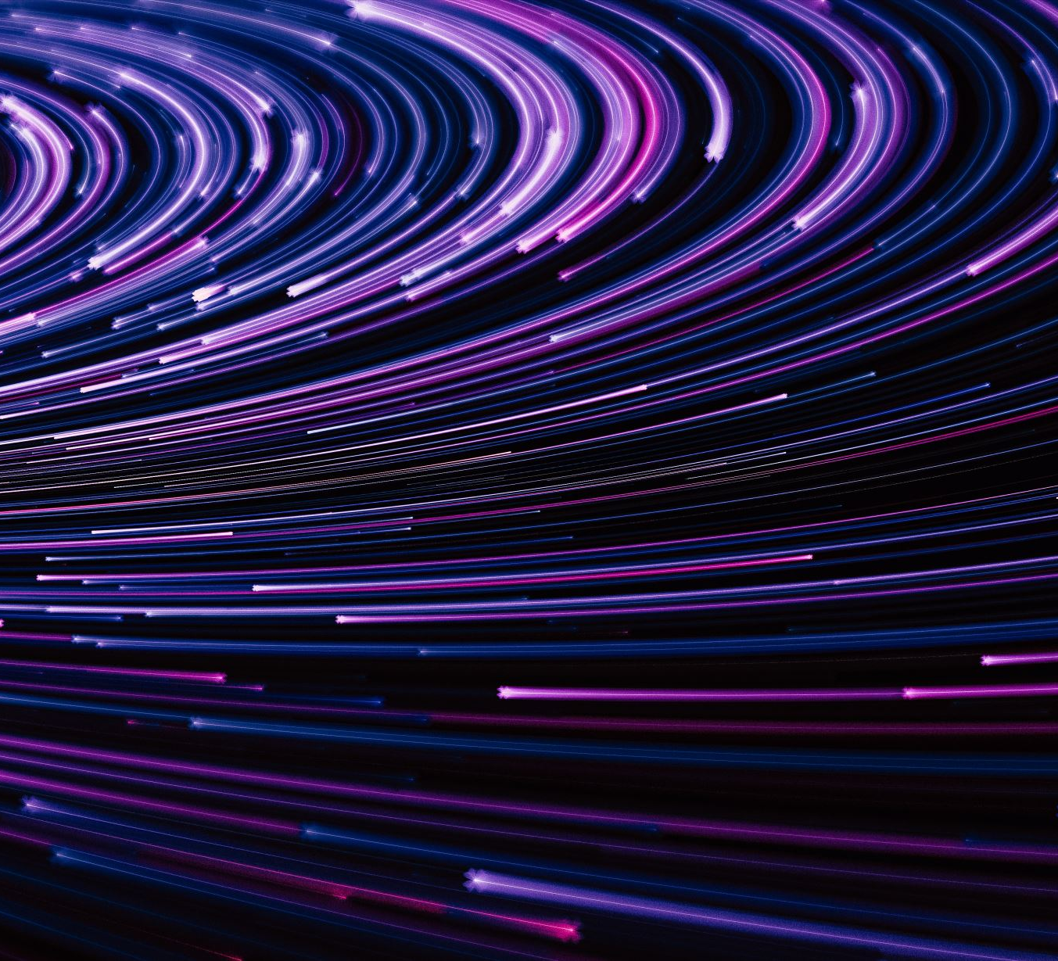
Social media assignment
By selena

Slide 2
How have social media platforms changed the way we consume and understand information
Well social media is the new news platform some people get all their information from face book or twitter ex there are so many places for people to get information some places might not be the best but now day if something happens in another part of the world us in Canada will know about it social media has change how we take things in and process them in same ways good and the other not so much but it is good that people know what is happening in other places of the world.

Slide 3
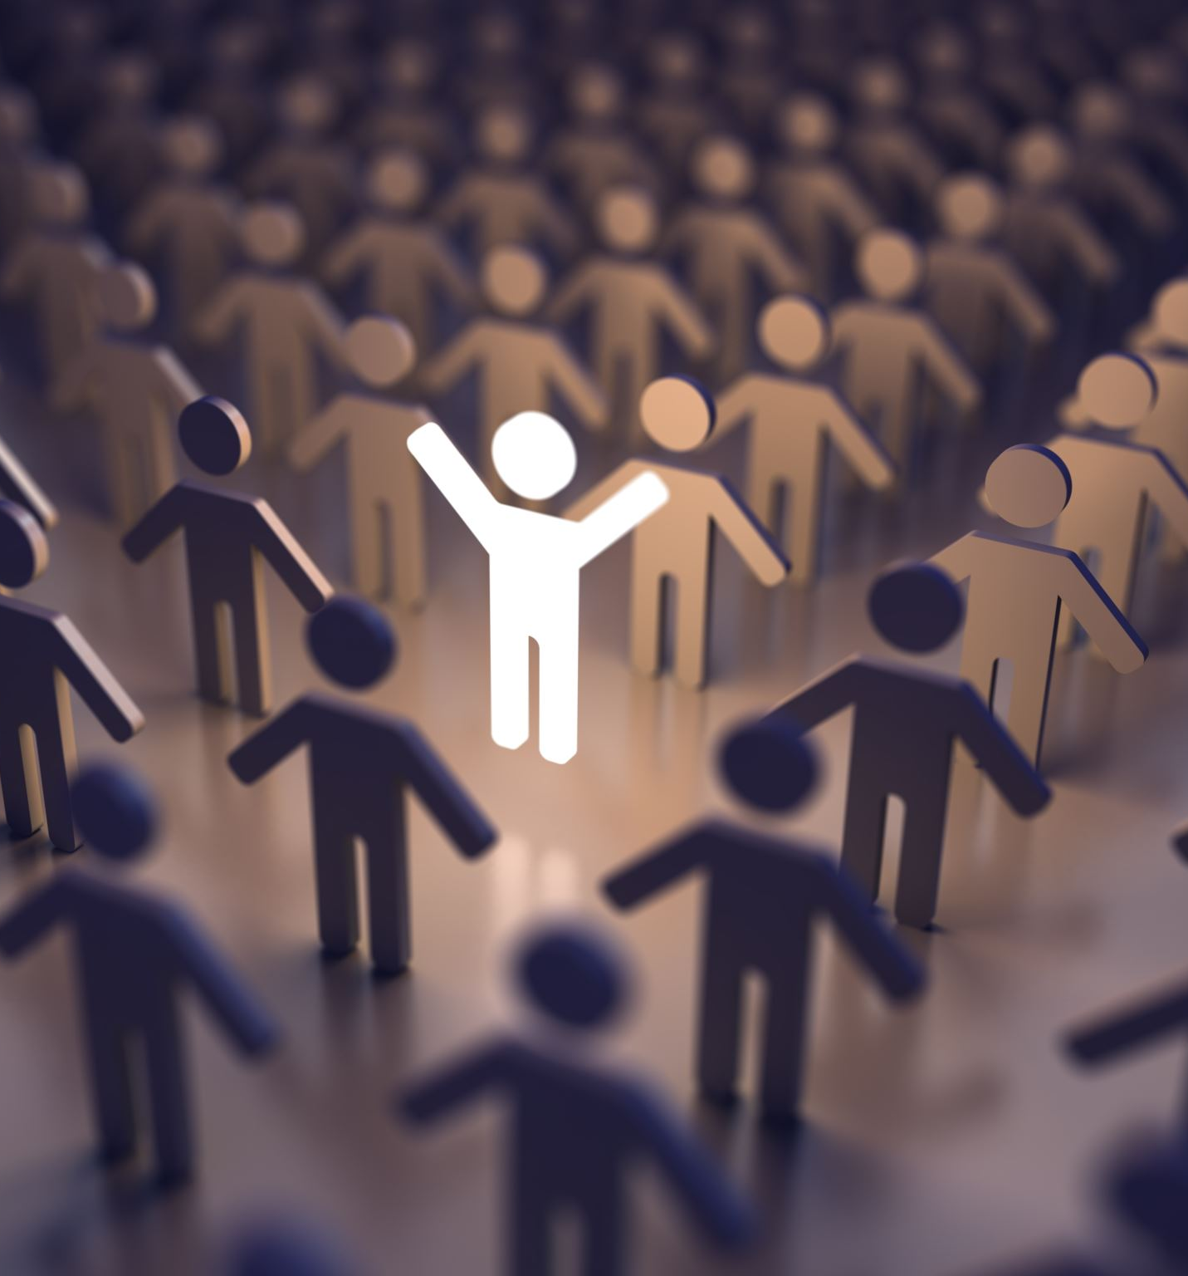
What value do you get from online social interactions
There are so many things you get from social interactions like Increased physical health. Seniors who engage in relationships tend to be more active, improving their physical health through their social activities. Boosted immune system. Studies show socially active seniors have increased immune systems, allowing them to fight of colds, flus and other ailments, more easily. More positive outlook on life. Staying connected with others makes us feel more connect-ed to the world and increases our sense of belonging. Seniors who engage in creating intentional connections with others improve their mood and overall outlook on life. Improved mental sharpness. Keeping our brains active and engaged can sharpen our minds and reduce the risk of cognitive decline.

Slide 4
How is social media and social capital helping to form youth culture
It Keeps connections between friends when they’re not always able to see each other when they want to. Also Social media also keeps you up to date with things that are going on around the world rather than just in your area. And It gives youth a place to express themselves in a way that a public place wouldn’t allow us to. Also It helps to develop social skills, a lot of friendships can stem from a social website. And It’s a fun way to interact with your peers, other than seeing them in person. In conclusion, social media can have both a beneficial and negative impact on the youth of my generation. It can help youth prosper in so many different ways. As well as hold them down in various ways. The impact that social media has on us is up for us to decide

Slide 5
Do you see any similarities between the world presented in this video and the world you live in
Yes and no in some ways the video is similar and in the other ways it is not I think the video is missing something about social media and how we use it and why like for me I use social media not that much the only thing I do it to talk to people I know in real life and ask them hey are you at school or let's talk about our project social media is not that bad only if you use in a good and most people don’t do that also social media can and is used in bad way that bad people use for bad things but you just need stay safe.

Slide 6
How does the main character gain and lose points
In the video you can get points by being nice or if people like you can also of you poste some picture that has a nice or caption on it and people rate you and you want a good score it is how people see you if it is low people will not want to be with in fear of their points going down too so everyone has to carful what they say do and also do online because everyone sees everything this is a messed up way to show the world but in some ways true to our world sad a it is people judge people of how many people follow you and what you say and do.

Slide 7
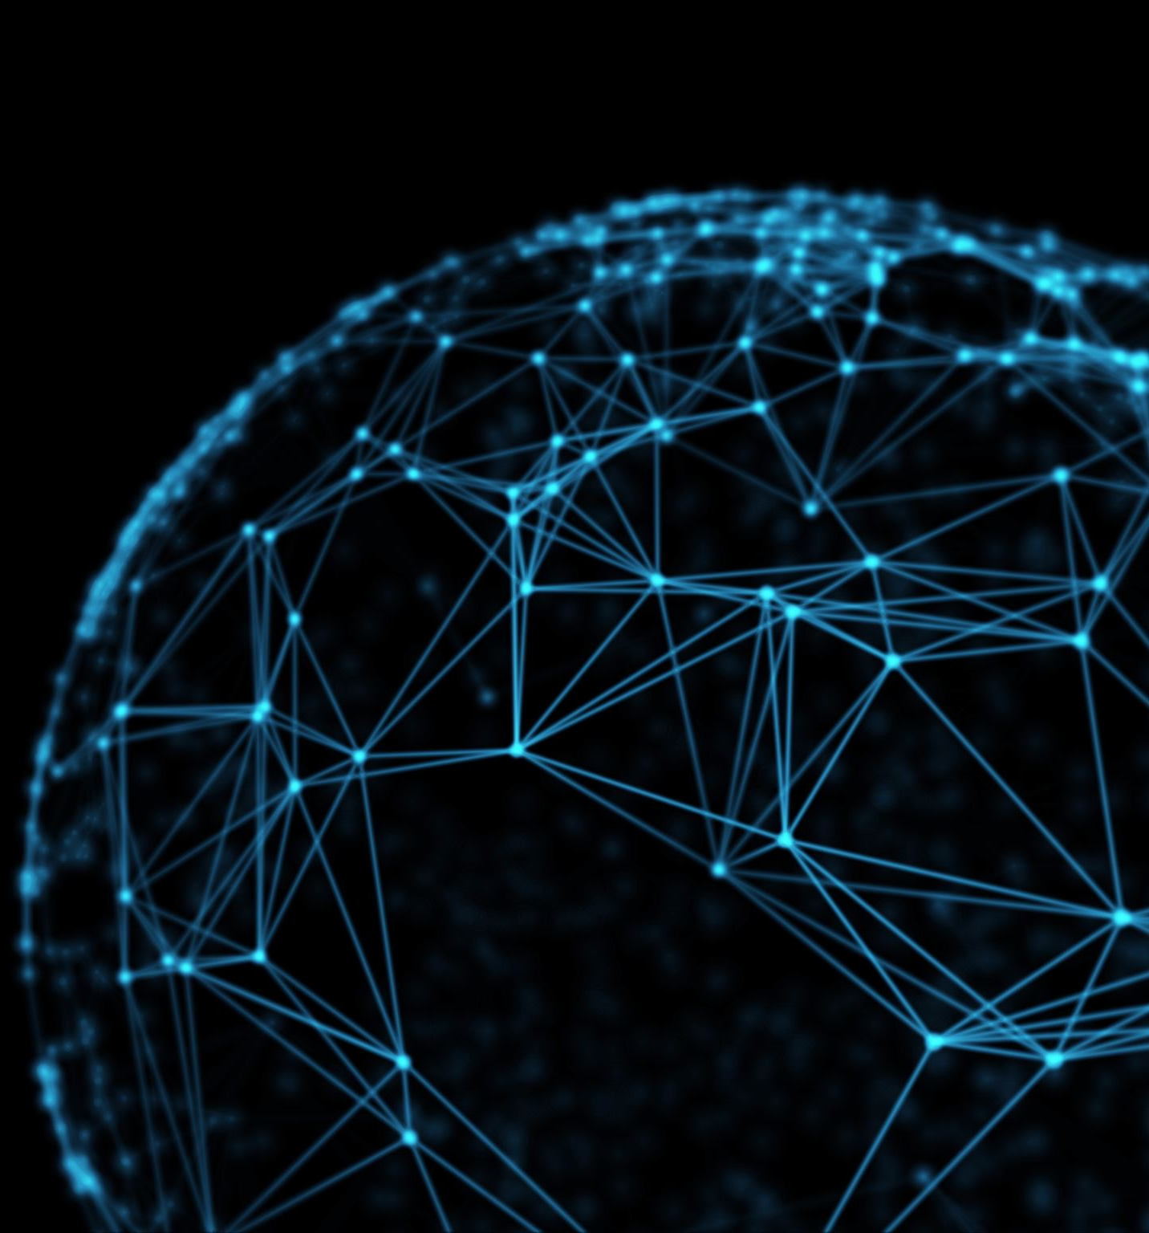
How are social interactions changed in the world of these clips
In the clips I watch social interaction has changed so much from ours in our world people judge others and some people care and others don’t well in this world how you are scored is hoe everyone sees you in a bad light or good now that is a bad way to use social media because if you say something that is bad everyone can score and your good score bad and it will be hard to dig your way back up to good because everyone sees you as a bad person

