Slide 1
My digital portfolio
I pick the drama play my woodwork jig saw piece and wrestling
By selena

Slide 2
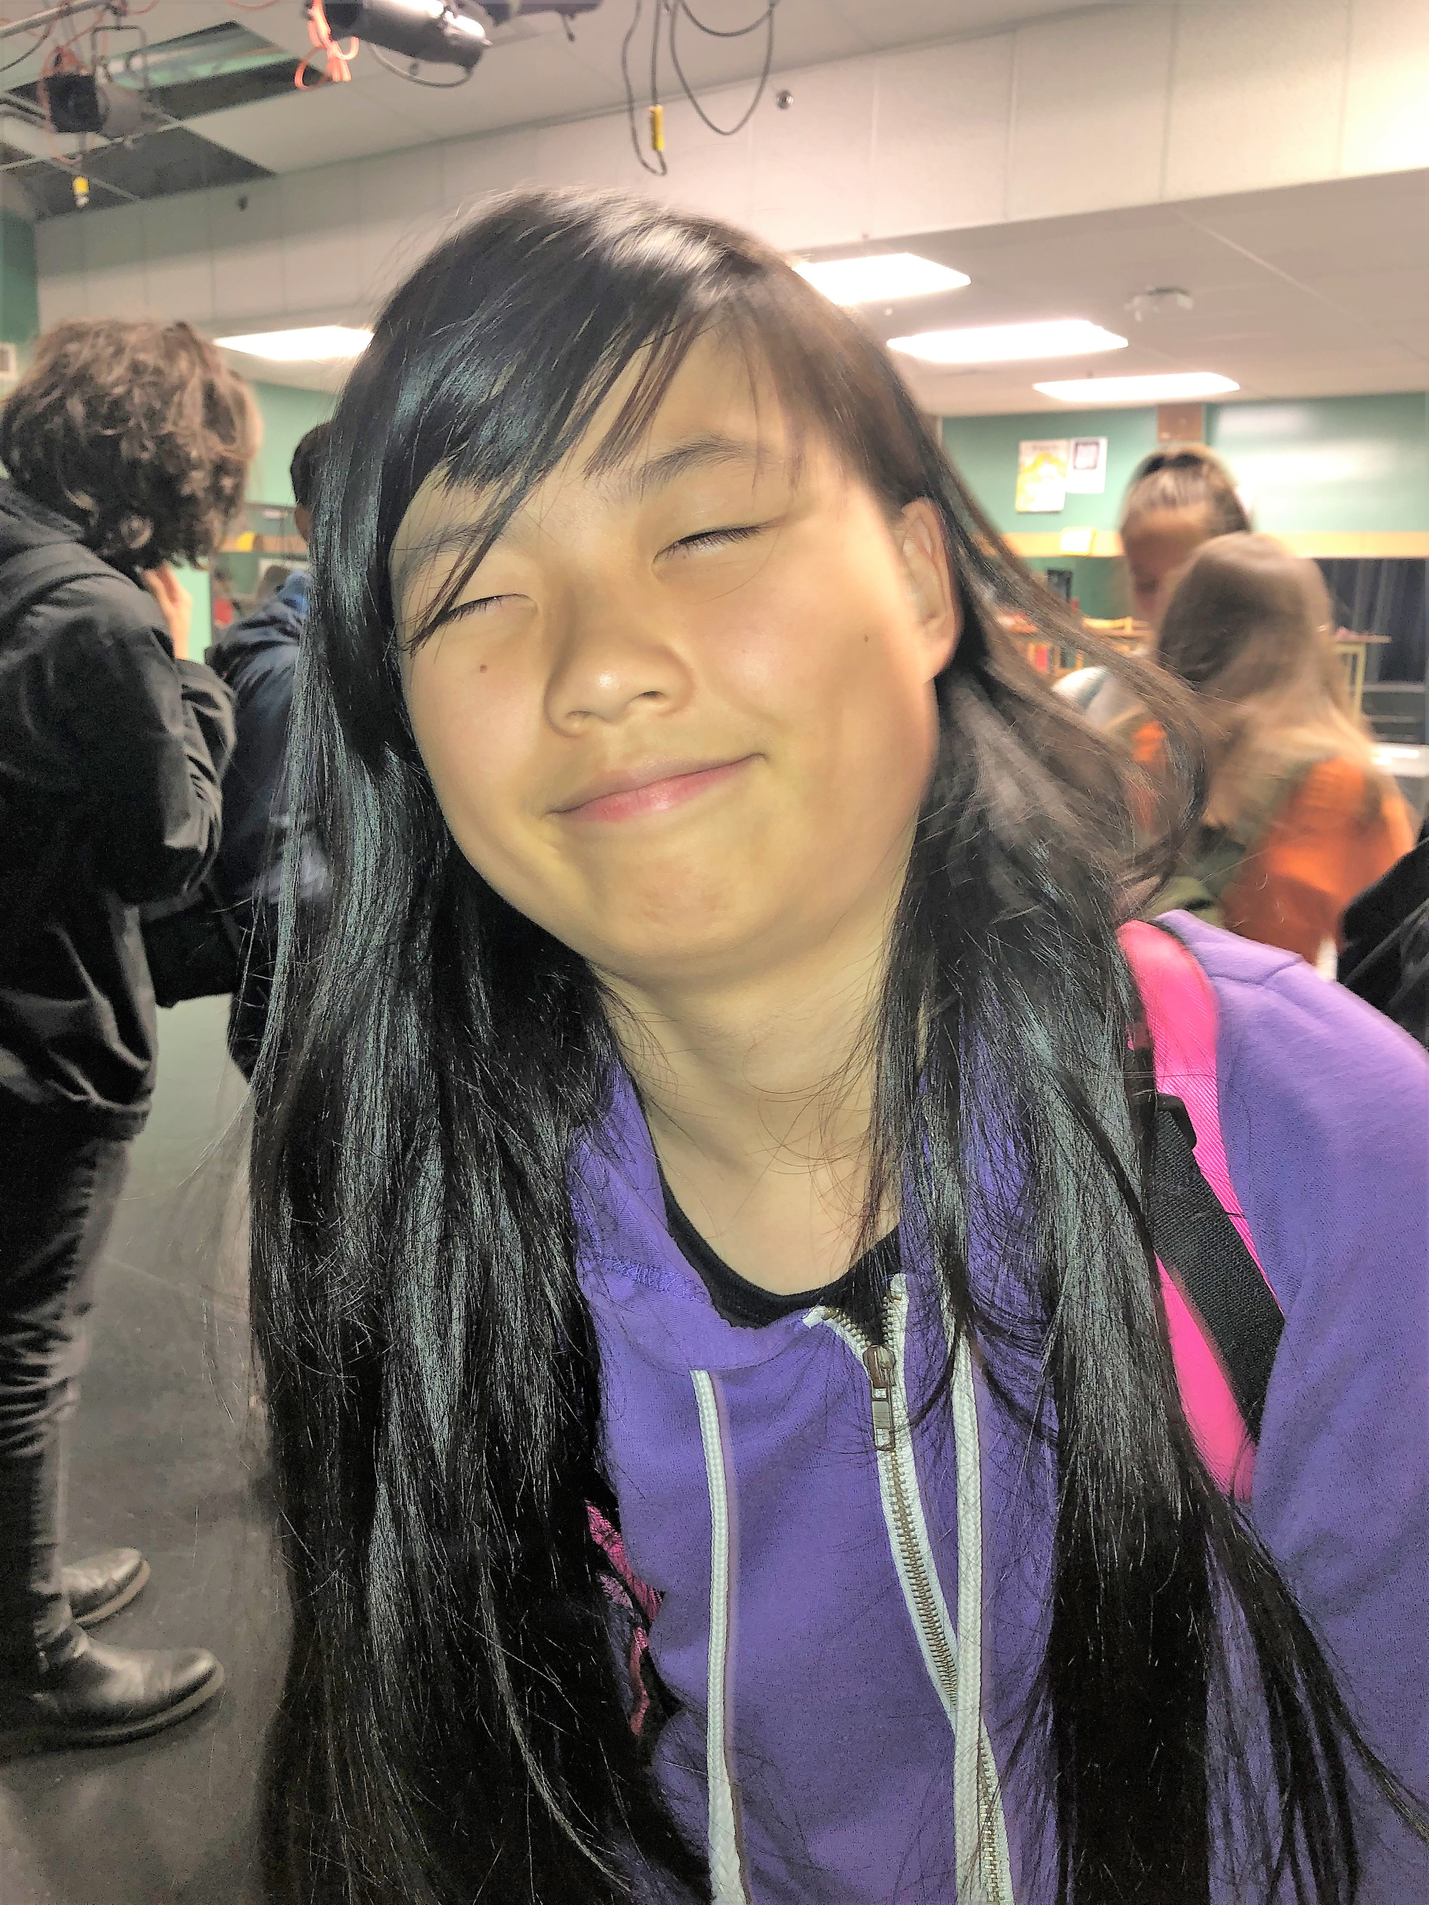
Why did I pick these achievements
First I pick my drama play because of how much fun I had on it and all the fun people I met. The whole time producing about the characters in the play we were having fun also we made the play our self it was called the curies case of hammerlock academy my part was a student at the school not the biggest role but I still got a good amount of lines for being a 9th grader, usually the 11 and 12th grader get the big role witch is ok for me they know more they teach us the 9th graders how to act better. Also I pick this because I'm extremely shy and hate talking to big groups or a lot of people, I don’t know so being in the class was good for me also we never get homework it is just a fun class to act and hang out. That is why I pick my drama play.

Slide 3
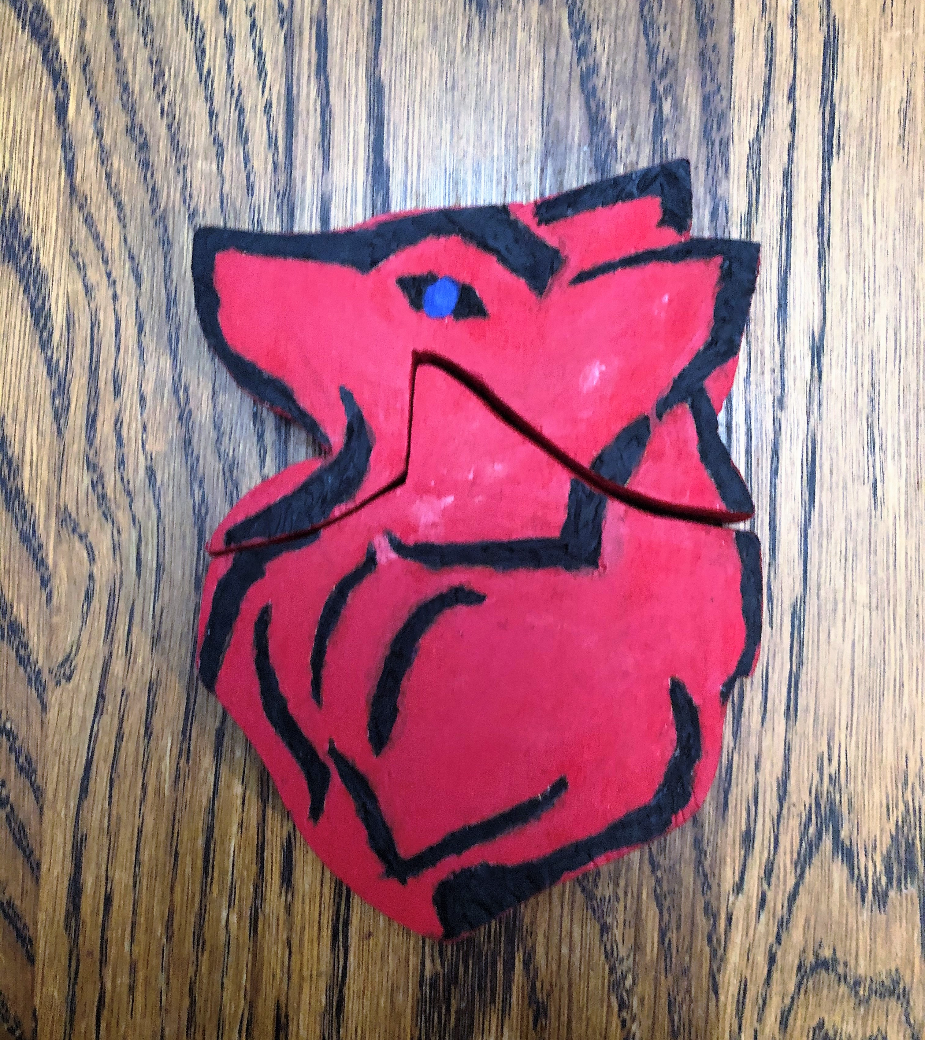
Why did I pick these achievements
My next is my woodwork jig saw project, it was our first thing we made in woodwork at first it was not fun but then we were told how too it was easy and a blast to make. In this class I got to learn how to use my hands more to make something that looks ok I got a A- so he sees I did good on it so I'm glad I'm doing good in it because I'm really starting to like woodwork. One more thing is also the people you meet in this class even though you make yourself you can ask for help or be the help for someone I would like to do this in grade 10 for sure and that is why I pick woodwork.

Slide 4
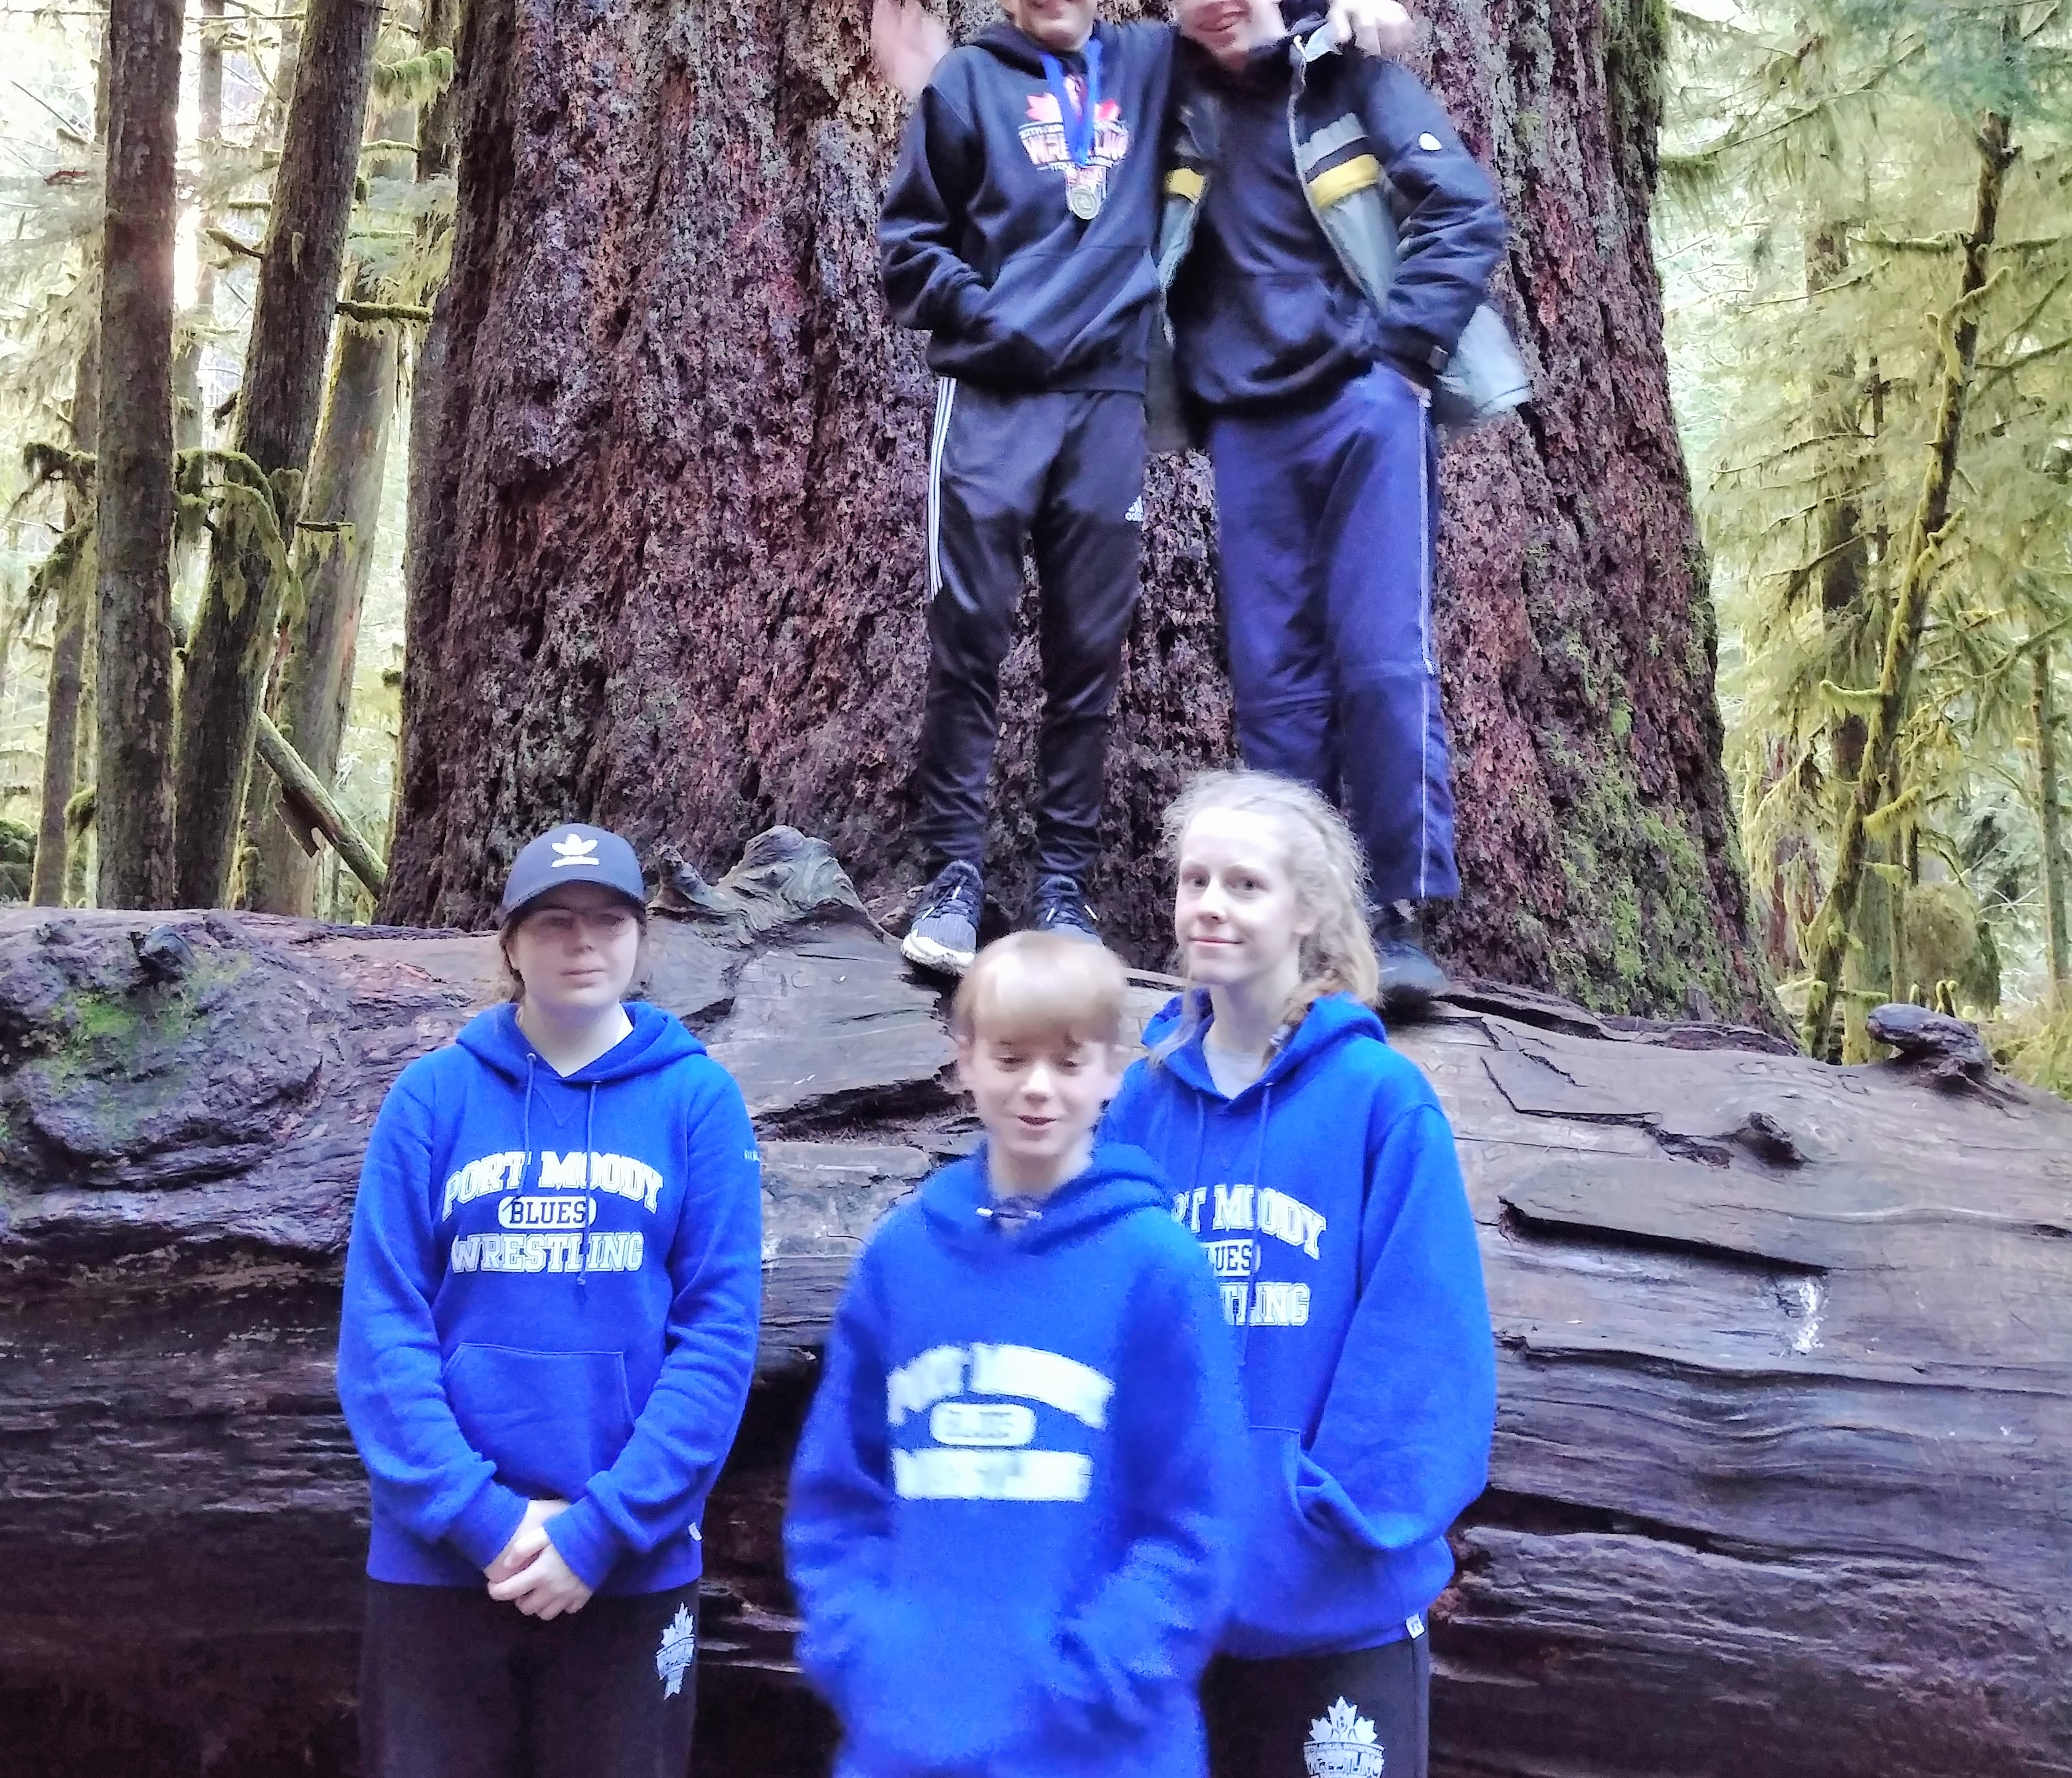
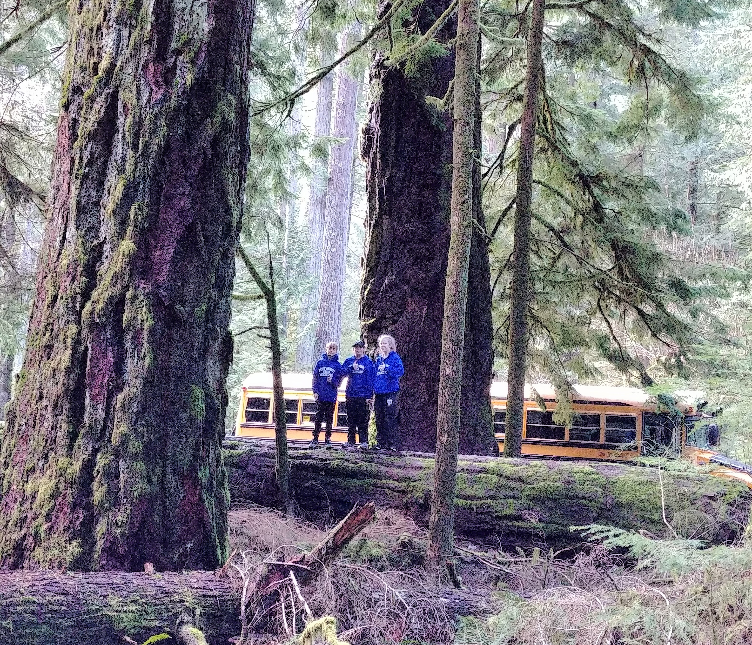
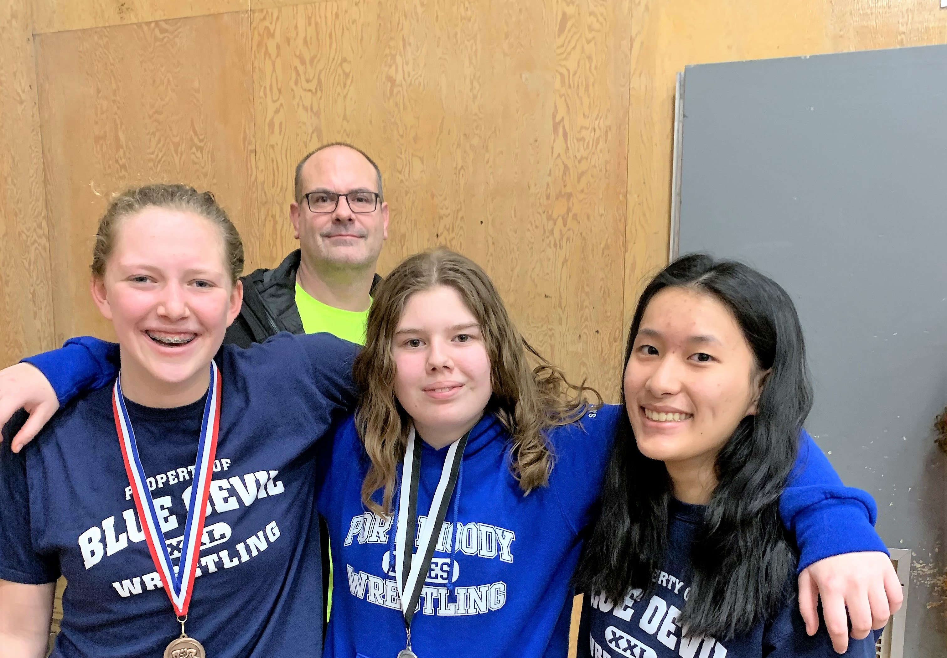
Why did I pick these achievements
My last one is my favorite one it is wrestling, too me one of the best school sports it has everything someone wants in a sport strength, indolence and smarts, you need all of them to have a good match and to be good in wrestling also when I started wrestling when I was in grade 6 and I fell in love with ever since then, the only thing you can get in middle school is district at the end of the session and in 6th grade I got 3rd, I was so proud because this was my first year so I know nothing then in 7th grade I went on a field trip and I witch I skip it to do wrestling then in 8th grade out teacher said all the 8th grades went to war on the floor which is a high school event so we were the youngest there I got 3rd on the first day then 8th on the second day then after that still in grade 8th we went to another high school event witch I got 3rd again the last thins was in grade 8th grade was the middle school districts next is grade 9 were I have got 4 meddles which is ok but I can do better.

Slide 5
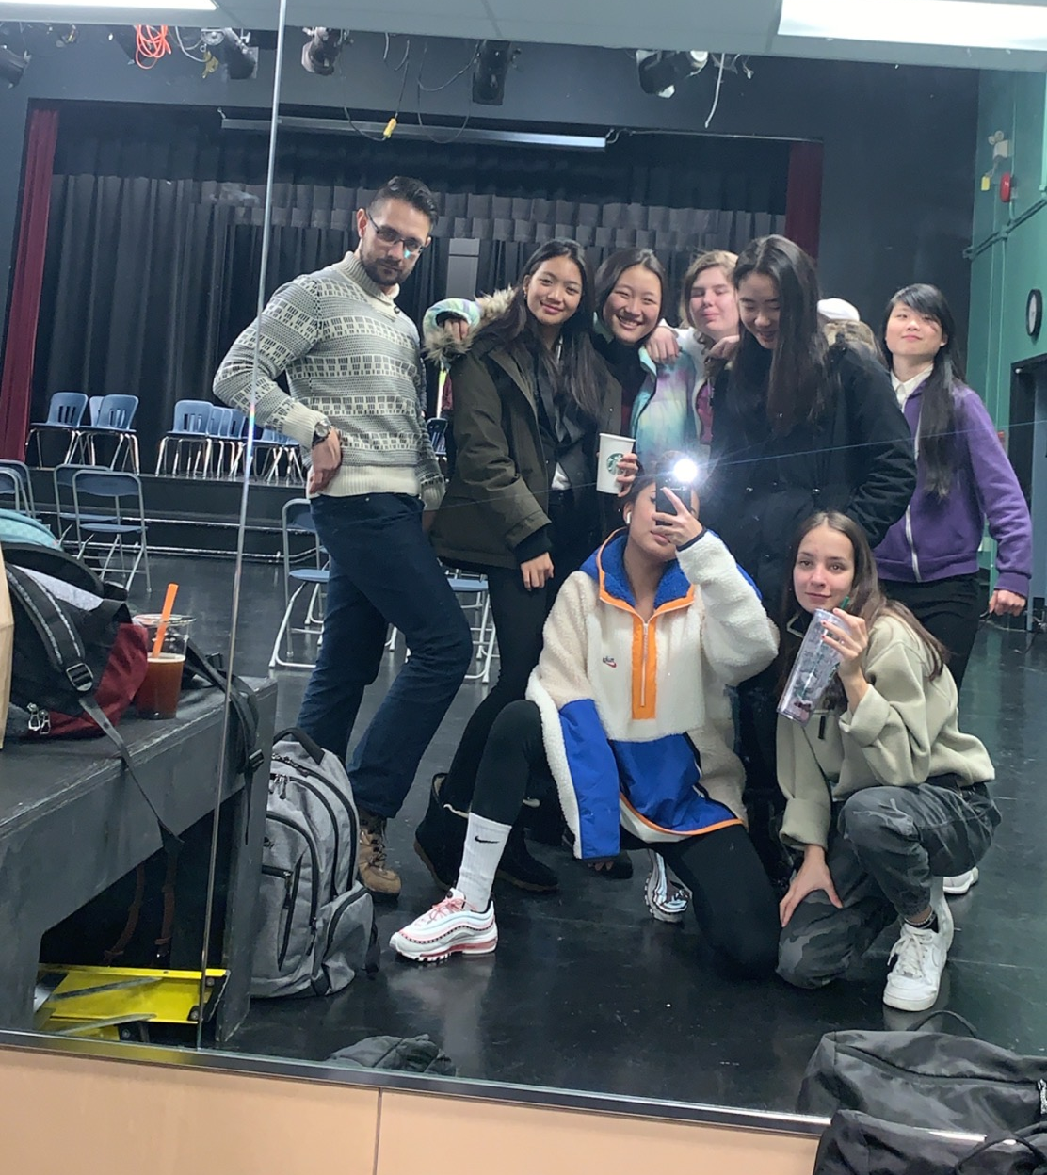
How does it represent my growth throughout the year
How does drama represent my growth well I have been less shy in big groups of people I don’t know also I have learned how to act and how to do all the things in drama also it’s a place to talk to people and have fun when we were doing the play a had a singing part it is not a sing play but we still did it and I did even if I was shy and did not want to do it but everyone was so supportive for me to do it and it was so glad that they would do that and that shows how much a group of people can change you for the better.

Slide 6
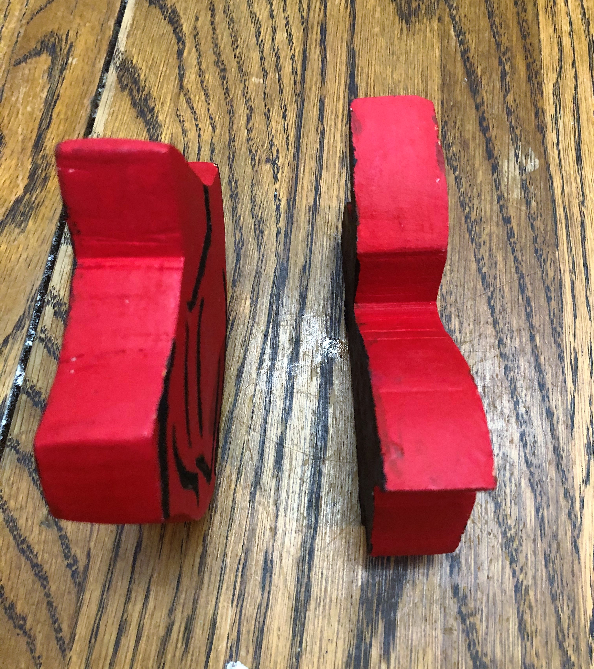
How does it represent my growth throughout the year
How does woodwork represent my growth well we get to use our hands in ways I have never used before but I have shop wood with my grandfather also he showed me how to change a tire and make fire, in wood work I can make a table and that is what we are doing right now and it is hard sometime but is very fun I also have not done anything really wrong he has left me when I was cutting my wood 4 time when I did new what to do a bit still wanted him there to make sure.

Slide 7
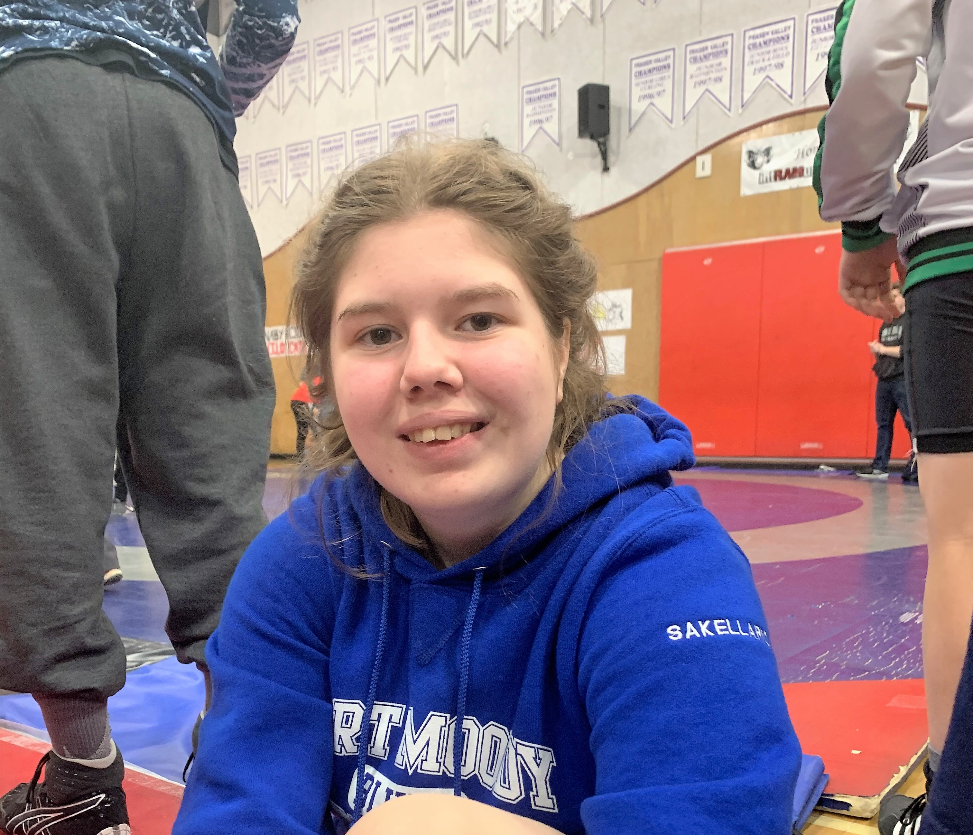
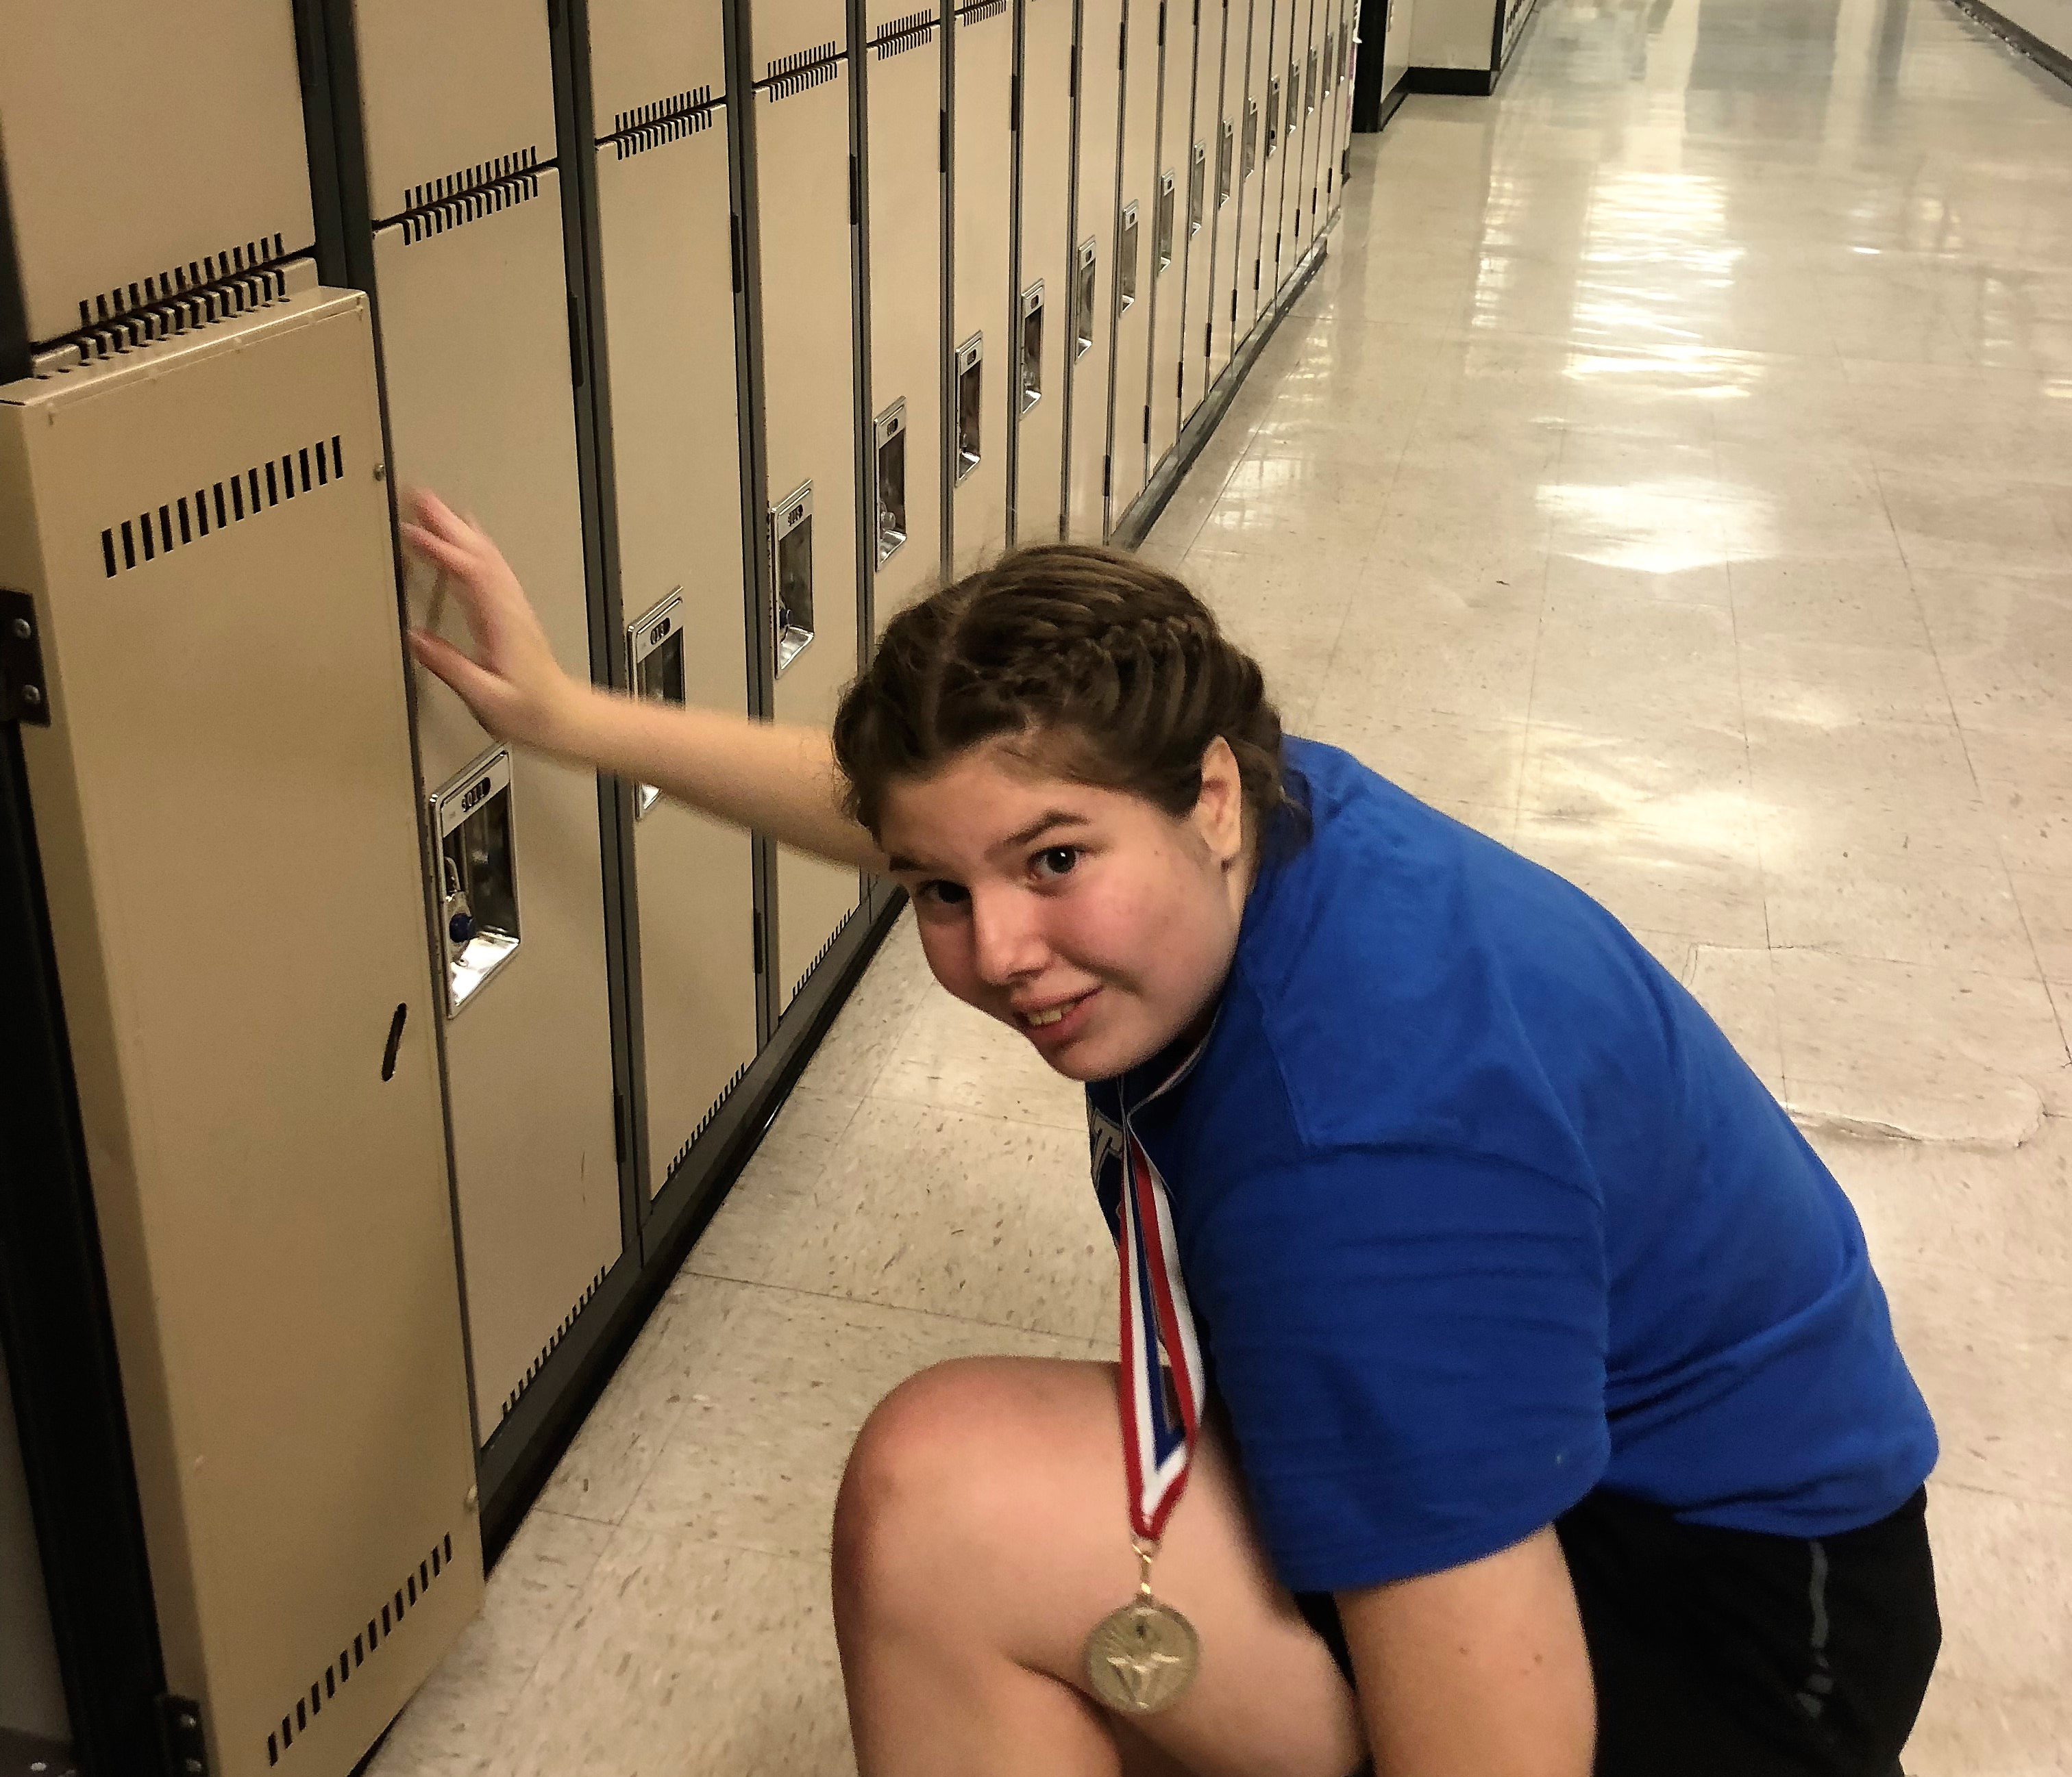
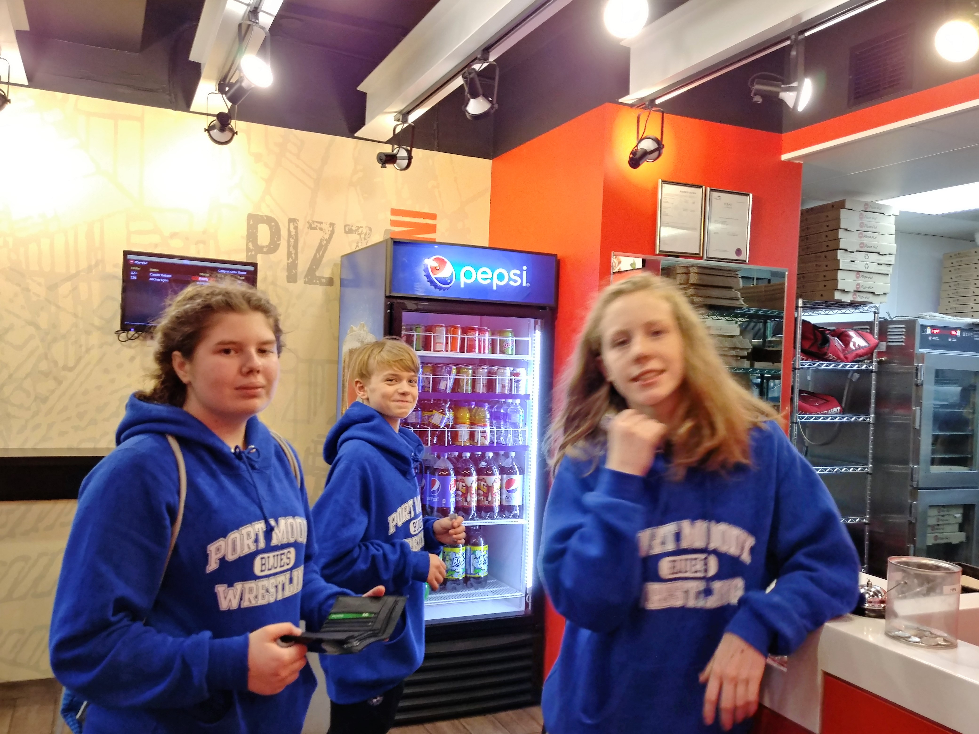
How does it represent my growth throughout the year
Well wrestling has made me a better person the people I meet are so nice and some people would think wrestlers are mean or not fun to talk to but you can make best friend from someone you are going agents in 10 minutes its great and still now when it is over we still talk I have a wrestling group chat and we just make jokes and talk about fun stuff also when you are in wrestling you have so much respect of others in the sport. I also have improved so much in the past year because it is so much harder in high school.

Slide 8
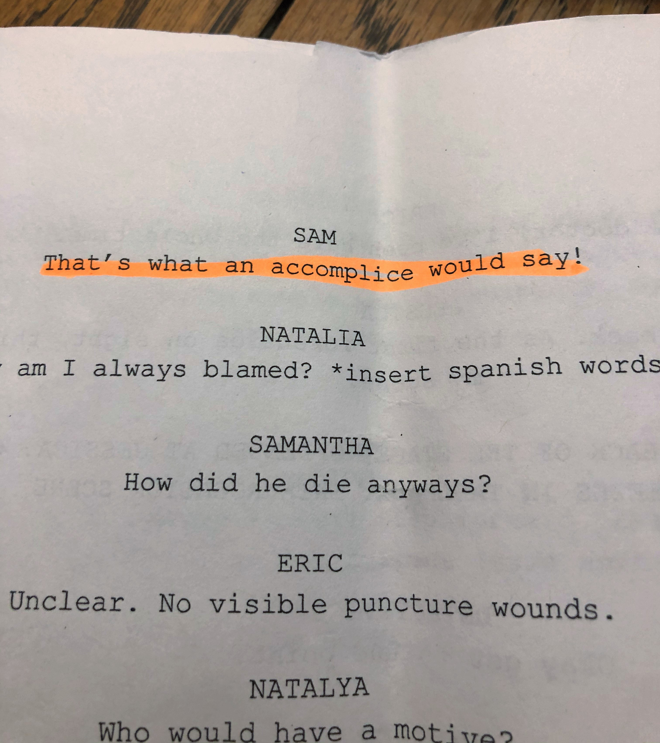
What were some challenges
The challenges in drama were just being out there like In the class you get to go crazy and be loud and I'm loud when I know everyone and we are all friends but in the class I knew no one but I made friends because I can make friends easy and just go talk to one person then you are friends with their friends or you too can make more friends like that it what I did but also you can't just make fun of everything you sometimes have to take charge and get it done and do what you have to do but not all the time and I would do this class again.

Slide 9
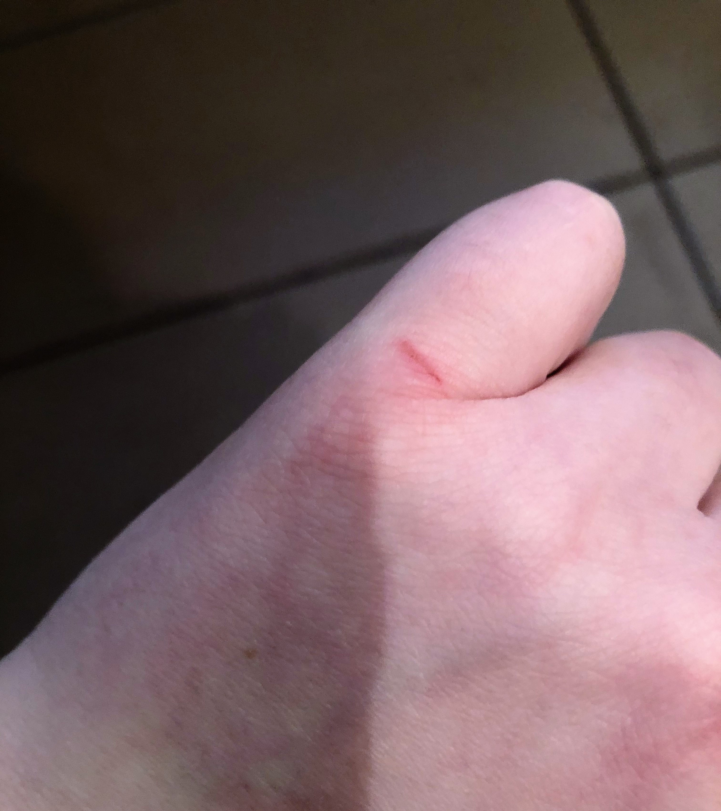
What were some challenges
The challenges in woodwork are well there is not that much he tell how to do everything and sometimes stays there when you use something also the only hard thing is when you don’t know what you are doing that is what it was like at the beginning of the semester I did not know how to use a jig saw or a sander also some of them are loud and you are using it for some while so some people can't handle it I can so its ok also we only get 1 test and this is what he told us that that will be fun.

Slide 10
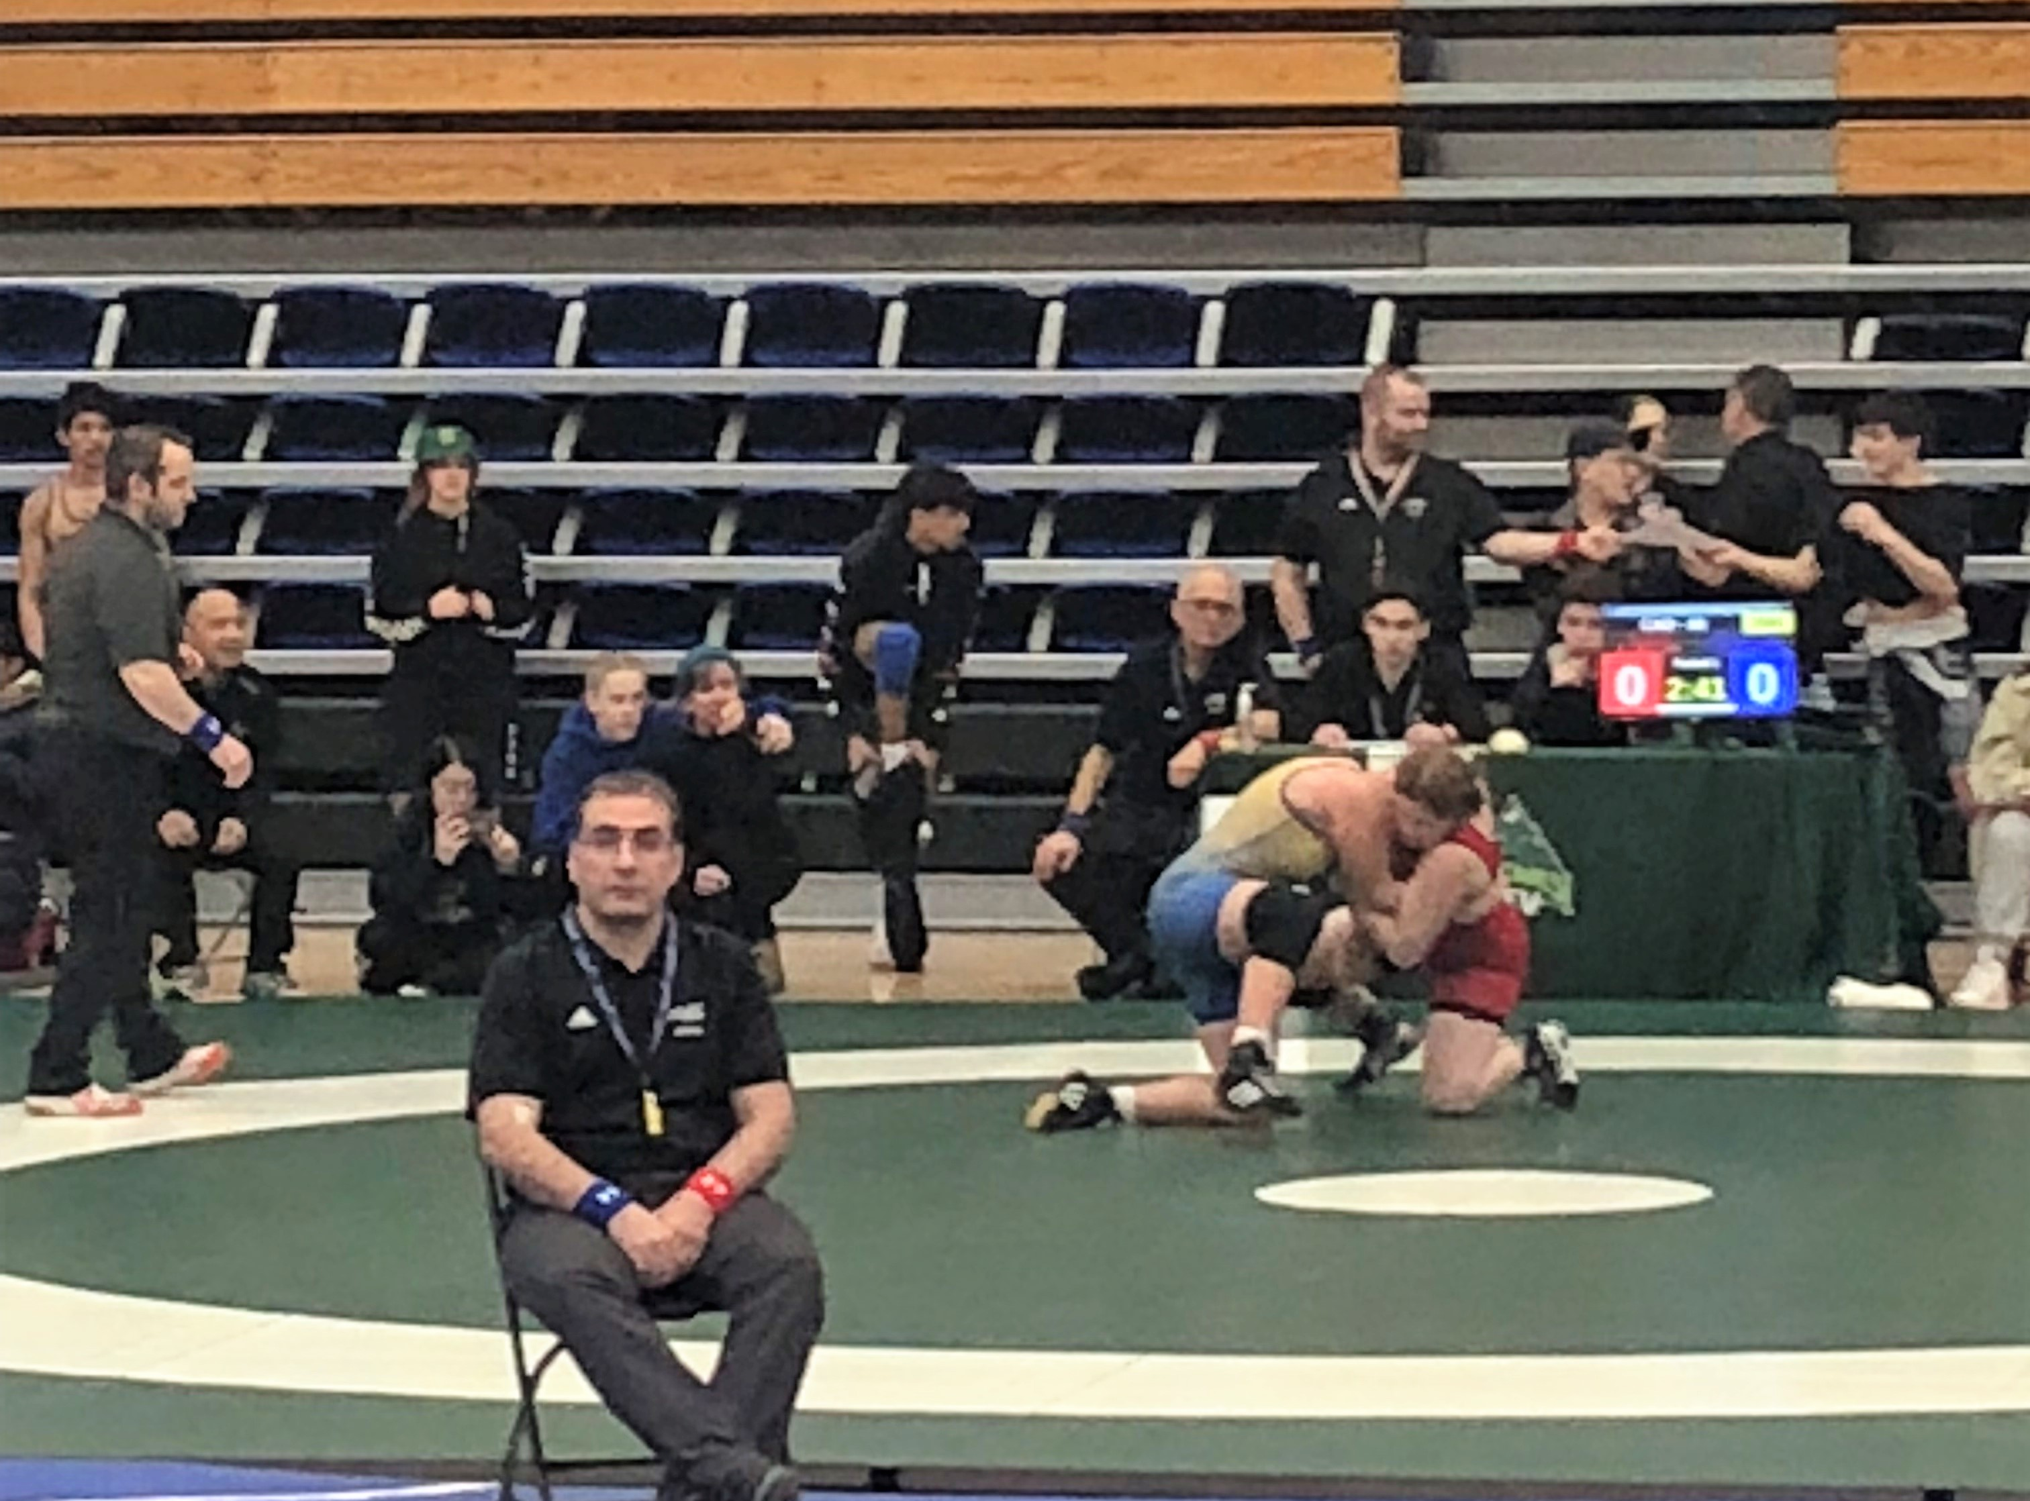
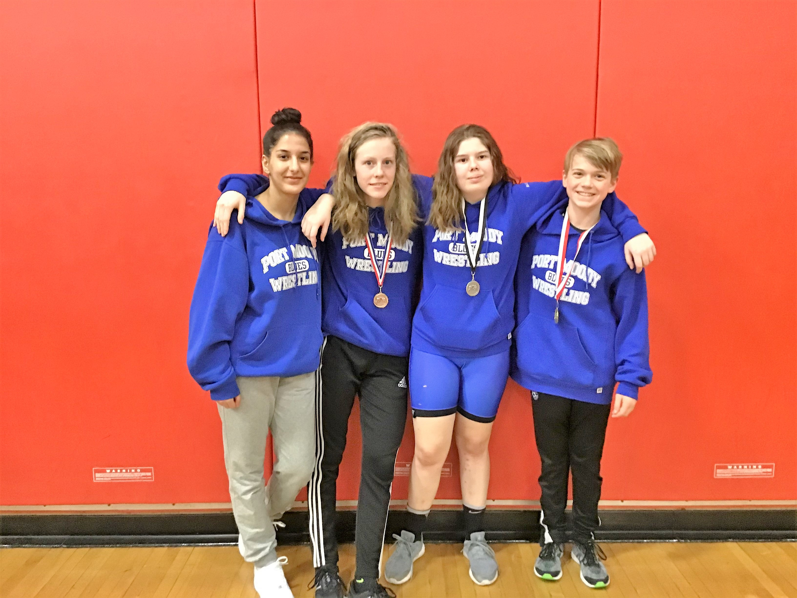
What were some challenges
you always have to get better and better and in high school wrestling it is way harder than middle school wrestling here either the person is in a club wrestling or they have been doing since there where 5 so every year you have to get and this year was a bit of a losing streak for me only getting 2nd 3rd or 4th I know that is not very bad but still not the best I need to better and I will overcome them by joining club wrestling. It is something I can do to be a better wrestler there program it great and it will be tuff but that is what makes it fun and to be better makes me want to do it more.

Slide 11
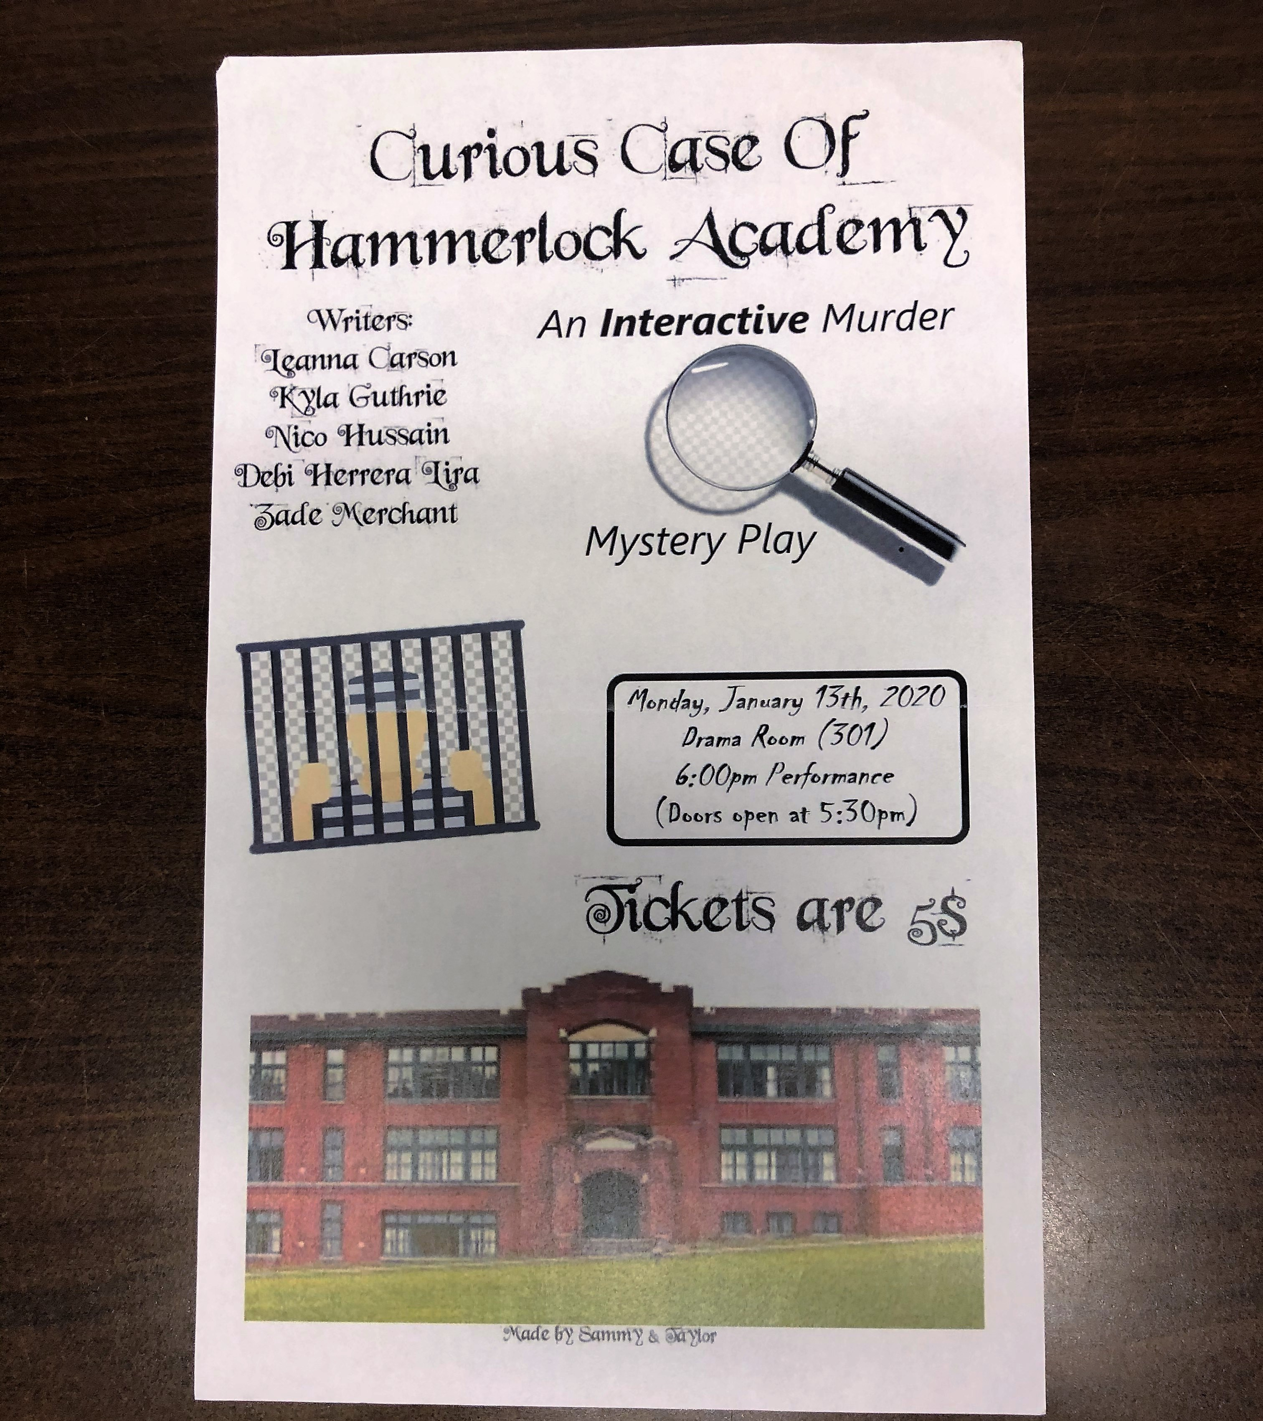
What are my goals
My goals for next year drama is to be way more out there like they want you to have fun and be out there witch I love also I want to act more be a little bit more in there also I want to meet more people because people in the class well some are very fun and next year there will be more people to meet also this ties in to what I already but be less shy and just don’t care but you know care and just have more fun and that is all.

Slide 12
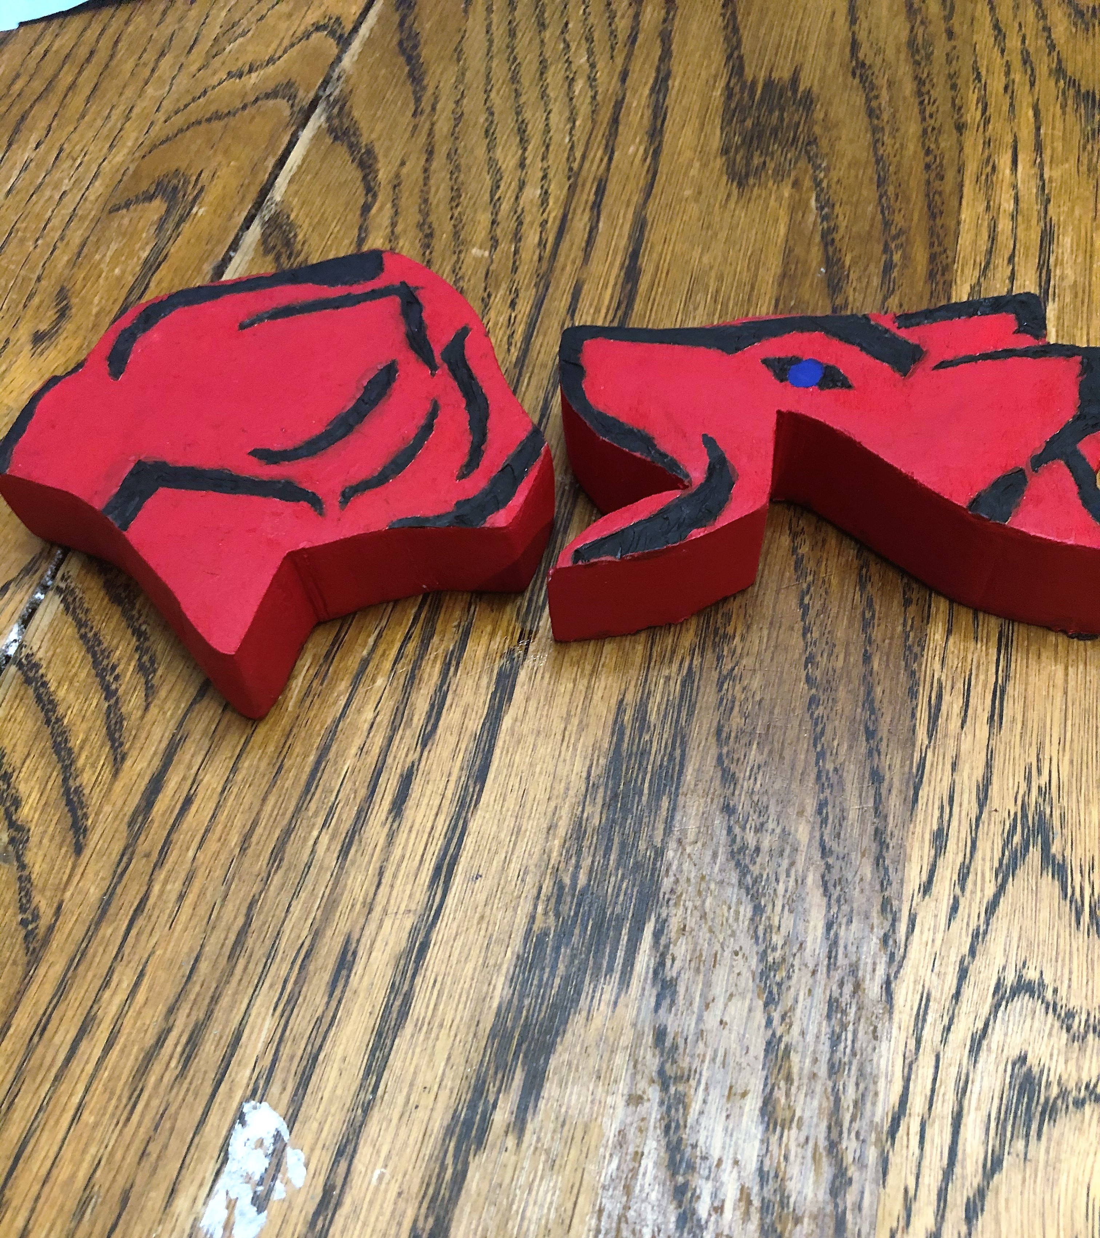
What are my goals
My goals for woodwork is to make sure I do it right like don’t rush do it right and make sure it looks good like I want someone to say oh that look good also we have a good woodwork program here so we can do some fun stuff also something I don’t want to do is get hurt I want to be safe and keep all my fingers also I want to have fun I'm already having fun so that goal is on point next is be on track don’t fall behind also I hope I can take this in my later years but not next year sadly but I hope in grade 11 or 12 because it was very fun and still is very fun.

Slide 13
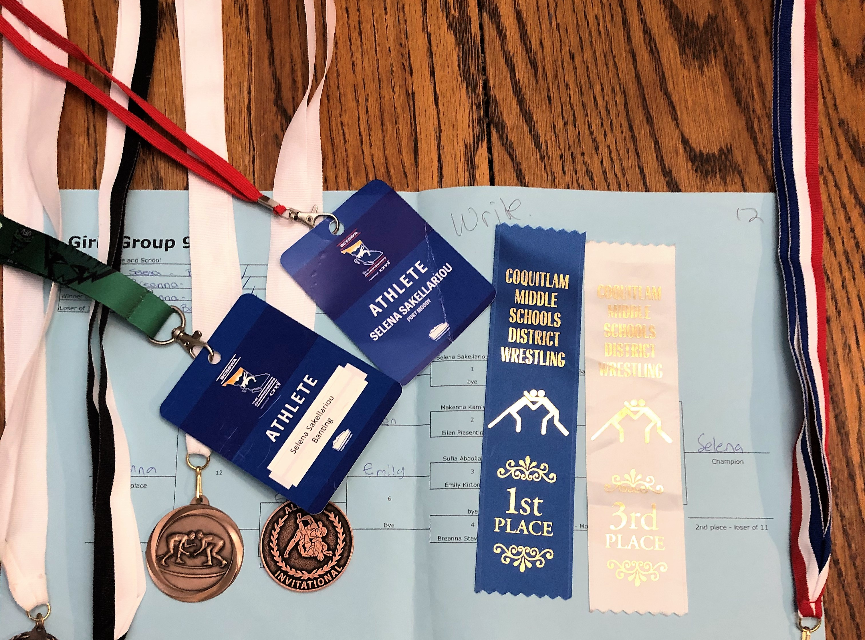
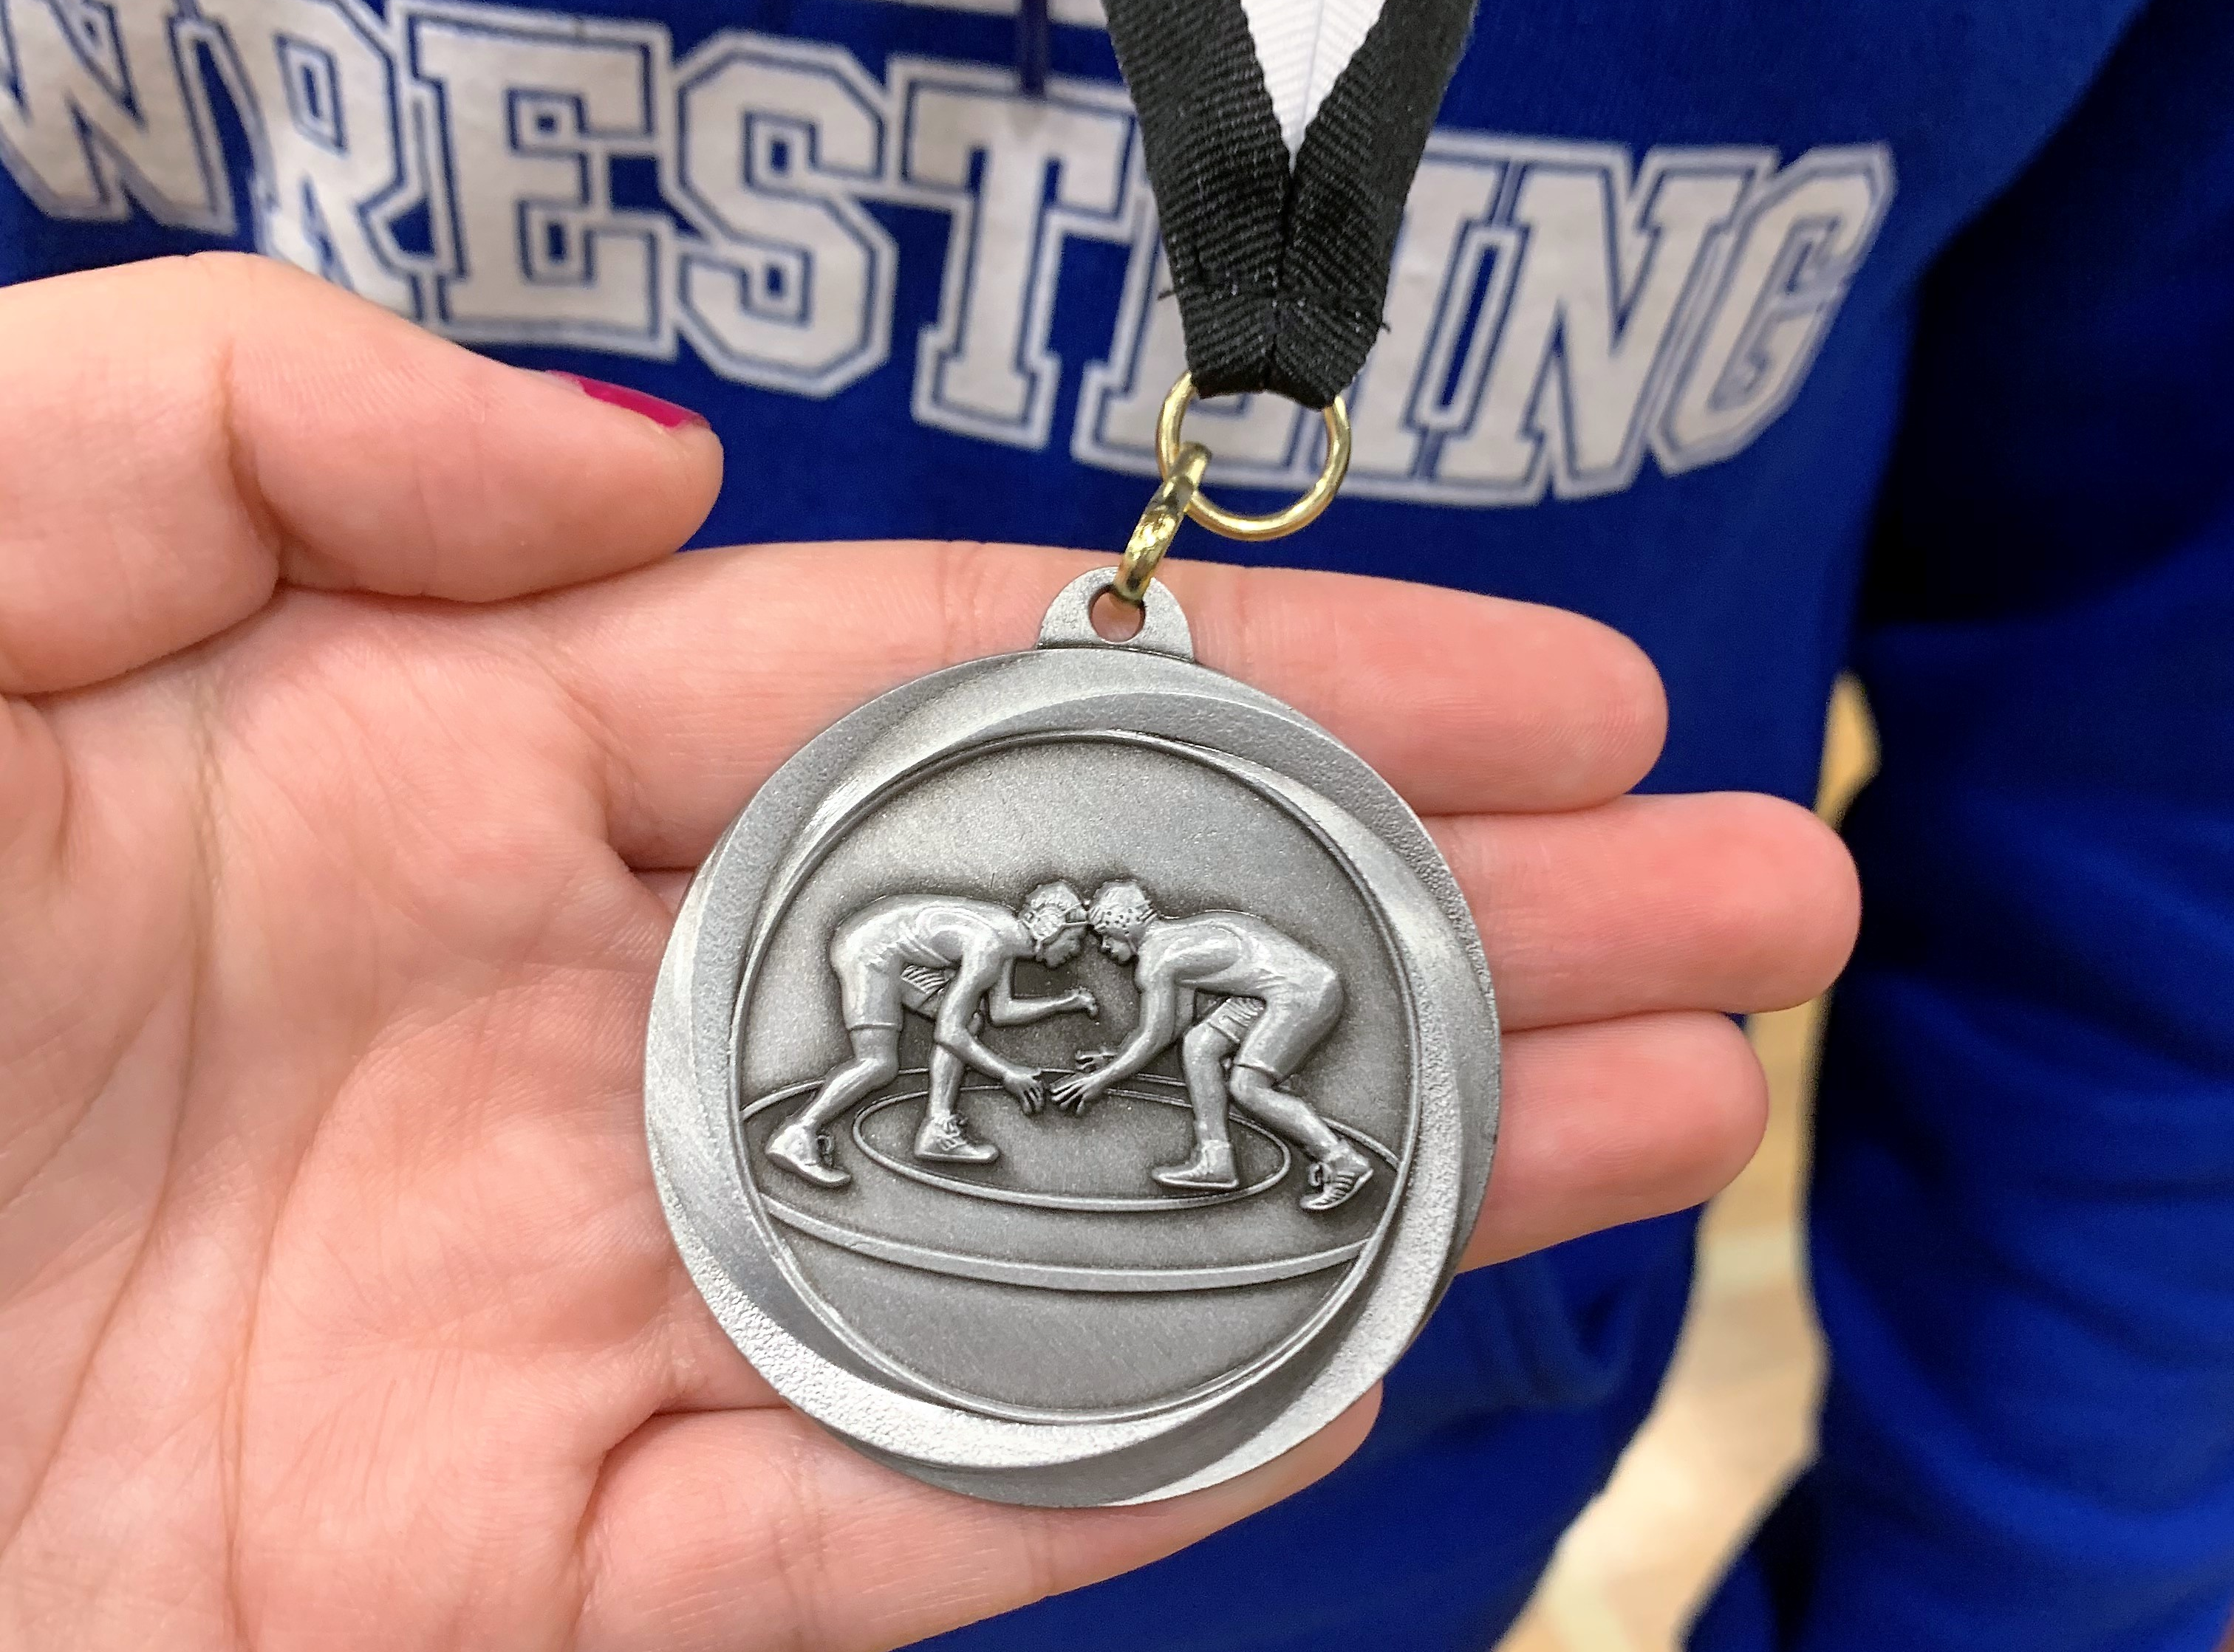
What are my goals
My goals for wrestling is to get better I want to be the best wrestler I can be, and I want to do that by joining club wrestling where they are good and have good wrestlers so I know if I join them I can and will get better so I can get 1st also it will be hard they do long sprints and other stuff but what you get out of it is being a good wrestler and I hope I can get more meddles because they are fun to have and in high school you can get so many. I also hope to raise my love for wrestling because it sucks to lose so I need to in the wining grove .

Slide 14
The end

