Slide 1
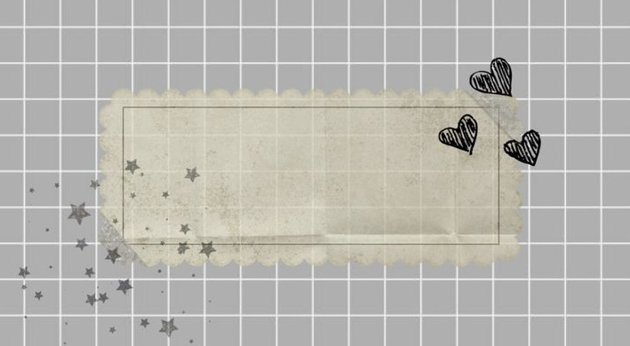
Sema Amin
SOCIAL MEDIA & ME

Slide 2
SECTION 2

Slide 3
HOW HAVE SOCIAL MEDIA PLATFORMS CHANGED THE WAY WE CONSUME AND UNDERSTAND INFORMATION?
Nowadays It’s easy to find information on social media. It’s
easier to post anything you want.
However, not everything you see online is true, you don’t
know which you should believe and not believe.
There's always different stories on everything you
hear about. It's important to
know what you read about and
what you believe and not believe.

Slide 4
WHEN YOU SEE OR READ NEWS ON SOCIAL MEDIA DO YOU TAKE TIME TO RESEARCHTHE STORY FURTHER?
I don’t usually look for information about a story on
social media. Because sometimes the story you read online
could be fake if no one talks about it.
If it’s a piece of important news that everyone talks about,
then I would know it's a real story I would dig more
into it to find out more information.
It's always good to know what's going
on around the world.

Slide 5
SECTION 2

Slide 6
WHAT VALUE DO YOU GET FROM ONLINE SOCIAL ITERACTIONS?
I don’t use social media a lot, but the only
interaction I have is talking with friends I'm close with and family.
To check up on how they are or facetime them and stay
connected and close to each other. I don't talk to anyone else
Other than my close friends and family members.

Slide 7
DESCRIBE THE ROLE OF SOCIAL MEDIA CURRENCY SHAPING YOUTH CULTURE?
There are a lot of negative posts on social media nowadays.
People post a lot of catfish images of themselves by editing
themselves to have thinner bodies and different face shapes or make themselves
look muscular. It gives stress to those who believe that's who the person is,
it could cause them to starve themselves and use a lot of makeup to look more like them.
There are a lot of people on social media that get into fights with
randoms or their online friends. Sometimes those
people might have pictures of you that they can expose on social media
and use negative words towards it and make fun of you for it.
which could cause depression and stress.

Slide 8
WHEN YOU POST ONLINE DO YOU CONSIDER HOW THE POST MAY BE SEEN BY OTHERS? EXPLAIN.
Yes, I thought of that a lot of how others see the things
that I post on my social media. I always think of
what other people think of my post whether they
think bad or good. I have my family members added on all the
social media I have I do think before posting because
I do not want to post something that will make them question me

Slide 9
Section 3

Slide 10
DO YOU SEE ANY SIMILARITIES BETWEENTHE WORLD PRESENTED IN THIS VIDEO AND THE WORLD YOU LIVE IN
There are lots of people who do things like
the person in the first video, they pretend to
do good things just to get likes and followers.
Sometimes they pretend that
they are giving money to the homeless that
isn't really homeless it's just one of their friends pretending
to get clout, so people think they
are doing good deeds.

Slide 11
HOW DOES THE MAIN CHARACTER GAIN AND LOSE POINTS? WHY ARE THESE POINTS IMPORTANT TO HER?
The character loses and gains these points
when they make a post,
and someone gives them a rating like good or bad.
If the rating increases, it gets better for the person
who made the post. It's important
to them because that’s how the people see it.

Slide 12
WHAT VALUES MIGHT BE DERIVED FROM THIS TYPE OF SOCIAL INTERACTION
This type of social interaction can stress you out a lot.
They make you feel like you're not enough
and think about others than thinking about themselves,
that could end you up in depression.
That's what makes someone a people pleaser.

Slide 13
HOW DID YOUR SOCIAL INTERACTIONS CHANGE IF YOU WERE A CHARACTER IN THESE VIDEOS?
I would think before posting what I want to.
Try to post nicer things to get more points or likes.
And think of what others would
think of the post I just made. I don’t post a
lot on social media because it's not
something that I normally do in life.

Slide 14
Section 4

Slide 15
HOW DID YOU TELL THE DIFFERENCE BETWEEN FACTS AND INTERPRETATIONS, OPINIONS, AND JUDGMENT.
A fact is something that has an existence, for example you read something online that is based on a true story.
An opinion is something everyone has, a lot of people on social media like to post their opinion's. Opinion is based on what the person believed .
Judgment is a person's decision or opinion as of a court given after careful consideration. For example, you are punished by a ordered court for a crime you did. That is a judgment.

Slide 16
HOW DID YOU ANALYZE EVIDENCE FROM DIFFERENT PRESPECTIVE?
I analyze different perspective by looking for more sources.
These points could be positive or
negative about what I analyze. I will try and
make sure that I'm right by reading over through
my information and analyzing it.

