Slide 1
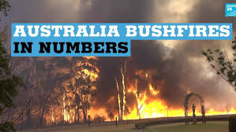

Slide 2
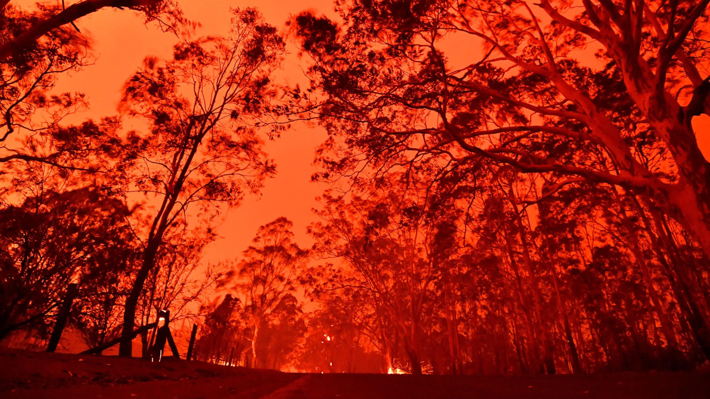
What causes the fires?
Each year there is a fire season during the Australian Summer, with hot, dry weather making it easy for blazes to spread.
Natural causes are mostly to blame like lightning strikes.
If plants are destroyed by the fire, there will be less oxygen produced.

Slide 3
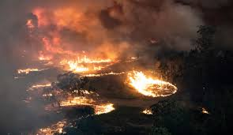
Fire season is always dangerous, but in this time, Australia has been experiencing one of its worst droughts in decades.
Strong winds make the fire and smoke spread more rapidly.
Experts say climate change has worsened and the impact of natural disasters has become more extreme.
The fires are so bad the sky turned dark orange and red and eventually black due to the smoke.
Because of the extreme winds spreading the fire more plants are getting destroyed.
Why are the fires so bad?

Slide 4
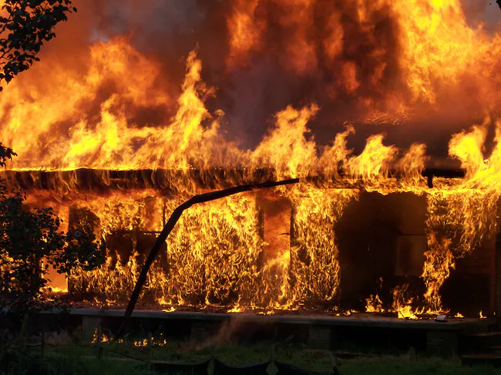
How much damage did the fires do?
Some towns were entirely engulfed in flames making over 2000 houses has been destroyed.
The blazes has turned the skies orange and made breathing the air in Sydney as bad as smoking 19 cigarettes.
As the fire spreads due to the extreme wind it may catch alight on buildings and burn them down leaving ash on the ground.

Slide 5
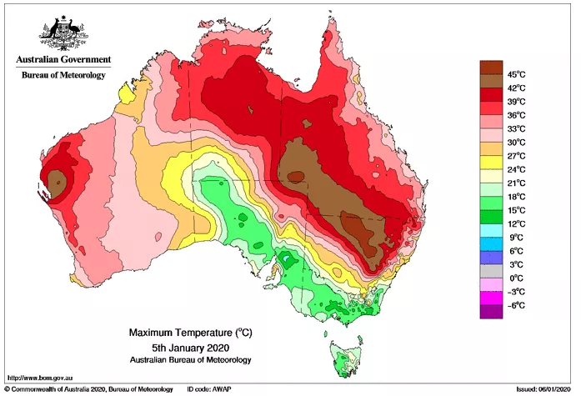
Where has the most amount of risk?
The fires are happening in bushland, wooded areas and national parks.
Fires are getting a higher risk because crops are dry due to the lack of water.

Slide 6
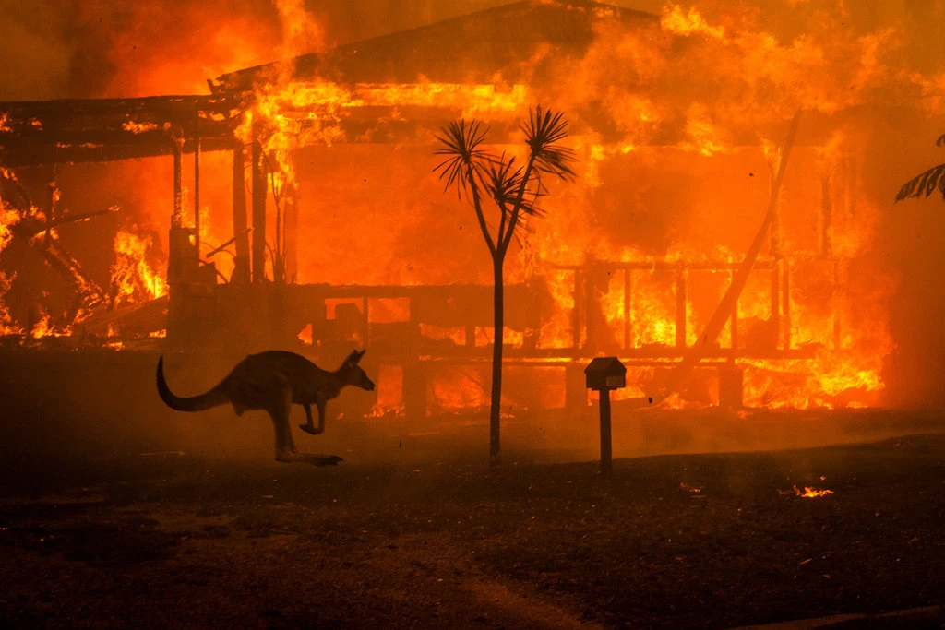
How many animals have died?
About half a billion animals has been affected.
And at least 24 people has been killed as bushfires have burned more than 12 million acres in Australia.
Even if the animals survive the enviroment they would be in would be inhabitable.

Slide 7
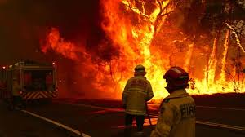
What is being done?
People are donating to help fight the fires.
Military aircraft and navy cruises are also being used alongside Australian fire service kit.
Aircrafts have been key to tackling the flames.
Water has been used to put out flames on the plants and buildings.

Slide 8
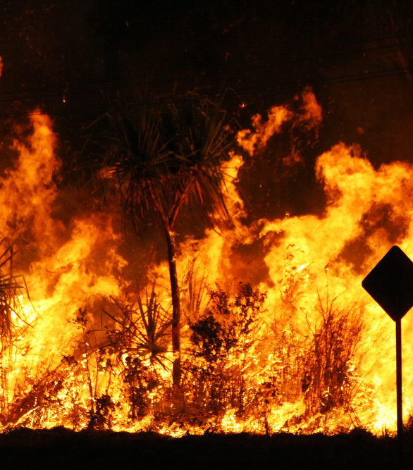
When will the fires end?
The fires have no sign in stopping and it has only been half of summer.

Slide 9
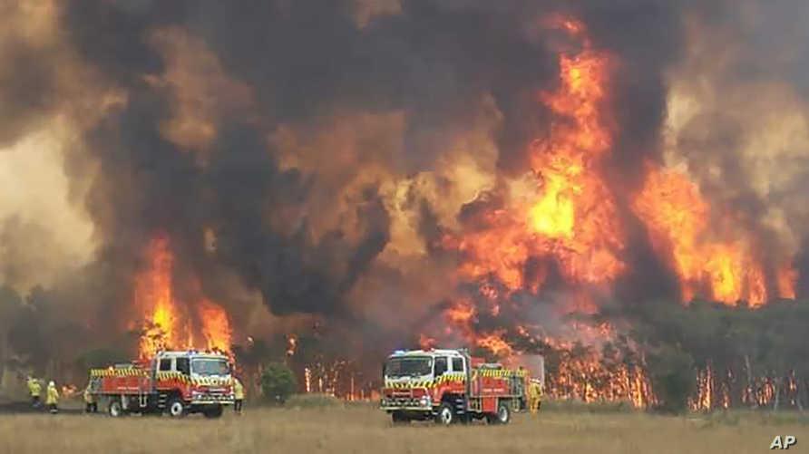
How much of Australia is on fire
More than 63 000 km of Australia was or still is on fire

Slide 10
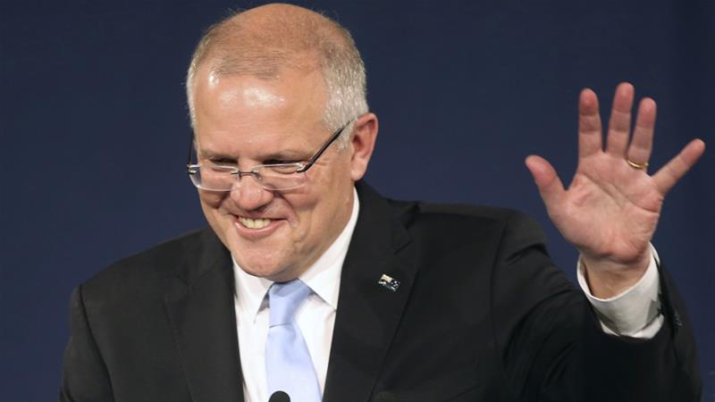
What is the government doing
Each state runs its own emergency operation, but Prime Minister Scott Morrison has promised better funding for firefighting and payouts for volunteer firefighters, and an additional $2billon. $1.4 for the recovery. B

Slide 11
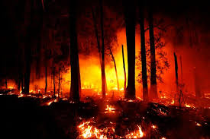
Record Breaking
The fires made a record-breaking heat wave.

Slide 12
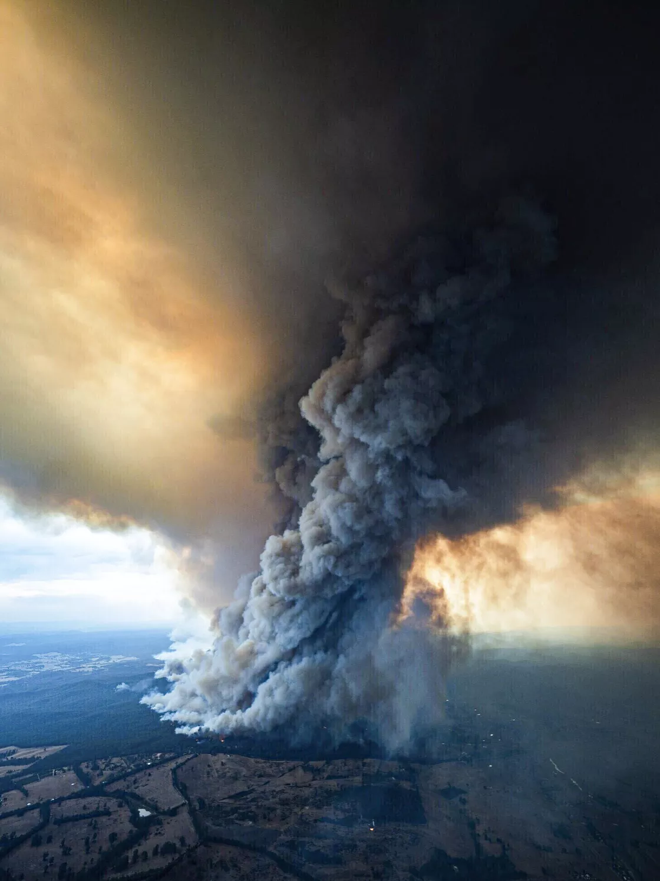
How bad is the Australian bushfire aftermath?
Australian bushfire smoke is so severe, NASA says it will do a 360 of the planet.

Slide 13
Connections
When the buildings (biosphere )are on fire it produces ash to go into the air (atmosphere )
There has been no rain (hydrosphere) so the ground (geosphere )is dry
The plants (biosphere) are dying producing less oxygen (atmosphere)
Since there is no rain (hydrosphere) animals (biosphere) will die from dehydration
Fire (geosphere) are making people lose their jobs (biosphere)
Fire (geosphere) is destroying plants (biosphere)
Fire (geosphere) is burning down wood (biosphere) which we need as a resource.
Fire (geosphere) are destroying shelter for animals (biosphere)
The wind (atmosphere) blows the ash to different areas of the earth (geosphere)
The wind ( atmosphere ) spreads the fire to other places like forests ( biosphere )
The plants (biosphere ) are dry due too the drought ( hydrosphere)
Smoke ( atmosphere ) is so bad it is killing animals ( biosphere )
NASA said the smoke (atmosphere ) is so bad it is going to do a 360 of the earth ( geosphere )

Slide 14
Citations
Ryan, Jackson. “Australia Is Burning: Everything We Know, How You Can Help and Where to Donate.” CNET, https://www.cnet.com/how-to/australian-fires-everything-we-know-about-the-crisis-and-how-you-can-help/. Accessed 16 Jan. 2020.
“Bushfires Are Raging Outside Every Major City in Australia.” Time, https://time.com/5753584/bushfires-australia-catastrophic-fire-alert/. Accessed 17 Jan. 2020.
“Australia Bushfires in Numbers.” France 24, 8 Jan. 2020, https://www.france24.com/en/20200108-australia-bushfires-in-numbers.
Ciaccia, Chris. “Effects from Australian Bushfires Felt All over as Smoke Lingers over South America.” Fox News, 8 Jan. 2020, https://www.foxnews.com/science/effects-australian-bushfires-smoke-south-america.
Climate Change Is Bringing a New World of Australian Bushfires. https://phys.org/news/2019-09-climate-world-ofaustralian-bushfires.html. Accessed 17 Jan. 2020.
Kwai, Isabella. “What to Read on Australia’s Bushfire Crisis.” The New York Times, 10 Jan. 2020. NYTimes.com, https://www.nytimes.com/2020/01/10/world/australia/bushfire.html.
Benson, Thor. “Wrapping Houses in Giant Fire Blankets Could Save Them from Wildfires.” Inverse, https://www.inverse.com/article/60109-fires-california-houses-burned-blankets. Accessed 17 Jan. 2020.
https://trees.org/post/fire-food-australia/?gclid=Cj0KCQiA04XxBRD5ARIsAGFygj80l46JpILym9YK0MnE_j6TKN2tLv9NFnnN4isWCl1GR-nZ1NgzxSoaAhGPEALw_wcB
Eagles, Digital. “Australian Bushfires Responsible for Half of the Country’s Carbon Emissions – TIME Reports.” Energy Matters, 26 Dec. 2019, http://www.energymatters.com.auhttps://www.energymatters.com.au/renewable-news/australian-bushfires-responsible-for-half-of-the-countrys-carbon-emissions-time-reports/.
https://www.bbc.com/news/world-australia-50980386
https://www.voanews.com/east-asia-pacific/millions-sparks-weather-raises-australias-fire-danger
https://www.aljazeera.com/news/2019/05/australia-conservatives-set-secure-majority-government-190520025604433.html
Irfan, Umair. “Australia’s Hellish Heat Wave and Wildfires, Explained.” Vox, 30 Dec. 2019, https://www.vox.com/2019/12/30/21039298/40-celsius-australia-fires-2019-heatwave-climate-change.
Resnick, Brian. “8 Things Everyone Should Know about Australia’s Wildfire Disaster.” Vox, 8 Jan. 2020, https://www.vox.com/science-and-health/2020/1/8/21055228/australia-fires-map-animals-koalas-wildlife-smoke-donate.
Lewis, Dyani. “Catastrophic Australian Bushfires Derail Research.” Nature, Jan. 2020. www.nature.com, doi:10.1038/d41586-020-00130-4.

