Slide 1
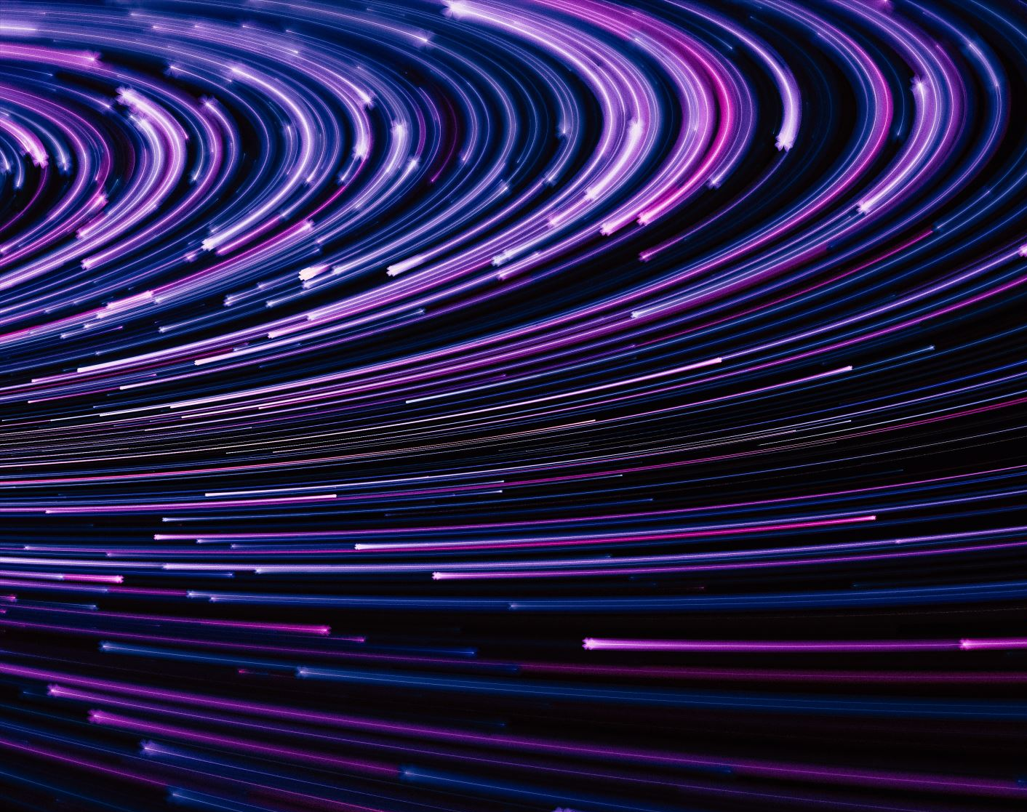
Social Media and Me
By: William Li

Slide 2
Section 1: Article
Social media has changed the way I consume lots of information, it gives easier access to new information. Instead of reading newspapers or watching the news, socials media helps us access news from our fingertips, we see posts about recent news from reliable accounts. It also presents the news from different perspectives from different creators and give us different views of the situation. It creates new forms that the news can be presented like a video, a post, stories and direct messages. However, there could also be fake news or misconceptions created by socials media, since everyone could post and create content therefore, we need to check reliable sources from big social media accounts to prevent hearing fake news.

Slide 3
Ted Talk
Socials medias interactions can give different values depending on how you consume the information given and how you process it. There are four stressors that could affect you, the highlight reel, social currency, F.O.M.O, and online harassment. Socials media interactions could have consequences to mental health and the way you think of yourself. What others say on social media about you could change your opinion. The negative comments however could be taken as different way and not affect you. The way you take in the information is extremely important.

Slide 4
Ted Talk
Social media and social capital help form youth culture since the people who are most active on social media are either teenagers or young adults. When we post about hanging out, memes or our vacation. Others tend to follow. Celebrities or influencers create trends that teenagers find interesting, and we talk about it in school which forms some youth culture.

Slide 5
Black Mirror
The rating system in the video is like the social currency in our world. When someone likes and comments on your post you gain more "social status". You achieve the amount of likes you want, and you feel better about yourself and your "social status". You tend to compare yourself to others like the amount of likes you get and comments you get. Therefore, Instagram changed its interface so that only you can see the amount of likes you not and others cannot.

Slide 6
Black Mirror
The main character gains or loses points based on the rating that others give her. These ratings are given based on the interaction's others have with her. These points are important to her since it gives others an impression of what she is like and it also helps with her day to day life like job interviews. The impression of "being good" and "acting cool" is important since you want your ratings to be impressive.

Slide 7
Black Mirror
Social interactions are changed in the Black Mirror world by a lot. These interactions are based on the rating you have, and people who have higher ratings are more respected and more people try to talk to them since they could improve your rating. The motivation is to get a higher rating. You try to impress others for the good rating so that your own rating could increase. You must present your "perfect" self and these interactions are often fake.

Slide 8
Citations
Youtube. (n.d.). Retrieved January 23, 2020, from https://www.youtube.com/watch?v=GQW6mUK2aDQ&list=PLJk1a21GKEZXxT9wwmnVle-zautJw4q12&index=2
Youtube. (n.d.). Retrieved January 23, 2020, from https://www.youtube.com/watch?v=Czg_9C7gw0o
Youtube. (n.d.). Retrieved January 23, 2020, from https://www.youtube.com/watch?v=LC5Ds3UftEE&list=PLJk1a21GKEZXxT9wwmnVle-zautJw4q12&index=4
Horgan, C. (2019, October 16). Confusion is the point. Medium. https://gen.medium.com/the-confusion-is-the-point-6ab1d5a933aa
Images are from PowerPoint

