Slide 1
MY DIGITAL FOOTPRINT
By YASIR SHALASH

Slide 2
QUESTION 1
My digital footprint has an immense impact on my personal brand and future opportunities for post secondary because say if I were to go to a party and someone filmed me and posted it on socials media managers and people that could potentially hire me may see the discrepancy on my social media and say that I am the incorrect fit and if I were to post something inappropriate about someone else it could ruin their job opportunity’s and different carrier options. Due to the fact that it can mangle your Carrier options and other possible people may also be hurt in the process

Slide 3
Question 2
The three strategies I use that I feel help me stay on track are. Look up the website read some reviews make sure it has the lock at the top and that it is green before you enter any valuable information. If a site uses cookies it is most likely a scam stay away because this could result in fraud or viruses, so I stay away from those cites. My rules for Instagram and snapchat Is if I don’t know them, I don’t accept them small things like this can save me from predators or people just trying to get money or hack my account which could lead to my information getting out there.

Slide 4
Question 3
Digital permanence is important due to the fact that it’s your personal data and people need to respect that but we live in a world full of scam artists and creeps who would do anything for money even scam kids like me and it’s not right it is an extremely significant issue that needs to stop but is is becoming increasingly difficult to apprehend these scammers I believe there is hope for the future and I think that it is extremely important to explain this issue to the younger generations because they need to know what’s going on in soon the be their future

Slide 5
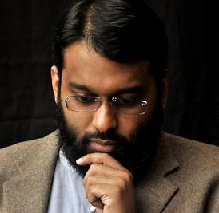
I googled myself and I got a picture of a a guy and he is like a priest but for Muslims and he talks about our bible and tells us what it means and everything we need to know about our daily live what’s a sin and what’s not

