Slide 1
iris's digital portfolio
made by Iris Zhu

Slide 2
目录
CONTENTS
PART 01
Math9 - Vacation Budget Project
PART 02
Photograghy 's project
PART 03
String band

Slide 3
math 9- vacation budget project

Slide 4
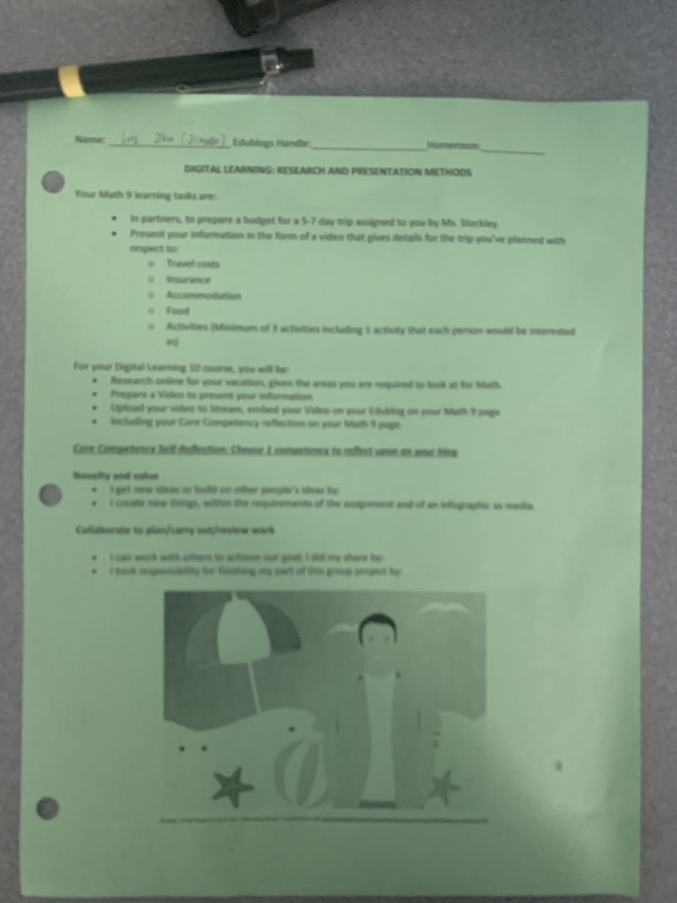
Why did I select this achivement?
Because this project is the first one completed by a group in Canada. I was a new student from China, so at that time, I was not confident in my English and dared not talk with my classmates in English. This project made me more confident. Although I still need to work hard on my English, I dare to communicate with other students now.

Slide 5

How does it represent my growth throughout the year?
At the beginning of the semester, I was an ordinary Chinese student. I knew only basic vocabulary and grammar. Because of my poor English, I have no confidence to speak to my classmates. However, through this project, I made progress in my English and began to look forward to my study abroad.

Slide 6
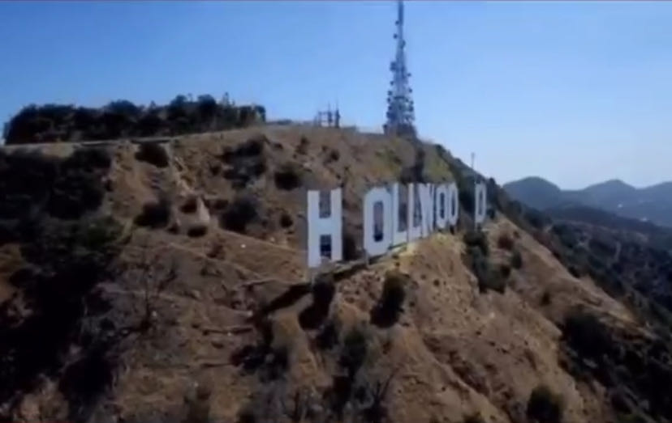
What were some challenges I faced during this achievement and how did I overcome them?
I didn't know how to edit the video at first, but when I learned that this was the job I was assigned, I panicked. But I soon calmed down and began searching the web for tutorials on how to edit videos. I ended up making the short film very successfully.
Two of my team members in this project are Korean and one is from Taiwan, China. I am the worst one in our group in English, so I met many strange words when they were discussing, so I could not join them. Then I spent my spare time memorizing the words and finally joined the discussion.

Slide 7
What are your goals in this activity for the future?
How might you use what you have learned in the future?
GOAL
If there will be such similar group demonstration activities in the future, I will be more enthusiastic to participate in, increase the friendship between me and my classmates, try my best to improve my English and learn more interesting knowledge.
HOW
Because of this project, I became interested in editing videos, and I want to try to make my own VLOG in the future. Take what I've learned and apply it to my life.

Slide 8
Photograghy 's progect

Slide 9
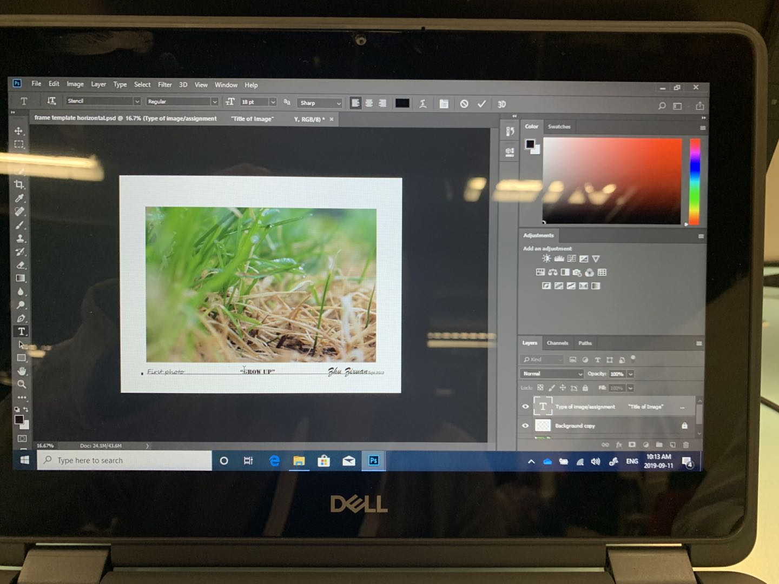
Why did I select this achivement?
Because this course gives me a great sense of accomplishment. In the middle of the semester, when Ms. Gardner sent me my report card for half a semester, I was really freaked out because I only got a C. I think this is a very low score, I can't accept it. After that, I adjusted my attitude and worked hard to improve my shortcomings, and finally got B. Although this result is not satisfactory to me, I have made obvious progress.

Slide 10
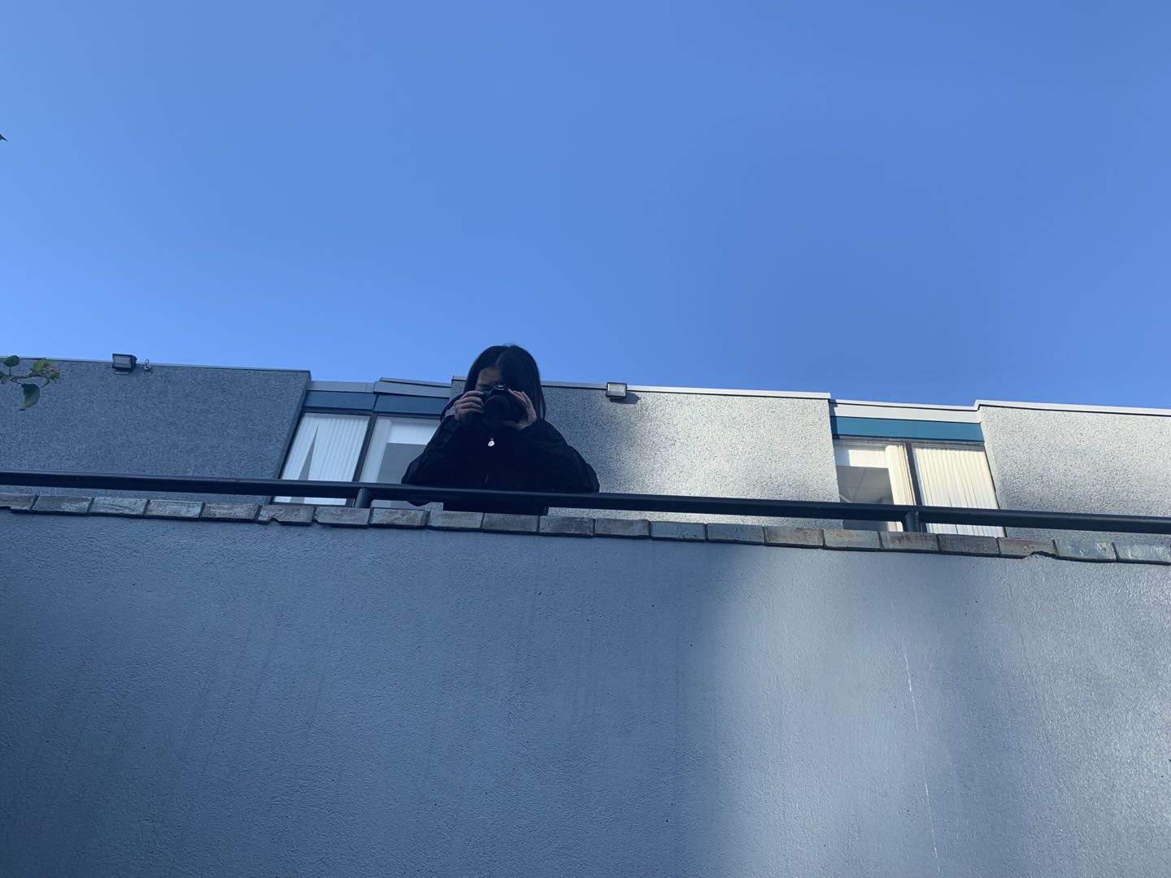
How does it represent my growth throughout the year?
In the first half of the semester, it was because I felt that a minor subject was not so important, in addition, there were many new words of professional terms in this course, and the camera I barely touched. So I quit. When I got my mid-term grades, I realized how bad I was, and I began to feel dissatisfied with myself, so I changed my attitude, began to take time to search for the Chinese meaning of those professional terms on the Internet, and began to try to take photos.

Slide 11
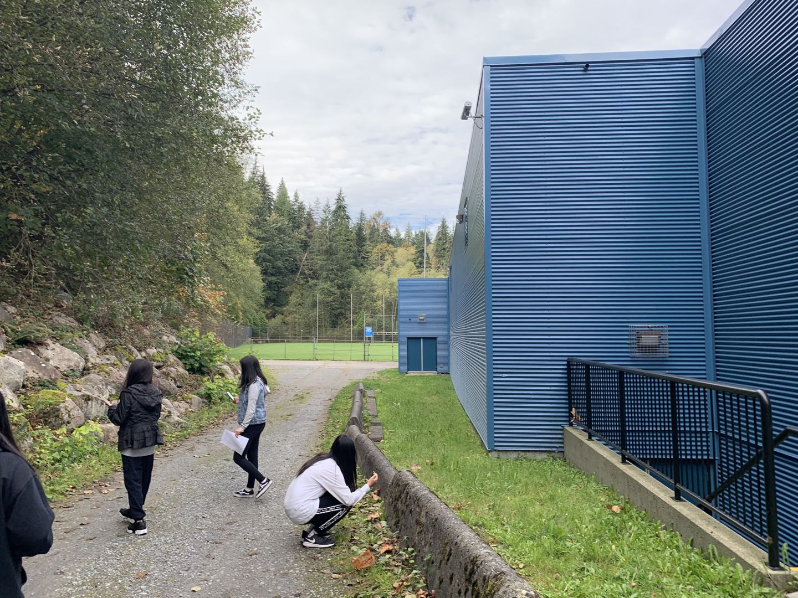
What were some challenges I faced during this achievement and how did I overcome them?
In the photography class, the teacher didn't let me use my cell phone very much, so I had many words that I didn't understand. So I was determined to find some students to ask the meaning of these words, those students are also very friendly, help me one by one to answer my question. After class, I combined what the students told me in class with the materials on the Internet, sorted out the most understandable meaning and memorized them.
To see a world in a grain of sand. And a heaven in a wild flower Hold infinity in the palm. To see a world in a grain of sand.

Slide 12
What are your goals in this activity for the future?
How might you use what you have learned in the future?
GOAL
In the future, I want to continue to learn photography, let it add color to my life, let my life become more rich. If I have this class next year, I want to get an A.
HOW
I will use the camera to record my colorful study abroad life, it can prove my growth. I can also be an amateur photographer, I may be able to open a photography studio in the future, find some like-minded friends to grow up together.

Slide 13
Sring band

Slide 14
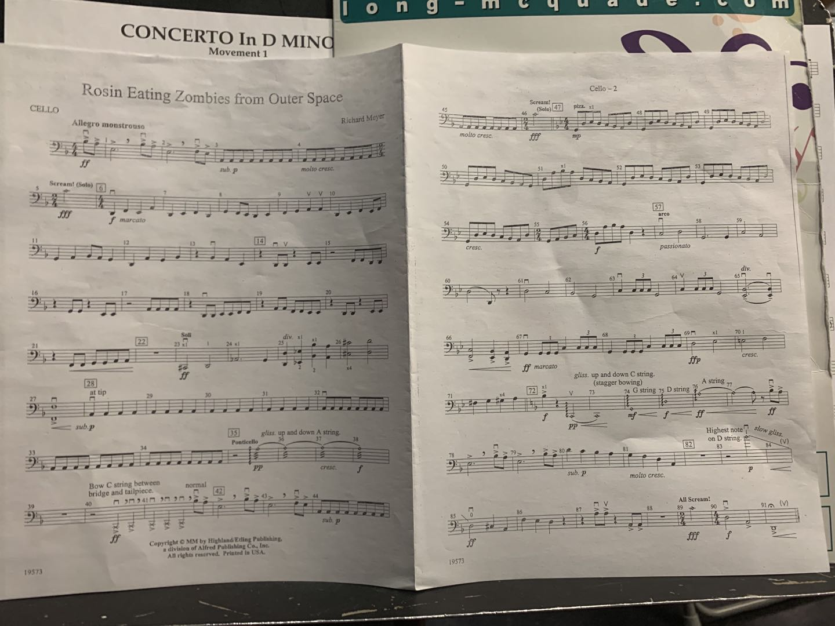
Why did I select this achivement?
Because I have been practicing the cello in China for three years, and I like playing the cello very much. However, when I just came to Canada, I did not take my cello to Canada because of too much luggage. In January this year, my mother helped me to bring my cello to Canada, so I joined the string orchestra of our school. This is my first club in Canada, so it's very memorable.

Slide 15
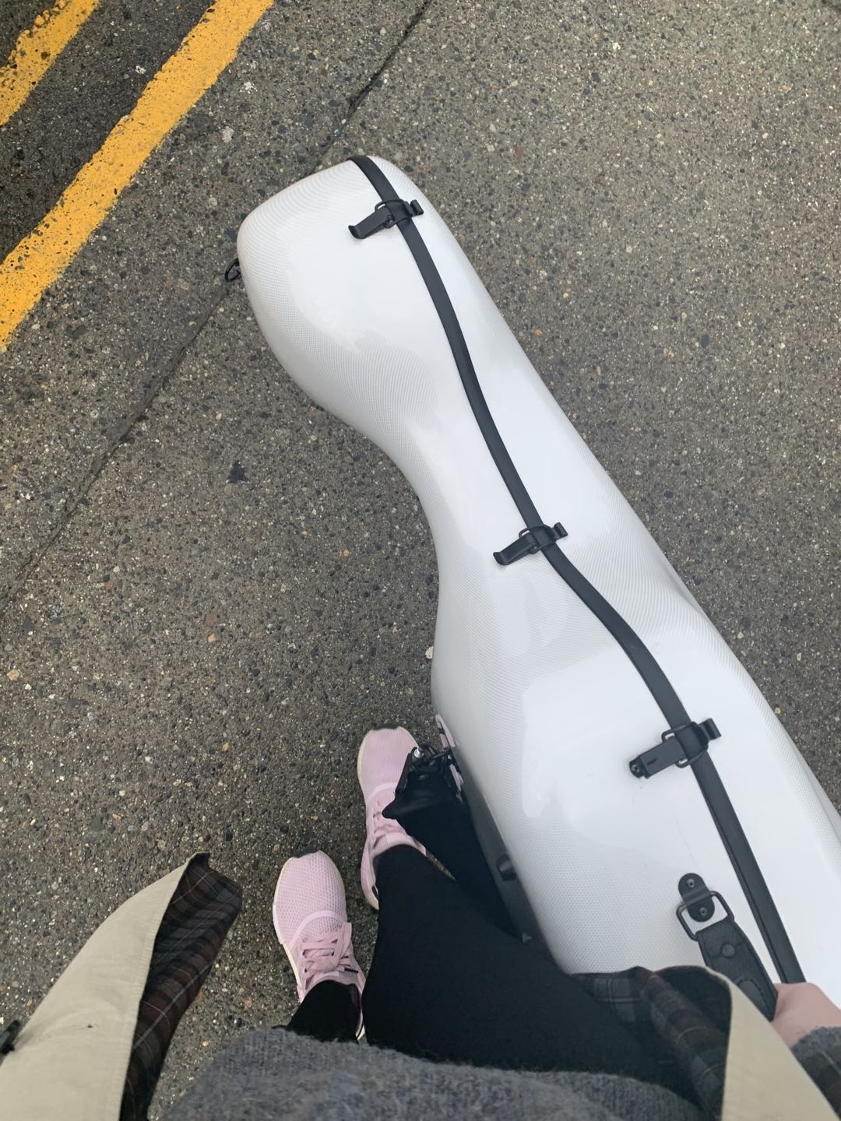
How does it represent my growth throughout the year?
When I first joined the band, I had no confidence in myself, because the music I learned in China was not pronounced the same way as here, and there were five scores at once. I joined the band in the middle of the school year, and it was a huge challenge for me to get good music in a week after others had practiced for half a year. After a while, I was able to fully integrate into the band. I think this proves that I'm making progress.

Slide 16
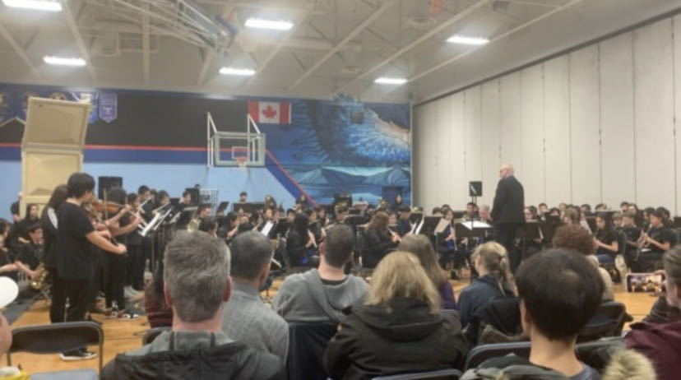
What were some challenges I faced during this achievement and how did I overcome them?
I joined the band in the middle of the school year, and it was a huge challenge for me to get it right in a week after someone else had practiced for half a year, and there were five songs I needed to practice. During that time, I always treasured every minute of practice time, and went to the piano room to practice whenever I was free. Finally, I practiced five pieces of music.

Slide 17
What are your goals in this activity for the future?
How might you use what you have learned in the future?
GOAL
My goal is to keep practicing the cello, continue to participate in the orchestra, and strive to become the principal cello of the orchestra to prove my ability.
HOW
I will sum up what I have experienced into the experience, tell the future freshmen, so that they can catch up with our progress faster, together with refueling.

Slide 18
THANKES
To see a world in a grain of sand. And a heaven in a wild flower Hold infinity in the palm of your hand. To see a world in a grain of sand.

