Slide 1
Mount St. Helen Eruption
Earth Science Unit
By: Zohid Nazir, Ahmad Nahro

Slide 2
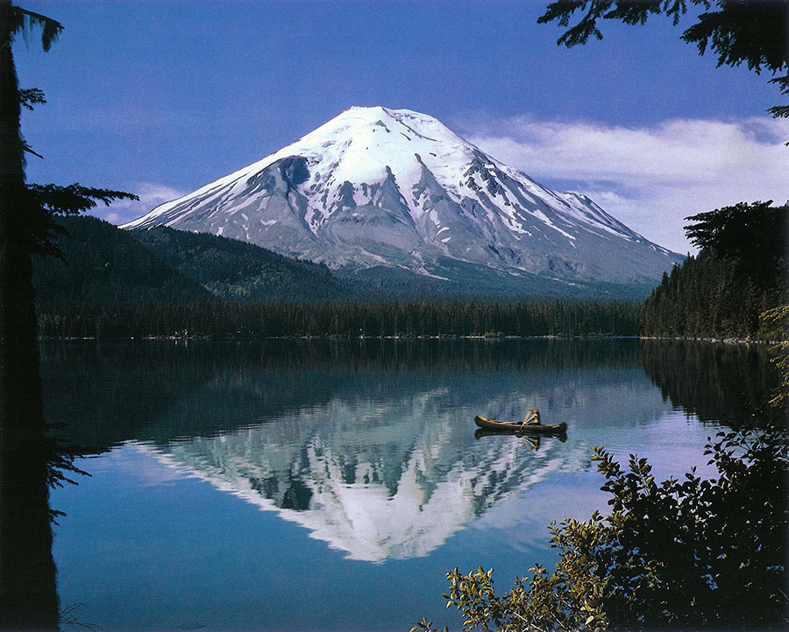
Before the Eruption
This was before the eruption of Mount St. Helen in Washington 1980.
The height of Mount St. Helen before eruption at its peak was 9,677 FT/ 2,950M.
Before the eruption in 1980 it erupted 100 years ago.
Mount St. Helen was about 2 to 3 km wide.

Slide 3
Before the Eruption
Labeling
Hydrosphere
Atmosphere
Geosphere
Biosphere
Hydrosphere

Slide 4
Before the Eruption
Connections
The trees (Biosphere) are touching the ground (geosphere).
The snow melts which turns into water and evaporates (hydrosphere)and goes into the (atmosphere).
(Biosphere) the boat is travelling through the water (Hydrosphere) and the water is Hydrosphere.
(Biosphere) the sea animals need to breath in water (Hydrosphere) provides the water.

Slide 5
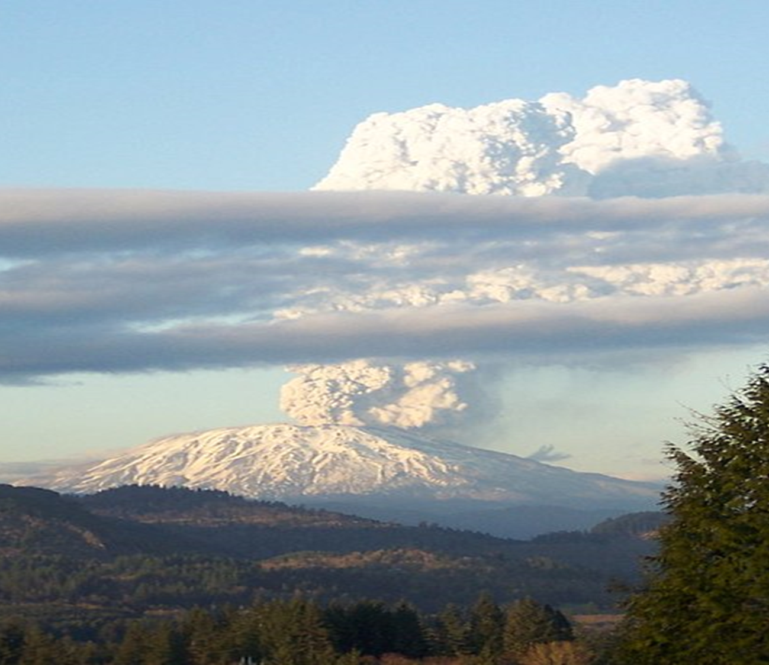
During the Eruption
It happened in Washington, America in 1980.
It caused a massive avalanche and killed 57 people.
The Mount St. Helen eruption cause of bunch of small earthquakes.
The eruption of Mount St. Helen energy released 24 megatons and it was a direct blast.

Slide 6

During the Eruption Labeling
Atmosphere
Geosphere
Hydrosphere
Biosphere

Slide 7
During the Eruption
Connections
(Atmosphere) the smoke/gas coming out of the volcano (Geosphere) the rocks in the smoke/gas.
(Atmosphere) the sky brings the snow (Hydrosphere) the snow turns into water.
(Biosphere) plants produce oxygen (Atmosphere) oxygen= atmosphere.
(Geosphere) the rocks/dust goes into the smoke the smoke goes into the sky (Atmosphere)

Slide 8
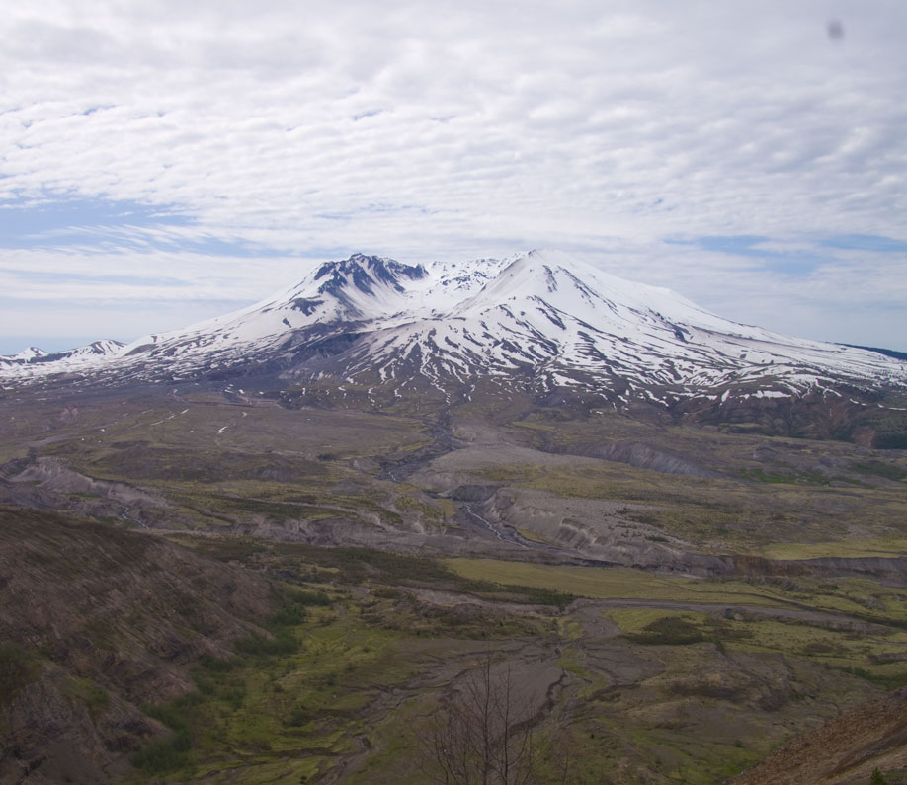
After the Eruption
After the eruption, the forest got burned and the animals in the area died because they had no home (Forest Gone).
After the eruption 57 people died, 100s of animals died, and 200 hundred homes were destroyed.
The roads and the railways got damaged and some buildings collapsed.
The damage of the eruption of Mount St Helen cost America 860 million dollars.
After the eruption, the gasses and ashes spread estimate of 35 miles which was dangerous to inhale.
Before the eruption, of Mount St. Helen the height was 2,950m after the eruption the height was 2,550m.

Slide 9
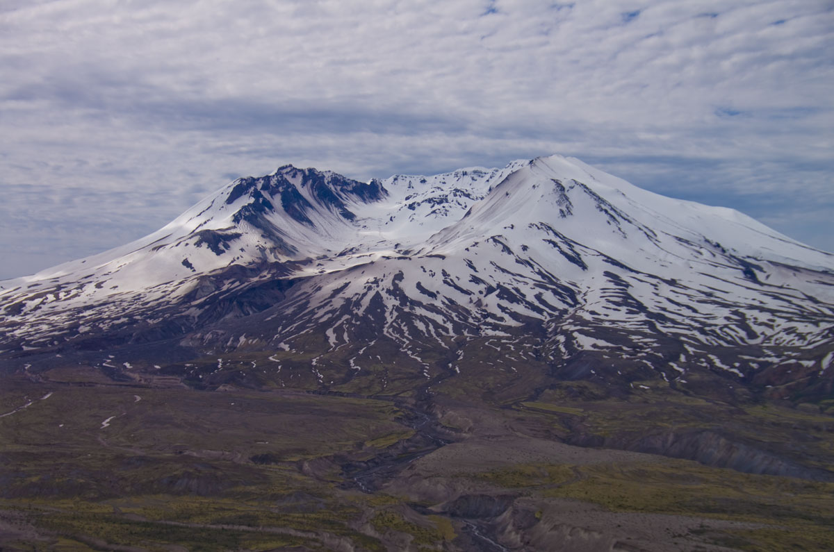
After the Eruption
Labeling
Atmosphere
Hydrosphere
Geosphere
Biosphere

Slide 10
After the Eruption
Connections
(Hydrosphere) the snow is touching the ground Geosphere).
(Hydrosphere) the snow melts into water then goes into the soil where the grass is which is (Biosphere).
(Geosphere) the lava and ashes burning down the forest (Biosphere) the forest (plants and trees).
(Atmosphere) the clouds (Hydrosphere) the rain or snow.

Slide 11
Work Cited-APA Style
What were the effects on people when mt st helens erupted? | volcano world | oregon state university. (n.d.). Retrieved January 16, 2020, from http://volcano.oregonstate.edu/what-were-effects-people-when-mt-st-helens-erupted
Wikipedia contributors. (2020, January 16). 1980 eruption of Mount St. Helens. In Wikipedia, The Free Encyclopedia. Retrieved 06:58, January 16, 2020, from https://en.wikipedia.org/w/index.php?title=1980_eruption_of_Mount_St._Helens&oldid=935985979
Contributor 2018-10-16T22:14:00Z, M. B.-L. (n.d.). Mount st. Helens eruption: Facts & information. Livescience.Com. Retrieved January 16, 2020, from https://www.livescience.com/27553-mount-st-helens-eruption.htm
Taylor, A. (n.d.). The eruption of mount st. Helens in 1980—The atlantic. Retrieved January 16, 2020, from https://www.theatlantic.com/photo/2015/05/the-eruption-of-mount-st-helens-in-1980/393557/

