Slide 1
Social and Me
Zohid Nazir

Slide 2
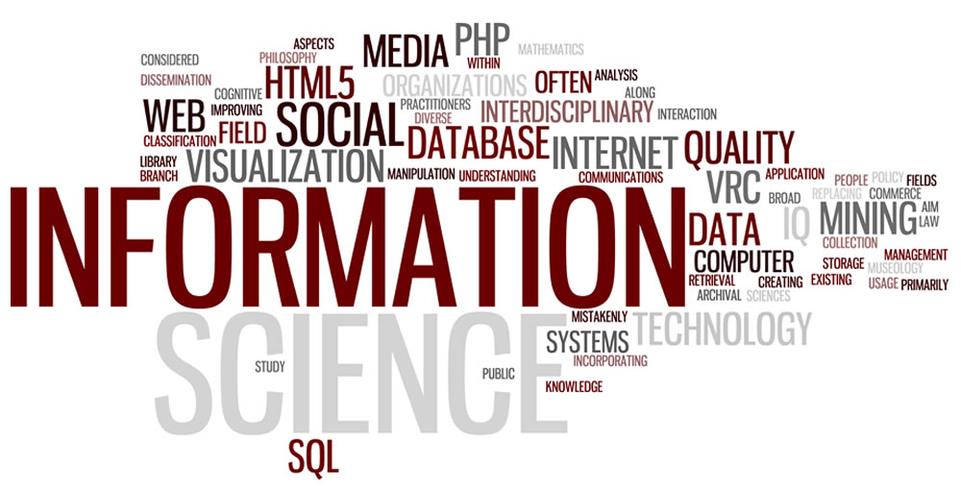
Confusion is the point
Getting information nowadays is easy we jus go on our phones or device and search it up. Unlike back in the days where they had the television, newspaper for information about what's going on. It has changed a lot since then. Everything on the internet either getting information or making money off giving information we all do this for a benefit. Even for just scrolling through social media we do it to entertain our self which is the benefit of it. Us understanding what information we are searching up and understanding why are we searching it up is just a whole confusing topic which concludes me with “confusion is the point”.

Slide 3
Is Social Media Hurting Your Mental Health?
Social Media can bring is a variety of feeling to one's body. Either being happiness or sadness social media can do anything. Yes social media can hurt some one's mental health by someone spreading negativity towards the person which ultimately hurts their mental health by causing stress, panic, and hate. Why don’t people just stop going on Social media because its part of our nature we always used social media to just take it away is hard. People might say back in the days they didn’t use the internet so its no difference so you could just not use it, wrong it is different because back in the day they didn’t have internet, so they never had to deal with using it or having to lose it. In the other hand we do use it daily and to just take it away is hard and is not the same as it was back in the day.

Slide 4
Black Mirror
Black mirror is judge by how popular you are. From what you are a famous actor, musician, youtuber, boxer, e.t.c… To base off how popular you are is the numbers of followers you have on the platform you work on. Number is an important factor of how relevant you are on the platform you work on. Some people aren’t popular off social media, but they are known to be rich off other stuff they worked on which then makes them popular on social media and they are known as the “Rich Guy”. Overall on social media it’s the more followers u have the more relevant you are.

Slide 5
Bibliography
https://www.weforum.org/agenda/2016/04/6-ways-social-media-is-changing-the-world/
https://www.helpguide.org/articles/mental-health/social-media-and-mental-health.htm
https://www.forbes.com/sites/alicegwalton/2017/06/30/a-run-down-of-social-medias-effects-on-our-mental-health/#7630343c2e5a

