Slide 1
Digital Portfolio
Zohid Nazir

Slide 2
Questions
A- Why did I select this achievement.
B- How does it represent my growth throughout the year.
C-What were some challenges I faced during this achievement and how do I overcome them.
D- What are your goals in this class/activity/subject for the future? How might you use what you learned in the future?

Slide 3
Electronics Project
A-The reason I selected this project is because it was the first electronic project I ever made. It was cool because we could design the mask so, we made it a shark. It’s a game of trusting one another and it was overall fun making this project.
B-This represents my growth from learning new electronic components and parts that are even used today. This should my growth throughout the year by learning how to make electronic project and knowing what is wrong and right.
C-The challenges I've been through is making mistakes while trying to build the electronic project. The way overcome them is by learning from my mistakes that I've made and that is how I learn more about electronic.
D-In the future I hope to continue learning about electronics and continue making fun projects. I will probably take electronics in grade 11 but for next year im just going to try new activities to see what I enjoy. Electronics will always be one of the subjects that I've enjoyed in school.

Slide 4
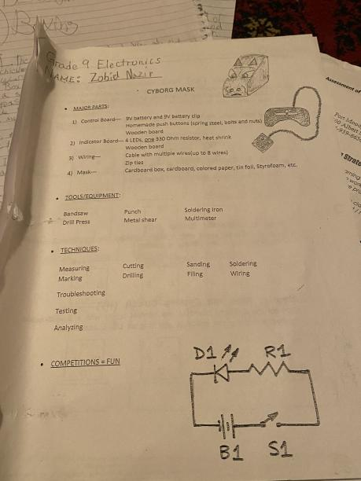
This is layout of the electronics project.

Slide 5
English Short Story
A-The reason I picked this achievement is because it was my favourite short story of this semester. It was fun making my own twist at the ending of the story's outcome.This assignment was more of an assignment that I enjoyed working onand that is why I choose this achievement.
B-This represents my growth because it shows that Im now changing stories which means that im expanding my thought to create different ending of the story. It ultimately shows my growth from expanding my thought throughout the semester.
C-The challenges I've faced throughout this assignment is how should I end the ending of the story because there was a lot of options that where giving to me. I overcame the obstacle by choosing what felt right as what the alternative ending should be.
D-My goal is beyond just this little short story that I recreated. This assignment made me more interested in writing essays about interesting topics. For my future which I mean next year im taking creative writing as my english course to improve my essay,story,paragraph, and more writing.

Slide 6
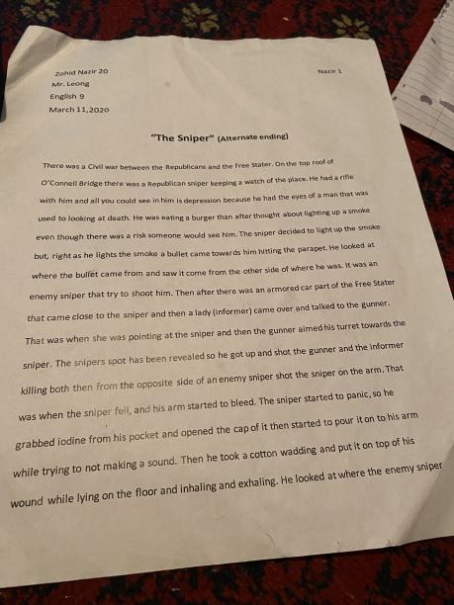
This is the alternate ending short story

Slide 7
Boxing
A-The reason I picked boxing as my achievement is because it’s a passion, I've had throughout boxing for the past 2 years. I've worked hard to improve my skill and stamina for boxing, and I try to keep my daily exercise to stay healthy. .
B-This represents my growth by learning more about how to box by learning the technique and skill to improve. Boxing isnt just a sport to me it’s a passion of mine and it is something that I wish to stay with throughout the years.
C-The challenges I've faced during doing boxing is overall trying to improve wither on my skill or stamina. Working hard and practicing is a challenge and to overcome it you just haveto know why are you working hard to box it can either be to lose weight or it can be that you are training more a fight. The reason you work hard because if you don’t it won't benefit you like they say, "No pain, No gain".
D-My goal with boxing is to just keep working hard and keep improving as a boxer. I also want to stay healthy and that is one of my goals. In the future I want to improve and work hard to get fit and stay healthy. I ultimately just don’t want to give up on boxing and that is my final goal.

Slide 8
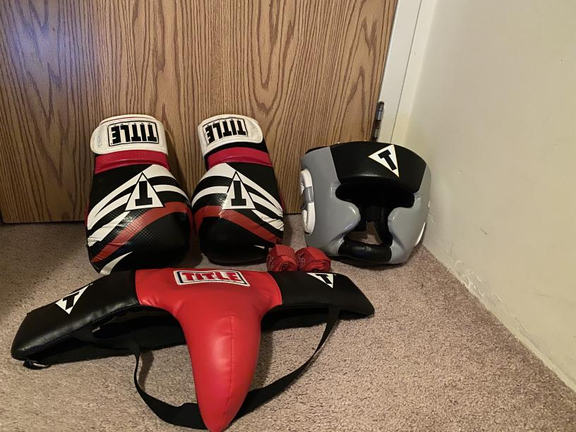
This is my boxing gear

Slide 9
THE END

